Slide 1
Superstore Data
Avadhoot Deshpande

Slide 2
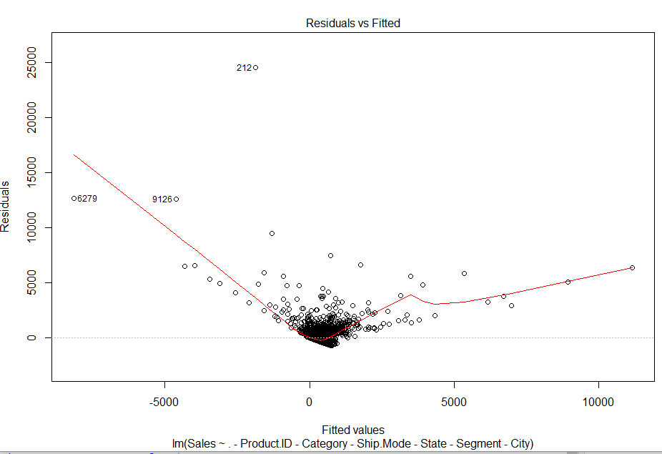
Model1

Slide 3
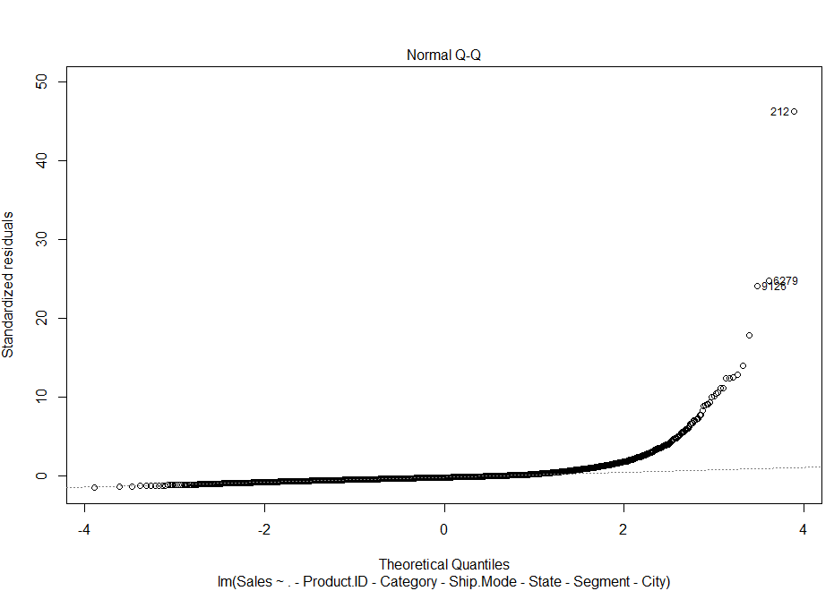

Slide 4
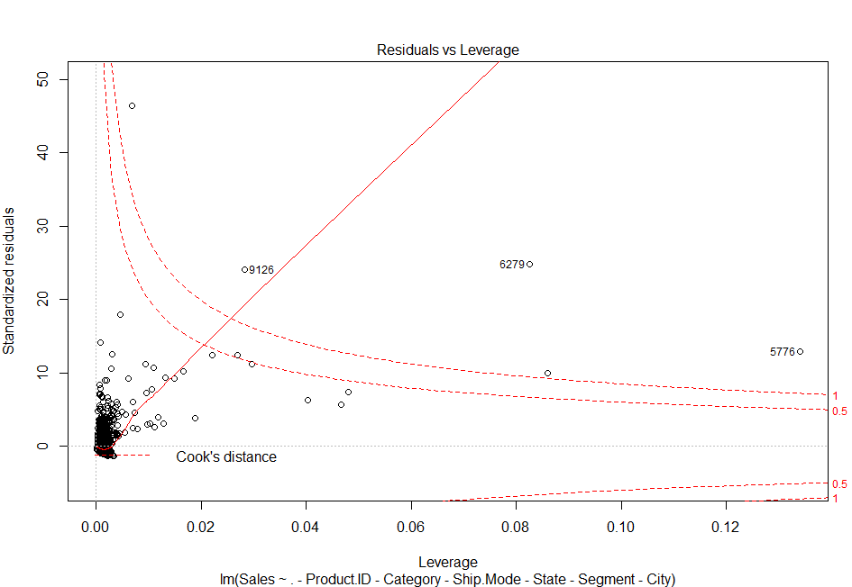

Slide 5
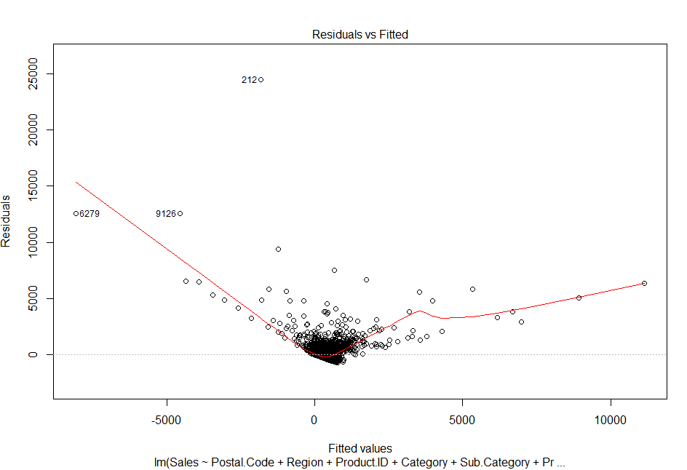
Model 2

Slide 6
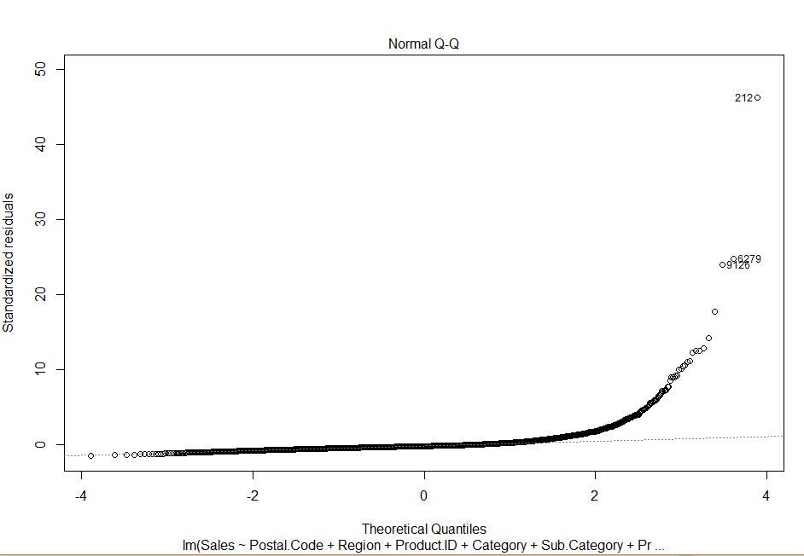

Slide 7
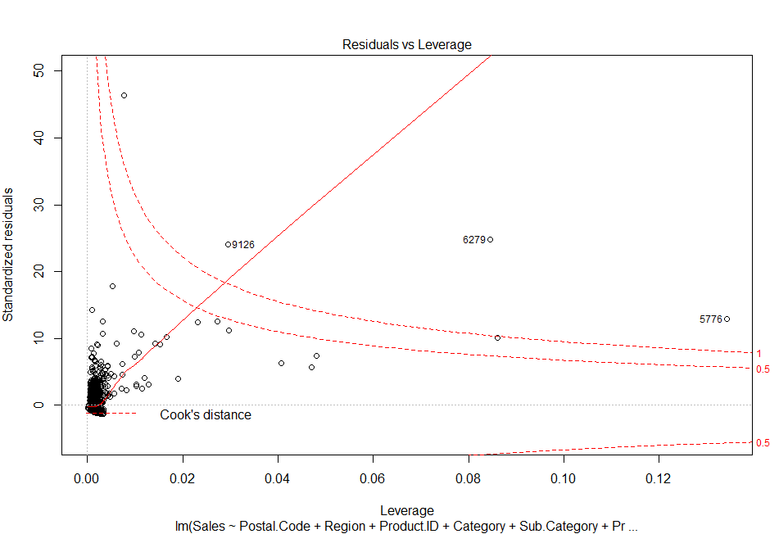

Slide 8
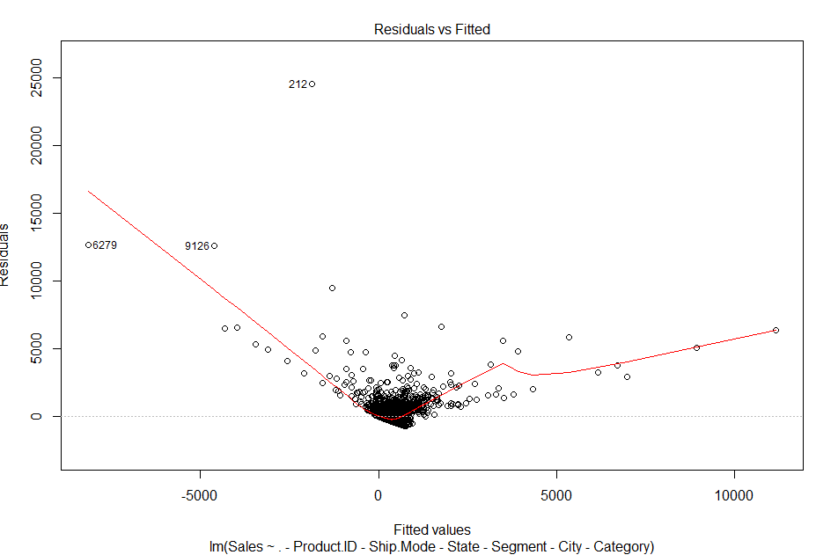
Model 3

Slide 9
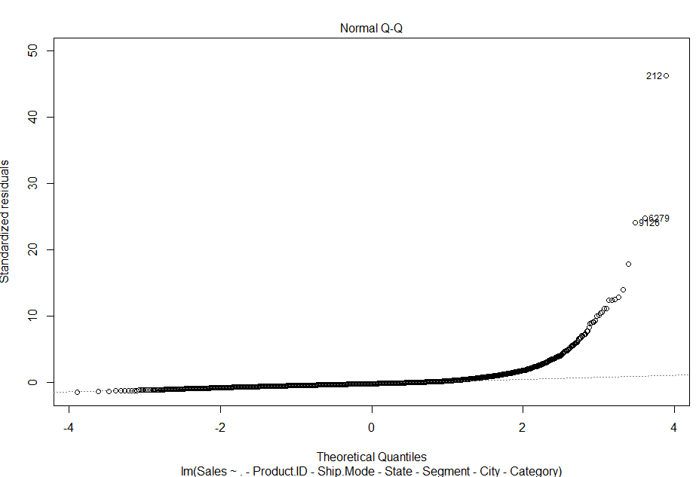

Slide 10
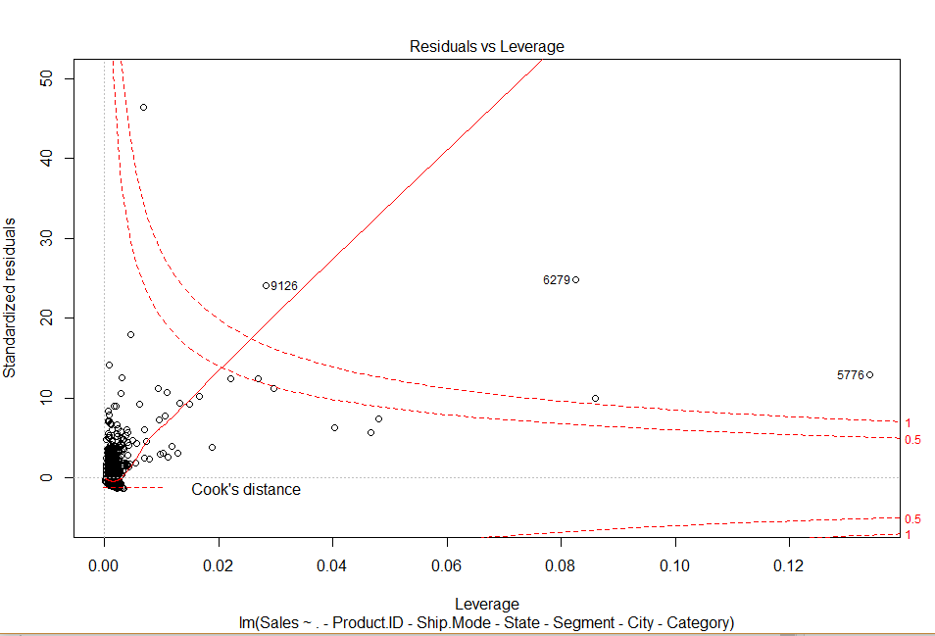

Slide 11
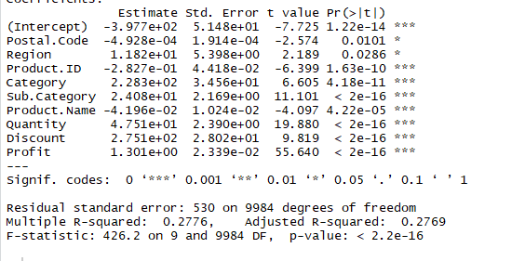
Result
R^2 value for model 1 is 0.2739 and R^2 value model 2 is 0.2769 and R^2 value for model 3 is 0.2739
Sales is dependent on following factors and model 2 is better

