Slide 1
Lane Detection in Adverse Weather Conditions
Project Group 23
Members:
Avadhut Vijay Talbar
Kunal Gaurang Mehta
Mohit Shailesh Somaiya
Krishna Eknath Kabra

Slide 2
Current Scenario
Recently, an immense accentuation has been committed towards the implementation of Artificial Intelligence, Computer Vision, and Machine Learning in Vehicle-level Applications. Numerous models and studies have been conducted where vehicles have driven effectively over long separations for the clear climate condition. In any case, driving in unfavorable climate conditions isn’t well-considered and research is still going on. Unfavorable climate conditions can affect the various types of sensors and in-vehicle cameras and cause the models to decrease their accuracy accordingly, since the colors of the environment alter, as in rain or snow. we are going to present the descriptive analysis inclined within the course of impact on different in-vehicle utilities due to adverse weather causing poor predictions, and a brief comparison and examination of different strategies for road detection

Slide 3
Effects of Adverse weather
During normal weather conditions, the sensors such as LiDAR, Cameras work effectively.
The car's sensors can be blocked by snow, ice or rain droplets, and their ability to read road signs and markings can be affected upto a certain extent
Camera, LiDAR and RADAR are the primary perceptual sensors that are usually adopted. However, since these are visible spectrum sensors, the data is affected dramatically by bad weather.
LiDAR works by bouncing laser beams off surrounding objects and can give a high-resolution 3D picture on a clear day, but it cannot see in fog, dust, rain or snow’.

Slide 4
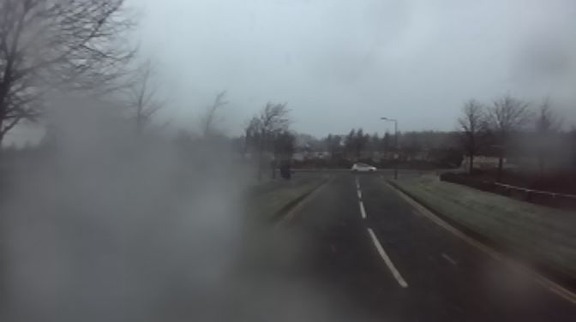
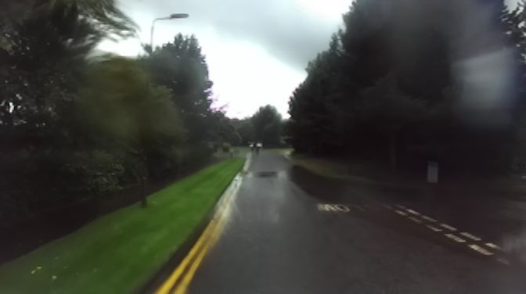
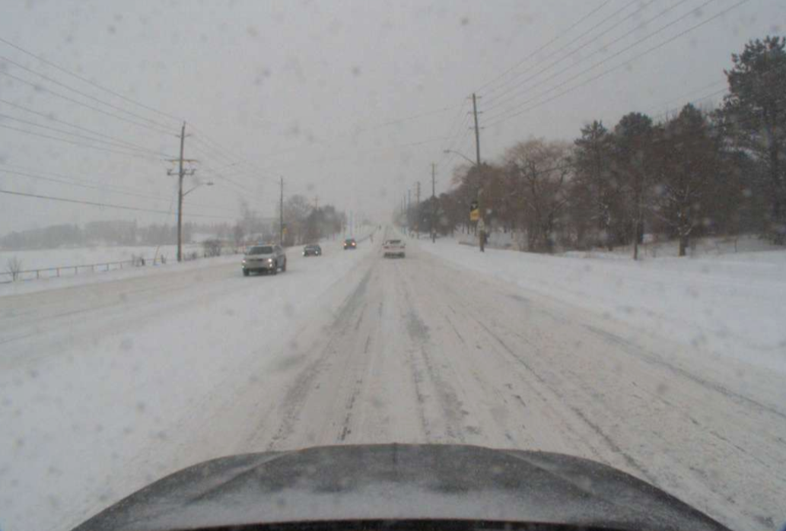
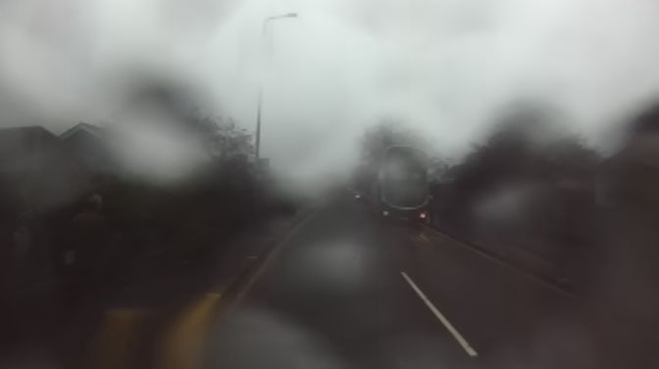
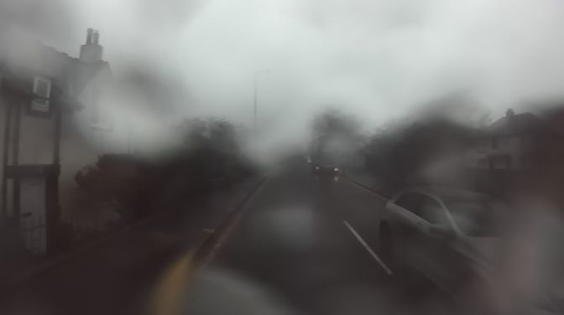
Snow, Rain and Foggy Weather Images

Slide 5
Solution for adverse condition
1. Train existing models on data collected in adverse weather using Deep Learning methods -- Data can be collected using real/simulated adverse weather conditions.
2. Improve Light detection and ranging (LiDAR)
More than 95% of currently available LiDARs uses in 905 nm wavelengths.Changing to higher wavelengths (1550 nm) wavelength, which gives an opportunity to use 20 times more power compared to the traditional 905 nm.
3. Use of multiple Radar Radar based object detection is less affected by the adverse weather, especially in foggy scenarios, where recognition from LiDAR data fails at a very short range depending on the fog density. By having two radars at different vantage points with an overlapping field of view, we get a high probability of detecting the objects that are present. The system consists of two radar sensors placed on the hood and spaced an average car’s width apart (1.5 meters). Having two radar sensors arranged this way is key—they enable the system to see more space and detail than a single radar sensor.

Slide 6
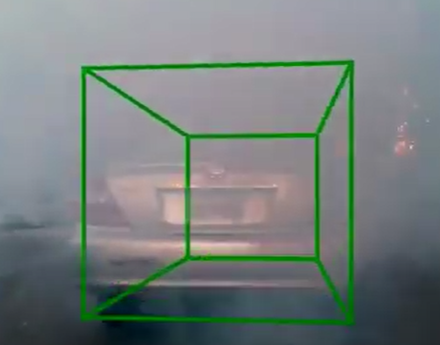
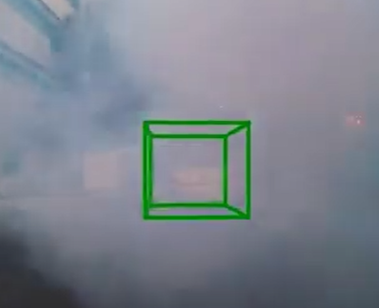
Solution: Use of Multiple Radars
For example, a car that has LiDAR, if it's going in an environment where there is a lot of fog, it won't be able to see anything through that fog. But at the same time, with this new multi-radar system they can actually pass through all these bad weather conditions and can even see through fog or snow.
Below Image shows car is detected even during foggy condition.

Slide 7
Solution : V2I infrastructure
4. During worst weather conditions these on-board sensors such as cameras, LiDAR, and radars are of very limited benefit. In the case when all of the above solutions fail one can rely on Vehicle-to-Infrastructure(V2I) communication to retrieve images stored in the cloud, which consist of the reference images captured at the same geographical location when visibility was clear and weather conditions were good. These images are used to detect and localize lane lines. Image registration techniques are used to align both the sensed images during adverse weather and the reference image. Once both are aligned, the lane line information from the reference image is then superimposed on the local map built by the Autonomous driving system.

Slide 8
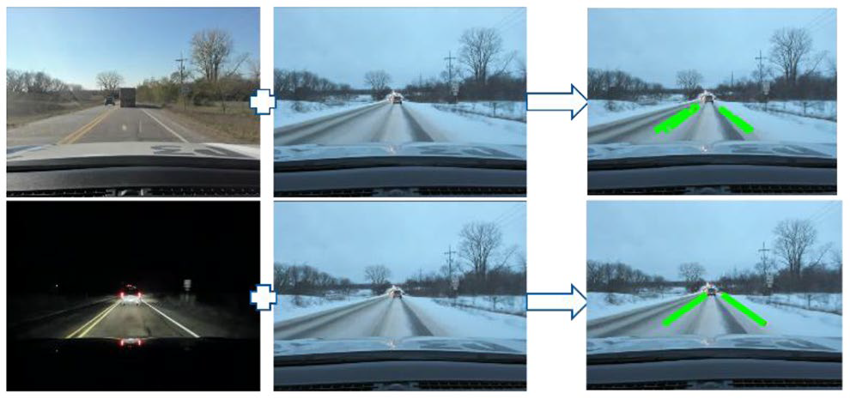
Solution : V2I infrastructure
Below image shows the superimposed lines on image collected in adverse weather.
The sensed image in the snow day had no traces of the lane lines to be detected by a lane line detection module. But, after applying the V2I framework it was possible to find lane lines that can be used to assist the driver navigate.

Slide 9
Solution: Deweathring & Image Enhancement
The de-weathering / Image enhancement methods can be categorized into two types: model based methods and non-model based methods.
Non-model based methods use the information in the image for processing. Histogram equalization is the best example for this method. One of the popular non-modal based algorithm used is Retinex Algorithm.
The retinex is an image enhancement algorithm that improves the brightness, contrast and sharpness of an image.
The aim of the algorithm is to obtain a balance between the human vision and the machine vision.
This algorithm suits a real time vision based driver assistance system because of the performance.
This algorithm can produce a maximum performance of 34.1fps (frames per second). This is higher than the real time requirement of 30fps.

Slide 10
Solution: Deweathring & Image Enhancement
Model based methods use physical models to predict the pattern of image degradation. Physics based methods provide a better output.
Researchers have treated various poor weather conditions such as haze, fog, rain with separate methods. Few of the methods are:
De-fog : It uses moving mask technique to correct and enhance image quality. It is assumed that the pixels in a mask have the same scene depth.
De-rain: The visual effects of rain are complex. E.g.: small size, high velocity and spatial distribution. The statistical characteristics of rain and snow are used in this method in order to produce better results.
De-haze: Haze refers to the reduced contrast of image. This method employes contrast correction technique used in image analysis.

Slide 11
Conclusion
As per the analysis, it can be concluded that following solutions can greatly improvise lane detection in adverse weather conditions:
1)Training models using data which contains adverse weather data. 2) Using LiDAR of higher wavelength(1550nm) as compared to traditional LiDAR(905nm). 3) Using multiple Radars can enable the system to see more details in adverse weather conditions
4) Using reference images which were captured during clear weather condition and superimposing them on images captured in unclear weather can find candidate lane lines.
5) De-weathering the captured images can improve the visibility of road lanes.

Slide 12
References:
http://pro.hw.ac.uk/radiate/ - Heriot-Watt University Dataset
Marcel Sheeny, Emanuele De Pellegrin, Mukherjee Saptarshi, Alireza Ahrabian, Sen Wang and Andrew Wallace. RADIATE: A Radar Dataset for Automotive Perception. arXiv:2010.09076, 2020
https://www.sae.org/publications/technical-papers/content/2019-01-0684/
https://www.semanticscholar.org/paper/Automotive-LiDAR-performance-verification-in-fog-Kutila-Pyykonen/3ee48b297f3c590bf1523243df39c7d503982d73
https://ieeexplore.ieee.org/document/6089128
http://xyzhang.ucsd.edu/papers/Kun.Qian_CVPR21_MVDNet.pdf
https://jacobsschool.ucsd.edu/news/release?id=3161

