Slide 1
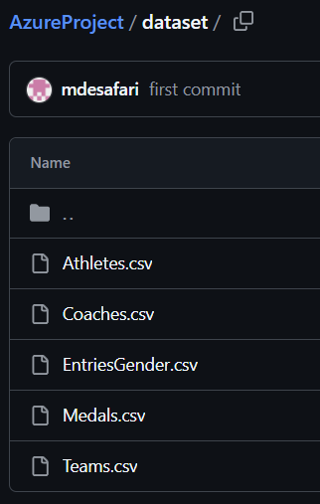
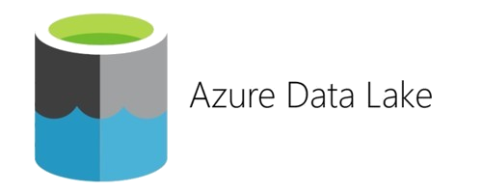

From data source to target: Global schema
1
Data source
(On your GitHub)
3
Data target
(Azure Data Lake)
2
Ingest data
(In the Data Lake)

Slide 2

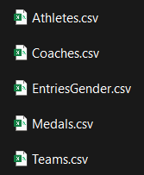

From data source to target: Data ingestion
1
What do we need ?
Three steps to create Containers
1
Containers
(Azure Data Lake)
1
Data Lake folders where you store your data
Create a Resource Group
(Azure)
2
Create a storage account SA
(Azure Data Lake)
3
Create a container in the SA + subfolders
(Azure Data Lake)

Slide 3
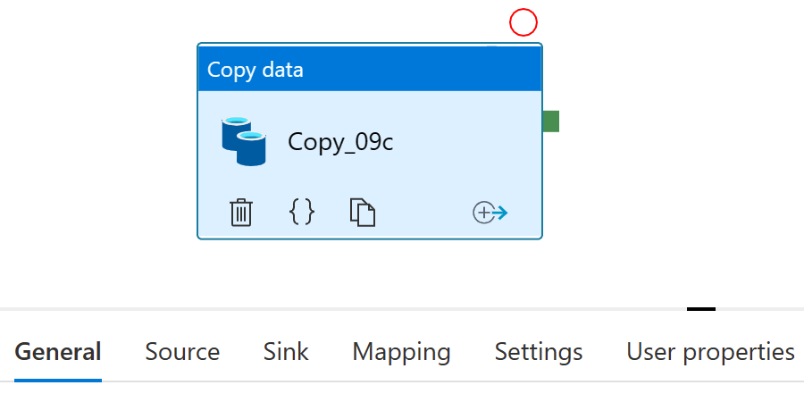
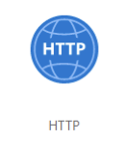
From data source to target: Data ingestion
1
What do we need ?
2
Data ingestion Pipeline
(Azure Data Factory)

Slide 4
From data source to target: Data ingestion
1
What do we need ?
2
Data ingestion Pipeline
(Azure Data Factory)
Three steps to create Data Ingestion Pipeline
1
2
3
Create an instance of Data Factory
(Azure Data Factory)
Set up and open the Data Factory
(Azure Data Factory)
Create an ingestion pipeline
(Azure Data Factory)

Slide 5
Transform data and store: Data transformation
3
3
Data target
(Azure Data Lake)
Data target
(Azure Data Lake)
4
Transform data
(Using Databricks)

Slide 6
Transform data and store: Data transformation
1
What do we need ?
1
Create Azure Databricks (AD) Service
(Azure Databricks)
5
3
Transform the data
(Azure Databricks)
Authorize AD to access Our Data Lake
(Azure)
2
4
Create AD Workspace
(Azure Databricks)
Create a connection between AD and Azure Data Lake
(Azure Databricks)

