Slide 1

Comparative Analysis of Techniques for Toxic Content Classification
Sri Greeshma Avadhootha
UFID : 16136609
avadhoothas@ufl.edu

Slide 2
Contents
Abstract
Introduction
Description
Literature Survey
Experiment
Results
Conclusion
References

Slide 3
Abstract
With the growth of social media platforms, there has been a tremendous increase in the number of people having a significant online presence these days. This comes with its own share of pros and cons.
Pros : Mélange of diverse and constructive conversation which enables everyone to understand each other's views and beliefs.
Cons : The existence of bad actors who spew bigoted and racist comments.
With this project, the challenges posed by content moderation will be addressed. Efficiency in identifying these hateful comments can be achieved by the application of the appropriate classification technique.
This paper will present a comparison of the traditional approaches such as Support Vector Machine, Naive Bayes versus the deep learning models such as Convolutional Neural Networks, Aritifical Neural Networks and Long Short Term Memory.

Slide 4
Introduction
The ease of access and popularity of the internet’s social media platforms has led to the rise of the amount of content generated and submitted by the users of these platforms.
This has many advantages by helping people connect with one another, but there are a multitude of problems such as online abuse, cyber-bullying, propagation of fake news, etc.
The onus of the policing falls on the companies as they are becoming increasingly responsible to maintain the quality of their platforms.
But the challenge they face is the fact that there are billions of users and terabytes of content which makes it impossible for companies to manually filter and sanitize each one.
This is where the machine learning algorithms and models come into play. These models are leveraged in order to automatically parse text, comments and other content and flag them appropriately.

Slide 5
Description
The focus of this project is to identify and classify derogatory comments efficiently.
First I explore the traditional models such as Logistic regression, Naive Bayes and SVM.
Traditional approaches involve two phases. The first is the extraction of handcrafted features followed by application of traditional machine learning models.
The sparse representation of linguistic information leads to problems such as the curse of dimensionality. In order to solve this, dimensional reduction from the feature set is needed to optimize the memory needed for textual representation.
In this part of the project, feature extraction is done via the traditional Bag-of-Words(BOW) approach using Term frequency-Inverse document frequency (TF-IDF).
However, this is not best method for classification of text semantically since the preservation of context is lacking in these traditional approaches which eventually leads to wrong classification of the text. There is a high possibility that constructive criticism would be classified as toxic.

Slide 6
Literature Survey
Logistic Regression
A sigmoid function is used for this purpose. Suppose a single input x is represented as a vector of features.
The value 1 is assigned to the output y if the input is a member of the class or the value 0 is assigned if the it is not a member of the class.
Each sentence returns an output in the form of a confidence value based on the classification of the text as toxic or nontoxic.
The range of the values is [0,1] where 0 indicates no toxicity and 1 indicates toxicity

Slide 7
Literature Survey
Naïve Bayes
The Bayesian theorem is used by Naive Bayes classifiers due to which they are also known as probabilistic classifiers.
The assumption in this case is that the features of a data-set are mutually independent. In practical applications, it is known that the independence rule is not strictly adhered to.
Despite this unrealistic assumption, these classifiers tend to perform well. From previous research we know that Bayes classifiers can perform better than the more powerful machine learning algorithms for small sample sizes
When zero is the conditional probability of a feature, the zero probability problem comes in play which causes this technique to result in wrong classification.

Slide 8
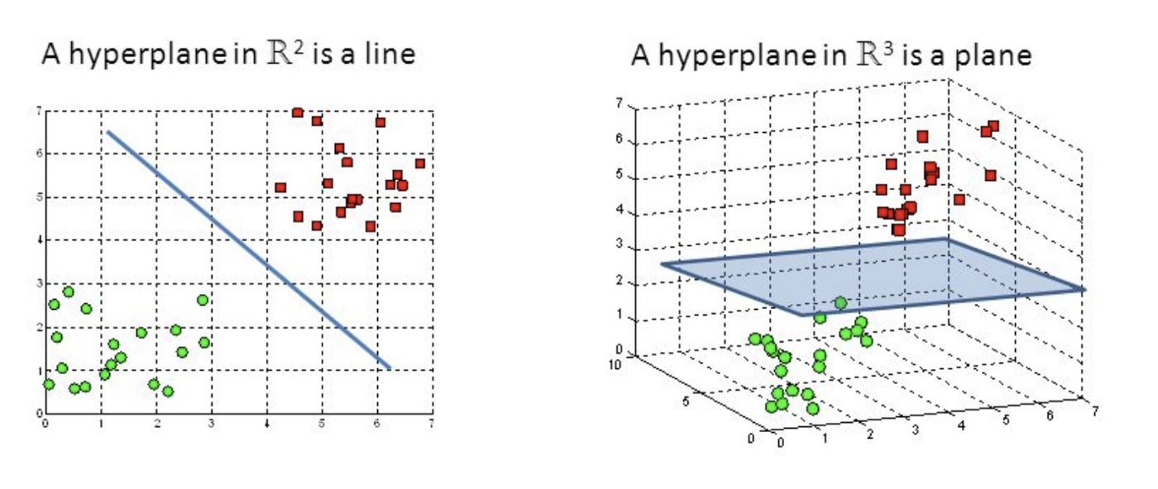
Literature Survey
Support Vector Machines
An attempt is made to compute an optimal hyperdimensional plane which is capable of dividing data points into classes on either side of the plane.
However, as the data becomes more complex and intricate, a simple line is not sufficient to divide it into different classes.
SVM helps overcome this shortcoming by transforming and helping in addition of more dimensions to the space. Once the new dimensions are added, data is divided using a new hyperdimensional plane.
In this paper, SVM is used to create a hyperplane which segregates data into toxic and non-toxic classes. The test data gets classified on the basis of which side of the hyperplane it lies on.

Slide 9
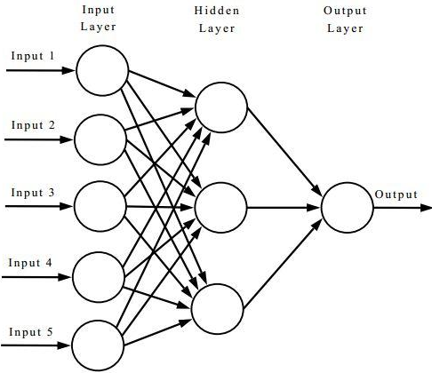
Literature Survey
Artificial Neural Networks
The ANN is a fully connected multi-layer neural network architecture where each node is responsible for performing the sum of all weighted output from the previous layer nodes and then applying an activation function over the summation.
The input training data is given at the left in the diagram and weights are calculated for each forward path that is computed.
Furthermore, there is tuning with each iteration which results in the final output in the right.
This approach is time consuming in the learning phase because of the iterative manner of execution.
The interconnecting path weights are recalculated constantly in order to obtain the best possible weights. By doing so, we can get the higher accuracy for calculating the outcome of the test data.

Slide 10
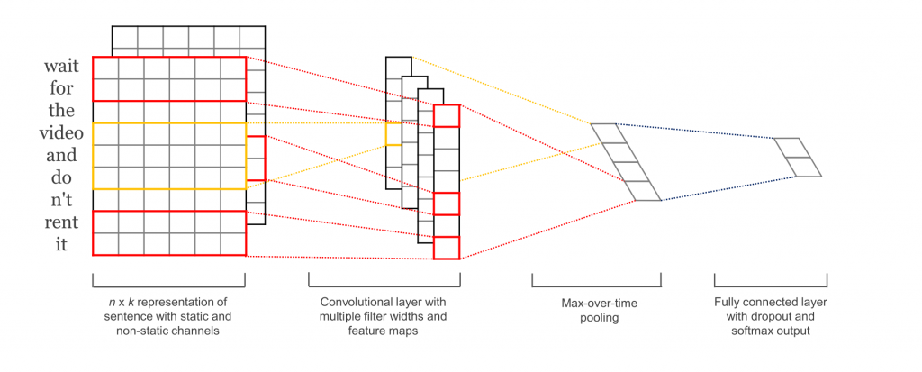
Literature Survey
Convolutional Neural Networks
The CNN contains convolutional layers that have filters. The filters scan the input data and look for a particular pattern.
The next layer of filters take the output from the previous layers as input and try to extract higher level features.
The transition from low level features to high level features is possible by using CNN and hence, it is appropriate for text classification tasks.

Slide 11
Literature Survey
Long Short Term Memory
LSTM is a popular variant of Recurrent Neural Networks. RNN’s are powerful for NLP tasks because they have a memory associated with each node.
LSTM is capable of solving the vanishing gradient problem. In this method, as the gradient approaches zero, the weight does not get updated.
Due to this, the older nodes lose their importance for later outputs. There are four parts to this - cell, input gate, output gate and forget gate. Gates are combinations of sigmoid neural network layer and pointwise multiplication operation.

Slide 12
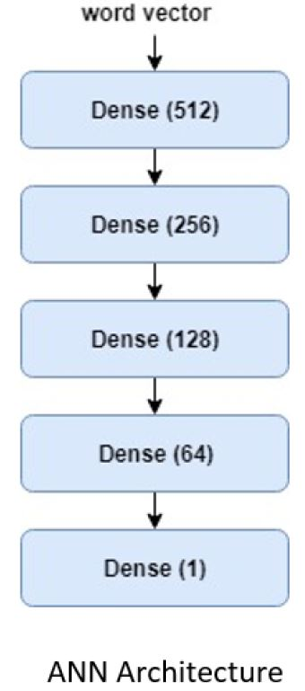
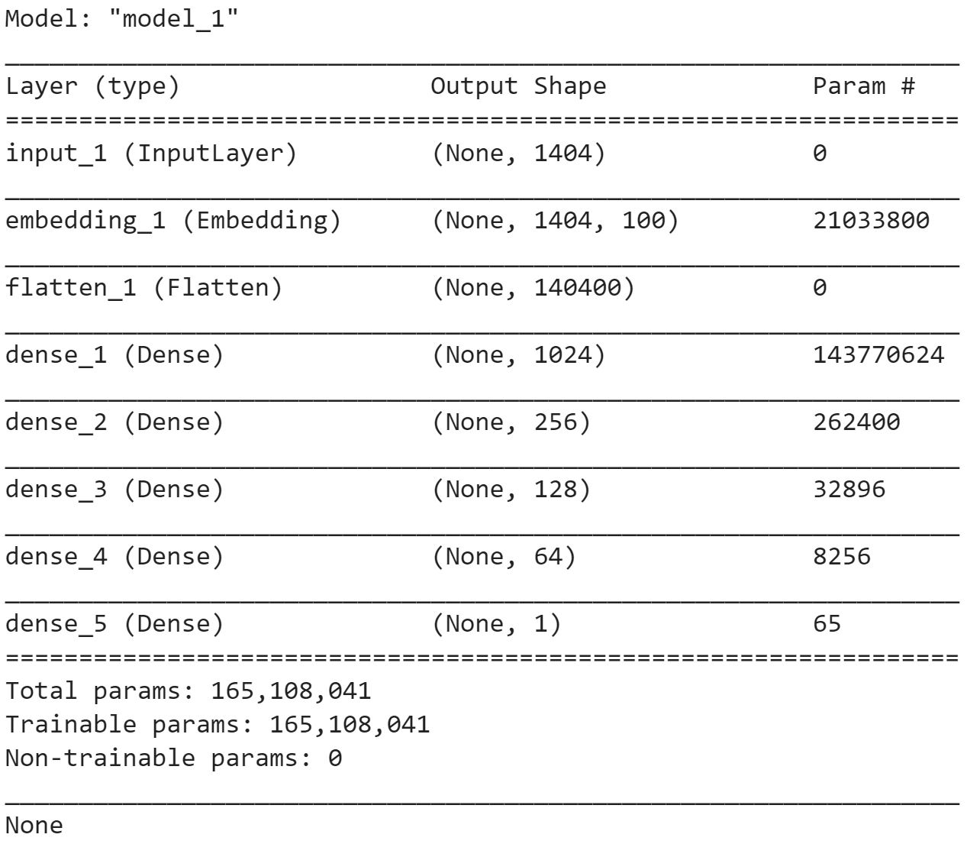
Experiment
ANN Architecture
Training parameters:
•Cost function : BinaryCross-Entropy
•Optimization : ADADELTA
•Batch size : 512
•Epochs : 40

Slide 13
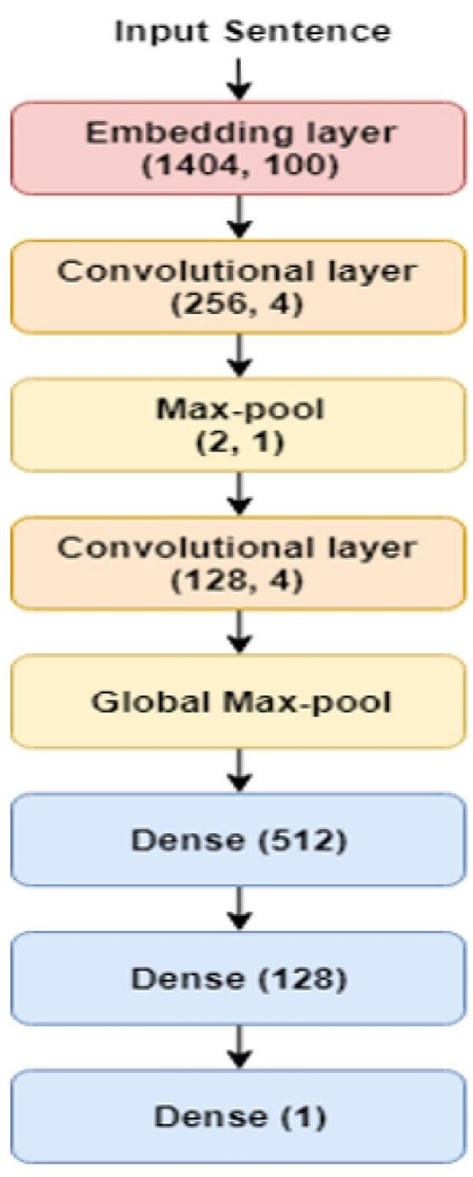
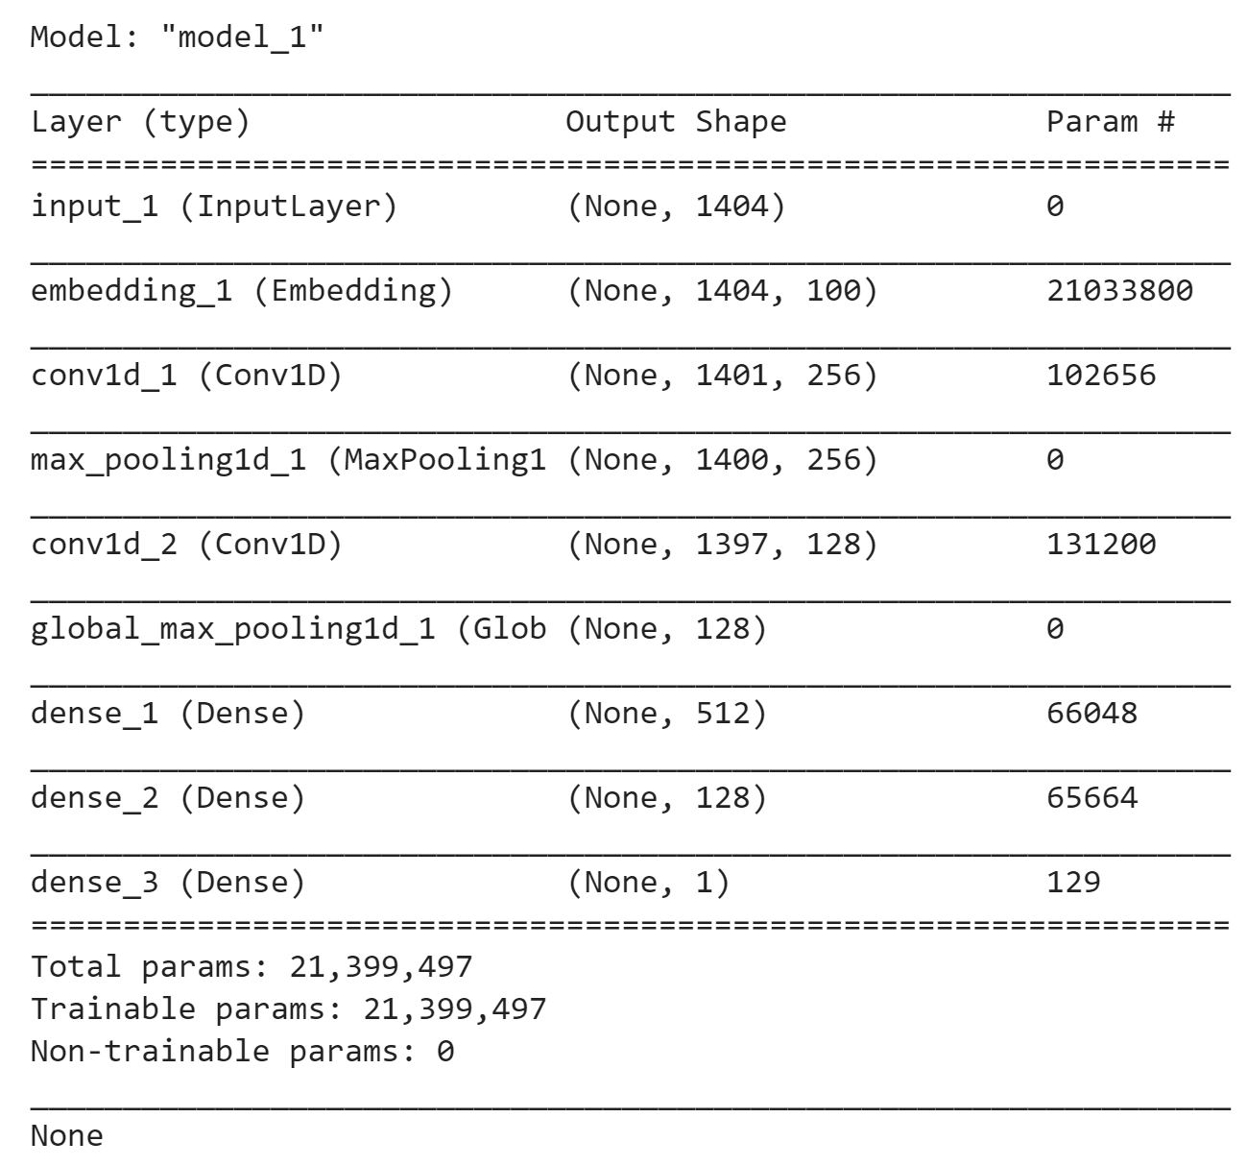
Experiment
CNN Architecture
Training parameters:
•Cost function : BinaryCross-Entropy
•Optimization : ADADELTA
•Batch size : 512
•Epochs : 30

Slide 14
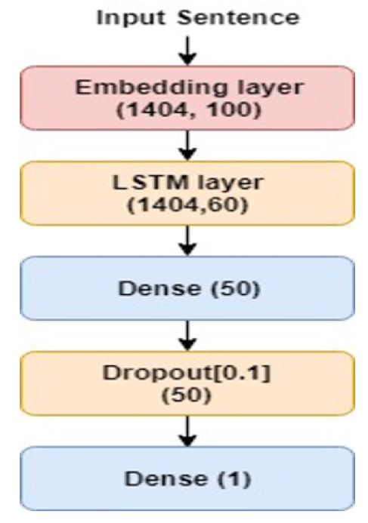
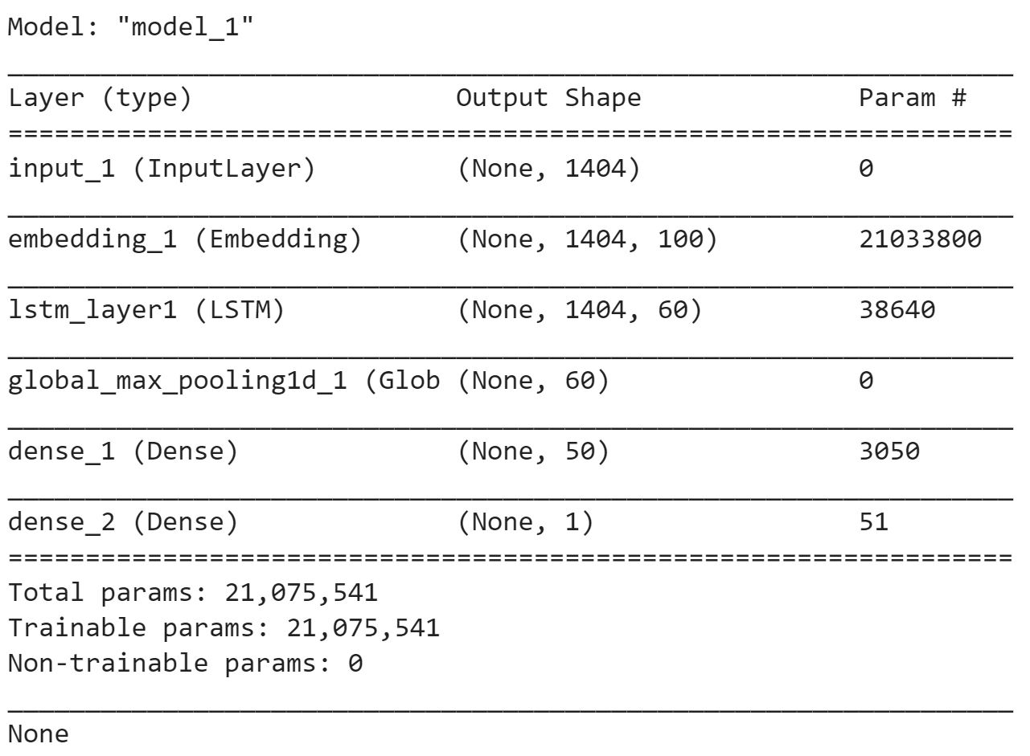
Experiment
LSTM Architecture
Training parameters:
•Cost function : BinaryCross-Entropy
•Optimization : ADADELTA
•Batch size : 512
•Epochs : 10

Slide 15
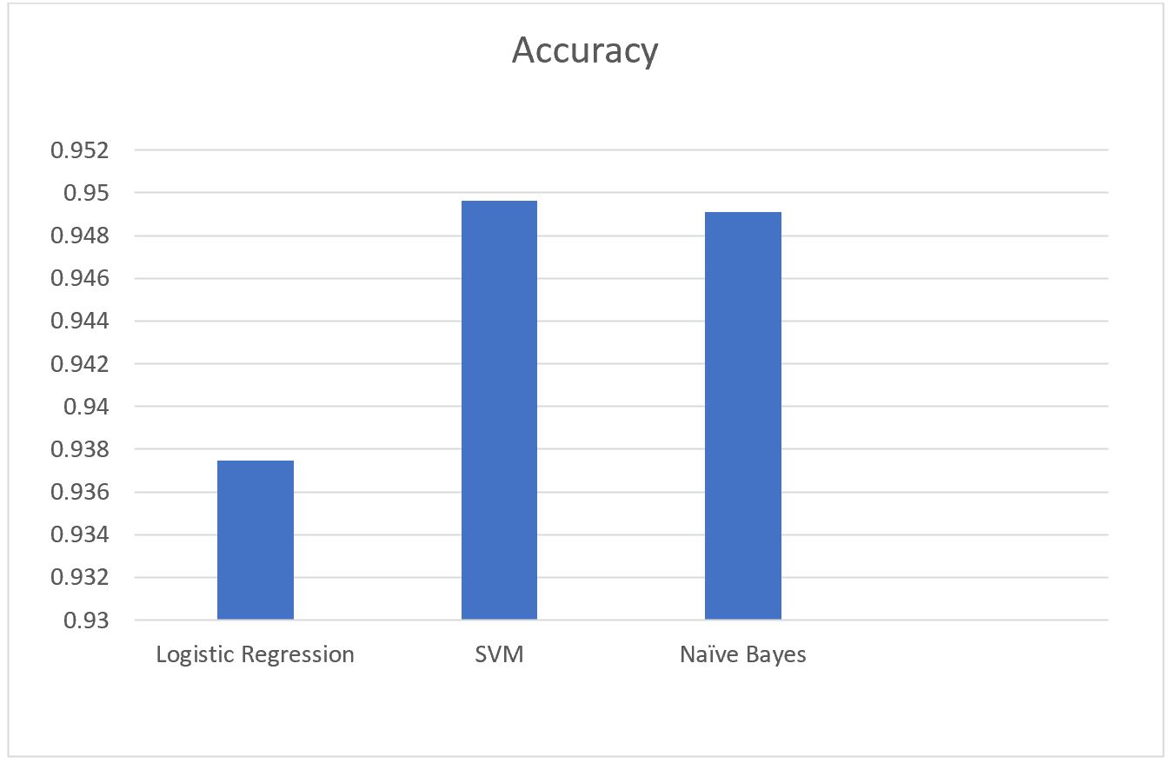
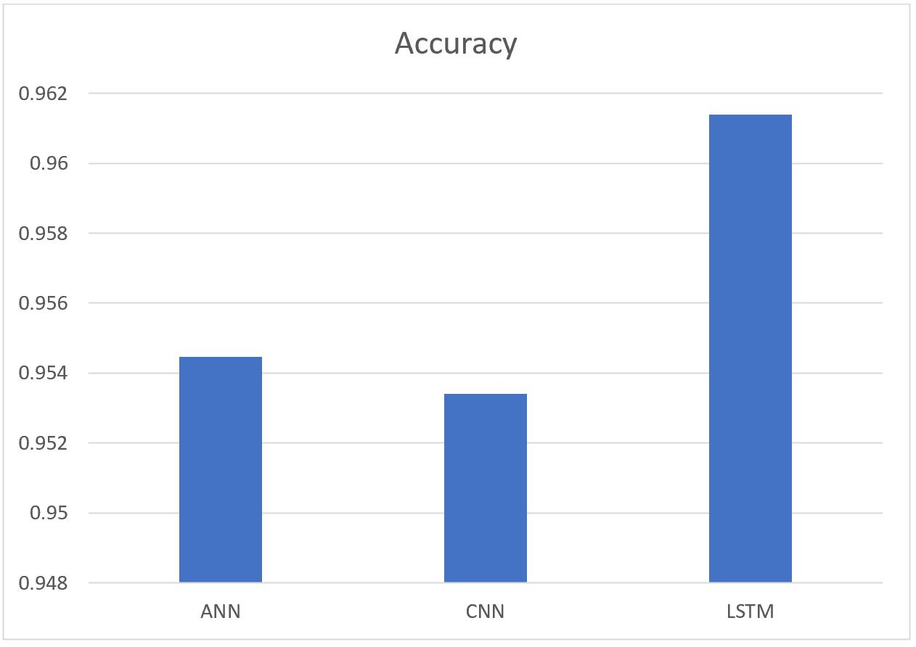
Results - Accuracy

Slide 16
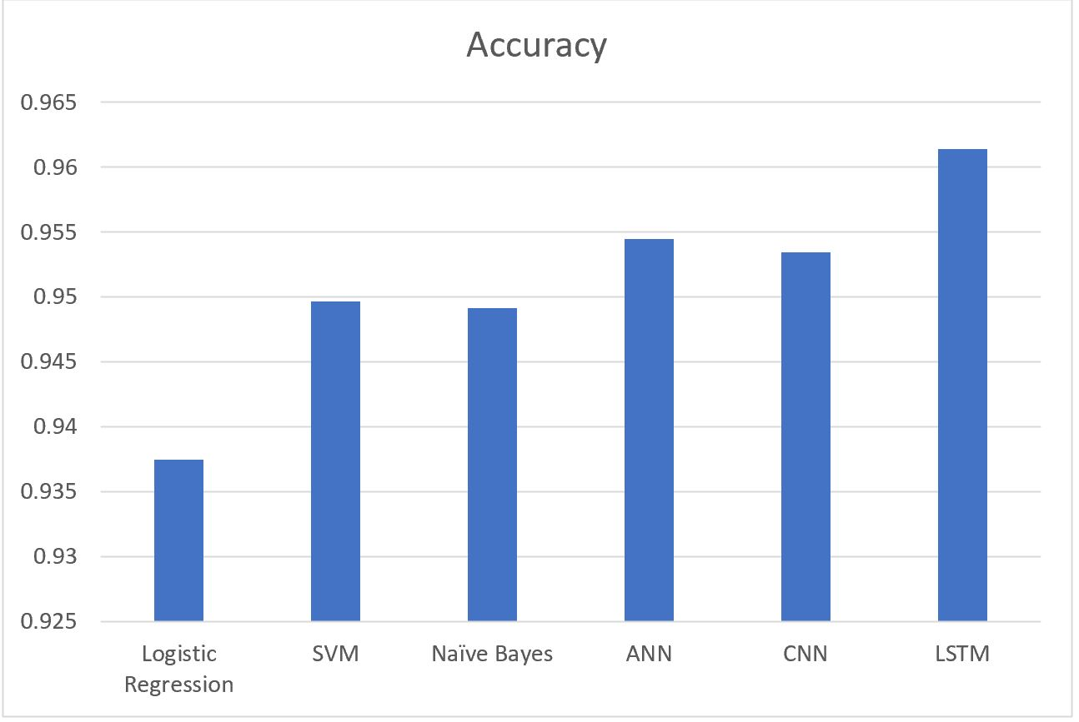
Results - Accuracy

Slide 17
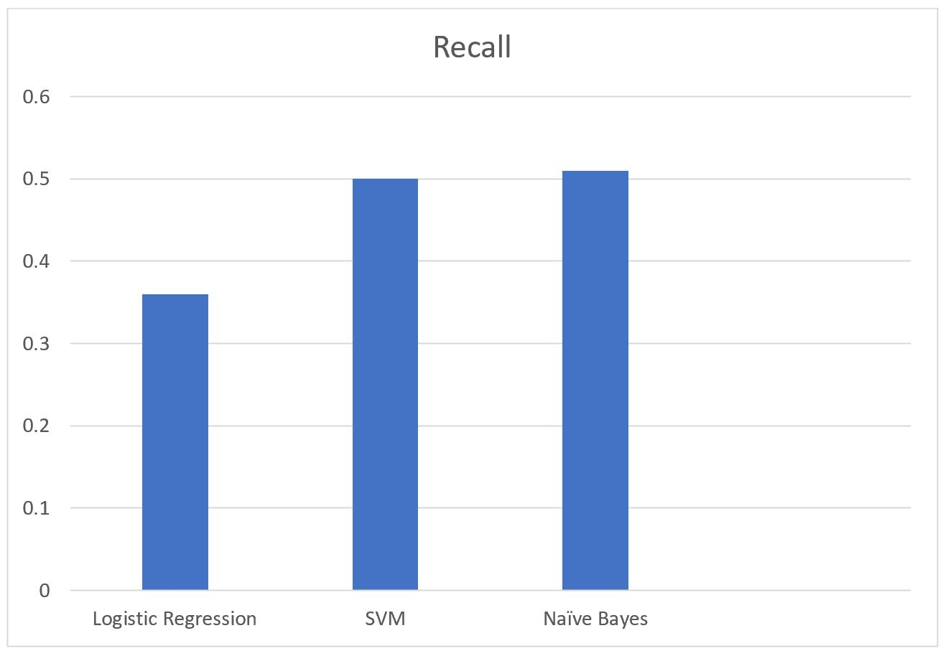
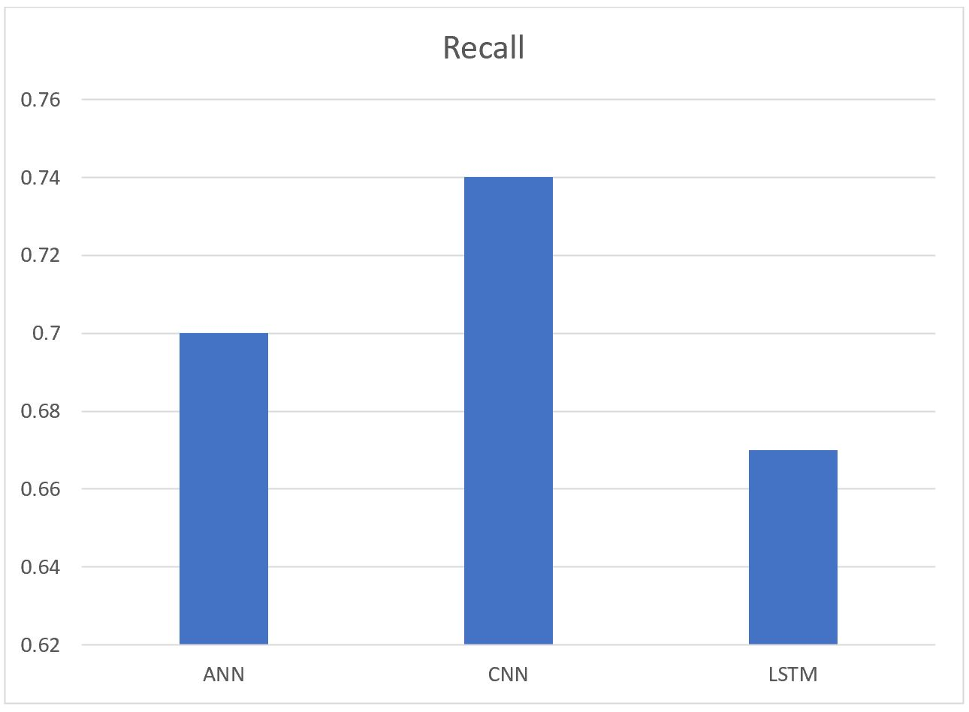
Results - Recall

Slide 18
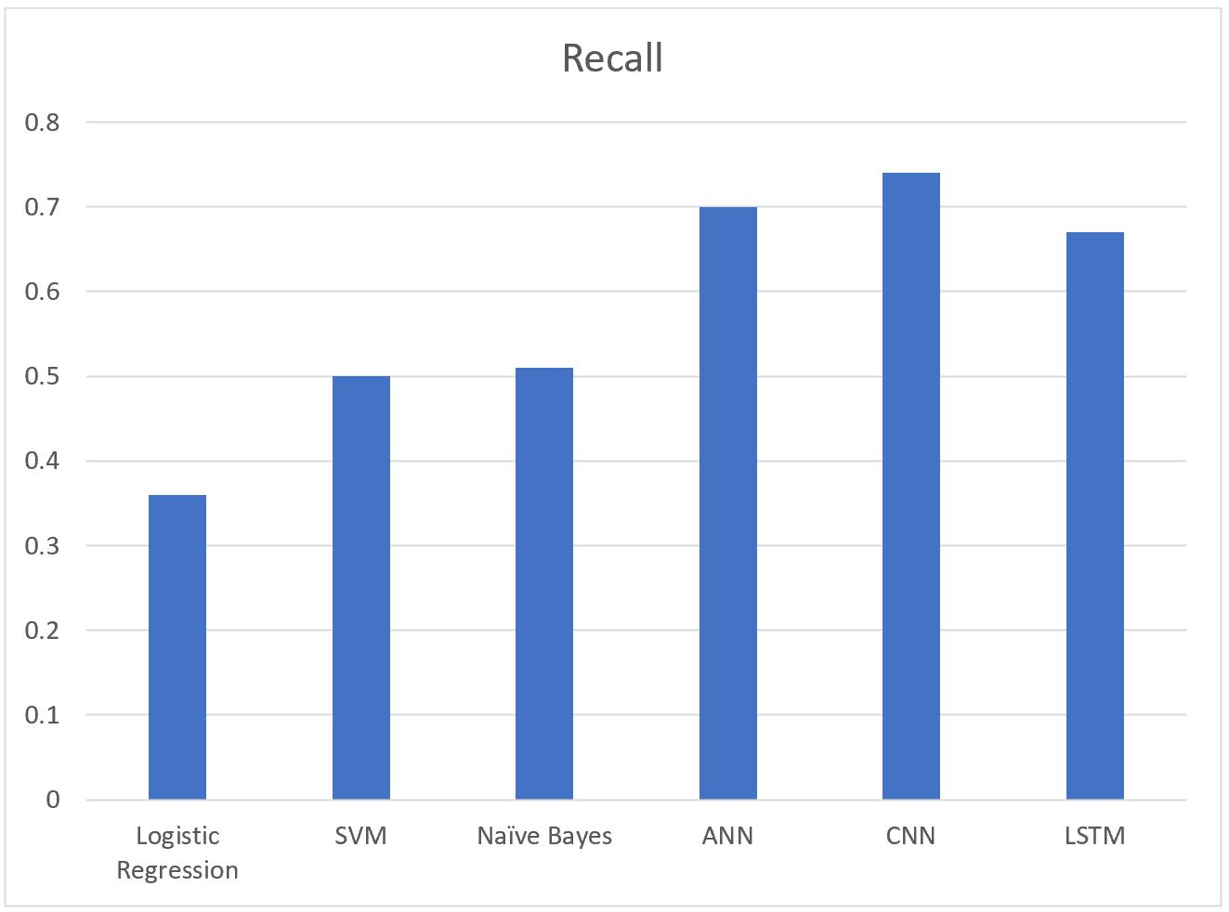
Results - Recall

Slide 19
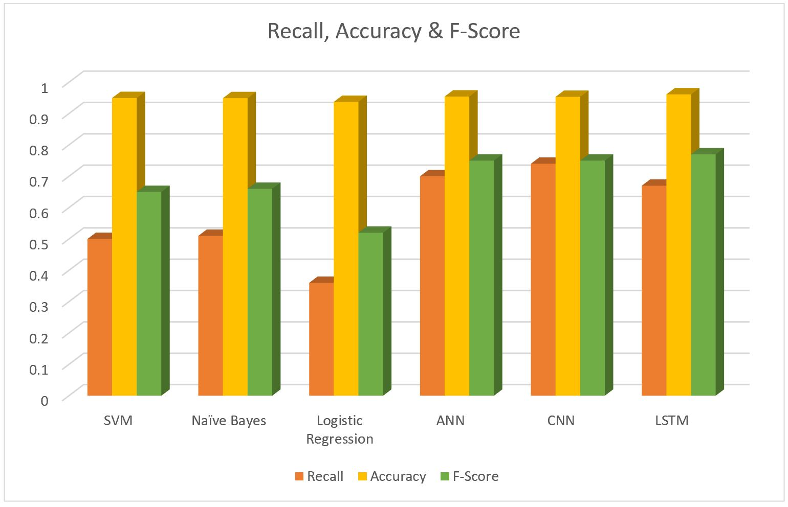
Results – F-Score, Accuracy & Recall

Slide 20
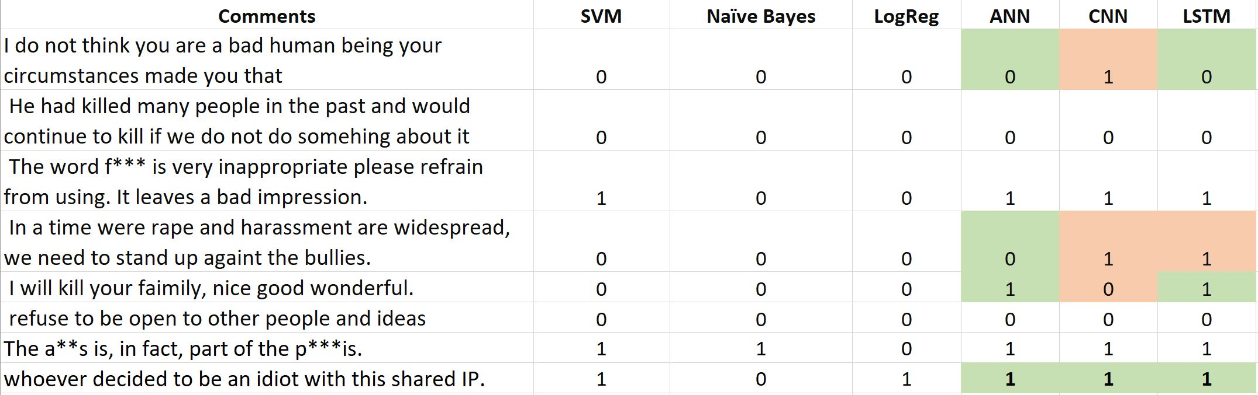
Results – Comments

Slide 21
Conclusions
I have implemented Traditional and Deep learning models for toxic content classification
From the results, I have concluded that LSTM performs best for my use case and Logistic Regression performs the worst.
Overall, the deep learning models are more reliable and accurate than the traditional models for classification of toxic content
Future scope : The depth of the neural networks can be increased to get better results. Focus can be put on the LSTM model as it performs very well for 10 epochs. Increasing the number of epochs would help efficient classification of toxic content.

Slide 22
Links
Youtube Video : https://youtu.be/lCgj00z6t_M
Github : https://github.com/avads1/ToxicContentClassifier.git
Code sources :
  LSTM : https://www.kaggle.com/jhoward/improved-lstm-baseline-glove-dropout Built my LSTM architecture based on this source.
  ANN : https://www.kaggle.com/poigal/ann-on-tfidf . ANN architecture was inspired from here. I increased the number of layers.
  CNN : https://www.kaggle.com/kashyap32/keras-cnn-gru . The two layer convolution neural network was motivated from here.

Slide 23
References
[1] Kim, Yoon. "Convolutional neural networks for sentence classification." arXiv preprint arXiv:1408.5882
[2] S. Bharathidason, C. Jothi Venkataeswaran. "Improving Classification Accuracy based on Random Forest Model with Uncorrelated High Performing Trees". International Journal of Computer Applications (0975 – 8887),Volume 101– No.13, September 2014
[3] Kim, Sang-Bum, et al. "Some effective techniques for naive bayes text classification." IEEE transactions on knowledge and data engineering 18.11 (2006): 1457-1466
[4] Ifrim, Georgiana, Gökhan Bakir, and Gerhard Weikum. "Fast logistic regression for text categorization with variable-length ngrams." Proceedings of the 14th ACM SIGKDD international conference on Knowledge discovery and data mining. ACM, 2008
[5] Joachims, Thorsten. "Text categorization with support vector machines: Learning with many relevant features." European conference on machine learning. Springer, Berlin, Heidelberg, 1998 [6] Pennington, Jeffrey, Richard Socher, and Christopher Manning. "Glove: Global vectors for word representation." Proceedings of the 2014 conference on empirical methods in natural language processing (EMNLP). 2014.
[7] Xin Yao. "Evolving artificial neural networks." Proceedings of the IEEE ( Volume: 87, Issue: 9, Sep 1999)
[8] Cho, Kyunghyun, et al. "Learning phrase representations using RNN encoder-decoder for statistical machine translation." arXiv preprint arXiv:1406.1078 (2014).
[9] Lee, Ji Young, and Franck Dernoncourt."Sequential short-text classification with recurrent and convolutional neural networks." arXiv preprint arXiv:1603.03827 (2016)
[10] Yin, Wenpeng, et al. "Comparative study of cnn and rnn for natural language processing." arXiv preprint arXiv:1702.01923 (2017)
[11] Mikolov, Tomas, et al. "Efficient estimation of word representations in vector space." arXiv preprint arXiv:1301.3781 (2013)

Slide 24
References
[12] van Aken, Betty, et al. "Challenges for Toxic Comment Classification: An In-Depth Error Analysis."arXiv preprint arXiv:1809.07572 (2018).
[13] Ibrahim, Mai, Marwan Torki, and Nagwa El-Makky. "Imbalanced Toxic Comments Classification Using Data Augmentation and Deep Learning." 17th IEEE International Conference on Machine Learning and Applications (ICMLA). IEEE, 2018.
[14] Jozefowicz, Rafal,Wojciech Zaremba, and Ilya Sutskever. "An empirical exploration of recurrent network architectures." International Conference on Machine Learning. 2015.
[15] Michael Cogswell, Faruk Ahmed, Ross Girshick, Larry Zitnick, Dhruv Batra. "Reducing Overfitting in Deep Networks by Decorrelating Representations."arXiv preprint arXiv:1511.06068 (2016).
[16] Das, Bijoyan, and Sarit Chakraborty. "An Improved Text Sentiment Classification Model Using TF-IDF and Next Word Negation." arXiv preprint arXiv:1806.06407 (2018).
[17] Daniel Jurafsky and James H.Martin. "Speech and Language Processing (second edition)" [18] Kamran Kowsari, Kiana Jafari Meimandi, Mojtaba Heidarysafa, Sanjana Mendu,Laura Barnes and Donald Brown. "Text Classification Algorithms: A Survey" arXiv 1904.08067

