Slide 1
Tamarin Workshop
RI.SE – 2019-10-29
Simon BOUGET
(w/ slides from David Basin, Cas Cremers, Jannik Dreier, Ralf Sasse)

Slide 2
Overview
2 hours
  Half lecture, half hands-on
Adapted from a one-day tutorial
  6 hours cut down to 2
  Removed most of the theory
Interrupt if you don’t follow

Slide 3
Introduction
How to know if a protocol is secure?
With a structured, systemic approach?
Notion of trace properties
  When a protocol is run, it generates a “trace”
    e.g. messages sent, data logged, etc.
Encode (and prove) properties
  Authentication:
  In all traces, if an initiator completes,
  there exists a responder with…
  Secrecy:
  There is no trace in which Adversary learns k

Slide 4
Tamarin: high-level
Modeling protocol & adversary done using multiset rewriting
  Specifies transition system; induces set of traces
Property specification using fragment of first-order logic
  Specifies “good” traces
Tamarin tries to
  provide proof that all system traces are good, or
  construct a counterexample trace of the system (attack)
Notes:
Mention we’ll give Naxos examples

Slide 5
What can Tamarin do for you?
Rapid prototyping
Finding attacks before you start a proof effort
Provide a symbolic proof
Explore alternative designs/threat models quickly

Slide 6
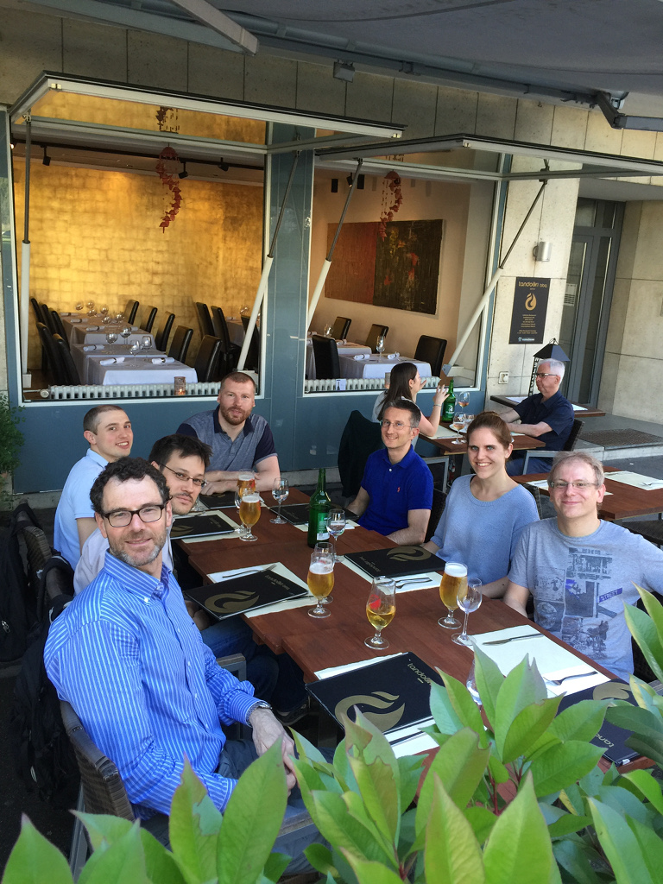
Resources & documentation
Sources on github
100+ page manual
Plenty of examples/case studies
Algorithm details in theses, papers

Slide 7
Selected case studies
AKE
  Naxos
  Signed DH
  KEA+
  UM
  Tsx
Group protocols
  GDH
  TAK
  (Sig)Joux
  STR
ID-based AKE
  RYY
  Scott
  Chen-Kudla
Loops
  TESLA1 & 2
Non-monotonic global state
  Keyserver
  Envelope
  Exclusive secrets
  Contract signing
  Security device
  YubiKey
  YubiHSM
PKI with strong guarantees
  ARPKI (also global state)
Transparency
  DECIM (also global state)
TLS 1.3
  Rev 10, 10+, and current

Slide 8
Modelization in Tamarin: Overview
Modeling protocols and threats:
  What is the current state of the system?
  What’s the situation, the state of the world?
  How can the system evolve?
  What are the possibilities? How can the system progress?

Slide 9
Modelization in Tamarin: State
State of the system → multiset / bag
  Facts (think “general statement”)
    parametrized with Terms
    (think “specific instance”)
  E.g. “Agent A owns the secret/public key pair (sk_A, pk_A)”
  KeyPair(A, sk_A, pk_A)
Initial state is empty
You can define any arbitrary fact you want
  Foo(x,y), Toto(a,b,c), KeyPair(A, sk, pk), …
  Purely symbolic, no meaning attached
  ==> meaning is in the rules,
  in the relationships between facts)

Slide 10
Modelization in Tamarin: Change
Changes → transition rules
  [ conditions ] --[ actions ]-> [ conclusions ]
  E.g. “If A has a secret key sk_A
  and knows the public key pk_B of B,
  then A can send a message m to B, signed and encrypted.”
  [ !SecKey(A, sk_A), !PubKey(B, pk_B) ]
  --[ Send(A, B, m) ]->
  [ Out(<aenc(m, pk_B), sign(aenc(m, pk_B), sk_A)>) ]
For a rule to be applied:
  it must match the conditions (or premises)
  and it generates the conclusions

Slide 11
Semantics: example 1
‘c’ constant
Rules
  rule 1: [ ]--[ Init() ]-->[ A('5') ]
  rule 2: [A(x)]--[ Step(x) ]-->[ B(x) ]
ONE possible run
An infinity of other possibilities
Rule applied | Current state | Trace
Initial state | [ ] | ()
Rule 1 | [ A(‘5’) ] | ( Init() )
Rule 1 | [ A(‘5’), A(‘5’) ] | ( Init(), Init() )
Rule 2 | [ A(‘5’), B(‘5’) ] | ( Init(), Init(), Step(‘5’) )

Slide 12
Example 2: persistent facts
‘c’ constant
“!Persistent” vs “Linear” facts
  Linear facts are consumed by rules that match them,
  i.e. removed from the state of the system when the rule is applied
  Persistent facts can be matched any number of times
Rules
  rule1: [ ]--[ Init() ]-->[!C('ok'), D('1')]
  rule2: [!C(x), D(y)]--[Step(x,y)]-->[ D(h(y)) ]
Execution example
Rule applied | Current state | Trace
Initial state | [ ] | ()
Rule 1 | [ !C(‘ok’), D(‘1’) ] | ( Init() )
Rule 2 | [ !C(‘ok’), D(h(‘1’)) ] | ( Init(), Step(‘ok’, ‘1’) )
Rule 2 | [ !C(‘ok’), D(h(h(‘1’))) ] | ( Init(), Step(‘ok’, ‘1’), Step(‘ok’, h(‘1’)) )

Slide 13
Now we have the basics…
… let’s move onto real protocols!
We still need a few missing pieces
  How to model the network and the adversary?
  Randomness?
  Cryptography?
Tamarin has built-ins for that.
Don’t need to start from scratch!

Slide 14
Modelization in Tamarin: Built-In
1 special fact: Fr(~x) → get a fresh value x
  Always matches
  All instances are distinct,
  i.e. Fr(~a) & Fr(~b) => ~a != ~b
2 pre-defined rules controlling network messages
1.rule irecv: [ Out( x ) ] --> [ !KD( x ) ]
2.rule isend: [ !KU( x ) ] --[ K( x ) ]-> [ In( x ) ]
  Note the use of In(), Out(),
  and K() = the adversary Knows
  (you can ignore !KU() and !KD())
You can add more capabilities to the adversary if you want
  E.g. reveal long term keys
Notes:
The irecv rule states that any message sent by an agent using the Out fact is learned by the adversary. Such messages are then analyzed with the adversary’s message deduction rules, which depend on the specified equational theory. The isend rule states that any message received by an agent by means of the In fact has been constructed by the adversary.

Slide 15
Equational theories
Equational theories are used in symbolic protocol verification to model the algebraic properties of the cryptographic primitives.
Example (asymmetric encryption):
adec( aenc(m,pk(k), k ) = m
Built-in: encryption (sym and asym), (blind) signing,
Diffie-Hellman, bilinear pairing, multiset, xor
You can add your owns (with limitations)
  Subterm convergent
    Right-hand side is subterm of left hand side (or constant)
  Active development

Slide 16
Tamarin explore ALL possible interactions with the adversary
Your protocol
modeled with
rewrite rules
DY-style adversary
a.k.a.
The network
Out(t)
In(t)
Notes:
Do I need to show the built-in rules for Out/In (DY adversary?)

Slide 17
Property specification
Timed first order logic interpreted over a trace
  Ex x y i. Fact(x,y) @ #i
  All a b j. Fact(a,b) @ #j
  Timepoint ordering: #i = #j / #i < #j
  IMPLY, NOT, AND, and OR logic operators:
  All Client Server k #i #j.
  Complete(Client, Server, k)@i & Secret(k)@j
  ==>
  not K(k) | (Ex l. Revealed(k)@l & l<i)

Slide 18
Demo time
  Sources
  Using the tool
    UI
    Read graphs

Slide 19
Syntax Issues: Type Annotations
Mark timepoint (index) variables with a hashmark (#) in quantification.
Mark fresh values with ~
Mark public values with $
Be consistent! If a rule contains ~x, $x, and x that is interpreted as three different variables!
You do get a warning about it, and should fix it.

Slide 20
Warnings on Loading a theory
Warnings give good information what is wrong:
  Mismatch of type: use of $x and x in same rule
  Using a fact name with different arities
  Guardedness problems in formula
Tamarin strict mode stops you from working with warnings, but is optional:
  Add command-line parameter: --quit-on-warning

Slide 21
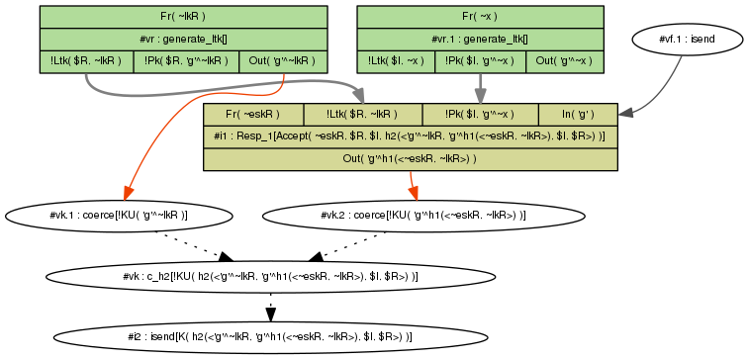
Reading Tamarin’s graphs
f

Slide 22
Basic principles
Backwards search using constraint reduction rules (27!)
Turn negation of formula into set of constraints
Case distinctions
  E.g.: Possible sources of a message or fact
Try to establish:
  no solutions exist for constraint system, or
  there exists a „realizable“ execution (trace)
If multiple rules can be applied: use heuristics

Slide 23
Heuristics?
If Tamarin terminates, one of two options:
  Proof, or
  counterexample (in this context: attack)
At each stage in proof, multiple constraint solving rules might be applicable
  Similar to “how shall I try to prove this?”
  Choice influences speed & termination, but not the outcome after termination
Complex heuristics choose rule
  user can give hints or override

Slide 24
How do I know my model is correct?
Lots of ways to cause errors
Look at the chains...
  (requires an understanding of the algorithm)
Executability
Break the protocol on purpose
Much easier to check these things than in manual proofs!

Slide 25
Cocnlusion

Slide 26

Tamarin: Conclusions
Tamarin offers many unique features
  Unbounded analysis, flexible properties, equational theories, global state, …
  Enables automated analysis in areas previously unexplored
It has many other features I don’t have time to go in details into
  Many new features planned! Still active dev.
Tool and sources are free;
development on Github
mailing list on Google Groups

Slide 27
Bonus: Advanced features
More accurate models
  Executability lemmas => sanity checks
  Restrictions => limit allowed runs
  Channel models => restrict adversary control of network
  Custom equational theories
  Observational Equivalence => stronger notion of secrecy
Easier proofs
  Source lemmas => reduce search space
  Induction => forward instead of backward search
  Custom Heuristics / Guided proofs

Slide 28
Executability Lemmas

Slide 29
Executability Lemmas
Executability lemmas are existential properties
These show the existence of some protocol trace satisfying the formula…
… instead of the usual case where all traces must satisfy the formula.
Heuristics tuned for verification
  Manual intervention needed more often for executability
lemma exec: exists-trace “...(formula)...”

Slide 30
Channel models

Slide 31
Channel models
By default, the adversary controls EVERYTHING on the network
You can write custom rules governing the network with alternatives to In() and Out()
A lot of variants in the manual already
=> don’t try making your owns
Make sure you REALLY need a secure channel

Slide 32
Channel models: Example
Default rules
rule irecv:
[ Out( x ) ]
-->
[ !KD( x ) ]
rule isend:
[ !KU( x ) ]
--[ K( x ) ]->
[ In( x ) ]
Confidential Channel rules
rule ChanOut_C:
[ Out_C($A,$B,x) ]
--[ ChanOut_C($A,$B,x) ]->
[ !Conf($B,x) ]
rule ChanIn_C:
[ !Conf($B,x), In($A) ]
--[ ChanIn_C($A,$B,x) ]->
[ In_C($A,$B,x) ]
rule ChanIn_Cadv:
[ In(<$A,$B,x>) ]
-->
[ In_C($A,$B,x) ]

Slide 33
Restrictions

Slide 34
Restrictions
Restrictions exclude undesired traces
  Take care not to exclude attacks!
Safe to use for certain checks:
  Equality
  Inequality
  LessThan
  GreaterThan
  OnlyOnce
Use same format as lemmas
Essentially: Conditional Rewriting

Slide 35
Restriction Example
restriction once:
“All #i #j. OnlyOnce()@#i & OnlyOnce()@#j ==> #i=#j”
Rules
  rule 1: [ ] –[ OnlyOnce() ]→ [ A('5') ]
  rule 2: [ A(x) ] –[ Step(x) ]→ [ B(x) ]
Execution removed by restriction
    [ ]
    –[ OnlyOnce() ]→ [ A('5')]
    –[ OnlyOnce() ]→ [ A('5'), A('5') ]
    –[ Step('5') ]→ [ A('5'), B('5') ]
Execution still allowed
    [ ]
    –[ Init() ]→ [ A('5'), A('5') ]
    –[ Step('5') ]→ [ A('5'), B('5') ]

Slide 36
Restriction Example 2
restriction InEq:
“All x #i. Neq(x,x)@#i ==> F”
Rules
  rule 1: [ ] –[ A1() ]→ [ A('1') ]
  rule 2: [ ] –[ A2() ]→ [ A('2') ]
  rule 3: [ A(x), A(y) ] –[ Neq(x,y) ]→ [ B(x,y) ]
Execution removed by restriction – valid without restriction
    [ ]
    –[ A1() ]→ [ A('1')]
    –[ A1() ]→ [ A('1'), A('1') ]
    –[ Neq('1','1') ]→ [ B('1','1') ]
Execution allowed
    [ ]
    –[ A1() ]→ [ A('1')]
    –[ A2() ]→ [ A('1'), A('2') ]
    –[ Neq('1','2') ]→ [ B('1','1') ]

Slide 37
Source lemmas

Slide 38
State space reduction
Pre-computation
Partial deconstructions
Sources lemmas

Slide 39
Precomputation
Idea: for all facts in rule premises compute their possible sources
sources are (combinations of) rules yielding such a fact as (part of the) result
Initial precomputations are called raw sources
Sometimes these precomputations are incomplete, and give partial deconstructions
GUI shows both raw and refined sources

Slide 40
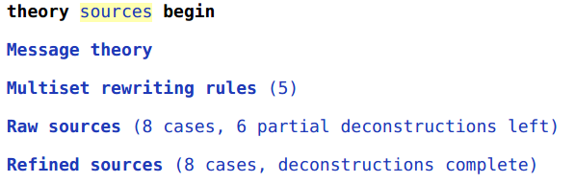
Demo
Notes:
Show top-left of GUI, particularly raw and refined sources.

Slide 41
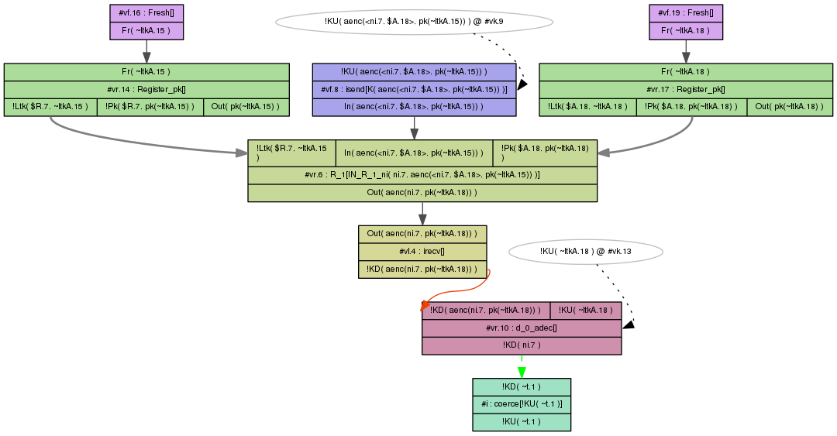
Partial deconstruction – derive any value

Slide 42
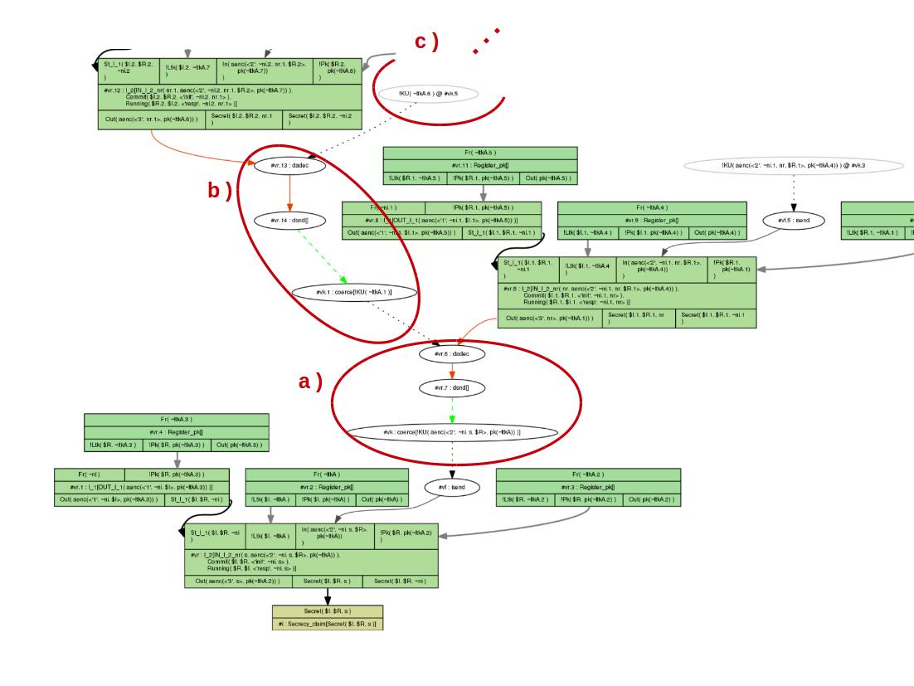
See demo for detail
Notes:
Only show demo after a couple more slides!

Slide 43
Partial deconstructions – issues
Proofs much more complicated
  Possibly non-termination due to partial deconstructions
Need to resolve such partial deconstructions
Claim (and then prove) such deconstructions are not possible, by sources lemma

Slide 44
Example protocol
1. I -> R: {ni,I}pk(R)
2. I <- R: {ni}pk(I)
rule I_1:
let m1 = aenc{~ni, $I}pkR in
[ Fr(~ni) , !Pk($R, pkR) ]
--[ OUT_I_1(m1) ]->
[ Out( m1 ) ]
rule R_1:
let m1 = aenc{ni, I}pk(ltkR)
m2 = aenc{ni}pkI in
[ !Ltk($R, ltkR) , In( m1 ), !Pk(I, pkI) ]
--[ IN_R_1_ni( ni, m1 ) ]->
[ Out( m2 ) ]
This looks like a decryption oracle for values ni

Slide 45
Really? Extract everything?
Realization: only values actually sent by legitimate party (whose private key must be compromised) or adversary-generated terms
  which are known to the adversary previously
lemma types [sources]:
" (All ni m1 #i.
IN_R_1_ni( ni, m1) @ i
==>
( (Ex #j. K(ni) @ j & j < i)
| (Ex #j. OUT_I_1( m1 ) @ j) ) ) "

Slide 46
Demo
Problems with partial deconstructions
Sources lemma removes partial deconstructions for refined sources
Automatic proof of sources lemma
Notes:
Sources-nolemma-load bottom to show repeated abuse of partial deconstruction
Sources – shows that deconstructions gone in refined sources, and sources lemma verified with induction

Slide 47
Sources lemmas
Explain where terms can come from or what their form must be
Tamarin actions in order:
Determine possible sources (raw)
Apply sources lemma to raw sources to get refined sources
Prove sources lemma WRT raw sources
Prove other lemmas WRT refined sources

Slide 48
Induction

Slide 49
Induction
Proof goal:
  ? Not needed in formula, but will hold
Naive constraint solving does not work
Such properties are needed:
  “Reuse” lemmas
  “Sources” lemmas
Notes:
Why is this induction?
- start at empty state
- induction on length of trace
- for all FINITE-length traces there is a Start

Slide 50
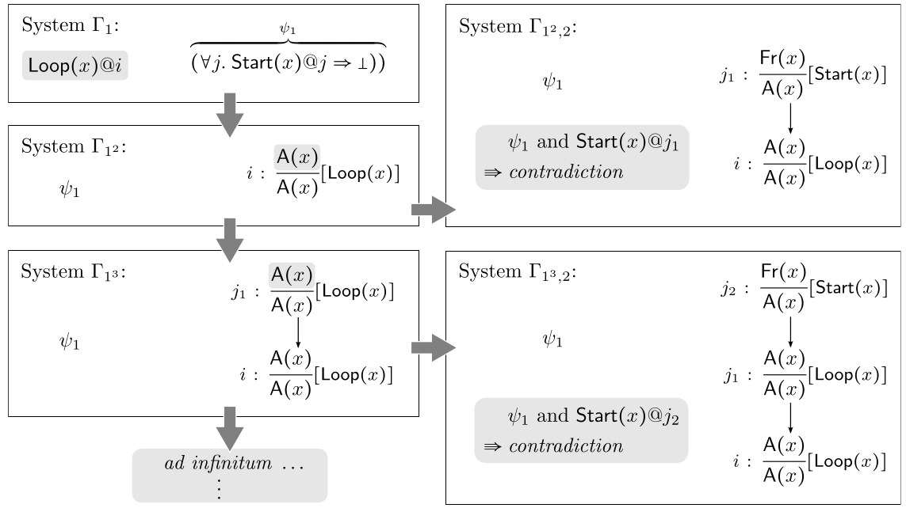
Constraint solving failure

Slide 51
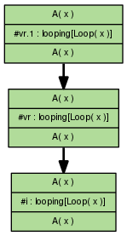
Demo
Notes:
Backwards search on loop showing exactly the problems from previous math notation slide in the tool.

Slide 52
Induction – on time points
Informally, induction works on previous slide
Formally, for IH
  Check if holds for empty trace
  Consider special last rule index on trace
      Assume holds at all non-last indices, and prove for last
Added constraint reduction rules for last atoms
Allows proof of previous example

Slide 53
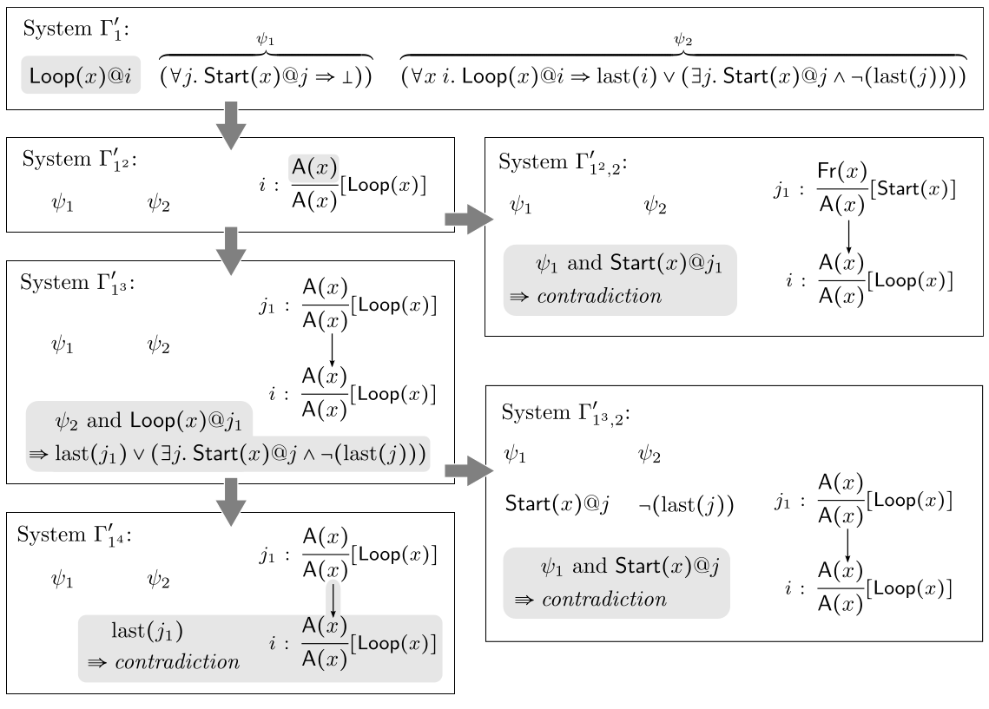
Example – solved by induction

Slide 54
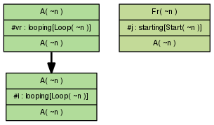
Demo – using induction
Notes:
Use induction instead of simplify and get this solution because for the non-last time point the IH holds.

Slide 55
Induction in general
Required for all “sources” lemmas
Often required for “reuse” lemmas
Helps for all looping constructs, used in e.g.:
  YubiKey
  TPM
  PKCS11
  Group protocols
  Counters

Slide 56
Observational equivalence

Slide 57

Observational equivalence
Two types of properties:
Trace properties
  (Weak) secrecy as reachability
  Authentication as correspondence
Observational equivalence

Slide 58
Why observational equivalence?
Consider classic Dolev-Yao adversary for deterministic pub-key encryption:
adec( aenc(x, k), pk(k) ) = x
Adversary can only decrypt if he knows the secret key
Consider a simple voting system:
  Voter chooses v=”Yes” or v=”No”
  Encrypt v using server’s public key pk(k):
  c = enc(v,pk(k))
  Send c to server
Is the vote secret?
  Dolev-Yao: Yes, adversary does not know server’s secret key
  Reality: No, encryption is deterministic and there are only two choices
    Attack: encrypt “Yes”, and compare to c

Slide 59
Observational equivalence vs reachability
Reachability-based (weak) secrecy is insufficient
Stronger notion: adversary cannot distinguish
  a system where the voter votes “Yes” from
  a system where the voter votes “No”
Observational equivalence between two systems
Can be used to express
  Strong secrecy
  Privacy notions

Slide 60
Running example
Auction system for a shout-out auction
Property: strong secrecy of bids
Property violated:
  Broadcast bid (e.g., A or B)
  Send “A” in first system
  Send “B” in second system
  Observer knows if he is observing first or second system
Property holds using shared symmetric key:
  Shared symmetric key k between bidder and auctioneer
  Send “{A}_{k}” in first system
  Send “{B}_{k}” in second system
  Observer has no access to k, does not know which system he observes

Slide 61
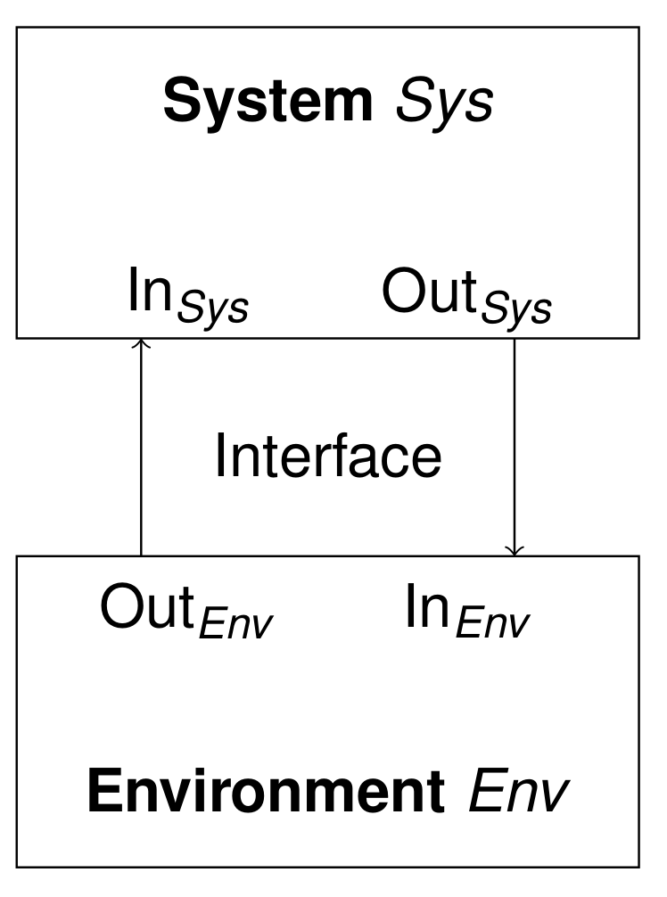
System and environment
We separate environment and system
  System: agents running according to protocol
  Environment: adversary acting according to its capabilities
Environment can observe:
  Output of the system
  If system reacts at all

Slide 62
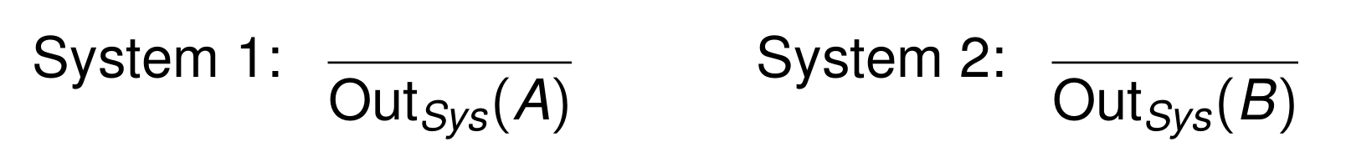
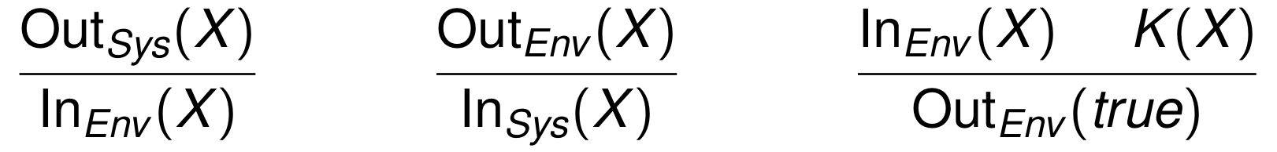
Defining observational equivalence
Two system specifications given as set of rules
  One rule per role action (send/receive)
  Running example shout-out auction:
Interface and environment/adversary rule(s):
  Last rule models comparison by the adversary
Each specification yields a labeled transition system
Observational equivalence is a kind of bisimulation accounting for the adversaries’ viewpoint and capabilities

Slide 63
Diff terms
General definitions of observational equivalence difficult to verify: requires inventing simulation relation
Idea: specialize for cryptographic protocols
  Consider strong bid secrecy:
    both systems differ in secret bid only, i.e.,
    both specifications contain same rule(s), which differ only in some terms
  Exploit this similarity in description and proof
Approach: two systems described by one specification – using diff-terms
  Running example
  Is equivalent to one rule with a diff-term

Slide 64
Approximating observational equivalence using mirroring
Both systems contain same rules modulo diff-terms
Idea: assume that each rule simulates itself
Compute mirrors of each execution into the other system
If the mirrors are valid executions, we have observational equivalence (sound approximation)

Slide 65
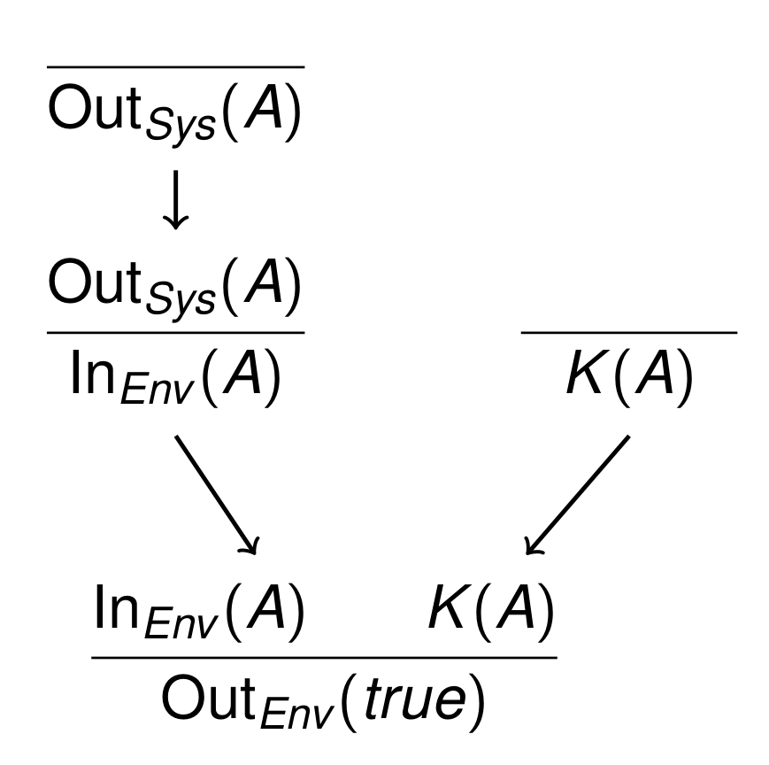
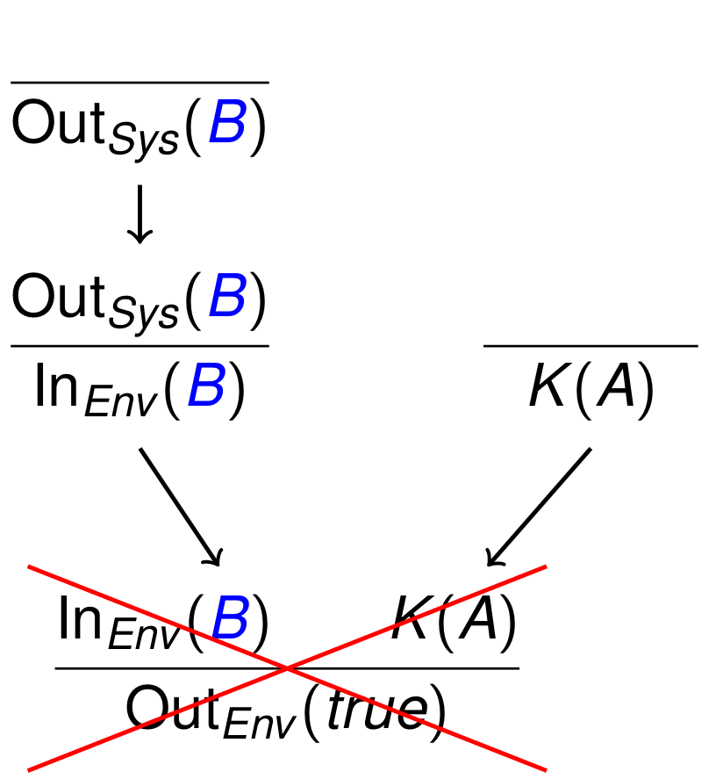
Invalid mirrors and attacks
Bidder picks A/B, observer compares to public value A
Counter example to observational equivalence

Slide 66
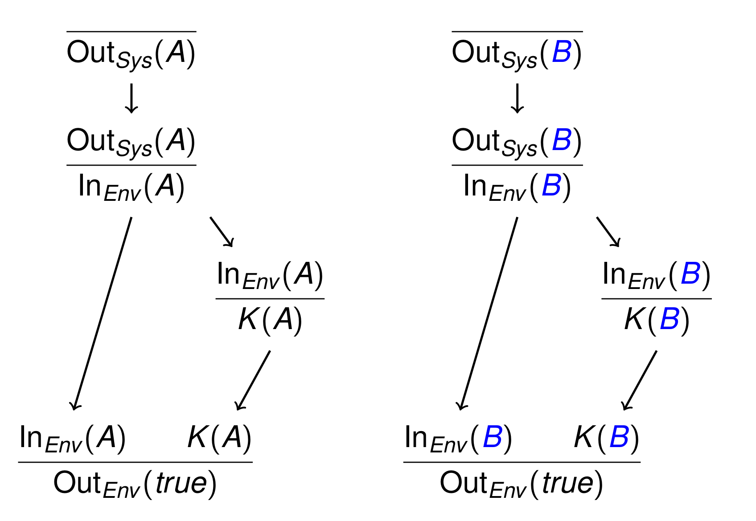
Valid mirror
Observer compares system output to itself
  All mirrors need to be valid for observational equivalence

Slide 67
Dependency graph equivalence
A diff-system is dependency graph equivalent if mirrors of all dependency graphs rooted in any rule on both sides are valid.
  Sound but incomplete approximation
  Efficient and sufficient in practice
Input:
  Protocol specification
  Property: equivalence given two choices for some term(s)
    Example: random value vs expected value
Output:
  Yes, observational equivalent
  No, dependency graph with invalid mirror
  Non-termination possible

Slide 68
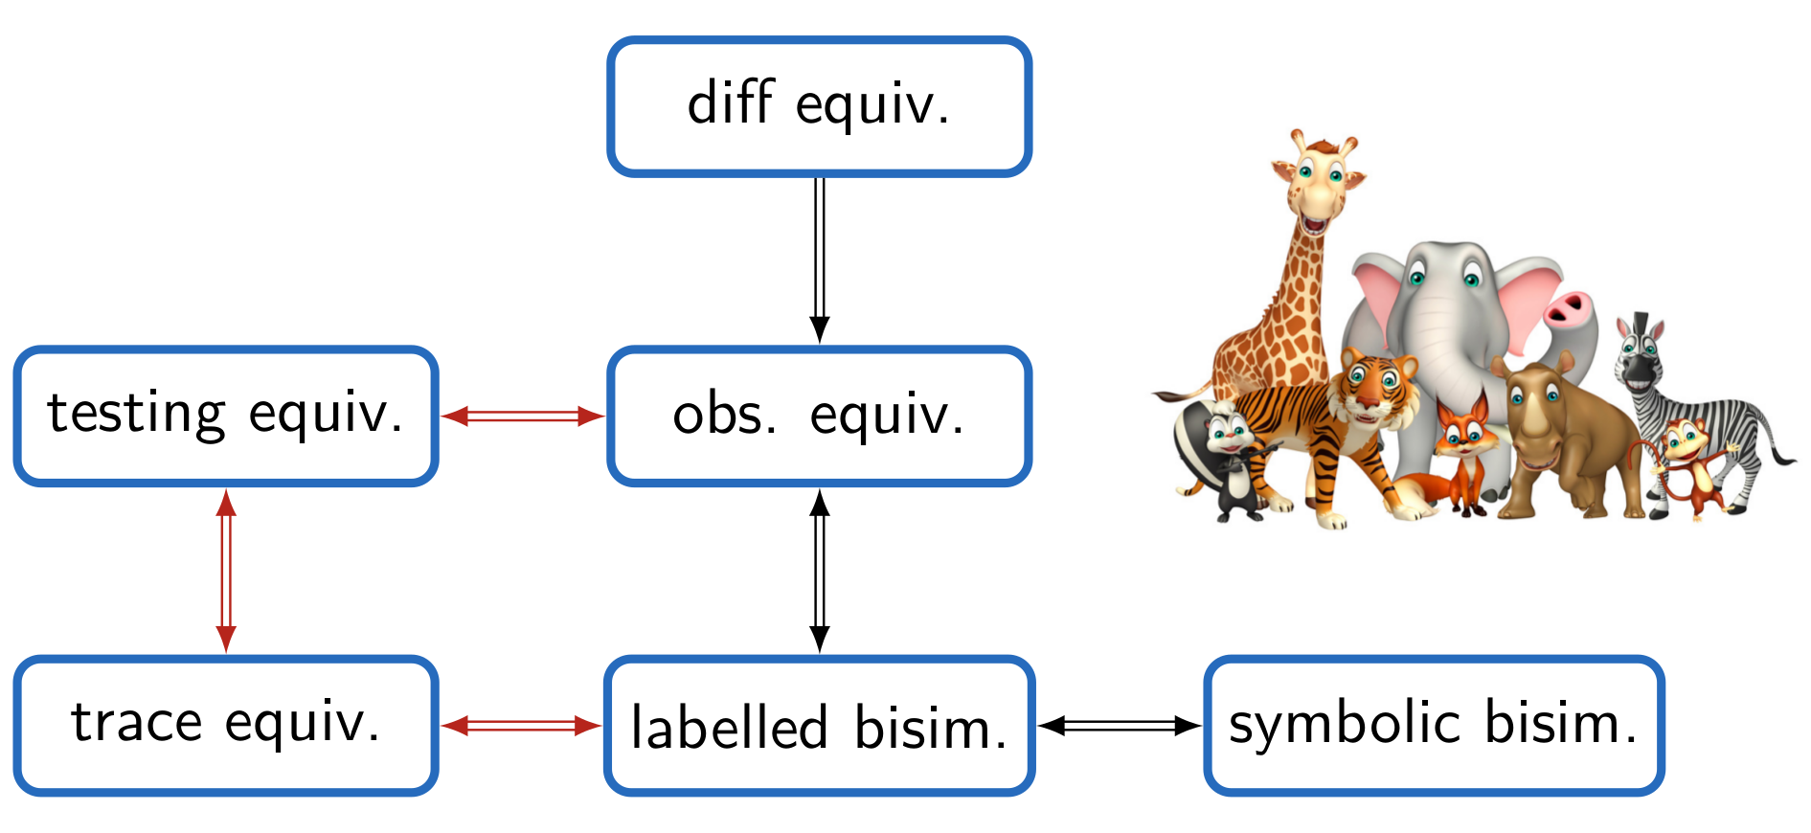
The equivalence zoo
Red arrows require assumptions: determinate processes + bounded sessions (no replication)

Slide 69
Guided proofs & Custom Heuristics

Slide 70
Lemmas
When it doesn’t terminate…
Guide the proof manually; export
Write lemmas
  “Hints” for the prover
    They don't change the proof obligation, only help finding a proof
  Specify lemma that can be used to prune proof trees at multiple points

Slide 71
Storing Proofs
Complete (or partial) proofs can be stored
  Click the “Download” button in top right
These can be reloaded like normal theories
  Proof is rechecked!

