Slide 1
String Matching with Finite Automata
by Caroline Moore

Slide 2
String Matching
Whenever you use a search engine, or a “find” function like sed or grep, you are utilizing a string matching program. Many of these programs create finite automata in order to effectively search for your string.

Slide 3
Finite Automata
A finite automaton is a quintuple (Q, Σ, δ, s, F):
Q: the finite set of states
Σ: the finite input alphabet
δ: the “transition function” from QxΣ to Q
s ∈ Q: the start state
F ⊂ Q: the set of final (accepting) states
Notes:
Σ = Sigma
δ = delta

Slide 4
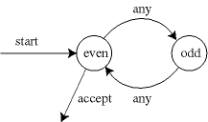
How it works
A finite automaton accepts strings in a specific language. It begins in state q₀ and reads characters one at a time from the input string. It makes transitions (φ) based on these characters, and if when it reaches the end of the tape it is in one of the accept states, that string is accepted by the language.
Graphic: Eppstein, David. http://www.ics.uci.edu/~eppstein/161/960222.html

Slide 5

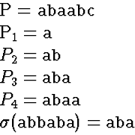
The Suffix Function
In order to properly search for the string, the program must define a suffix function (σ) which checks to see how much of what it is reading matches the search string at any given moment.
Graphic: Reif, John. http://www.cs.duke.edu/education/courses/cps130/fall98/lectures/lect14/node31.html

Slide 6
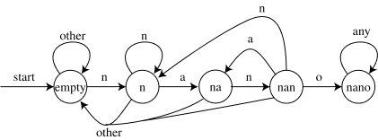
Example: nano
n a o other
empty: n ε ε ε
n: n na ε ε
na: nan ε ε ε
nan: n na nano ε
nano: nano nano nano nano
Graphic & Example: Eppstein, David. http://www.ics.uci.edu/~eppstein/161/960222.html

Slide 7
String-Matching Automata
For any pattern P of length m, we can define its string matching automata:
Q = {0,…,m} (states)
q₀ = 0 (start state)
F = {m} (accepting state)
δ(q,a) = σ(P_{q}a)
Notes:
Last line: at any point on the tape, the current state and character (in the transition function) has an equivalent state in the suffix function.

Slide 8
The transition function chooses the next state to maintain the invariant:
φ(T_{i}) = σ(T_{i})
After scanning in i characters, the state number is the longest prefix of P that is also a suffix of T_{i}.
Notes:
I.e., the transition function must agree with the suffix function.

Slide 9
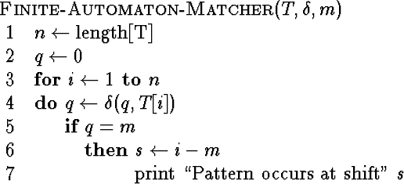
Finite-Automaton-Matcher
The simple loop structure implies a running time for a string of length n is O(n).
However: this is only the running time for the actual string matching. It does not include the time it takes to compute the transition function.
Graphic: http://www.cs.duke.edu/education/courses/cps130/fall98/lectures/lect14/node33.html

Slide 10
Computing the Transition Function
Compute-Transition-Function (P,Σ)
m ← length[P]
For q ← 0 to m
do for each character a ∈ Σ
do k ← min(m+1, q+2)
repeat k ← k-1
until P_{k} ⊃ P_{q}a
δ(q,a) ← k
return δ
This procedure computes δ(q,a) according to its definition. The loop on line 2 cycles through all the states, while the nested loop on line 3 cycles through the alphabet. Thus all state-character combinations are accounted for. Lines 4-7 set δ(q,a) to be the largest k such that P_{k} ⊃ P_{q}a.

Slide 11
Running Time of
Compute-Transition-Function
Running Time: O(m³ |Σ|)
Outer loop: m |Σ|
Inner loop: runs at most m+1
P_{k} ⊃ P_{q}a: requires up to m comparisons

Slide 12
Improving Running Time
Much faster procedures for computing the transition function exist. The time required to compute P can be improved to O(m|Σ|).
The time it takes to find the string is linear: O(n).
This brings the total runtime to:
O(n + m|Σ|)
Not bad if your string is fairly small relative to the text you are searching in.

Slide 13
Sources
Cormen, et al. Introduction to Algorithms. ©1990 MIT Press, Cambridge. 862-868.
Reif, John. http://www.cs.duke.edu/education/courses/cps130/fall98/lectures/lect14/node28.html
Eppstein, David. http://www.ics.uci.edu/~eppstein/161/960222.html

