Slide 1
VIRTUAL FILE MANAGEMENT SYSTEM
CSE 2005:OPERATING SYSTEM
REVIEW 2

Slide 2
TEAM MEMEBERS
Vaibhav Agarwal(19BCE1413)
Soumyarup Chatterjee(19BCE1031)
Siddharth Mishra(19BCE1362)

Slide 3
PROBLEM DESCRIPTION​
Implementing and maintaining a file framework is difficult. OS usefulness is famously difficult to create and debug, and file frameworks are even more so than most due to their size and workings with different OS segments. ​
File system implementations also depend on various internal OS function. For example, a file system developer must understand the memory allocation, caching, threading, locking/pre-emption, networking (for distributed _le systems), and device access (for local file systems) interfaces and semantics. Though difficult during initial file system development, these dependencies particularly complicate porting a file system to different OSs or even OS versions., the other OS internal interfaces greatly vary, making porting of file systems painful and effort-intensive. ​
VFS interfaces vary very slightly across operating system. So as a result, the use of a VFS can make the task easier.

Slide 4
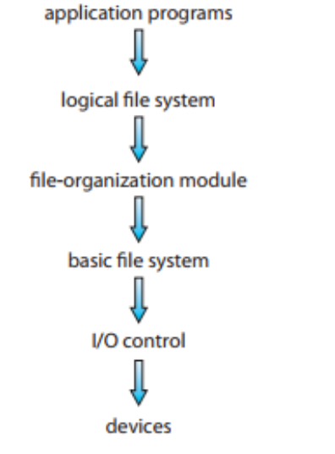
FILE SYSTEM STRUCTURE
File systems provide easy access to the storage by storing, locating, and retrieving data easily.A file system has two different design problems. The first problem is how the file system will look for the user. This errand includes defining a file its characteristics, the operations permitted on a file, and the directory structure for sorting out directory. The second issue is making algorithms and data structures to outline logical file system onto the physical secondary-storage devices.The file system itself is made of many different layers. The structure shown in the figure is an example of a layered design. Each layer uses the features of lower layer to create new features for higher layers.

Slide 5
FILE SYSTEM STRUCTURE
The I/O control level consists of device drivers and interrupt handlers to exchange information back and forth between the main memory and the disk system. A device driver can be pictured as a translator. Its input consists of high-level commands such as “delete block 53.” Its output contains low-level, hardware-specific data that are used by the hardware controller, which interfaces the I/O device to the system.The basic file system is needed only to send generic commands to the device driver to read and write physical blocks on the disk. The file-organization module has data about the files and their logical blocks and also the physical blocks. By knowing the type of file allocation used and the address of the file, the file-organization module can translate logical block addresses to physical block addresses for the basic file system to transfer.

Slide 6
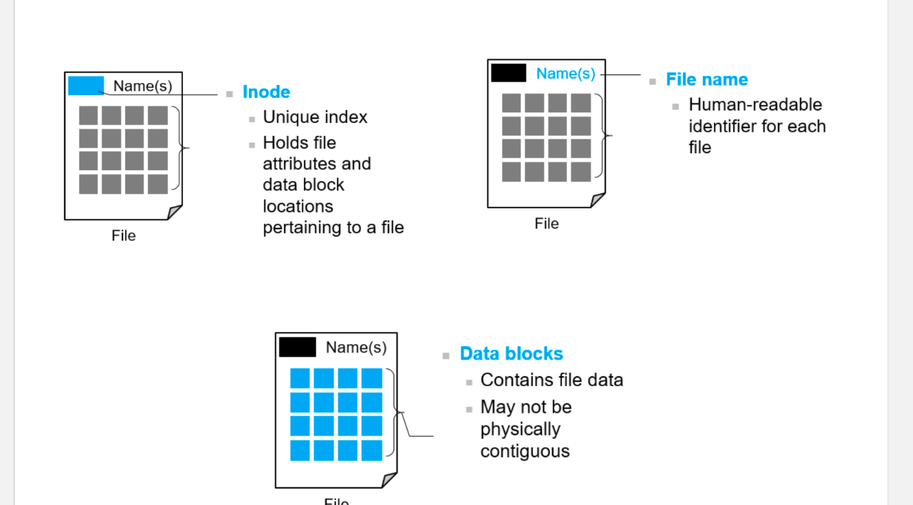
FILE SYSTEM STRUCTURE
The basic file system is needed only to send generic commands to the device driver to read and write physical blocks on the disk.
The file-organization module has data about the files and their logical blocks and also the physical blocks.
By knowing the type of file allocation used and the address of the file, the file-organization module can translate logical block addresses to physical block addresses for the basic file system to transfer.
Finally, the logical file system manages metadata information. Metadata includes all of the file-system structure except the actual data (or contents of the files).
The logical file system manages the directory structure to provide the file-organization module with the information the latter needs, given a symbolic file name.

Slide 7
INTRODUCTION TO VIRTUAL FILE SYSTEM
Data structures and procedures are used to isolate the basic system call functionality from the implementation details. Thus, the file-system implementation consists of three major layers, as depicted schematically here. The first layer is the file-system interface, based on the open (), read (), write (), and close () calls and on file descriptors. The second layer is called the virtual file system (VFS) layer. The VFS layer serves two important functions:
· It separates file-system-generic operations from their implementation by defining a clean VFS interface.
· It provides a mechanism for uniquely representing a file throughout a network. The VFS is based on a file-representation structure, called a vnode that contains a numerical designator for a network-wide unique file.
Thus, the VFS distinguishes local files from remote ones, and local files are further distinguished according to their file-system type. The VFS activates file-system-specific operations to handle local requests according to their file-system types and calls the NFS protocol procedures for remote requests. File handles are constructed from the relevant vnodes and are passed as arguments to these procedures. The layer implementing the file-system type or the remote-file-system protocol is the third layer of the architecture.

Slide 8
VIRTUAL FILE SYSTEMS
Let’s briefly examine the VFS architecture in Linux. The four main object types defined by the Linux VFS are:
The inode object, which represents an individual file
The file object, which represents an open file
The superblock object, which represents an entire file system
The dentry object, which represents an individual directory entry
For each of these four object types, the VFS defines a set of operations that may be implemented. Every object of one of these types contains a pointer to a function table. The function table lists the addresses of the actual functions that implement the defined operations for that particular object

Slide 9
VIRTUAL FILE SYSTEMS
For example, an abbreviated API for some of the operations for the file object includes:
int open(. . .) – Open a file.
int close(...) – Close an already-open file.
ssize t read(. . .) – Read from a file.
ssize t write(. . .) – Write to a file.
int mmap(. . .) – Memory-map a file.
An implementation of the file object for a specific file type is required to implement each function specified in the definition of the file object.
Thus, the VFS software layer can perform an operation on one of these objects by calling the appropriate function from the object’s function table, without having to know in advance exactly what kind of object it is dealing with.

Slide 10
THANK YOU

