Slide 1
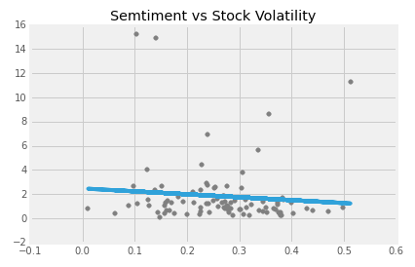
Price Change(High-Low)
Sentiment

Slide 2
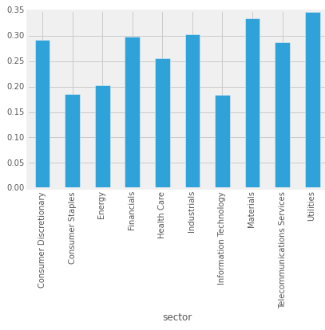
Sentiment

Slide 3
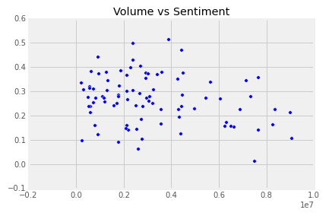
Sentiment
Volume

Slide 4
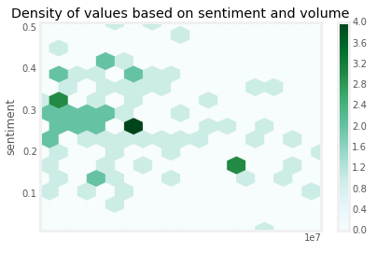
volume

