Slide 1
6 WEEK INDUSTRIAL TRAINING IN
DATA STRUCTURE USING C IN LINUX
SUBMITTED TO SUBMITTED BY
Ms. Rititka Aman Vaishya
Mr. Tanvi B.E. (I.T.) 7th SEM
Mr. Divya SG12805

Slide 2
PROJECT & APPLICATION
DATA COMPRESSION & ENCRYPTION USING ITERATIVE TECHNIQUE
DEVELOPED APPLICATION :
“Compressor”

Slide 3
SOURCE CODE STRUCTURE OF APPLICATION
Using this application any text file can be compressed.
Basically, any character stored in a file using the ASCII code.
ASCII code is 7-bit code. But due to machine structure we use 8-bit codes.
Every character has been assigned unique ASCII code.
7-bits codes means we can use 128 distinct characters.
If a file has less than 256 distinct characters then we can assign every character our own code
if a file has greater than 8 and less than 16 distinct characters then we can assign the codes from 0000 - 1111 for every character.

Slide 4
SOURCE CODE STRUCTURE OF PROJECT
First of all file is opened on the file descriptor (FD) of the process context using open() function.
Then, distinct characters of the file are selected and stored in a file. Now, this file will be used as encryption key.
Number of distinct characters will decide what will be the cede length of every character in the source file.
For example, if a file have following data :
Data structure
then the distinct characters will be
Dat sruce
Now, there are 9 distinct characters in the file. We can assign every character from beginning the binary codes from 0000 to 1001.
So, by using 4-bits codes, we can create the complete text file. There is no need of 8-bit ASCII codes.

Slide 5
SOURCE CODE STRUCTURE OF PROJECT
In the computer system, only 8-bits ASCII codes can be transferred or processed.
Due to 8-bit designed blocks, we have to adjust these codes (of any length) within the block.
4-bits 4bits
If the code length of the character is 4-bit then we can adjust two characters within one character space. So, we can compress the file up to 50% as described in the example.
For other code lengths we can adjust the characters as compact as possible.
First character | Next Character

Slide 6
WORKING OF THE PROJECT
The working can be described by an example.
ENCRYPTION & COMPRESSION :
We have the file “ffc” in which character are following
Storage class
The will be opened by the open() function in the process context and stored in a temporary buffer for different types of operations.
The distinct characters of the file will be selected and in a file. This file will work as encryption key and used for encryption and decryption both.
The contents of the encryption key file is
Storage cls

Slide 7
WORKING OF THE PROJECT
Number of distinct characters is 11.
We can assign the binary codes for Storage cls from 0000 – 1011
respectively. So, we can use only 4-bits codes to represent every character.
Here, both encryption key and source file contents are stored in the temporary buffer.
Every character of the source file will be compared with every character of the encryption key. If these are matched to each-other then the index of the character of the encryption key will be the code for that particular character of the source file.
This code is of integer type, now it is converted into the character type to become 8-bits from 32-bits.
Now, two characters of 4-bits are adjusted in 1 byte space instead of ASCII code.

Slide 8
WORKING OF THE PROJECT
So, once two characters of the source file are arranged in one character space and written in a file in the case of 4-bit code.
During these complete operations bit-wise operators are widely used to arrange every bit in the 8-bit block.
When codes of two characters are merged in one 8-bit block then that resultant character is interpreted by the computer according to the ASCII codes which can not be understood by human.
Since, we have adjusted two characters in only one character space, the file has been compressed to 50 % .
Since, a human cannot understand the compressed data, so it has been encrypted.
This encrypted data is called cipher text.

Slide 9
WORKING OF THE PROJECT
Decryption & Decompression
Decompression is completely opposite process of encryption of the file.
In this process, we need two types of files :
compressed file &
encryption key
These two files are opened on the file descriptors of the process context.
Now, characters of compressed file and encryption key are read and stored in a different temporary buffers.
Every character of the compressed file is interpreted by the decryption algorithm.

Slide 10
WORKING OF THE PROJECT
Once a character is read and split into two 4-bits parts.
Now, every 4-bit represents a particular character of the plain text.
Every 4-bit is converted into 8-bit by zero-padding concept for character representation.
This 8-bit code of the character is converted into 32-bit integer by using atoi() function or simply by typecasting.
Integer representation is necessary because it is the index where the character of plain text is stored in the encryption key buffer.
The plain text character from encryption key buffer is fetched and stored in a file.
The file generated from this process will contain the plain text character.
This process is called decryption.

Slide 11
TEXT EDITOR
The complete project has been done on VIM editor.
It is a console application which can run only in terminal mode.
It is improved version of the Vi editor available already in the Ubuntu Operating.
Due to command interface, the processing of any type of file is too fast on the VIM editor.
There are two mode of working of a VIM editor
Command mode & Insert mode
File can be recovered easily, that has been lost due to any system crash.

Slide 12
COMPILER
GNU COMPILER COLLECTION (gcc)
The complete application has been designed for C language.
If a program has been written in “gedit” editor, it can be compiled by using gcc compiler.
GCC has various steps in order to convert the C language to object codes :
Preprocessor Expansion [gcc -E file_name.c]
Assembly Conversion [gcc -S file_name.c]
Object File [gcc -c file_name.c]
Linking [gcc -o file_name file_name.c]

Slide 13
DEBUGGER
The GNU Debugger (gdb)
GDB can do four main kinds of things (plus other things in support of these) to help you catch bugs in the act:
Start your program, specifying anything that might affect its behavior.
Make your program stop on specified conditions.
Examine what has happened, when your program has stopped.
Change things in your program, so you can experiment with correcting the effects of one bug and go on to learn about another

Slide 14
APPLICATION GUIDE
Compressor
CRYPTOGRAPHY TOOL
.............encryption decryption system
This application has been designed on the theory of multiple data compression and encryption using iterative technique, specially for operating systems having GNU Compiler and library files.
Give application the permission for execution
[chmod +x script]
Now Execute the application
[./script]

Slide 15
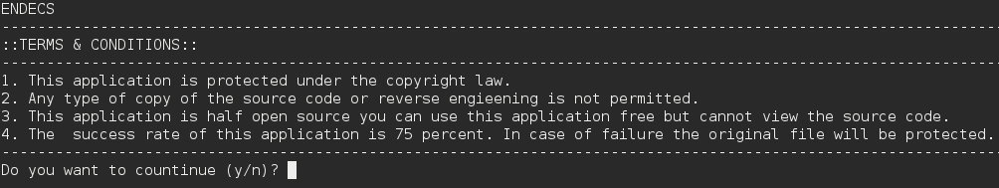
APPLICATION GUIDE
After executing the application you will get the following screen :
Now, If you are agree with terms and condition then reply with 'y' then you have the welcome window,

Slide 16
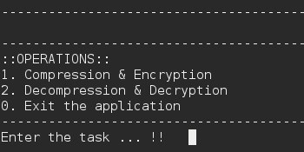
APPLICATION GUIDE
Now,, Choose options for encryption, decryption or exit.
If you choose the encryption option then you will be asked for the file name which contains the plain text.

Slide 17
APPLICATION GUIDE
After entering the file_name press <enter>.
On the screen you will get the complete information regarding encryption :
Contents of the file and number of character of source file
Contents of the encryption key
Number of distinct characters in the source file
file_name where compressed compressed data is stored(CFILE)
file_name where encryption key stored (CKEY)

Slide 18
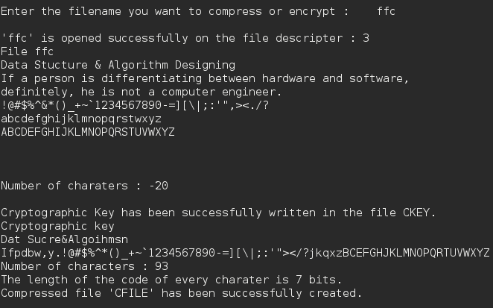
APPLICATION GUIDE

Slide 19
APPLICATION GUIDE
Now, for decryption choose option 2
You will be asked for two files :
Compressed File
Encryption key
Enter the file_names
You will get the information regarding decryption
Code-length of the characters
file_name where decompressed data is stored (DFILE)
These two operations can be separately performed on distinct computer system

Slide 20
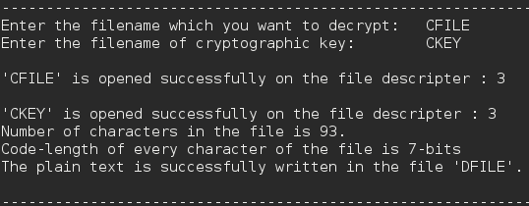
APPLICATION GUIDE
A screen shot has beentaken during the decryption is as following :

Slide 21
FUTURE OF APPLICATION
Server to manage the database of all users
Users have to first register on the server to get the user Id and password.
After registration a security constraints file will be attached with the file.
If a sender sends the data, he has to first give the user name of the receiver and then a set of security characters will be attached with encryption key of the file and data will be encrypted.
On the receiver side, if the security characters fulfill the security constraints of the receiver file the application will be allowed to decompress the data, not otherwise.

Slide 22
THANK YOU !

