Slide 1
CS 487/587 Adversarial Machine Learning
Dr. Alex Vakanski

Slide 2
Lecture 10
AML in Cybersecurity – Part I:
Network Intrusion Detection

Slide 3
Lecture Outline
Adversarial Machine Learning in cybersecurity
Taxonomy of AML attacks in cybersecurity
AML in cybersecurity versus computer vision
Network intrusion detection
Goals of NIDS
Datasets for network intrusion detection
Anomaly detection with Machine Learning
One-class SVM
Autoencoders
Variational autoencoders
GANs
Sequence-to-sequence models
Adversarial attacks on ML-based NIDS
Feature-level attacks
Packet-level attacks

Slide 4
ML in Cybersecurity
Adversarial Machine Learning in Cybersecurity
The cybersecurity domain is marked with a perpetual battle between security analysts and adversaries
Adversaries continually innovate and adapt their attack approaches, resulting in ever-increasing complexity of cyber attacks
Security analysts attempt to quickly respond to new attacks, and try to be one step ahead of cyber adversaries
Machine Learning (ML) models have a potential for addressing the complexity of recent attacks, and are increasingly used in cybersecurity
Yet, all ML models are vulnerable to adversarial attacks
Investigating adversarial attacks and defenses against ML models in cybersecurity applications is crucial for this domain
Examples of adversarial ML attacks in cybersecurity:
Spam messages designed to avoid ML-based spam filters
Ransomware developers evading anti-malware ML-based systems
Malware worms evading ML classifiers, and spreading across the network
Crypto software evading ML systems, and using resources for mining crypto-currency
Rosenberg (2021) – AML Attacks and Defense Methods in the Cyber Security Domain

Slide 5
Cybersecurity Challenges
Adversarial Machine Learning in Cybersecurity
Traditional cyber defense relied predominantly on signature-based and heuristic-based methods
Signature is a unique set of features that identifies a specific file (e.g., malware)
Heuristic is a set of rules developed by security analysis for protection against specific attacks
Challenges: both signature- and heuristic-based methods require knowledge about the malicious files, in order to determine the signature or heuristic rules
E.g., these approaches have difficulties detecting unknown variants of malware
Other challenges in cybersecurity:
Traditional defense methods based on manually crafted signatures or heuristic rules are unable to keep pace with recent attacks, which are becoming more complex and sophisticated
Organizations are also experiencing a shortage of cybersecurity skills and talent
These cybersecurity challenges can be addressed by ML solutions, due to the capacity to handle large volumes of data, and ability to automatically identify signature features or rules for attack identification

Slide 6
ML Specifics in Cybersecurity
Adversarial Machine Learning in Cybersecurity
Application of ML in cybersecurity also introduces unique challenges, including:
Requirement for large representative datasets for model training
Acquisition of cybersecurity datasets and sample labeling is expensive and time-consuming
Small or imbalanced datasets can lead to poor performance (e.g., missing harmful files, or high false alarms rate)
Requirement for interpretability of trained ML models
Current best performing ML models (deep neural nets, SVMs, ensembles) are the least interpretable
E.g., it is difficult to understand the parameters’ importance in a deep NN with millions of parameters
Interpretable ML provides transparency to the internal decision-making process by the models, and explains models’ predictions in human-understandable terms
Requirement for low false negatives
Unlike other ML applications, in cybersecurity even a single false negative (i.e., missed malicious file) can have significant consequences
Requires different evaluation approaches, e.g., different metrics to ensure low false negatives
Requirement for updating the models continuously
The fast-evolving pace of adversarial attacks requires updated and more capable models
Otherwise, model performance degrades over time
Slide credit: Kaspersky Lab (2020) – ML Methods for Malware Detection

Slide 7
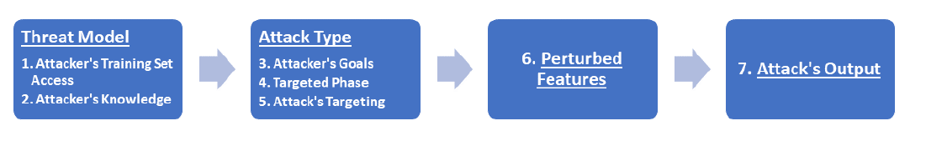
AML in Cybersecurity
Adversarial Machine Learning in Cybersecurity
Adversarial ML in cybersecurity refers to the setting where an adversary manipulates (perturbs) the input data, in order to exploit specific vulnerabilities of ML algorithms and compromise the security of the targeted system
Rosenberg et al. (2021) proposed the following taxonomy of AML attacks in cybersecurity shown in the figure below
The taxonomy is based on 7 characteristics of AML attacks that are unique to the cybersecurity domain, listed under 4 categories (threat model, attack type, perturbed features, and attack’s output)
The taxonomy is explained further on next pages
Rosenberg (2021) – AML Attacks and Defense Methods in the Cyber Security Domain

Slide 8
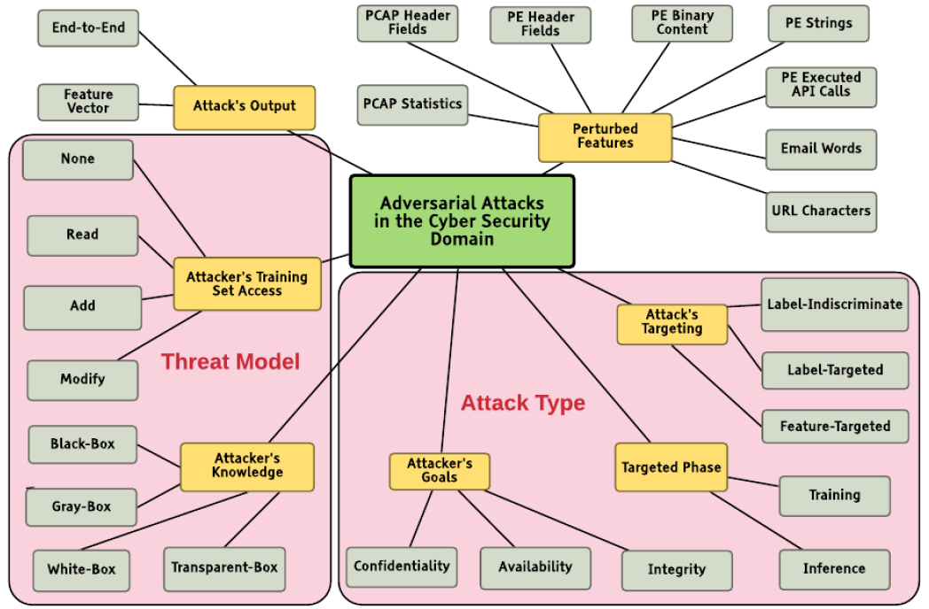
Taxonomy of AML Attacks in Cybersecurity
Adversarial Machine Learning in Cybersecurity
A detailed overview of the proposed taxonomy by Rosenberg et al. (2021)
Picture from: Rosenberg (2021) – AML Attacks and Defense Methods in the Cyber Security Domain

Slide 9
Taxonomy of AML Attacks in Cybersecurity
Adversarial Machine Learning in Cybersecurity
Threat model includes information about: (1) attacker’s access to the training set, and (2) attacker’s knowledge of the ML model
The attacker’s training set access can be described as: no access, read data, add new samples, and modify existing samples
Based on the attacker’s knowledge of the ML model, the attacks can be classified into black-box, white-box, gray-box, and transparent-box attack
Gray-box attack refers to having access to the confidence scores provided by the classifier (i.e., score-based attack)
Transparent-box attack means that the adversary has complete knowledge of the ML model, as well as knowledge about the defense methods used by the model
Attacker’s goals can include:
Confidentiality - acquire private information by querying the ML model
E.g., stealing the classifier’s model
Integrity - cause the ML system to perform incorrectly for some or all inputs
E.g., causing an ML-based malware classifier to misclassify a malware file as benign
Availability - cause the ML system to become unavailable
E.g., generate malicious sessions which resemble regular network traffic, causing the ML system to classify legitimate traffic sessions as malicious, and block legitimate traffic

Slide 10
Taxonomy of AML Attacks in Cybersecurity
Adversarial Machine Learning in Cybersecurity
Based on attack’s targeting, the attacks are categorized as:
Label-indiscriminate attack (non-targeted attack) - minimize the probability of correctly classifying a perturbed sample
Label-targeted attack (targeted attack) – maximize the probability that a specific class is predicted for the perturbed sample
Feature-targeted attack (backdoor trigger attack) – input features in the perturbed sample act as triggers for malicious behavior
In cybersecurity, ML-based systems often use more than one feature type, and hence, attackers often modify more than a single feature
Perturbed features depend on the attacked system, and can include PE header files, PCAP features, words in an email, characters in a URL, etc.
Based on the attack’s output, the attacks can be divided into:
Feature-vector attacks, where output of the attack is a perturbed feature vector (i.e., a perturbed vector of extracted features from a malware file)
End-to-end attacks, where the output of the attack is a generated functional sample (e.g., runnable PE file, a phishing URL, etc.)

Slide 11
AML in Cybersecurity vs Computer Vision
Adversarial Machine Learning in Cybersecurity vs Computer Vision
Most AML research has focused on the computer vision (CV) domain
AML in cybersecurity is even more relevant, since there are so many adversaries with specific goals and targets
On the other hand, AML in cybersecurity is more challenging
Differences between adversarial attacks in CV versus cybersecurity
Preserving the functionality of perturbed files
Any adversarially-perturbed executable file in cybersecurity must preserve its malicious functionality after the modification
E.g., in CV modifying pixels’ values does not result in an invalid image
Conversely, modifying an API call or arbitrary byte value might cause the modified executable file to perform a different functionality, or even crash
Small perturbations generated by gradient-based attacks (FGSM, PGD) are difficult to be directly applied to input features in many cybersecurity applications
Input samples (e.g., executables) are more complex than images
Image files typically have a fixed size (e.g., 28×28 pixels MNIST images), and are easily resized, padded, or cropped
Executable files contain different types of input information, and have variable files size (that can range from several KB to several GB)

Slide 12
AML Applications in Cybersecurity
Adversarial Machine Learning in Cybersecurity
The main AML applications in cybersecurity are in the following areas:
Network intrusion detection
Malware detection and classification
URL detection
Spam filtering
Cyber-physical systems
Industrial control systems
Biometric systems
Face recognition
Speaker verification/recognition
Iris and fingerprint systems

Slide 13
Network Intrusion Detection
Network Intrusion Detection
Network security is critical to every organization, as all computer systems suffer from security vulnerabilities
Network security requires solutions in place for protection from the increasing number of cyber threats
It is essential for every organization to implement some form of intrusion detection systems that can discover potential threat events early and in a reliable manner
An intrusion is a deliberate unauthorized attempt, successful or not, to break into, access, manipulate, or misuse some valuable property, which may result into or render the property unreliable or unusable
An intrusion detection system (IDS) is a security tool for detecting unauthorized intrusions into computer systems and networks
A security system used to secure networks from unauthorized intrusions is a network intrusion detection system (NIDS)
NIDS should prevent possible intrusions by continuously monitoring the network traffic, to detect any suspicious behavior that violates the security policies and compromises the network confidentiality, integrity, and availability
Slide credit: Ahmad (2020) – Network Intrusion Detection System: A Systematic Study of ML and DL Approaches

Slide 14
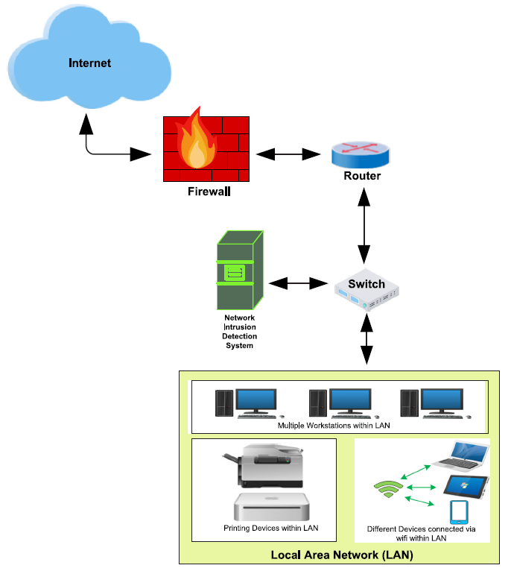
Network Intrusion Detection
Network Intrusion Detection
NIDS is implemented in the form of a device or software that monitors all traffic passing through a strategic point in the network for malicious activities
It is typically deployed at a single point, for example, it can be connected to the network switch (as in the figure)
If malicious behavior is detected, NIDS will generate alerts to the host or network administrators
Figure from: Ahmad (2020) – Network Intrusion Detection System: A Systematic Study of ML and DL Approaches

Slide 15
Goals of NIDS
Goals of Network Intrusion Detection Systems
The main goals of NIDS include:
Detect wide variety of intrusions
Previously known and unknown attacks
Suggests if there is a need to learn/adapt to new attacks
Detect intrusions in timely fashion
And minimize the time spent verifying attacks
Depending on the system criticality, it may be required to operate in real-time, especially when the system responds to (and not only monitors) intrusions
Problem: analyzing commands may impact the response time of the system
Present the analysis in a simple, easy-to-understand format
Ideally as a binary indicator (normal vs malicious activities)
Usually the analysis is more complex than a binary output, and security analysts are required to examine suspected attacks
The user interface is critical, especially when monitoring large systems
Is accurate
Minimize false positives, false negatives
Slide credit: Intrusion Detection - Chapter 22 in “Introduction to Computer Security”

Slide 16
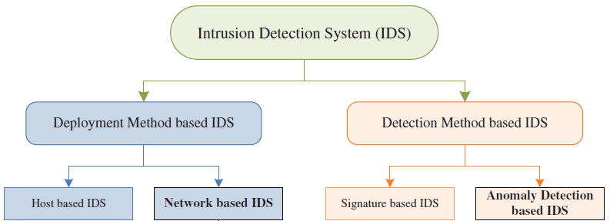
IDS Categories
IDS Categories
The figure depicts an IDS taxonomy based on the deployment methods or detection methods
Deployment methods
Host-based IDS – deployed to monitor the activities of a single host and scan for security policy violations and suspicious activities
Requires information processing for each single node in a network
Network-based IDS – deployed to monitor the activities of all devices connected to a network
Figure from: Ahmad (2020) – Network Intrusion Detection System: A Systematic Study of ML and DL Approaches

Slide 17
IDS Categories
IDS Categories
Based on the used detection methods, IDS can be broadly divided into:
Signature-based systems
These systems are also known as misuse intrusion detection
The system compares the incoming traffic with a pre-existing database containing signatures of known attacks
Signature databases need to be continuously updated with the most recent attacks
Detecting new attacks, for which a signature does not exist, is difficult
Anomaly-based systems
The system uses statistics to form a baseline (normal) usage of the network at different time intervals
Deviations from the baseline usage are considered anomalies
The advantage of these systems is that they can detect unknown attacks
The main challenge is the high false alarms rate (as it is difficult to find the exact boundary between normal and abnormal behavior)
Cuelogic Technologies Blog - Evaluation of Machine Learning Algorithms for Intrusion Detection System

Slide 18
NIDS with Machine Learning
Network Intrusion Detection with Machine Learning
Enormous increase in network traffic in recent years and the resulting security threats are posing many challenges for detecting malicious network intrusions
To address these challenges, ML and DL-based NIDS have been implemented for detecting network intrusions
Anomaly detection has been the main focus of these methods, due to the potential for detecting new types of attacks
In the remainder of the lecture, we will first overview the datasets that are commonly used for training and evaluating ML-based NIDS, followed by a description of the ML models used for anomaly detection, and followed by adversarial attacks on ML models for NIDS

Slide 19
Datasets for Network Intrusion Detection
Datasets for Network Intrusion Detection
There are several public datasets consisting of records of normal network traffic and network attacks
Each record in these datasets represents a network connection data packet
The data packets are collected between defined starting and ending times, as data flows to and from a source machine and a target machine under a distinct network communication protocol
Network connection data packets are saved as PCAP (Packet Capture) files (i.e., .pcapfile)
PCAP files have different formats, e.g., Libpcap (Linux and macOS), WinPcap (Windows), and Npcap (Windows)
PCAP files are used for network analysis, monitoring network traffic, and managing security risks
The data packets allow to identify network problems
E.g., based on data usage of applications and devices
Or, identify where a piece of malware breached the network, by tracking the flow of malicious traffic and other malicious communications

Slide 20
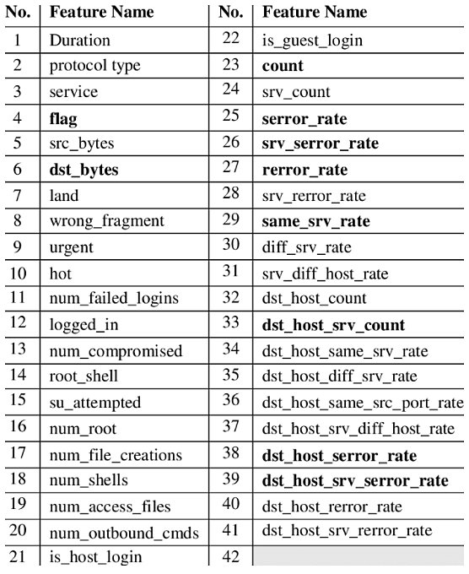
NSL-KDD Dataset
Datasets for Network Intrusion Detection
The most popular dataset for benchmarking ML models for NIDS has been the NSL-KDD dataset
It is an updated, cleaned-up version of the original KDD Cup’99 dataset (released in 1999)
NSL-KDD contains 150 thousand network data from packet records (PCAP files)
Each record has 41 features, shown in the table
The features include duration of the connection, protocol type, data bytes send from source to destination, number of failed logins, etc.
The 41 features are either categorical (4), binary (6), discrete (23), or continuous (10)
Many approaches use a subset of the 41 features
Every record has an associated label (indicating whether it is a normal traffic or attack) and a score (the severity of the traffic, on a scale from 0 to 21)
Table from: Gerry Saporito – A Deeper Dive into the NSL-KDD Data Set

Slide 21
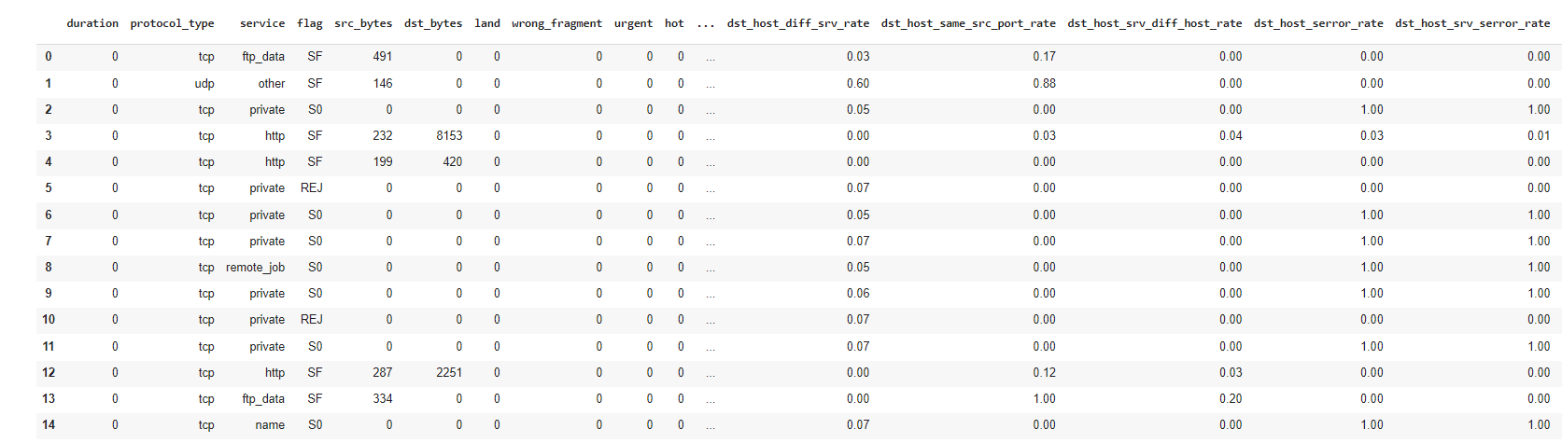
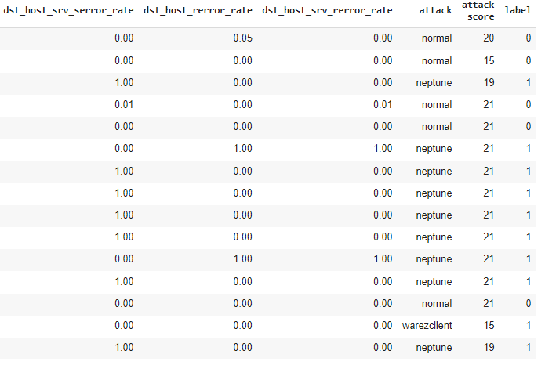
NSL-KDD Dataset
Datasets for Network Intrusion Detection
Examples of 15 PCAPs (each row is one PCAP file)
continued

Slide 22
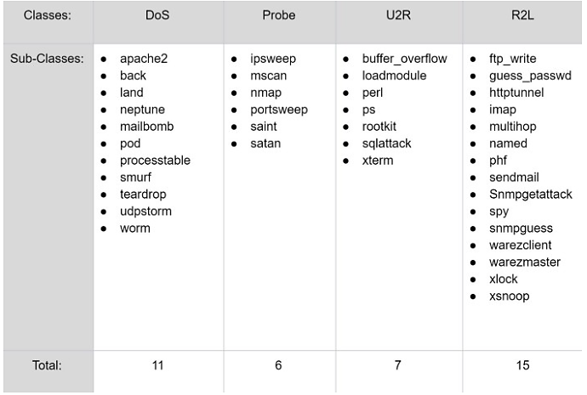
NSL-KDD Dataset
Datasets for Network Intrusion Detection
The attacks in the NSL-KDD dataset are categorized into 4 classes
DoS - Denial of Service, by flooding the server with abnormal amount of traffic
Probing - Surveillance and other probing attacks to get information from a network
U2R (User to Root) - Unauthorized access of a normal user as a super-user (root)
R2L (Remote to Local) - Unauthorized access from a remote machine to gain local access
The subclasses for each attack are shown below, resulting in 39 attacks
Table from: Gerry Saporito – A Deeper Dive into the NSL-KDD Data Set

Slide 23
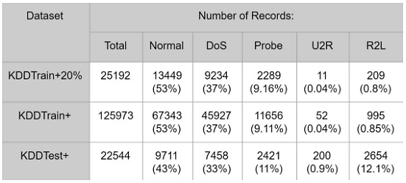
NSL-KDD Dataset
Datasets for Network Intrusion Detection
The records are divided into Train (125 K instances) and Test subsets (25 K instances)
As well as a smaller subset Train+20%, containing 20% of the train records (25 K)
The number of records per attack class is shown in the table
Majority of the records in the Train set are normal traffic (53%)
The most common attack in the Train set is DoS (37%), while U2R and R2L occur rarely
The Test set contains attack subclasses not seen in the Train set
Table from: Gerry Saporito – A Deeper Dive into the NSL-KDD Data Set

Slide 24
CSE-CIC-IDS2018 Dataset
Datasets for Network Intrusion Detection
CSE-CIC-IDS2018 dataset was collected with an attacking infrastructure consisting of 50 machines, and a victim infrastructure of 420 machines and 30 servers
The testbed includes both Windows and Linux machines
It is a collaborative project between the Communications Security Establishment (CSE) and the Canadian Institute for Cybersecurity (CIC)
Link to the dataset
It is a more recent dataset, in comparison to the most popular KDD Cup’99 dataset
The dataset includes the network traffic records (PCAP files) and system logs of each machine, captured with the CICFlowMeter-V3 device
The records have 80 network traffic features, which include duration, number of packets, number of bytes, length of packets, etc.
There are 7 types of attack (details about the attacks are presented on the next two pages)
Table from: https://www.unb.ca/cic/datasets/ids-2018.html

Slide 25
CSE-CIC-IDS2018 Dataset
Datasets for Network Intrusion Detection
Brute-force attack – submit many passwords to guess login information
Heartbleed attack – scan for vulnerable applications (e.g., OpenSSL), and exploit them to retrieve the memory of the web server (can include passwords, credit card numbers, private email or social media messages)
Botnet attack - Zeus and Ares malware used for requesting screenshots from infected devices every 7 minutes, and stealing information by keystroke logging
DoS attack - Slowloris Denial of Service attack allows a single device to take down the web server of another device, by overwhelming it with network traffic
DDoS attack - Low Orbit in Cannon (LOIC) Distributed Denial of Service attack used 4 devices to take down the web server of a target device
Web attacks – scan a website for vulnerable applications, and conduct SQL injection, command injection, and unrestricted file upload
Infiltration of the network from inside attack – a vulnerable application (e.g., PDF Reader) is sent via a malicious email attachment, and if exploited, it is followed by IP sweep, full port scan, and service enumerations

Slide 26
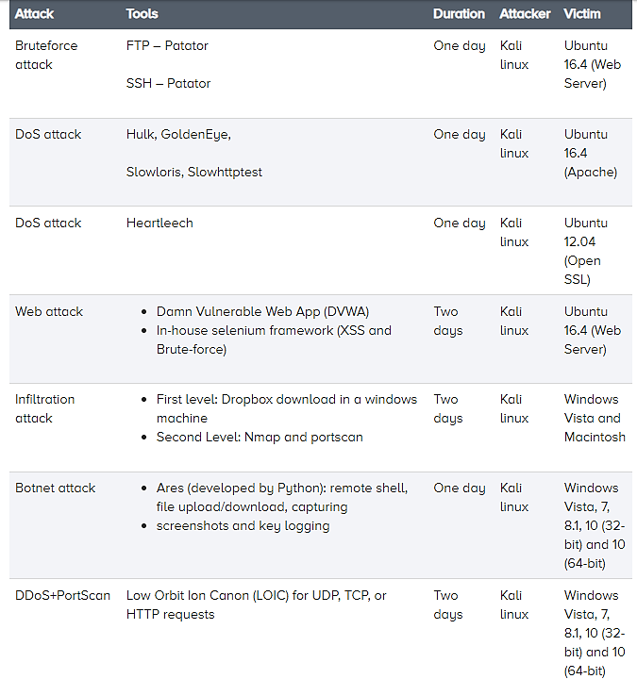
CSE-CIC-IDS2018 Dataset
Datasets for Network Intrusion Detection
Attacks in the CSE-CIC-IDS2018 dataset
Table from: https://www.unb.ca/cic/datasets/ids-2018.html

Slide 27
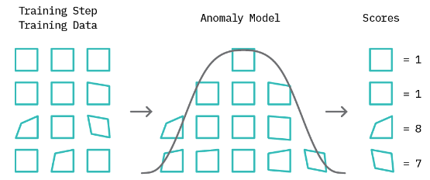
Anomaly Detection with Machine Learning
Anomaly Detection with Machine Learning
An anomaly is a data point or pattern in data that does not conform to a notion of normal behavior
Anomalies are also often referred to as outliers, abnormalities, or deviations
Anomaly detection is finding such patterns in data that do not adhere to expected normal behavior, given previous observations
Anomaly detection has applications in many other domains besides network intrusion detection, including medical diagnostics, financial fraud protection, manufacturing quality control, marketing and social media analytics, etc.
Approach: first model normal behavior, and then exploit it to identify anomalies
Blog: Cloudera Fast Forward – Deep Learning for Anomaly Detection

Slide 28
Anomaly Detection with Machine Learning
Anomaly Detection with Machine Learning
Anomaly detection can be addressed as:
Supervised learning task – train a classification model using labeled normal and abnormal samples
E.g., signatures of normal and abnormal samples can be used as features for training a classifier, and at inference, the classifier can be used to flag abnormal samples
This approach assumes access to labeled examples of all types of anomalies that could occur
Unsupervised learning task – train a model using only unlabeled normal samples, to learn the structure of the normal data
At inference, any sample that is significantly different than the normal behavior is flagged as an anomaly
Semi-supervised learning task – train a model using many unlabeled samples and a few labeled samples
E.g., train a model in unsupervised way using many samples (presumably most of which are normal), and afterward fine-tune the model by using a small number of labeled normal and abnormal samples
Blog: Cloudera Fast Forward – Deep Learning for Anomaly Detection

Slide 29
Anomaly Detection with Machine Learning
Anomaly Detection with Machine Learning
Various conventional Machine Learning approaches have been employed for anomaly detection
Clustering approaches: k-means clustering, SOM (self-organizing maps), EM (expectation maximization)
Nearest neighbor approaches: k-nearest neighbors
Classification approaches (One-class SVM)
Statistical approaches (HMM, regression models)
State-of-the-art results in anomaly detection have been typically reported by Deep Learning approaches
Due to the capacity to model complex dependencies in multivariate and high-dimensional data
These approaches commonly fall in the following categories:
Autoencoders
Variational autoencoders
GANs
Sequence-to-sequence models
Blog: Cloudera Fast Forward – Deep Learning for Anomaly Detection

Slide 30


One-Class SVM for Anomaly Detection
Anomaly Detection with Machine Learning
One-class SVM (OCSVM) for anomaly detection is a variant of SVM designed for learning a decision boundary around normal data instances
Approach:
Train the OCSVM model on normal data (to model normal behavior)
At inference, for an input instance calculate the distance to the decision boundary (i.e., the separating hyperplane)
If the distance is positive then label the instance as normal data, and if it is negative then label it as abnormal data (anomaly)
Blog: Cloudera Fast Forward – Deep Learning for Anomaly Detection

Slide 31
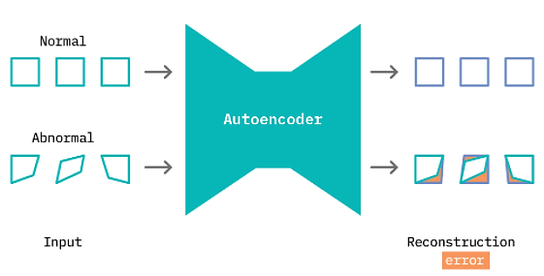
Autoencoders for Anomaly Detection
Anomaly Detection with Machine Learning
Autoencoders (AE)
An encoder maps inputs into a lower-dimensional representation (code, latent or encoded representation, encoding), and a decoder reconstructs the original inputs
Approach:
Train the autoencoder on normal data (to model normal behavior)
At inference, calculate the reconstruction error: e.g., RMSE deviation between the input instance and the corresponding reconstructed output
If the reconstruction error is less than a threshold then label the instance as normal data, if it is greater than the threshold then label it as abnormal data (anomaly)
The manually-selected threshold value allows the user to tune the “sensitivity” to anomalies
Blog: Cloudera Fast Forward – Deep Learning for Anomaly Detection

Slide 32
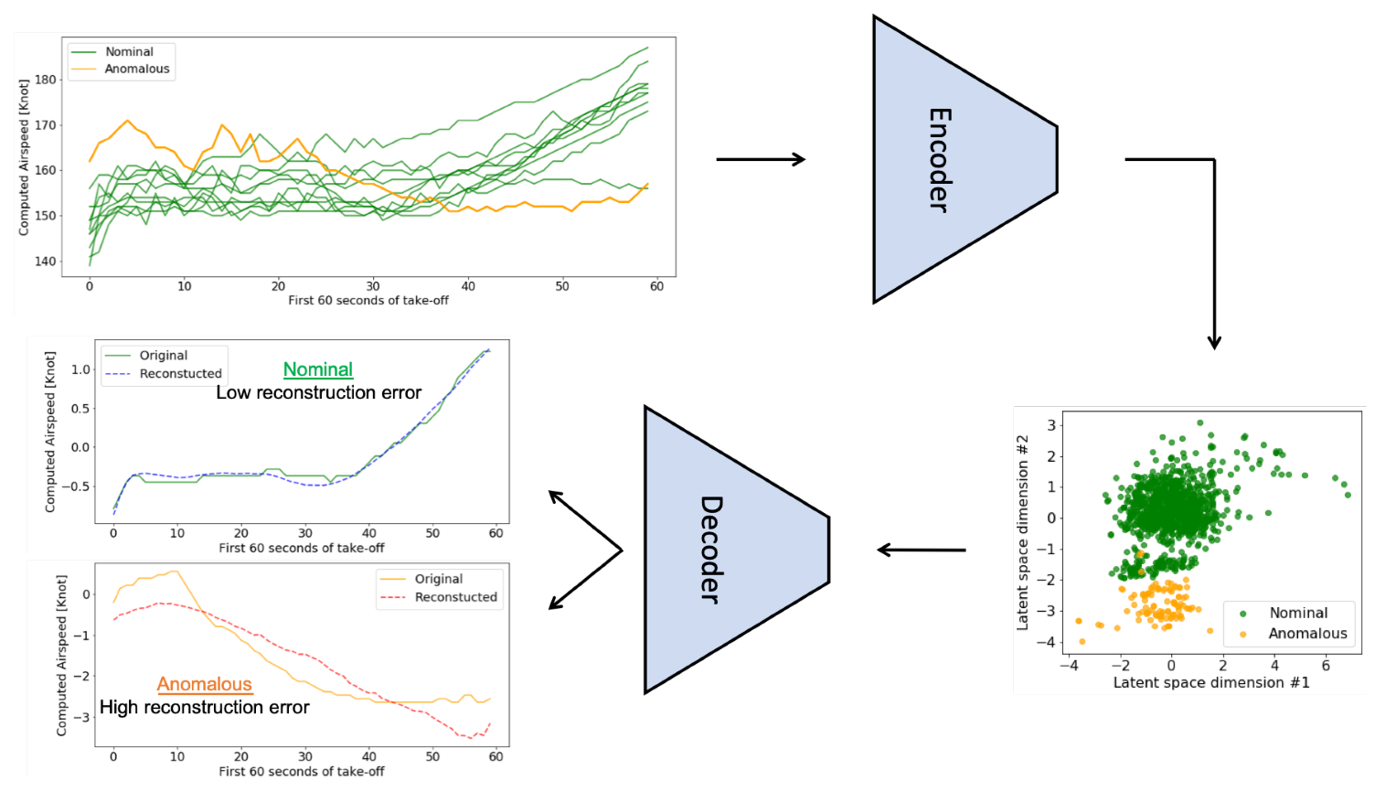
Autoencoders for Anomaly Detection
Anomaly Detection with Machine Learning
Use of autoencoder model for anomaly detection: airspeed during a takeoff
The orange line is anomalous speed, the green lines are normal speeds
Figure from: Memarzadeh (2020) Unsupervised Anomaly Detection in Flight Data Using Convolutional Variational Auto-Encoder

Slide 33
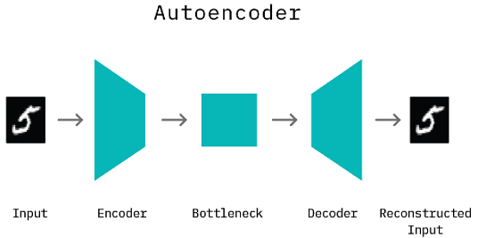
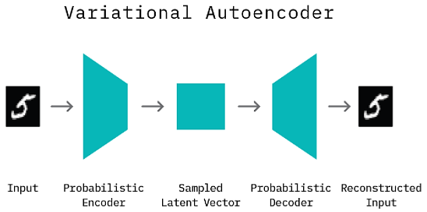
Variational Autoencoders for Anomaly Detection
Anomaly Detection with Machine Learning
Variational autoencoders (VAE) learn a mapping from input data to a distribution
I.e., the encoder network learns the parameters (mean and variance) of a distribution
The decoder network learns to reconstruct the original data by sampling from the distribution
Typically, a Gaussian distribution is used to model the reconstruction space
VAE are trained by minimizing the KL-divergence between the estimated distribution by the model and the distribution of the real data
VAE are also generative models, since they can generate new instances (by sampling from the latent code and reconstructing the sampled data)
Blog: Cloudera Fast Forward – Deep Learning for Anomaly Detection

Slide 34
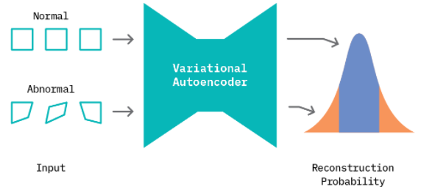
Variational Autoencoders for Anomaly Detection
Anomaly Detection with Machine Learning
Approach 1 (similar to the AE approach):
Train the VAE model on normal data instances (to model normal behavior)
At inference, calculate the reconstruction error: e.g., RMSE deviation between the input instance and the reconstructed output of the corresponding sample code
If the reconstruction error is less than a threshold then label the instance as normal data, if it is greater than the threshold then label it as abnormal data (anomaly)
Approach 2:
Train the VAE model on normal data instances (to model normal behavior)
At inference, calculate the mean and variance from the decoder, and calculate the probability that a new instance belongs to the distribution
If the data instance lies in a low-density region (i.e., below some threshold), it is labeled as abnormal data (anomaly)
Blog: Cloudera Fast Forward – Deep Learning for Anomaly Detection

Slide 35
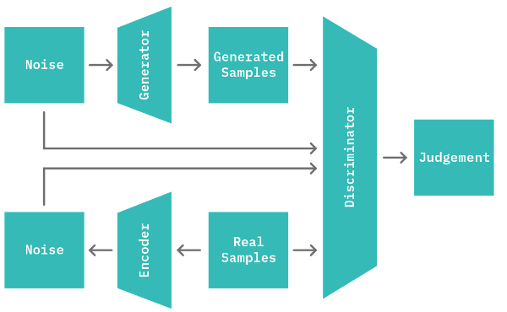
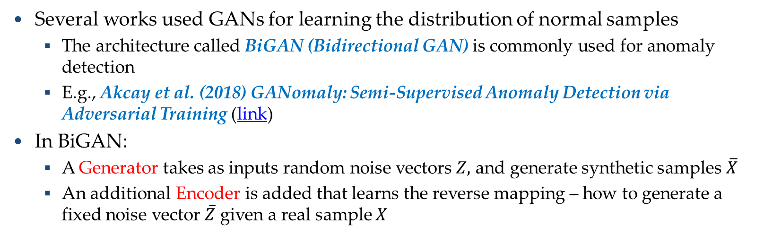
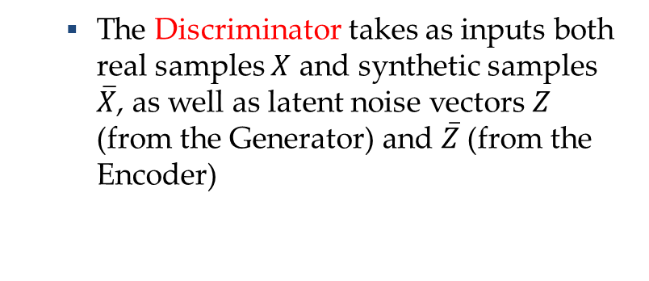
GANs for Anomaly Detection
Anomaly Detection with Machine Learning
Several works used GANs for learning the distribution of normal samples
The architecture called BiGAN (Bidirectional GAN) is commonly used for anomaly detection
E.g., Akcay et al. (2018) GANomaly: Semi-Supervised Anomaly Detection via Adversarial Training (link)
In BiGAN:
A Generator takes as inputs random noise vectors $Z,$ and generate synthetic samples$\overline{X}$
An additional Encoder is added that learns the reverse mapping – how to generate a fixed noise vector $\overline{Z}$ given a real sample $X$
The Discriminator takes as inputs both real samples $X$ and synthetic samples $\overline{X}$, as well as latent noise vectors $Z$ (from the Generator) and $\overline{Z}$ (from the Encoder)
Blog: Cloudera Fast Forward – Deep Learning for Anomaly Detection

Slide 36
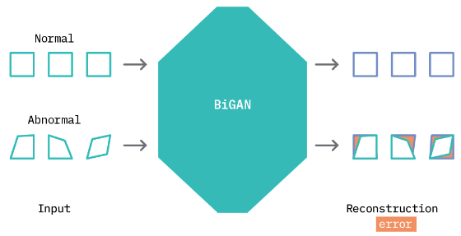
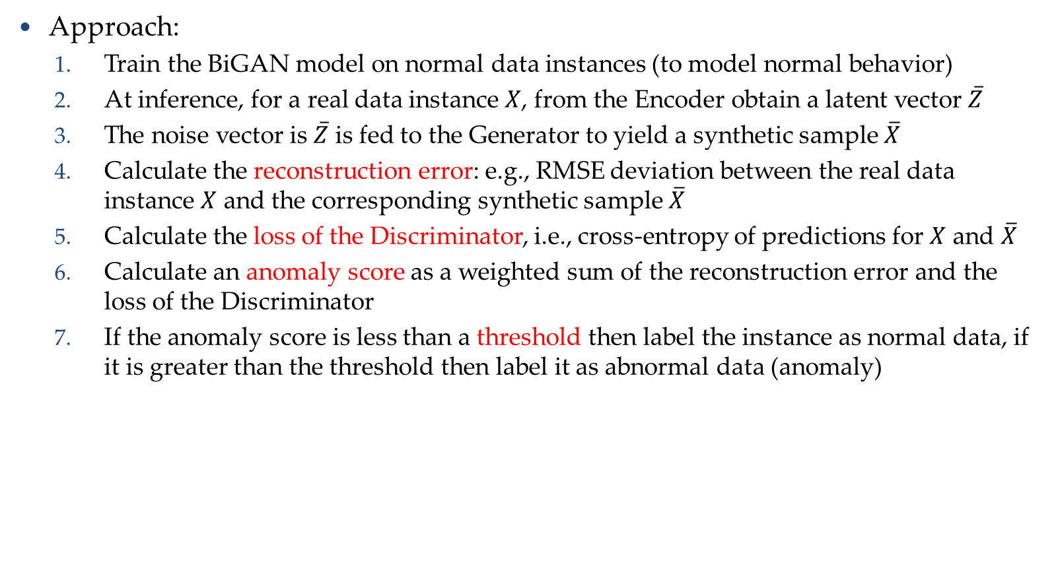
GANs for Anomaly Detection
Anomaly Detection with Machine Learning
Approach:
Train the BiGAN model on normal data instances (to model normal behavior)
At inference, for a real data instance $X$, from the Encoder obtain a latent vector $\overline{Z}$
The noise vector is $\overline{Z}$ is fed to the Generator to yield a synthetic sample $\overline{X}$
Calculate the reconstruction error: e.g., RMSE deviation between the real data instance $X$ and the corresponding synthetic sample $\overline{X}$
Calculate the loss of the Discriminator, i.e., cross-entropy of predictions for $X$ and $\overline{X}$
Calculate an anomaly score as a weighted sum of the reconstruction error and the loss of the Discriminator
If the anomaly score is less than a threshold then label the instance as normal data, if it is greater than the threshold then label it as abnormal data (anomaly)
Blog: Cloudera Fast Forward – Deep Learning for Anomaly Detection

Slide 37
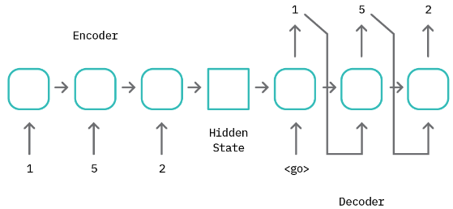
Sequence-to-sequence Models for Anomaly Detection
Anomaly Detection with Machine Learning
Sequence-to-sequence models are designed to learn mappings between sequential data (e.g., time-series signals)
Sequence-to-sequence models typically consist of an Encoder that generates a hidden representation of the input tokens, and a Decoder that takes in the encoder representation and sequentially generates a set of output tokens
The encoder and decoder are typically composed of recurrent layers, such as RNN, LSTM, or GRU, since recurrent networks are particularly suitable for modeling temporal relationships within input data tokens
Transformer Networks are also sequence-to-sequence models
The anomaly detection approach is similar to the Autoencoder models, i.e., based on the reconstruction errors for new examples
Blog: Cloudera Fast Forward – Deep Learning for Anomaly Detection

Slide 38
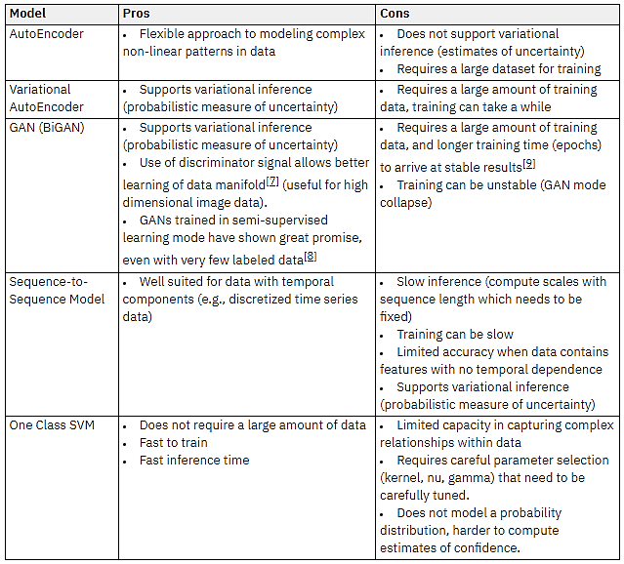
Anomaly Detection with Machine Learning
Anomaly Detection with Machine Learning
The table lists the pros and cons of the described ML approaches for anomaly detection
Blog: Cloudera Fast Forward – Deep Learning for Anomaly Detection

Slide 39
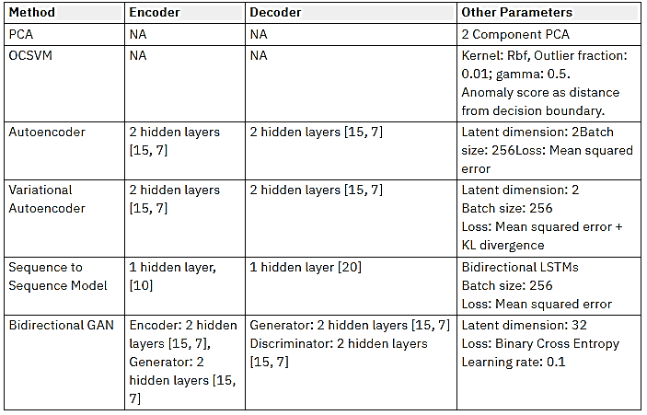
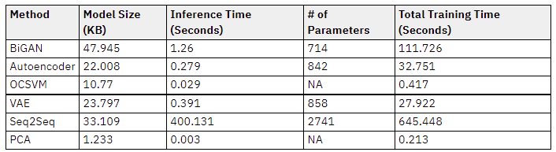
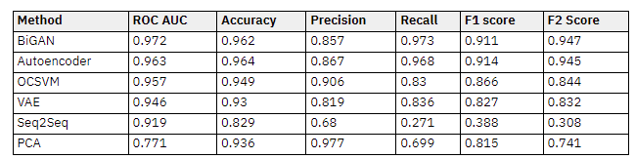
Benchmarking Models for Anomaly Detection
Anomaly Detection with Machine Learning
Performance by the presented models evaluated using the NSL-KDD dataset
The best performance was achieved by BiGAN and Autoencoder
Blog: Cloudera Fast Forward – Deep Learning for Anomaly Detection

Slide 40
Considerations for Anomaly Detection
Anomaly Detection with Machine Learning
Imbalanced datasets
Normal data samples are more readily available than abnormal samples
Consequently, the model may perform poorly on abnormal samples
Remedy: collect more data, or consider using precision, recall, F1 metrics
Definition of anomaly
The boundary between normal and anomalous behavior can evolve over time
It may require retraining the models to adopt to the changes in the data distribution
False alarms
Many of the found anomalies could correspond to noise in the data
False alarms require human review of the cases, which increases the costs
Computational complexity
Anomaly detection can require low latency (DL models are computationally intensive)
This may impose a trade-off between performance and accuracy
Blog: Cloudera Fast Forward – Deep Learning for Anomaly Detection

Slide 41
Adversarial Attacks on NIDS
Adversarial Attacks on NIDS
Feature-level (feature vector) attacks on ML-based NIDS
Feature-level attacks are achieved by perturbing a vector of extracted features from PCAP files: the generated adversarial samples are feature vectors
Although such adversarial attacks can be successful in evading ML models trained on datasets of extracted features, these attacks are less useful in practice
Since the inputs to the ML model for network intrusion detection are PCAP files
Also, typically it is not known what type of features were used by the ML model
Packet-level (end-to-end) attacks on ML-based NIDS
Packet-level attacks generate full PCAP files, rather than network features
In the taxonomy by Rosenberg et al. (2021), these attacks are end-to-end attacks based on the attack’s output
Such attacks are more practical, because the generated adversarial samples can be used to directly evade ML models for network intrusion detection
Limitation of current packet-level methods: most attacks focus on evaluating the ability to evade ML models used for network intrusion detection
Less attention is paid to evaluating the functionality of adversarial samples (i.e., whether a perturbed benign sample has preserved its functionality and its malicious behavior)

Slide 42
Feature-level Adversarial Attacks on NIDS
Feature-level Adversarial Attacks on ML-based NIDS
Warzinsky et al. (2018) Intrusion Detection Systems Vulnerability on Adversarial Examples (link)
White-box evasion attack against a three-layer MLP classifier using the NSL-KDD dataset
FGSM (Fast Gradient Sign Method) was used to create perturbed samples by modifying input features
The adversarial samples were misclassified as normal samples by the MLP model
The outputs of the attack are modified feature vectors
Clements et al. (2019) Rallying Adversarial Techniques against Deep Learning for Network Security (link)
White-box evasion attack against Kitsune – a NIDS comprising an ensemble of autoencoders
An anomaly score is calculated based on a weighted RMSE deviation of the ensemble of autoencoders
The authors implemented 4 attacks: FGSM, JSMA (Jacobian-based Saliency Map Attack), Carlini & Wagner, and ENM (Elastic Net Method) attack
It has the same limitation, as only the feature vectors were perturbed

Slide 43
Feature-level Adversarial Attacks on NIDS
Feature-level Adversarial Attacks on ML-based NIDS
Huang et al. (2019) Adversarial Attacks on SDN-Based Deep Learning IDS System (link)
White-box evasion attack on port scanning NIDS classifiers in a software-defined network (SDN)
SDNs use software-based controllers to control network traffic (instead of using dedicated hardware-based devices, such as routers or switches)
Attacked are three NIDS deep learning models, employing LSTM, CNN, and MLP architectures
FGSM and JSMA attacks were performed on regular traffic packets to generate adversarial samples
Besides the evasion attack, this work also demonstrated an availability attack
JSMA was applied on regular traffic data packets, which were classified by the port scanning NIDS as attacks, resulting in blocked legitimate traffic
Rosenberg (2021) – AML Attacks and Defense Methods in the Cyber Security Domain

Slide 44
GANs for Adversarial Attacks on NIDS
Feature-level Adversarial Attacks on ML-based NIDS
Lin et al. (2018) Generative Adversarial Networks for Attack Generation against Intrusion Detection (link)
Against seven traditional ML-based NIDS: SVM, naïve Bayes, MLP, logistic regression, decision tree, random forest, and k-NN classifier
A GAN architecture called IDS-GAN (GAN attacks against Intrusion Detection Systems) is proposed
NSL-KDD dataset was used for training the classifiers, and for evaluating the adversarial samples (with perturbed feature vectors)
Yang et al. (2018) Adversarial Examples Against the Deep Learning Based Network Intrusion Detection Systems (link)
Against a deep NN model using the same features from the NSL-KDD dataset as in Lin et al. (2018)
C&W, ZOO (Zeroth Order Optimization), and a GAN-based attack were used to add small perturbations to the input feature vectors, so as to deceive the deep NN model and misclassify malicious network packets as benign
Rosenberg (2021) – AML Attacks and Defense Methods in the Cyber Security Domain

Slide 45
Packet-level Adversarial Attacks on NIDS
Packet-level Adversarial Attacks on ML-based NIDS
Homoliak (2019) Improving Network Intrusion Detection Classifiers by Non-payload-based Exploit-independent Obfuscations: An adversarial approach (link)
Packet-level attacks against five traditional ML classifiers: naïve Bayes, decision trees, SVM, logistic regression, and naïve Bayes with kernel density estimation
Evaluated on a dataset collected by the authors called ASNM-NPBO
The attack approach involve applying random obfuscations and modifications to the network packets
Examples of modifications are: adding time delay to a packet, reordering a packet, damage parts of a packet, duplicate parts of a packet, and fragmenting a packet
The modified network packets behave similar to normal traffic, and can evade ML models used in NIDS
The attack generated network packets, and not just modified feature vectors

Slide 46
Packet-level Adversarial Attacks on NIDS
Packet-level Adversarial Attacks on ML-based NIDS
Kuppa et al. (2019) Black Box Attacks on Deep Anomaly Detectors (link)
Query-efficient gray-box (score-based) evasion attack
Attacks against seven anomaly detectors: autoencoder, One-Class SVM, autoencoder with Gaussian Mixture Model, anoGAN, deep SVM, isolation forests, and an adversarially learned model
The seven classifiers were trained on the CSE-CIC-IDS2018 dataset
The work employs a manifold approximation algorithm to project pcap files into a subspace where an adversarial sample is found that is the closest to the original clean file
Afterward, the adversarial sample is projected back into a pcap file
Rosenberg (2021) – AML Attacks and Defense Methods in the Cyber Security Domain

Slide 47
Additional References
Rosenberg et al. (2021) – Adversarial Machine Learning Attacks and Defense Methods in the Cyber Security Domain (link)
Ahmad (2020) – Network Intrusion Detection System: A Systematic Study of Machine Learning and Deep Learning Approaches (link)
Cloudera Fast Forward – Deep Learning for Anomaly Detection (link)
Blog Post by Cuelogic Technologies – Evaluation of Machine Learning Algorithms for Intrusion Detection System (link)
Intrusion Detection – Chapter 22 in “Introduction to Computer Security”
Blog Post by Gerry Saporito – A Deeper Dive into the NSL-KDD Data Set (link)

