Slide 1
CS 487/587 Adversarial Machine Learning
Dr. Alex Vakanski

Slide 2
Lecture 14
Bias and Fairness in Machine Learning

Slide 3
Lecture Outline
Bias and fairness definitions
Introduction to ML bias
Data bias
Algorithmic bias
Bias amplification
Fairness metrics
Mitigation strategies

Slide 4
Introduction
Introduction
Although ML models are increasingly used to influence decisions that impact society, from loan approvals to hiring processes, the models are not inherently neutral
ML models reflect the biases present in their training data, potentially expanding and amplifying existing societal inequalities
When deployed at scale, biased ML models can systematically disadvantage marginalized groups

Slide 5
Bias and Fairness Definitions
Introduction
Bias in ML and AI
Bias is a systematic error in the ML model that produces skewed results that favor or disadvantage certain demographic groups
Bias often originates from imbalanced or non-representative training data or biased assumptions in model development
Fairness in ML and AI
Fairness is the absence of prejudice or favoritism toward individuals or groups based on their protected characteristics
Fairness extends beyond equality of treatment, providing different levels of support to achieve just outcomes across diverse populations
Multiple mathematical definitions of fairness exist, each representing different perspectives on what constitutes "fair" outcomes

Slide 6
Introduction to ML Bias
Introduction to ML Bias
Understanding bias and fairness in ML requires recognizing that these concepts are nuanced and context-dependent
What constitutes "fair" in one application may not be appropriate in another application: this requires ongoing evaluation and adjustment
Sources of ML bias
Data bias
Data bias is one of the main reasons for fairness issues in ML systems
Recognizing the sources of data bias is important for building trustworthy AI, as ML models can only be as fair as the data used to train them
Algorithmic bias
Even with balanced training data, the choice of ML algorithm can introduce or intensify unfairness in model outcomes
Algorithmic bias can emerge at various stages of the ML pipeline, from data collection to deployment
Assumptions in the ML model design can amplify certain characteristics over others, leading to biased outputs

Slide 7
Types of Data Bias in ML
Data Bias
Historical bias
Includes pre-existing historical societal inequalities reflected in data, even when the data is collected accurately
E.g., criminal justice data overrepresenting certain demographics
E.g., medical research data historically focused on male subjects
Data aggregation bias
Combining data in ways that ignore disproportions between subgroups
E.g., averaging outcomes across different demographic groups
Representation bias
Samples that fail to reflect the diversity of the population
E.g., facial recognition ML model trained primarily on light-skinned faces
E.g., voice recognition ML model struggling with certain accents
Omitted variable bias
Arises when important features are excluded from the ML model
E.g., a credit scoring algorithm that considers only traditional credit history may disadvantage communities with limited access to banking services
Measurement bias
Errors or inconsistencies in data collection or labeling
E.g., health sensors less accurate for darker skin tones
E.g., inconsistent labeling standards across different groups

Slide 8
Types of Algorithmic Bias in ML
Algorithmic Bias
Algorithm bias
Originates from inherent limitations or design flaws in ML algorithms
Some ML model architectures may be more likely to amplify bias present in the training data, or may prioritize optimization methods or metrics that don't align with fairness considerations
Regularization Bias
Regularization techniques can suppress minority group information and treat that information as noise
E.g., L₁/L₂ regularization might eliminate rare but important features
Transfer Bias
Occurs when models trained in one context (domain, population) are reused elsewhere without proper adaptation
E.g., a healthcare model trained on U.S. patient data performs poorly on data from another country
Evaluation bias
Occurs when the model is evaluated on a non-representative dataset
E.g., facial recognition evaluated on one demographic group lead to decreased performance when the system is deployed broadly across diverse populations

Slide 9
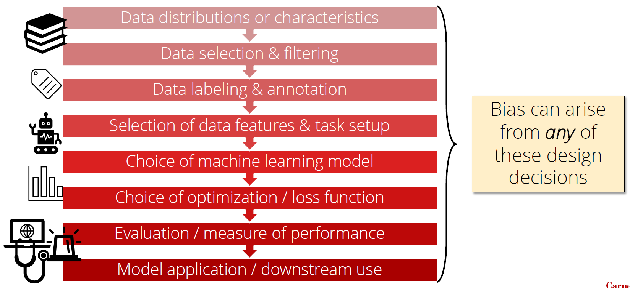
Sources of Bias in ML
Introduction to ML Bias
Figure from: Maarten Sap, “Safety, Ethics, and Biases in AI and NLP systems

Slide 10
Algorithmic Bias in ML Systems
Algorithmic Bias
Safiya Umoja Noble (2018) Algorithms of Oppression
Examines how search engines often prioritize content that reinforces racial stereotypes, showing how algorithmic structures reflect societal biases
Bender (2021) On the Dangers of Stochastic Parrots
Discusses risks in LLMs emphasizing that over-reliance on biased data leads to “parroting” harmful or inaccurate stereotypes
Highlights the responsibility of tech companies in managing and reducing bias in generative AI systems
Humble (2024) War, Artificial Intelligence, and the Future of Conflict
Explores ethical concerns around AI deployment in military and conflict scenarios
Raises awareness of how biased AI in conflict situations could disproportionately target specific groups

Slide 11
Bias Amplification
Bias Amplification
One of the most concerning aspects of bias in ML is the potential for bias amplification effects
When ML models trained on biased data are deployed in real-world scenarios, they can create feedback loops that reinforce existing inequalities
Example
ML algorithms direct more officers to neighborhoods with historically higher arrest rates
The increased police presence leads to more arrests
This generates more data points that reinforce the model's prediction that these areas have higher crime rates, regardless of the actual crime rate
Similar feedback effects can occur in hiring, lending, healthcare, and other domains, creating a cycle that becomes difficult to break

Slide 12

Bias Amplification
Bias Amplification
Biased data collection:
historical inequities create
imbalanced datasets
Model training:
algorithms learn and
amplify patterns of bias
Feedback loop:
new data reinforces
existing patterns
Deployment decisions:
biased predictions lead
to unfair outcomes

Slide 13
Why ML Bias Matters
Introduction to ML Bias
ML bias can have significant impact on society
Impact on discrimination: biased AI can lead to discriminatory decisions, affecting hiring, lending, policing, and healthcare
E.g., biased facial recognition algorithms may lead to wrongful arrests or surveillance of marginalized communities
E.g., predictive algorithms use historical crime data to predict future crimes: if past data overrepresents certain neighborhoods, ML models will produce biased outcomes
Impact on opportunities: AI bias can result in lost opportunities for demographic groups
E.g., biased hiring algorithms exclude qualified candidates based on gender, race, or socioeconomic background
Importance of awareness of ML bias
For ML developers: being aware helps developers create fair ML systems, conduct bias testing, and promote the development of inclusive datasets for model training
For society: a better-informed public can hold AI developers and companies accountable

Slide 14
Case Study: COMPAS
Case Study: COMPAS
COMPAS is an ML system that has been used in New York, Wisconsin, California, Florida, and other states
Person commits a crime, is arrested
COMPAS software predicts the chance that the person will commit another crime in the future (recidivism)
Recidivism scores impact criminal sentences: if a person is likely to commit another crime, they may get a longer sentence
2016 ProPublica article analyzed COMPAS scores for over 7,000 people arrested in Florida

Slide 15
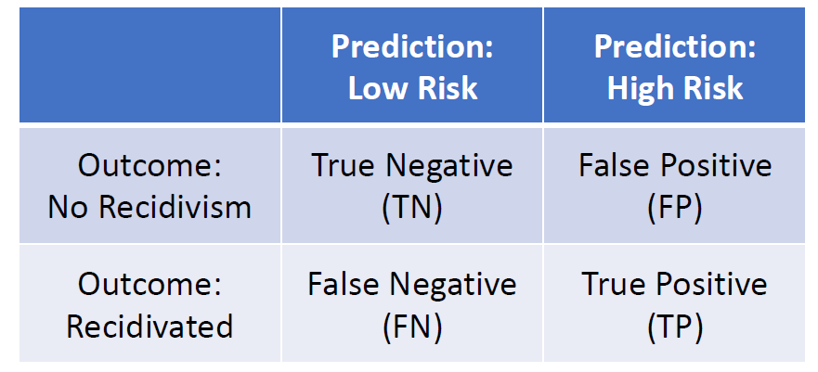
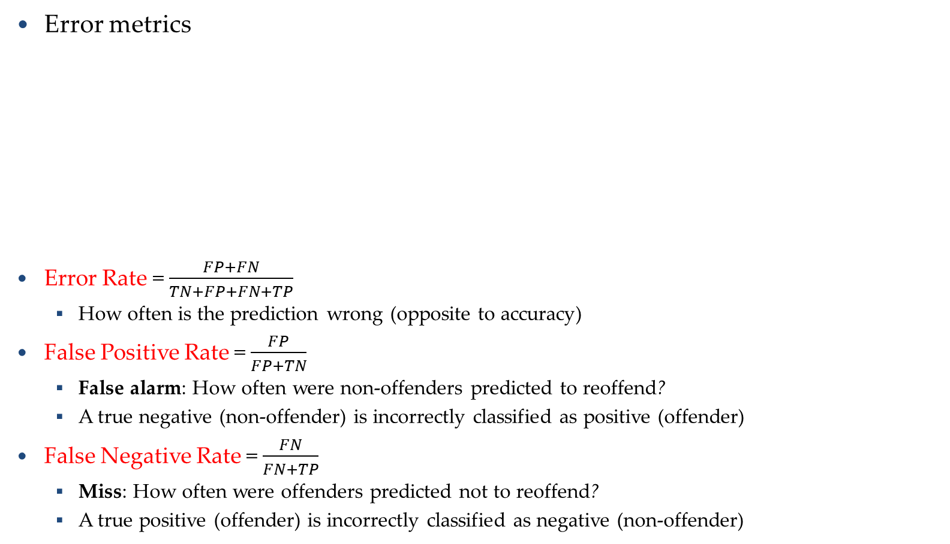
Case Study: COMPAS
Case Study: COMPAS
Error metrics
Error Rate = $\frac{FP+FN}{TN+FP+FN+TP}$
How often is the prediction wrong (opposite to accuracy)
False Positive Rate = $\frac{FP}{FP+TN}$
False alarm: How often were non-offenders predicted to reoffend?
A true negative (non-offender) is incorrectly classified as positive (offender)
False Negative Rate = $\frac{FN}{FN+TP}$
Miss: How often were offenders predicted not to reoffend?
A true positive (offender) is incorrectly classified as negative (non-offender)

Slide 16
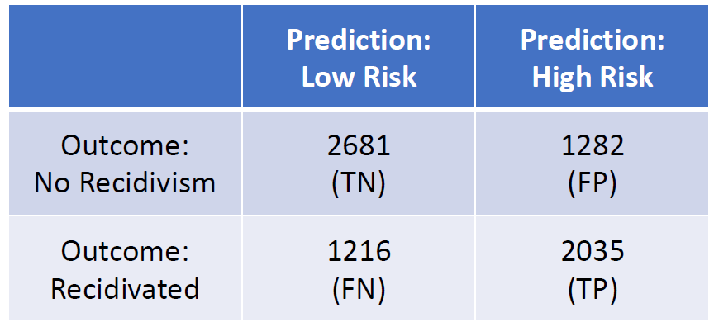

Case Study: COMPAS
Case Study: COMPAS
Metrics by the COMPAS model
Error Rate = $\frac{FP+FN}{TN+FP+FN+TP}$ ≈ 34.6%
False Positive Rate = $\frac{FP}{FP+TN}$ ≈ 32.4%
False Negative Rate = $\frac{FN}{FN+TP}$≈ 37.4%

Slide 17
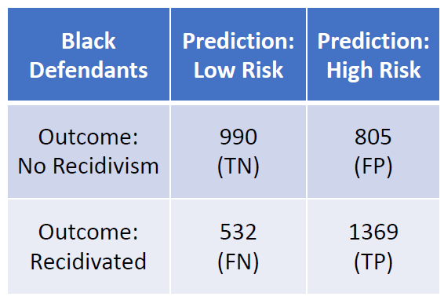
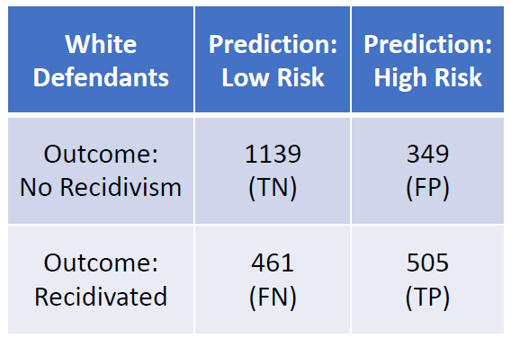
Case Study: COMPAS
Case Study: COMPAS
Metrics by the COMPAS model for black defendants and white defendants
Error Rate ≈ 36.2% Error Rate ≈ 33.0%
False Positive Rate ≈ 44.9% False Positive Rate ≈ 23.5%
False Negative Rate ≈ 28.0% False Negative Rate ≈ 47.7%
Similar error rates between white and black defendants
Black defendants have almost 2 times higher False Positive Rate (false alarm)
White defendants have almost 2 times higher False Negative Rate (miss)

Slide 18
Case Study: COMPAS
Case Study: COMPAS
COMPAS gives very different outcomes for white vs black defendants, but it does not use race as an input to the algorithm
Even if a sensitive feature (e.g. race) is not an input to the algorithm, other features (e.g. zip code) may correlate with the sensitive feature

Slide 19
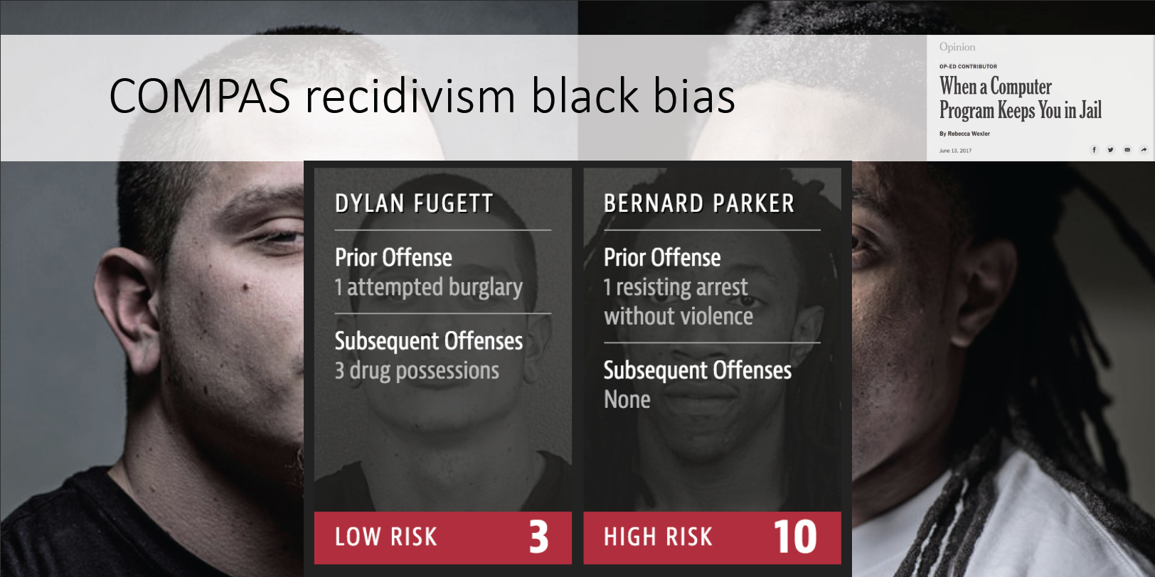
Case Study: COMPAS
Case Study: COMPAS

Slide 20
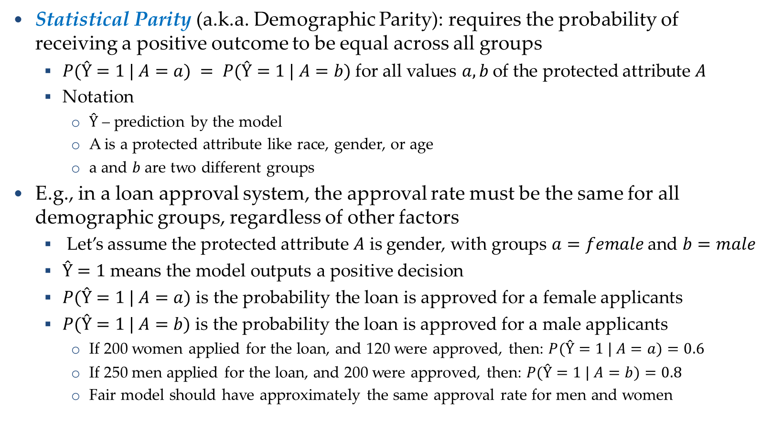
Fairness Metrics: Statistical Parity
Fairness Metrics
Statistical Parity (a.k.a. Demographic Parity): requires the probability of receiving a positive outcome to be equal across all groups
$P(Ŷ=1 | A=a) = P(Ŷ=1 | A=b)$for all values $a, b$of the protected attribute $A$
Notation
$Ŷ$ – prediction by the model
A is a protected attribute like race, gender, or age
a and 𝑏 are two different groups
E.g., in a loan approval system, the approval rate must be the same for all demographic groups, regardless of other factors
Let’s assume the protected attribute $A$ is gender, with groups $a=female$and $b=male$
$Ŷ=1$ means the model outputs a positive decision
$P(Ŷ=1 | A=a)$ is the probability the loan is approved for a female applicants
$P(Ŷ=1 | A=b)$ is the probability the loan is approved for a male applicants
If 200 women applied for the loan, and 120 were approved, then: $P(Ŷ=1 | A=a)=0.6$
If 250 men applied for the loan, and 200 were approved, then: $P(Ŷ=1 | A=b)=0.8$
Fair model should have approximately the same approval rate for men and women

Slide 21
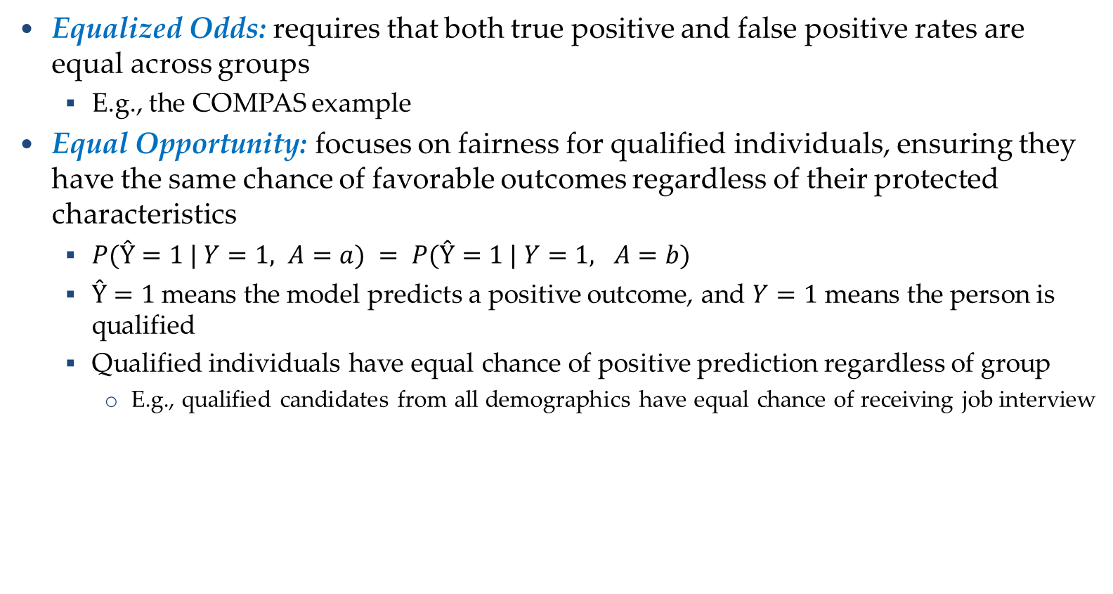
Other Fairness Metrics
Fairness Metrics
Equalized Odds: requires that both true positive and false positive rates are equal across groups
E.g., the COMPAS example
Equal Opportunity: focuses on fairness for qualified individuals, ensuring they have the same chance of favorable outcomes regardless of their protected characteristics
$P(Ŷ=1 | Y=1, A=a) = P(Ŷ=1 | Y=1, A=b)$
$Ŷ=1$means the model predicts a positive outcome, and $Y=1$ means the person is qualified
Qualified individuals have equal chance of positive prediction regardless of group
E.g., qualified candidates from all demographics have equal chance of receiving job interview

Slide 22
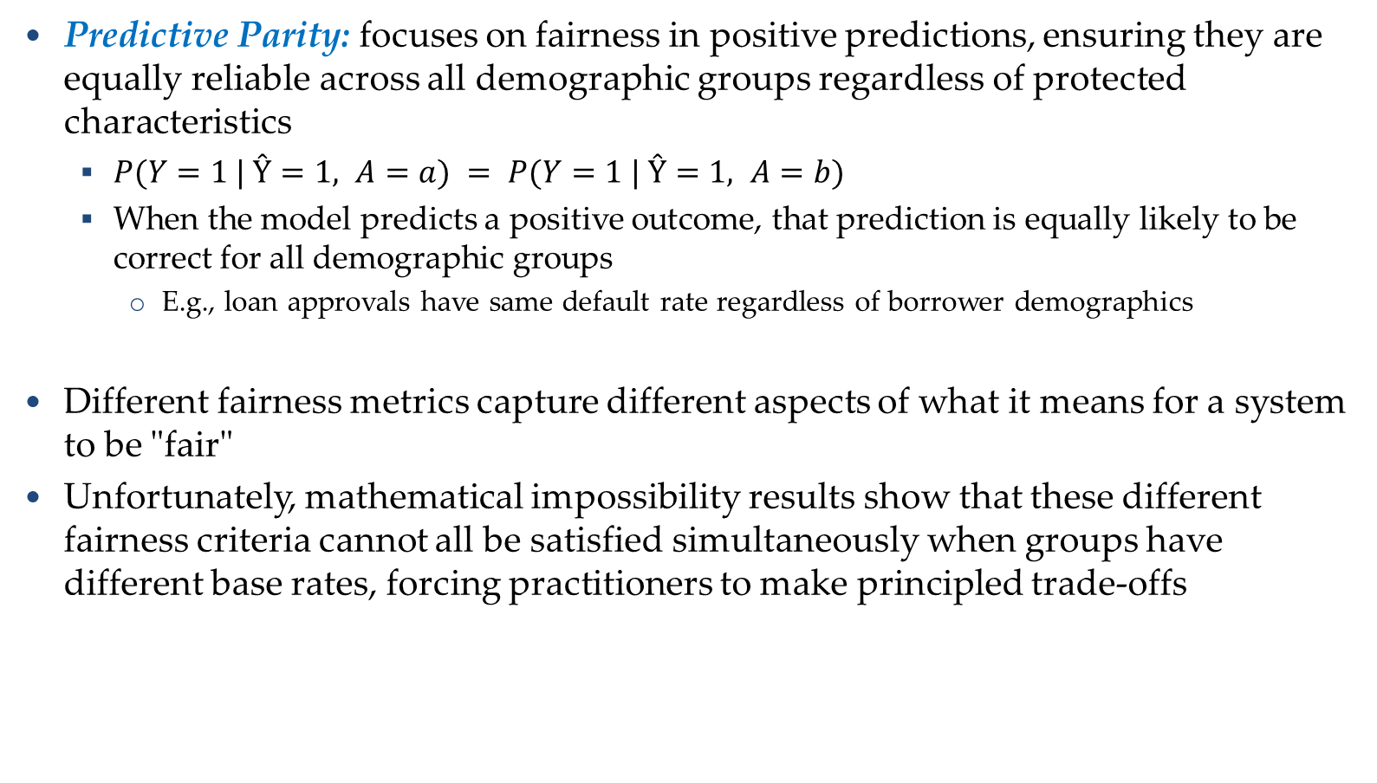
Other Fairness Metrics
Fairness Metrics
Predictive Parity: focuses on fairness in positive predictions, ensuring they are equally reliable across all demographic groups regardless of protected characteristics
$P(Y=1 | Ŷ=1, A=a) = P(Y=1 | Ŷ=1, A=b)$
When the model predicts a positive outcome, that prediction is equally likely to be correct for all demographic groups
E.g., loan approvals have same default rate regardless of borrower demographics
Different fairness metrics capture different aspects of what it means for a system to be "fair"
Unfortunately, mathematical impossibility results show that these different fairness criteria cannot all be satisfied simultaneously when groups have different base rates, forcing practitioners to make principled trade-offs

Slide 23
Testing for Bias in Language Models
Bias in LLMs
Kotek (2024) “Gender bias and stereotypes in Large Language Models”
Researchers tested prompts like “The doctor phoned the nurse because she was late for the morning shift.”
The AI often inferred that the nurse was female and the doctor male
Findings
On average, models were 6.8 times more likely to assign stereotypical female occupations to female pronouns and male occupations to male pronouns
Reinforces gender stereotypes, potentially affecting how language models are applied in industries like hiring and social media
Impact
This kind of bias, if unchecked, may influence societal expectations and perpetuate harmful stereotypes
Biases affect users’ trust in AI and the decisions influenced by AI

Slide 24
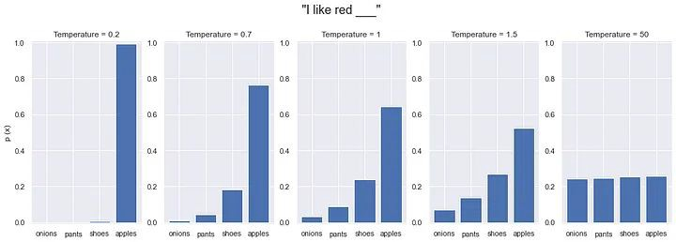
Randomness and Bias in LLMs
Bias in LLMs
To mitigate the potential harms of biased training data, LLM developers often implement safeguards such as fine-tuning and alignment techniques to reduce biased outputs
However, increasing the model’s temperature introduces more randomness into its responses, which can reduce the consistency and reliability of the safeguards
This raises concerns about the effectiveness of bias mitigation under high-temperature settings

Slide 25
Mitigation Strategies: Pre-processing
Mitigation Strategies
Pre-processing techniques focus on addressing bias in the training data
By modifying the dataset before ML model training, these approaches can help prevent biases from being encoded into the model
Pre-processing strategies are model-agnostic and can be applied regardless of the specific algorithm being used
Pre-processing techniques include:
Data reweighing
Assign different weights to training examples to counteract representation imbalances
Examples from underrepresented groups receive higher weights, increasing their influence during model training
Reduces impact of majority group dominance
Preserves all original data points
Helps model learn patterns from minority groups

Slide 26
Mitigation Strategies: Pre-processing
Mitigation Strategies
Strategic resampling
Modify the training dataset by either duplicating instances from underrepresented groups (over-sampling) or removing instances from overrepresented groups (under-sampling)
Creates more balanced class distribution
Relatively simple to implement
Can be combined with other techniques
Synthetic data generation
Create artificial data points to increase representation of underrepresented groups
E.g., using techniques like SMOTE (Synthetic Minority Over-sampling Technique) or generative models
Addresses data imbalance
Creates novel training examples

Slide 27
Mitigation Strategies: In-processing
Mitigation Strategies
In-processing techniques modify the ML algorithm to incorporate fairness considerations during training
This can be achieved via constrained optimization methods that balance prediction accuracy with fairness metrics
Advantages
Incorporate fairness constraints directly into the learning algorithm
Add regularization terms that penalize unfair solutions during training
Optimize for both accuracy and fairness as dual objectives

Slide 28
Mitigation Strategies: Post-processing
Mitigation Strategies
Post-processing techniques adjust the ML predictions after training is complete, such as applying different thresholds for different groups to match error rates
These approaches offer flexibility but may sacrifice some predictive performance to achieve fairness goals
Techniques
Adjust model outputs after training to satisfy fairness criteria
Apply different decision thresholds for different groups
Calibrate probability estimates across protected groups
Example: identify uncertain predictions near decision boundary and apply fairness-oriented rules
While pre-processing strategies focus on the data, in-processing and post-processing strategies address bias within the algorithm itself or its outputs

Slide 29
Towards Ethical AI
Towards Ethical AI
Building fair and unbiased ML systems requires continuous effort
It requires vigilance at every stage of the AI lifecycle, from problem formulation to deployment and monitoring
Transparency by ML developers is crucial, both in documenting design choices and in communicating limitations to users and stakeholders
This includes acknowledging trade-offs between different fairness criteria and being honest about the imperfect nature of all fairness solutions

Slide 30
Steps Towards Ethical AI
Towards Ethical AI
Education and awareness
Building fairness literacy among practitioners
Community engagement
Including affected communities in design and evaluation
Transparency and explainability
Making AI systems understandable to stakeholders
Multidisciplinary collaboration
Bringing together technical, ethical, legal, and domain experts
Continuous improvement
Ongoing monitoring, auditing, and refinement of ML systems

Slide 31
References
Aditi Rajesh Shah, Nick Szydlowski, “AI Bias: A Hands-On Workshop and Discussion,” available at https://tiny.sjsu.edu/ai-bias
Justin Joshnson, David Fouhey, “Lecture: Fairness in AI,”, EECS 442, University of Michigan, 2021

