Slide 1
CS 487/587 Adversarial Machine Learning
Dr. Alex Vakanski

Slide 2
Lecture 9
Defenses against Poisoning Attacks

Slide 3
Lecture Outline
Poisoning defenses
Blind backdoor removal
Offline inspection
Online inspection
Post backdoor removal
Neural Cleanse
SentiNet

Slide 4
Defenses Against Poisoning Attacks
Poisoning Defenses
Defense strategies against poisoning adversarial attacks were categorized in Gao et al. (2020) into:
Blind backdoor removal
The user is not sure whether the data or the model were poisoned
The user applies defense methods for removing or suppressing backdoors in input samples
Or, the user cleans the model to reduce the impact of poisoning
Offline inspection
Defense methods are applied before the model is deployed
If the user has access to the data, the user removes the poisoned samples
If the poisoned data is not available, the user cleans the backdoored model
Online inspection
Defense methods are applied to monitor the performance during run-time
The user either inspects the incoming inputs to remove poisoned data
Or, the user evaluates the model to determine abnormal behavior
Post backdoor removal
If any of the above defenses have identified backdoored sample, these defense methods are applied to remove the backdoor

Slide 5
Blind Backdoor Removal Defenses
Blind Backdoor Removal Defenses
Blind backdoor removal
This defense approach does not differentiate the backdoored model from a clean model (hence, it blindly applies backdoor removal)
The goal is to remove or suppress the effect of a potential backdoor while achieving high accuracy on clean inputs
The defense can be performed either offline or online
Fine-pruning defense
Liu (2018) Fine-Pruning: Defending Against Backdooring Attacks on Deep Neural Networks
Remove potential backdoor by pruning the neurons in DNN with the smallest contribution to the classification task
The main assumption is that different neurons are activated by clean and trigger inputs
Step 1: sort all neurons based on the activation values on clean inputs (e.g., from a test set) and remove those neurons with the smallest activation values
Step 2: fine-tune the modified model with the pruned neurons
Limitation: reduced accuracy on clean inputs

Slide 6
Blind Backdoor Removal Defenses
Blind Backdoor Removal Defenses
Suppression defense
Sarkar (2020) Backdoor Suppression in Neural Networks using Input Fuzzing and Majority Voting
The goal is to clean the triggers in poisoned images via fuzzing
Step 1: create many replicas of each image (without knowing if they are clean or backdoored images) by adding noise
The noise level is experimentally determined for a dataset
Step 2: train a DNN model using all fuzzied image replicas, and calculate a final prediction based on majority voting of the predictions on all perturbed replicas of an input image
The defense achieved a success rate of 90% on backdoored images in MNIST, and 50% on backdoored images in CIFAR-10
Limitation: reduced accuracy on clean inputs, low success rate on CIFAR-10 images
Note:
Blind backdoor removal defense does not distinguish a backdoored model from a clean model, or trigger inputs from clean inputs
It usually reduces the accuracy on clean inputs

Slide 7
Offline Inspection Defenses
Offline Inspection Defenses
Offline inspection defense
The defense is applied before the model is deployed in production
These defense strategy can be based on data inspection or model inspection
Offline data inspection defense
It is assumed that the poisoned data is available to the defender
Spectral signature defense
B. Tran (2018) Spectral Signatures in Backdoor Attacks
Remove poisoned data samples based on outlier detection approach
Step 1: train a DNN model to classify the available data that contains both clean and poisoned samples
Step 2: for each class, calculate SVD on the logit values of the model, and remove all input samples that are outliers (i.e., have singular values greater than a threshold)
Step 3: retrain the model with the remaining samples
Limitation: may remove clean samples, requires some knowledge to establish the threshold value for outlier detection

Slide 8
Offline Inspection Defenses
Offline Inspection Defenses
Gradient clustering defense, activation clustering defense
Chan (2019) Poison as a Cure: Detecting & Neutralizing Variable-sized Backdoor Attacks in Deep Neural Networks
Chen (2018) Detecting Backdoor Attacks on Deep Neural Networks by Activation Clustering
The assumption by this defense approach is that trigger inputs will produce either large gradients at the trigger location, or large logit activation values
Step 1: apply a clustering algorithm (e.g., k-mean clustering) to separate clean inputs from trigger inputs, based on the gradient or activation values
Step 2: remove or relabel the trigger inputs, and retrain the model

Slide 9
Offline Inspection Defenses
Offline Inspection Defenses
Offline model inspection defense
The defender has access to the backdoored model
This defense approach does not assume that poisoned data is available to the defender
Therefore, the assumptions are more realistic
Neural cleanse
Wang et al. (2019) Neural Cleanse: Identifying and Mitigating Backdoor Attacks in Neural Networks
The defense iterates though all labels to determine if any label requires much smaller perturbation to be applied to the inputs to achieve misclassification
An optimization algorithms is applied to reverse engineer the trigger
The reverse-engineered trigger is used to retrain the model, and remove the backdoor
Limitations: high computational costs for models with large number of classes, the reverse-engineered trigger is not always consistent with the original trigger
This defense method is explained in more details in this lecture

Slide 10
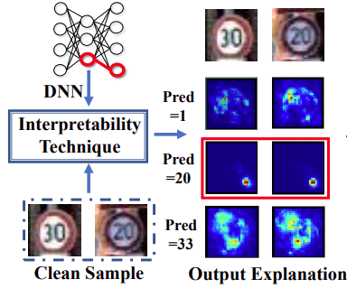
NeuronInspect
Offline Inspection Defenses
NeuronInspect
Huang (2019) NeuronInspect: Detecting Backdoors in Neural Networks via Output Explanations
Applies interpretability approaches to create heatmaps for the target class and non-target classes
The heatmaps for the target class differ significantly for clean and trigger inputs
In the figure, the target class is 20 (third row), and the trigger is noticeable in the heatmaps
Outlier detection is then applied on the produced heatmaps as a defense strategy
Note:
Offline model inspection requires high computational resources and time
Most offline defense methods cannot deal with large-sized triggers

Slide 11
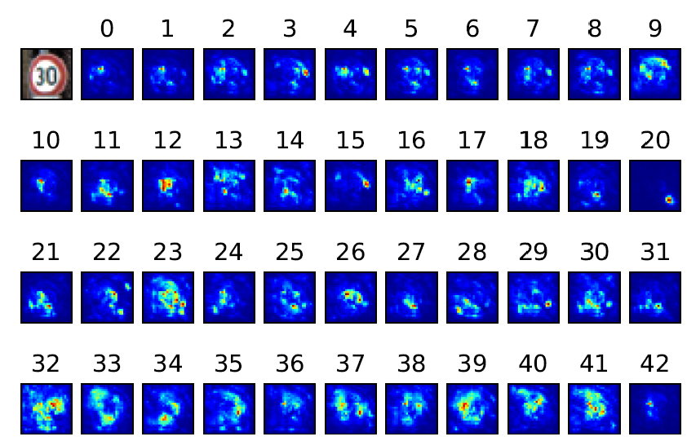
NeuronInspect
Offline Inspection Defenses
NeuronInspect (cont’d)
Explanation heatmaps for the Speed Limit 30 sign image, for all 43 classes of traffic signs
The heatmap for label 20 is an outlier, in comparison to heatmaps for all other labels

Slide 12
Online Inspection Defenses
Online Inspection Defenses
Online inspection defense
This defense is applied to monitor the behavior of input data or a model during run-time
Online data inspection defense
Most defense methods apply some form of anomaly detection to check if the inputs contain a trigger
STRIP defense
Gao (2019) STRIP: A Defense against Trojan Attacks on Deep Neural Networks
Step 1: apply random noise to create many replicas of an input image
Step 2: use the entropy of the replicas for anomaly detection
Replicas of trigger images have high entropy (the predicted class is more uniform), whereas clean images have low entropy (the predicted class is more random)
SentiNet defense
It is presented later in this lecture
It applies explainability approach to discover regions that may contain a trigger, and uses these regions to monitor incoming inputs

Slide 13
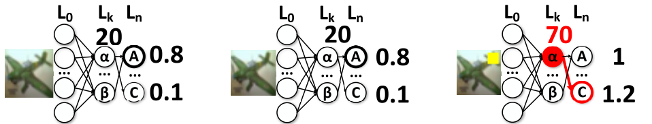
Online Inspection Defenses
Online Inspection Defenses
Online model inspection defense
Apply anomaly detection to identify abnormal behavior of a backdoored model
ABS defense
Liu (2019) ABS: Scanning Neural Networks for Back-doors by Artificial Brain Stimulation
Scan the DNN to identify individual neurons in the model with abnormally high activation values
If there is a large change in the neuron activation value for a specific label regardless of the provided input samples, then the model is potentially poisoned
Apply outlier detection to identify Trojaned models
Limitation: the target label needs to be activated by only one neuron, instead by a group of neurons
Benign model with benign image
Trojaned model with benign image
Trojaned model with trigger image

Slide 14
Online Inspection Defenses
Online Inspection Defenses
NIC defense
Ma (2019) NIC: Detecting Adversarial Samples with Neural Network Invariant Checking
Inspect the distribution of the activations by different layers of DNN to detect abnormal behavior
Determine if the flow of the activations is abnormal for some labels
This approach requires to learn the distributions of the activations in an offline step
Note:
Online inspection approaches typically require some preparations to be performed offline (e.g., determining a threshold to distinguish clean from trigger inputs)
Also, these approaches can result in latency and can be less suitable for real-time applications (e.g., self-driving vehicles)

Slide 15
Post Backdoor Removal Defenses
Post Backdoor Removal Defenses
Post backdoor removal defense
Includes techniques to remove the backdoor, after it is identified by the previous defense approaches
If the defender has access to poisoned data, they can remove trigger inputs, and retrain the model using only clean inputs
Another approach is to change the labels of the poisoned inputs with triggers to the correct labels, and then retrain the model
For this defense approach, it is required to reverse-engineer the trigger

Slide 16
Neural Cleanse
Neural Cleanse
Wang et al. (2019) Neural Cleanse: Identifying and Mitigating Backdoor Attacks in Neural Networks
Neural Cleanse introduces methods for detection and mitigation of backdoor attacks
The detection method identifies backdoored models and reconstructs possible triggers
The mitigation techniques include input filters, neuron pruning, and unlearning
The defense methods were validated against two poisoning attacks:
BadNet backdoor attack (input samples with backdoors)
Trojaned network (altered neurons)
Threat model assumptions
The defender has access to the trained DNN and a set of correctly labeled samples

Slide 17
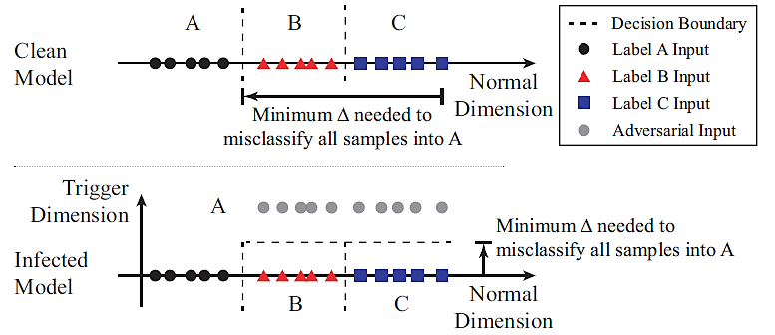
Defense Intuition and Overview
Neural Cleanse
Backdoor triggers produce a classification result to a target label A regardless of the ground-truth label the input belongs to
Backdoors create “shortcuts” for adversarial inputs to cross the decision boundaries
Defense strategy: detect the “shortcuts” by measuring the minimum perturbation necessary to change all inputs from one label to a target label

Slide 18
Detecting Backdoors Approach
Neural Cleanse
Step 1
Consider a given label to be a target label of a backdoor attack
Apply an optimization algorithm to calculate the “minimal” perturbation required to misclassify all samples from other labels to this target label
Step 2
Repeat Step 1 for each output label in the model
This results in multiple potential triggers for a target model
Step 3
Measure the size of each potential trigger from Step 2
Run an outlier detection algorithm to detect if any trigger is significantly smaller than other triggers
An outlier represents a real trigger with a corresponding target label of the backdoor attack

Slide 19
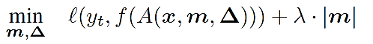
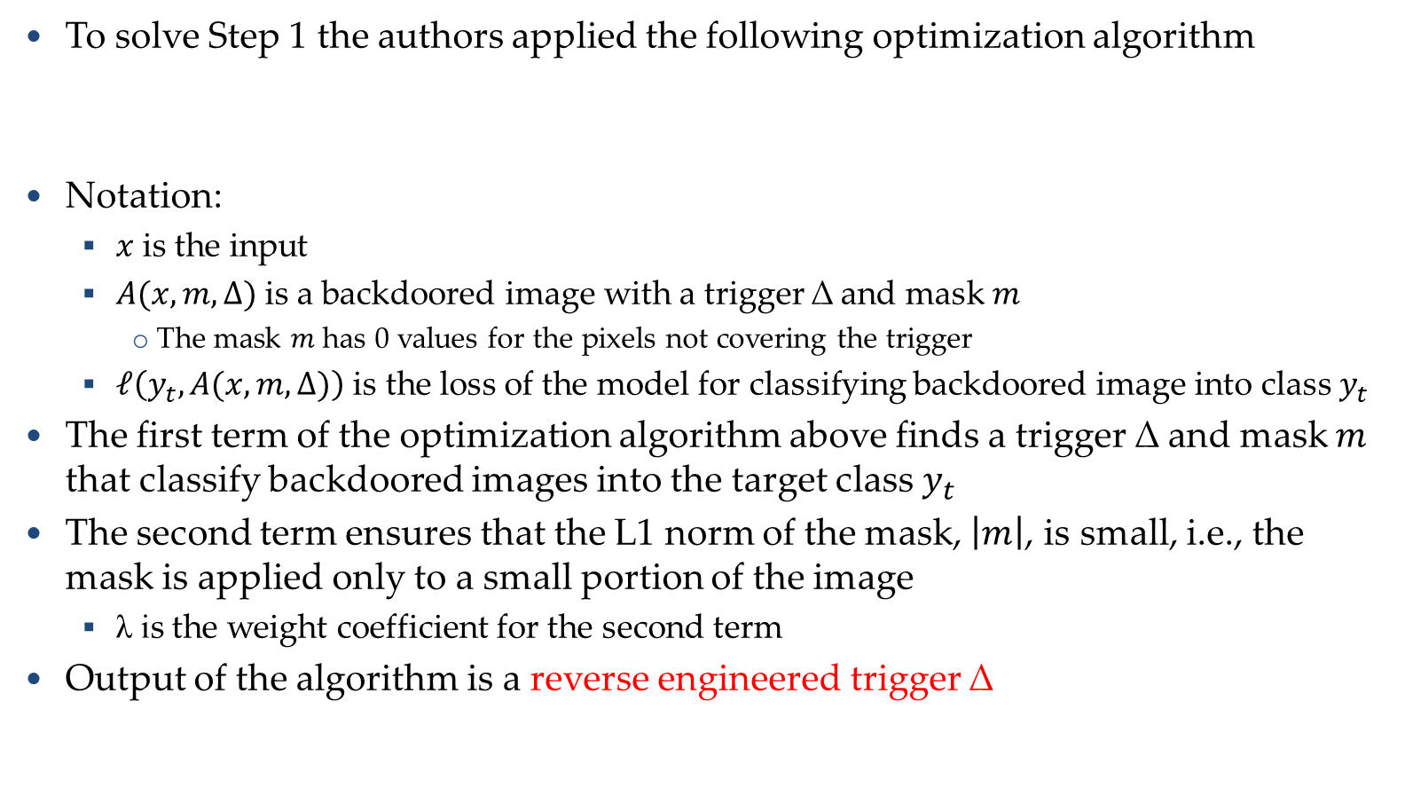
Reverse Engineering Triggers
Neural Cleanse
To solve Step 1 the authors applied the following optimization algorithm
Notation:
$x$is the input
$A(x, m, ∆)$is a backdoored image with a trigger ∆ and mask $m$
The mask $m$ has 0 values for the pixels not covering the trigger
$ℓ\left(y_{t},A(x, m, ∆)\right)$ is the loss of the model for classifying backdoored image into class $y_{t}$
The first term of the optimization algorithm above finds a trigger ∆ and mask $m$ that classify backdoored images into the target class $y_{t}$
The second term ensures that the L1 norm of the mask, $\left|m\right|$, is small, i.e., the mask is applied only to a small portion of the image
λ is the weight coefficient for the second term
Output of the algorithm is a reverse engineered trigger ∆

Slide 20
Considered Applications
Neural Cleanse
The authors implemented and validated Neural Cleanse on the following applications:
Handwritten digit recognition – MNIST dataset (10 digits)
Traffic sign recognition – GTSRB dataset (43 classes)
Facial recognition – YouTube Face dataset (1,283 people)
Contains 375 K training images extracted from YouTube videos
Large number of classes: 1,283
Facial recognition – PubFig dataset (65 people)
Contains 5 K dataset (small dataset)
The DNN classifier uses transfer learning from a large pretrained model

Slide 21
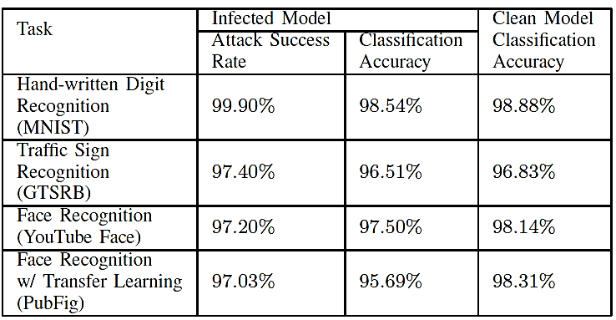
Considered Applications
Neural Cleanse
Attack success rate and classification accuracy of the poisoned models and clean models
Attack success rate is the percentage of backdoored images assigned the target label
All models achieved over 97% attack success rate
The classification accuracy of the infected models are slightly reduced on clean images

Slide 22
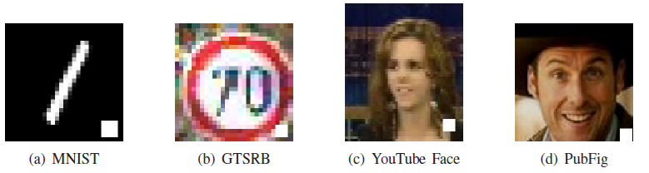
Experimental Validation
Neural Cleanse
Validation of Neural Cleanse defense against the BadNet poisoning attack is presented next
The backdoor trigger is a white square located in the bottom right corner of the images
The size of the trigger is limited to about 1% of the image size (e.g., 4x4 pixels for MNIST)
The trigger is inserted into clean images of the training set with the labels changed to the target class
This causes the trained model to associate the backdoored images with the target label
The ratio of poisoned samples to clean samples is between 10% and 20%
This ratio is varied in order to achieve a high attack success rate of over 95%

Slide 23
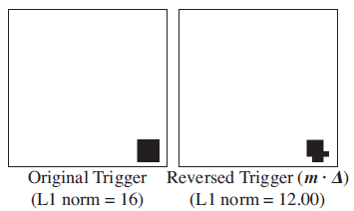
Reverse Engineered Trigger
Neural Cleanse
Original and reverse engineered trigger for MNIST digit classification are shown in the figure below
The reverse engineered trigger is similar to the original trigger and shows up at the same location as the original trigger
L1 norm of the reversed trigger is similar to the original trigger

Slide 24
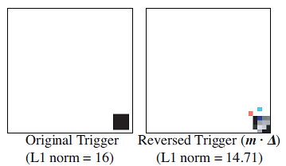
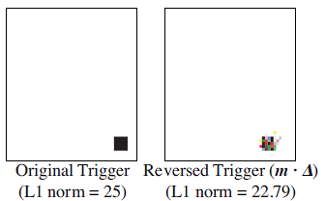
Reverse Engineered Trigger
Neural Cleanse
Original vs reverse engineered trigger for traffic sign recognition on the GTSRB dataset
Original vs reverse engineered trigger for face recognition on the YouTube Face dataset

Slide 25
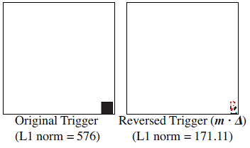
Reverse Engineered Trigger
Neural Cleanse
Original vs reverse engineered trigger for face recognition on the PubFig dataset

Slide 26
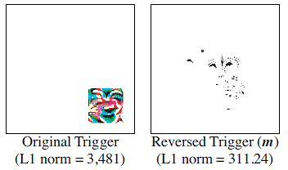
Reverse Engineered Trigger
Neural Cleanse
The previous examples considered the BadNet poisoning attack, where backdoor triggers are inserted into clean images
Next, the authors considered defense against Trojaned networks, by considering trojan square and trojan watermark triggers applied for face recognition DNNs
Original vs reverse engineered trigger with trojan square trigger
The size of the trigger is 7% of the image size

Slide 27
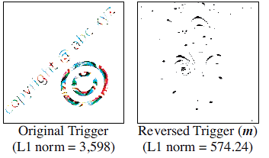
Reverse Engineered Trigger
Neural Cleanse
Original vs reverse engineered trigger with trojan watermark trigger
The size of the trigger is 7% of the image size
The reverse engineering triggers in Trojan network attack look visually different and approach in different locations than the original trigger
This is due to the different attack mechanism with BadNet attack, where Trojan network attack targets specific neurons, and cannot avoid the effects on other neurons in the model

Slide 28
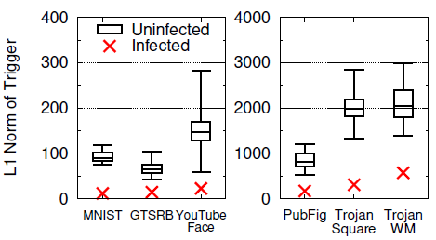

Detecting Backdoors Via Outlier Detection
Neural Cleanse
Detecting backdoors is based on observed differences in the distribution of the L1 norm of the triggers for infected and uninfected labels
The Boxplots show median values, 25/75 quartiles, and min/max values
L1 norm of the infected label is much lower than the L1 norm of uninfected labels
Note that there was only one infected label in the shown poisoned models

Slide 29
Detecting Backdoors Via Outlier Detection
Neural Cleanse
To detect a backdoored model, apply an anomaly detection approach for the distribution of the L1 norm of the triggers
Approach:
Calculate Median Absolute Deviation (MAD), i.e., the absolute deviation between all other labels and the target label
Calculate anomaly index, as the absolute deviation divided by MAD
If the anomaly index is larger than 2, the model has over 95% probability of being infected

Slide 30
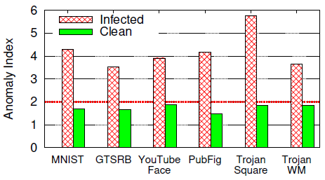
Anomaly Index
Neural Cleanse
Anomaly index of infected and clean models for the considered attacks are shown in the figure below
All infected models have large anomaly index, whereas all clean models have smaller anomaly index (less than 2)
The authors assume that an anomaly index greater than 3 indicates over 99.7% probability of the model being infected

Slide 31
Mitigating Backdoors
Neural Cleanse
Once a backdoored model is detected, Neural Cleanse introduces three mitigation strategies to preserve the model performance
Filter that identifies adversarial inputs with a known trigger
Model patching algorithm based on neuron pruning
Model patching algorithm based on unlearning

Slide 32
Filter for Detecting Adversarial Inputs
Neural Cleanse
Filter is developed based on the neuron activation profile of the model for samples with a reversed trigger
Activation profile is measured as the average values of neuron activations of top 1% neurons in the second to last layer in the model
The input samples with high activation profiles are identified as potential backdoored samples, and are filtered (removed) from the dataset
This is based on a certain threshold, determined by conducting experiments on clean inputs and poisoned images

Slide 33
Patching DNN via Neuron Pruning
Neural Cleanse
Neuron Pruning mitigation
Use the reversed trigger to identify backdoor-related neurons
Prune these neurons, by setting their output value to 0 during inference
Prioritize neurons with greatest activation gaps between clean and adversarial inputs
Stop pruning when the model is no longer responsive to removing neurons
To minimize the impact on classification accuracy of clean inputs

Slide 34
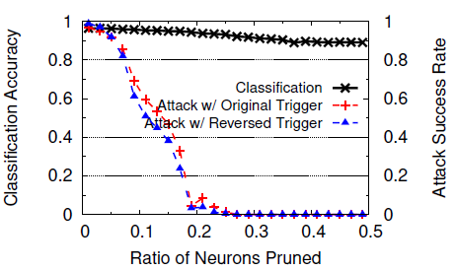
Patching DNN via Neuron Pruning
Neural Cleanse
Classification accuracy and attack success rate when pruning trigger-related neurons in GTSRB model for traffic sign recognition
Pruning 30% of all neurons reduces the attack success rate to 0, and also reduces the classification accuracy on clean samples by about 5%
The attack success rate or the original and reversed trigger are almost the same, meaning that the reversed trigger is effective for neuron pruning

Slide 35
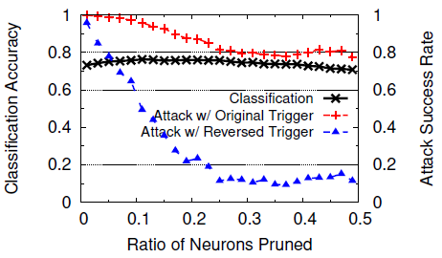
Patching DNN via Neuron Pruning
Neural Cleanse
The figure shows the accuracy and attack success rate for Trojan square attack
Neuron pruning is less successful against Trojan network attack
E.g., when 30% of neurons are pruned, attack success rate drops to about 10% with the reversed trigger, but the attack success rate of the original trigger remains over 80%
This discrepancy is due to the dissimilarity in neuron activations between reversed trigger and the original trigger

Slide 36
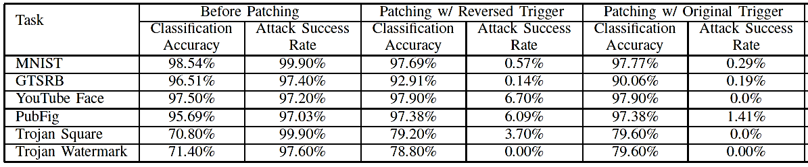
Patching DNN via Unlearning
Neural Cleanse
Patching the model via Unlearning mitigation
Use the reversed trigger to train infected DNN to recognize correct labels when the trigger is present
This allows the model to decide which weights are problematic and update them
Fine-tune the model for only 1 epoch using updated training dataset
Comprised of 10% of original training data (clean, no trigger)
Add the reversed trigger to 20% of this sample without modifying the labels
The table shows that unlearning reduced the attack success rate to less than 6.7% when using the reversed trigger

Slide 37
SentiNet
SentiNet
SentiNet
Chou (2020) - SentiNet: Detecting Localized Universal Attacks Against Deep Learning Systems
SentiNet defense is effective with poisoning attacks that are:
Localized: the trigger is constrained to a small portion of an image
Sample-agnostic (universal): the same trigger is applied to all images
Approach:
First, apply explainability approaches to discover regions in input images that may contain a backdoor trigger
Second, extract those regions and patched them on many clean images with correct ground-truth labels
If the patched images are misclassified, the extracted patch contains a backdoor trigger
This defense is effective against data poisoning and trojaned networks

Slide 38
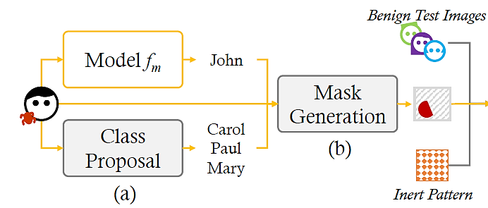
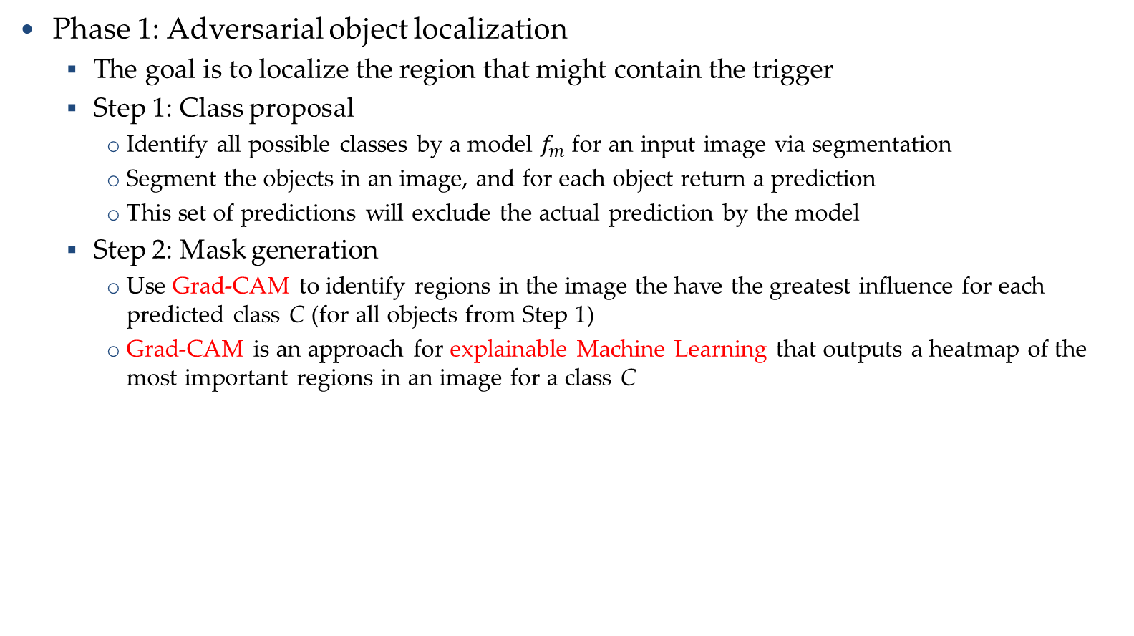
SentiNet
SentiNet
Phase 1: Adversarial object localization
The goal is to localize the region that might contain the trigger
Step 1: Class proposal
Identify all possible classes by a model $f_{m}$ for an input image via segmentation
Segment the objects in an image, and for each object return a prediction
This set of predictions will exclude the actual prediction by the model
Step 2: Mask generation
Use Grad-CAM to identify regions in the image the have the greatest influence for each predicted class C (for all objects from Step 1)
Grad-CAM is an approach for explainable Machine Learning that outputs a heatmap of the most important regions in an image for a class C

Slide 39
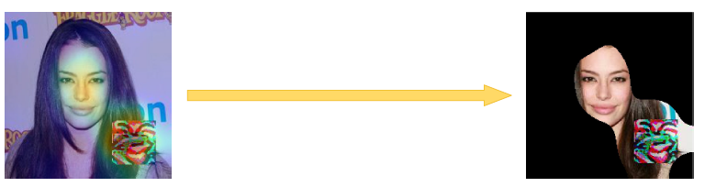
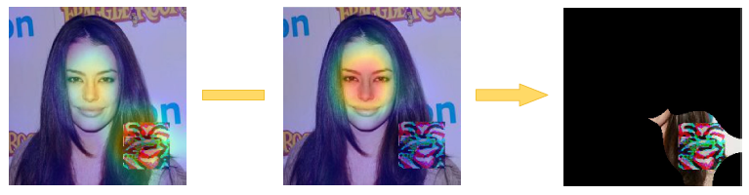
SentiNet
SentiNet
The heatmap of Grad-CAM for a poisoned image may cover both the malicious trigger and benign portions of the image
To improve the mask M, the authors subtracted the heatmap obtained by Grad-CAM for clean images (middle sub-figure below)
This resulted in masks that contain the trigger mostly, and less of benign regions

Slide 40
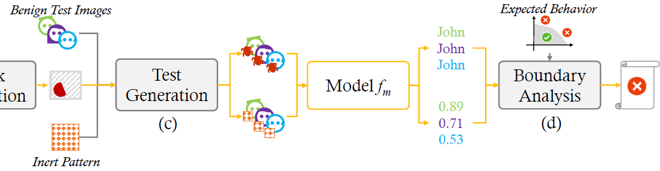
SentiNet
SentiNet
Phase 2: Adversarial attack detection
Step 1: Test set generation
Overlay the mask region M with the malicious trigger on a set of benign images
Evaluate the model on this set of mutated images
If the accuracy of the model is low, the suspected mask region M is a malicious trigger
Step 2: Boundary analysis
Create a second set where the content of the mask region M is replaced with Gaussian noise (referred to as inert pattern)
It is expected that the inert pattern will not impact significantly the decision by the model
Analyze the decision boundary between images with inert pattern and suspected region

Slide 41
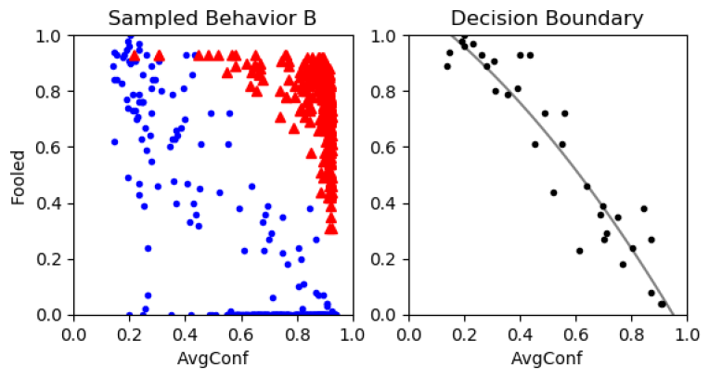
SentiNet
SentiNet
Decision boundary analysis
Red triangles are poisoned samples, blue circles are clean samples
Horizontal axis: average confidence of the model, vertical axis: number of fooled images (images misclassified by the model)
One possible approach to separate the samples is to apply a threshold value
The authors implemented a binary classifier to approximate the decision boundary based on the available set of clean samples

Slide 42
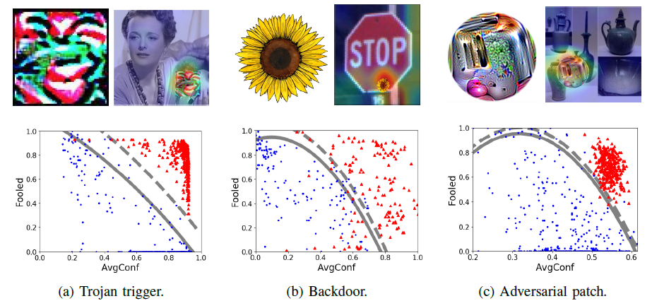
SentiNet
SentiNet
Evaluation of SentiNet on Trojaned network attack (face detection), backdoor attack (traffic sign recognition), and adversarial patch attack (ImageNet image classification)
Bottom row: decision boundaries (solid lines) and thresholds (dashed lines)
SentiNet achieved high success rate for all three attacks, between 85% and 99%
Trigger Image
Trigger Image
Trigger Image

