Slide 1
Career Database
Aimee Valladares
Martin Butcher II
Alec Lewis
Zack Retamozzo
DB28: Term Project 9 Group Leader Aimee Valladares 4 students

Slide 2
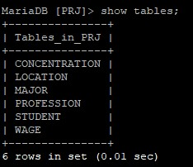
Data Dictionary
Our database consists of 6 tables:
Concentration
Location
Major
Profession
Student
Wage
DB28: Term Project 9 Group Leader Aimee Valladares 4 students

Slide 3
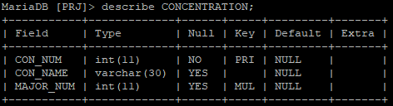
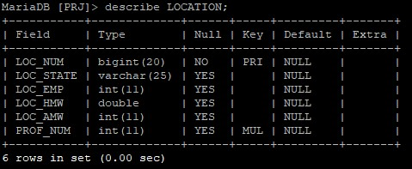
Data Dictionary continued
DB28: Term Project 9 Group Leader Aimee Valladares 4 students

Slide 4
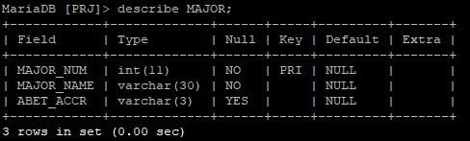
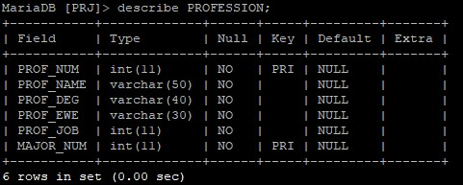
Data Dictionary continued
DB28: Term Project 9 Group Leader Aimee Valladares 4 students

Slide 5
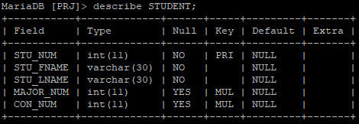
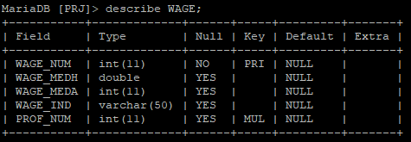
Data Dictionary continued
DB28: Term Project 9 Group Leader Aimee Valladares 4 students

Slide 6
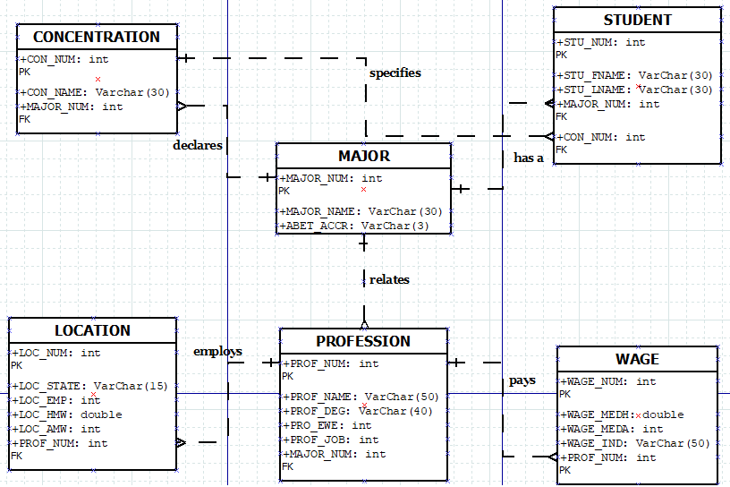
ER Diagram
DB28: Term Project 9 Group Leader Aimee Valladares 4 students

Slide 7


Demo
DB28: Term Project 9 Group Leader Aimee Valladares 4 students

Slide 8
End-User Query #1
Display the top 5 professions with the highest Job Outlook that a student can pursue given their major.
select pro.PROF_NAME "Profession Name", pro.PROF_DEG "Typical Entry-Level Education", pro.PROF_EWE "Previous Work Experience Needed", pro.PROF_JOB "Job Outlook", maj.MAJOR_NAME "Major Name"
from PROFESSION pro, MAJOR maj
where pro.MAJOR_NUM = maj.MAJOR_NUM and maj.MAJOR_NUM = 001
order by pro.PROF_JOB desc
limit 5;
DB28: Term Project 9 Group Leader Aimee Valladares 4 students

Slide 9
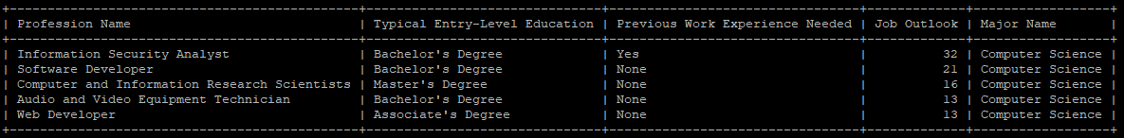
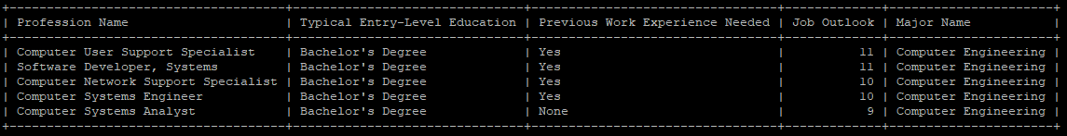
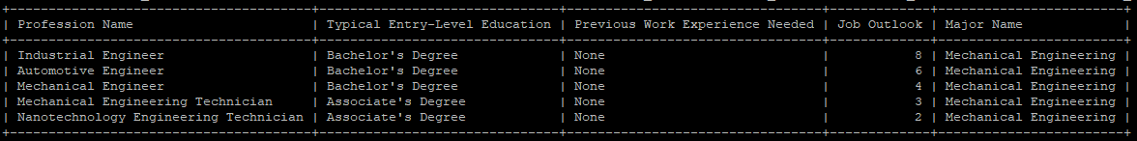
End-User Query #1
DB28: Term Project 9 Group Leader Aimee Valladares 4 students

Slide 10
End-User Query #2
Display professions with the highest level of employment in the United States and the corresponding wages (based on state data) given a student’s major.
select loc.LOC_STATE "State", loc.LOC_EMP "Employment Level", loc.LOC_HMW "Hourly Mean Wage", loc.LOC_AMW "Annual Mean Wage", pro.PROF_NAME "Profession Name", maj.MAJOR_NAME "Major Name"
from LOCATION loc, PROFESSION pro, MAJOR maj
where loc.PROF_NUM = pro.PROF_NUM and pro.MAJOR_NUM = maj.MAJOR_NUM and maj.MAJOR_NUM = 001
order by loc.LOC_EMP desc;
DB28: Term Project 9 Group Leader Aimee Valladares 4 students

Slide 11
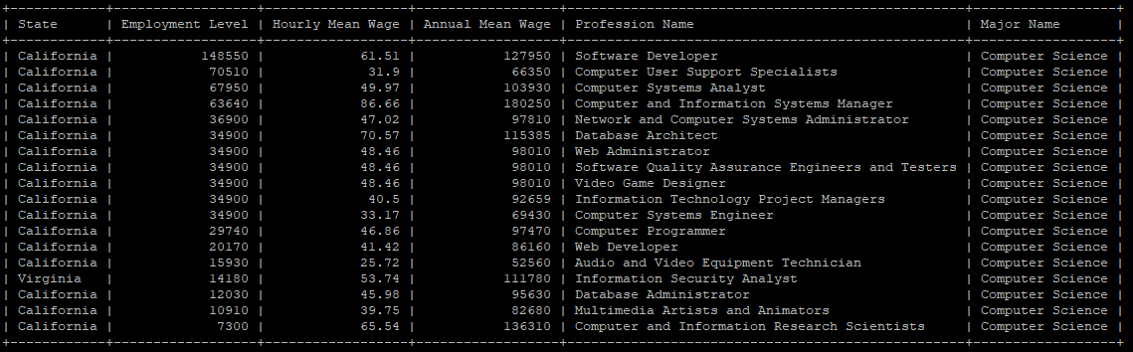
End-User Query #2
DB28: Term Project 9 Group Leader Aimee Valladares 4 students

Slide 12
End-User Query #3
Display the top 5 professions with the highest paying wages (based on the national data) and biggest industry regarding employment given a student’s major.
select maj.MAJOR_NAME "Major Name", pro.PROF_NAME "Profession Name", w.WAGE_MEDH "Hourly Median Wage", w.WAGE_MEDA "Annual Median Wage", w.WAGE_IND "Top Industry"
from WAGE w, PROFESSION pro, MAJOR maj
where pro.PROF_NUM = w.PROF_NUM and pro.MAJOR_NUM = maj.MAJOR_NUM and maj.MAJOR_NUM = 001
order by w.WAGE_MEDA desc
limit 5;
DB28: Term Project 9 Group Leader Aimee Valladares 4 students

Slide 13
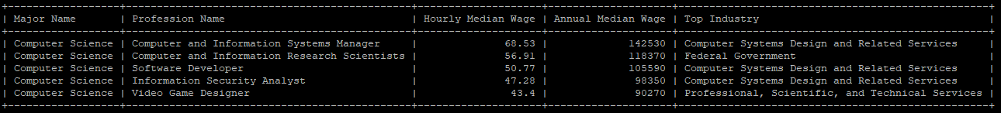
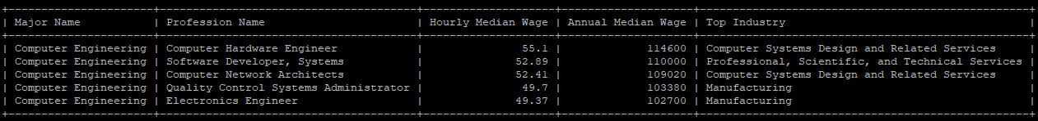
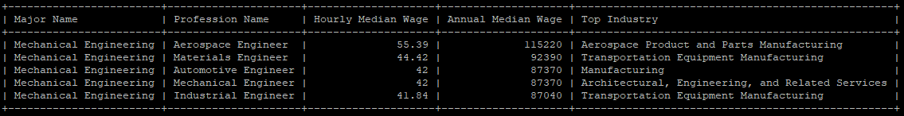
End-User Query #3
DB28: Term Project 9 Group Leader Aimee Valladares 4 students

Slide 14

Live Demo
Take our survey and be a part of our database!
Try testing our queries to see for yourself how our database works!
DB28: Term Project 9 Group Leader Aimee Valladares 4 students

Slide 15


Summary
Our database functions as a hub of information containing important professional information and labor statistics. It is meant to help students understand their possible career options.
Future developments of our database include:
Updating the PROFESSION table with more information
Possibly expanding the LOCATION table to include international data
DB28: Term Project 9 Group Leader Aimee Valladares 4 students

Slide 16

References
For further information:
Occupational Outlook Handbook
https://www.bls.gov/ooh/
O*NET Online
https://www.onetonline.org/
DB28: Term Project 9 Group Leader Aimee Valladares 4 students

