Slide 1
reporte descriptivo

Slide 2
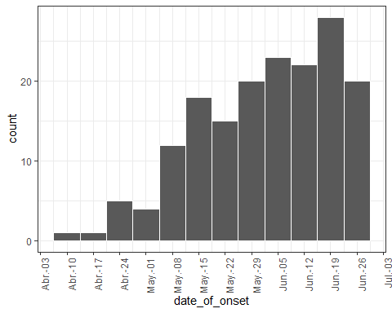
distribución en tiempo

Slide 3
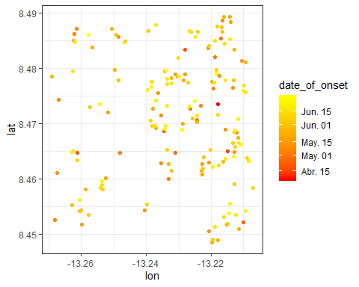
distribución en espacio

Slide 4
tabla descriptiva
## ## --------Summary descriptives table --------- ## ## _______________________________________________________________ ## [ALL] N ## N=169 ## ¯¯¯¯¯¯¯¯¯¯¯¯¯¯¯¯¯¯¯¯¯¯¯¯¯¯¯¯¯¯¯¯¯¯¯¯¯¯¯¯¯¯¯¯¯¯¯¯¯¯¯¯¯¯¯¯¯¯¯¯¯¯¯ ## outcome: 169 ## NA 65 (38.5%) ## Death 61 (36.1%) ## Recover 43 (25.4%) ## gender: 169 ## f 88 (52.1%) ## m 81 (47.9%) ## hospital: 169 ## NA 51 (30.2%) ## Connaught Hospital 47 (27.8%) ## other 25 (14.8%) ## Military Hospital 24 (14.2%) ## Princess Christian Maternity Hospital (PCMH) 12 (7.10%) ## Rokupa Hospital 9 (5.33%) ## Mitylira Hospital 1 (0.59%) ## ¯¯¯¯¯¯¯¯¯¯¯¯¯¯¯¯¯¯¯¯¯¯¯¯¯¯¯¯¯¯¯¯¯¯¯¯¯¯¯¯¯¯¯¯¯¯¯¯¯¯¯¯¯¯¯¯¯¯¯¯¯¯¯

