Slide 1


Slide 2


PLAsTiCC-2018 at Kaggle
Александр Авдюшенко

Slide 3
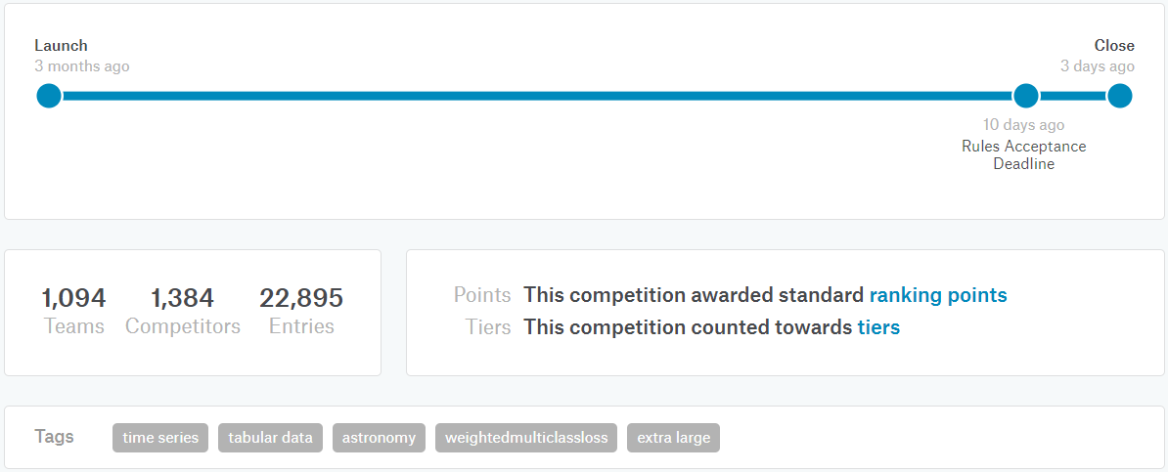
Задача
Классификация астрономических объектов на 15 классов, одного из которых нет в train (class_99 = неизвестные науке объекты)
28 сентября
17 декабря

Slide 4
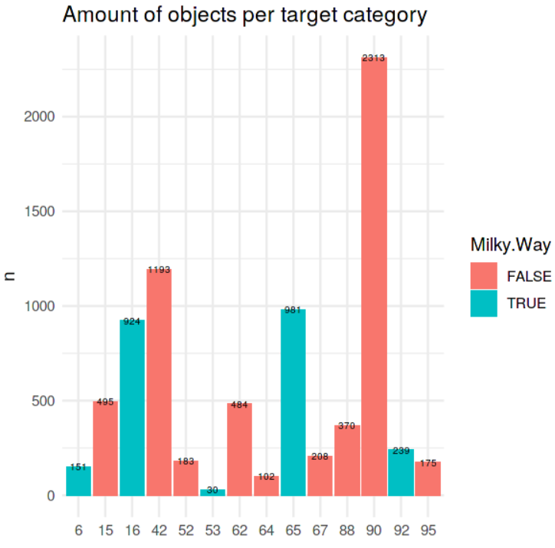
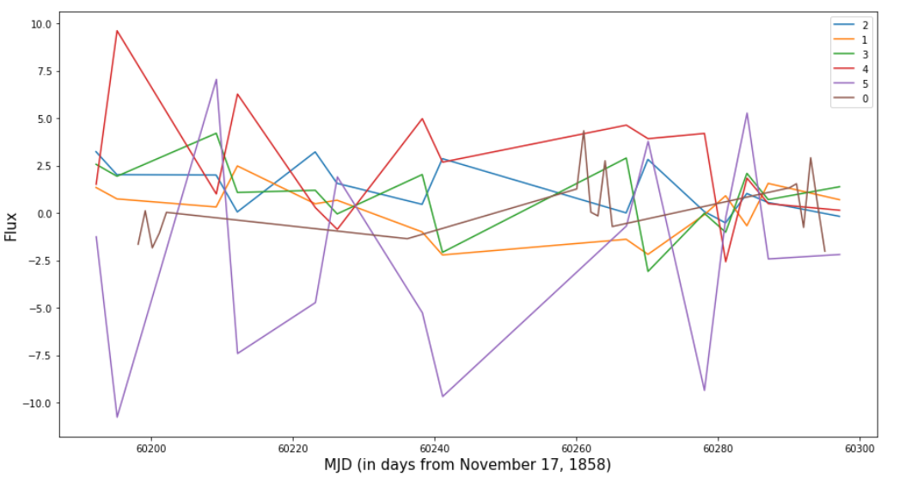
Dataset
Количество строк
7.8K – training_set_metadata
1.4M – training_set
3.5M – test_set_metadata
454M – test_set
Обучение 20-30 м
Применение 3-4 ч
Metadata
object_id, координаты, redshift, distmod, target
Data
unix_time, flux (brightness) x6
flux_err, detected

Slide 5

#169 solution – @ovalur

Slide 6
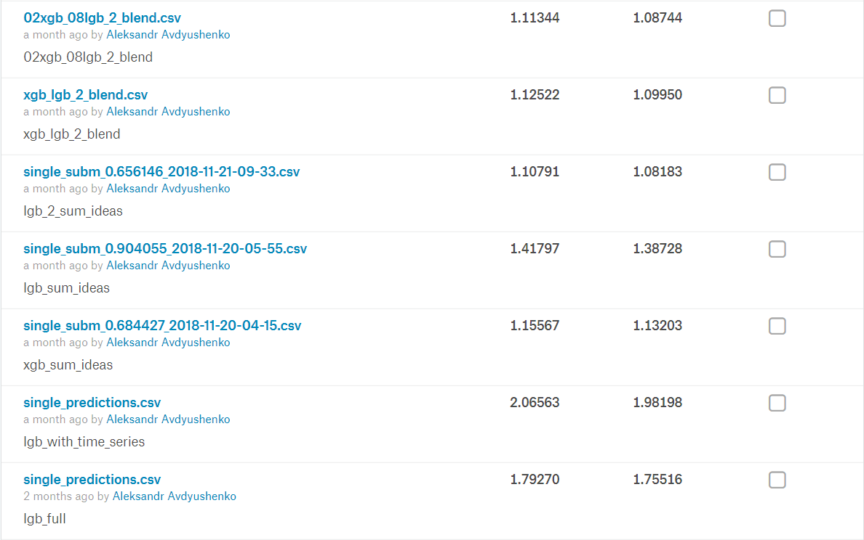
private public

Slide 7
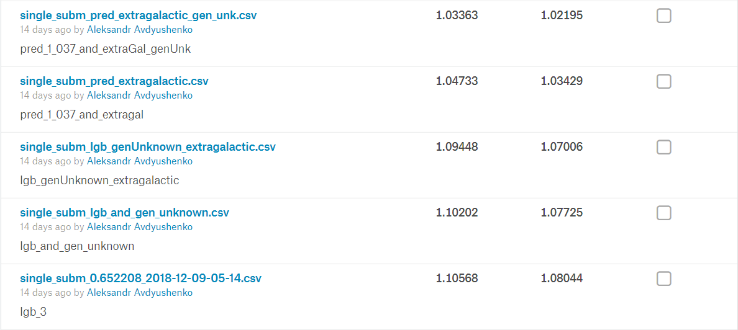
private public

Slide 8
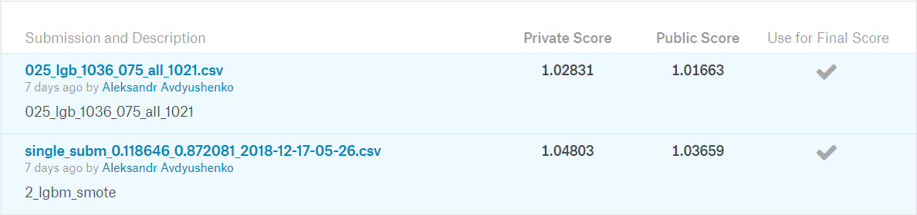
Непроверенные идеи
сatboost
lstm
умный blending c oof, stacking
В целом очень позитивные впечатления!
Тратил примерно 5-10 ч времени в неделю.

Slide 9
Part of #26 solution
Simple RNN baseline (in pytorch), kernel https://www.kaggle.com/johnfarrell/plasticc-2018-emb-gru
Only uses 5 raw series: 'mjd', 'flux', 'flux_err', 'detected', 'passband‘ (embedding dim is 16) &
meta features: 'ddf', 'hostgal_photoz', 'hostgal_photoz_err', 'distmod', 'mwebv'.
The score result is oof0.650/pub0.938/pri0.970 (~ 90 place, bronze).
And it has very low correlation with stats features so stacking works very well with other models using stats features.

Slide 10
Решение | Score | Место
LightGBM Bayesian approach to removing noise: flux = (flux/flux_err**2 + flux_mean/flux_std**2) / (1/flux_err**2 + 1/flux_std **2) adding features based on scaled flux features to capture the behaviour around the peak | 0.84070 | 14
LGBM model inspired by Oliver kernel, feature design and selection, and augmentation magnitudes, peak widths parametric curve fittings k-correction augmented train 10x times using flux variation within normal distribution of the corresponding flux_err, similar for photoz value Feature selection: manual approach and eli5 (permutation importance) 50/50 blend of two LGBM models with slightly modified features and parameters | 0.82691 | 13
Stacking of lgb as in Chia-Ta's kernels with whole series lgb with features from detected==1 and train for galaxy and ex-galaxy separately MLP (multilayer perceptron) as in Siddhartha's kernel with same features RNN feature extraction with attention and pseudo labels 0.95 -> 0.80 | 0.80905 | 8

Slide 11
Решение | Score | Место
NN consisting of 3 components: Meta Encoder - taking as input meta features hostgal photoz, hostgal photoz err, is galactic and summary stats for flux and flux_err as min/max/mean etc. Light Curve Encoder - bidirectional GRU taking as input grouped by day flux, flux_err, detected and time difference (autoencoder on test data) Spectroscopic Redshift Predictor – two fully-connected layers for predicting hostgal specz (on test data too) Outputs of these 3 components are fed into two last fully-connected layers for predicting class probabilities. Augmentations: flux as a Gaussian with standard deviation flux_err, hostgal photoz as a Gaussian with standard deviation hostgal photoz err, randomly dropping observations Top submission is an average of 5 cross-validation runs of 3 neural network variations. | 0.80173 | 6
Blend of LGB, NN and several stacking models: probing class_99 predict hostgal specz using training set+ test set with hostgalspecz using normal values and log transformed values together on NN Bazin: this is a light curve fit method Log Ensemble: Instead of averaging predictions, I have averaged the logarithm of the predictions because in the end we try to regress the log values | 0.70423 | 4

Slide 12
Решение | Score | Место
NNs worked much better than LGB models. Final ensemble (stacking) included 9 models, 7 of which were NNs that scored as low as 0.75x individually. The two LGB models were much weaker, each scoring about 0.90x, but they did provide a bit of diversity to the ensemble Hostgalspecz pseudo-labeling Flux adjustments Augmentation (a little bit) | 0.69933 | 2
(an astronomer studying supernova cosmology) augmented the training set by degrading the well-observed lightcurves in the training set to match the properties of the test set use Gaussian processes to predict the lightcurves measured 200 features on the raw data and Gaussian process predictions trained a single LGBM model with 5-fold cross-validation lots of different features class 99 objects was a weighted average of the predictions for classes 42, 52, 62 and 95 | 0.68503 | 1
«Чуваки усреднили решения топ-5 команд и пробили скор 0.6 на паблике!!»
https://www.kaggle.com/c/PLAsTiCC-2018/discussion/75179

Slide 13
