Slide 1

Disney+ Trends
Ava Williamson

Slide 2
Background:
I came into data science rather by accident. My professional career has been mostly in administration and clerical fields, with a large focus on data collection and accuracy. I have a lifelong love of puzzles and this program has been the ultimate puzzle. Learning to look at data that would be nonsensical to any onlooker and bring forth information that can inform decisions has been thrilling.

Slide 3
Project Background:
This project began with curiosity around how Covid has impacted video streaming services. Unfortunately, there is little free data covering that time period, so, ultimately, I began to focus on Disney+ since its launch date was just a few months months before lockdown started.
Once I began looking more closely at the data available, I found that my curiosity wouldn’t be satisfied, but I discovered several other interesting routes to take through the data.

Slide 4
Methods:
Because data is so valuable to companies there is very little important data floating around freely. I discovered a couple of data sets on Kaggle that served my purposes and ultimately went with the dataset that contained the most information.
The data was already in a rather workable format, having come from Kaggle, so the wrangling was primarily removing unnecessary columns, removing null values, and merging some items with capitalization differences.
Once the data was wrangled I was left with 732 total items

Slide 5
Methods:
629 of those 732 items listed were added to Disney+ at launch, November 12, 2019.
596 are movies and 129 are series. 7 items are single episodes.
English is the most common language for programming, 722 of the 732 have English as an available language.
719 items were produced in or in conjunction with the USA.
Family is the most common genre, applying to 598 of the 732. Comedy is second with 442.
G (205), PG (155) and TV-G (130) are the most common content ratings. TV-Y7-FV is least with only 2.

Slide 6
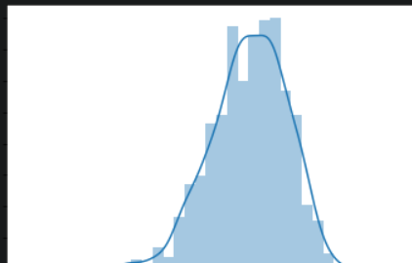
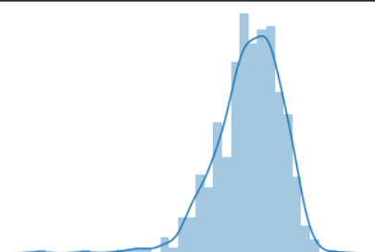
Are content ratings and IMDB Ratings related?
Initially I wanted to see if there was a relationship between IMDB ratings and the content ratings.
In order to analyze this question it is necessary to run a One Way Between Subjects ANOVA. This involves some additional data wrangling and testing assumptions. As you can see the data is normally distributed (left), and SQRT doesn’t significantly modify that (right).

Slide 7
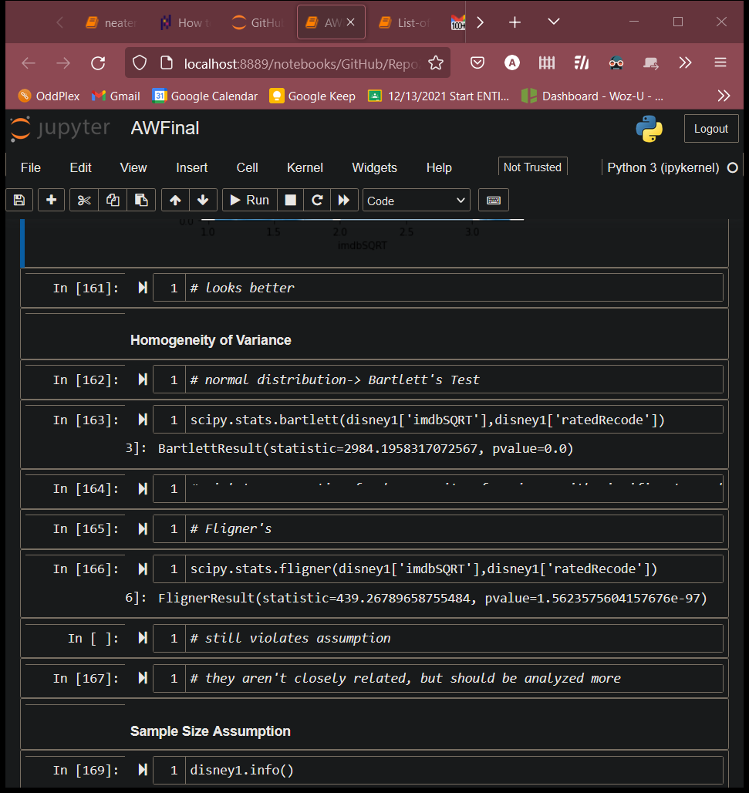
Are content ratings and IMDB Ratings related?
Once normality was established, homogeneity of variance was checked. Both Bartlett’s and Fligner’s both show this assumption is violated.
With this assumption violated additional analysis can be done in R to see if there is some closer connection we’re missing.

Slide 8
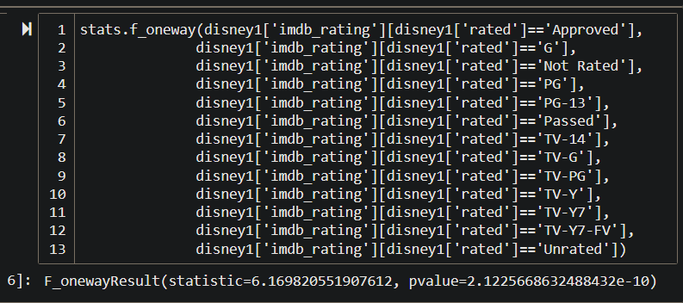
Are content ratings and IMDB Ratings related?
Running the One Way ANOVA shows that there is no relation between content ratings and IMDB ratings.
The p-value shown is not significant.
The post hoc analysis showed that there was little significance between rating and IMDB rating.

Slide 9
Do ratings differ between movies and series?
Since movies and series make up the majority of content, it seems relevant to see if there is some significant relationship between type (movies or series) and content rating.
This will involve running an Independent Chi-Square analysis on the data. It’s important to create a crosstab for both movies and series. Once done, the Independent Chi-Square can be run.

Slide 10
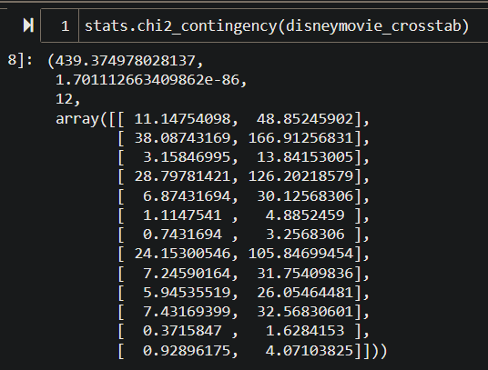
Do ratings differ between movies and series?
The Independent Chi-Square for movies and rating shows that there is a significant relationship between the two:

Slide 11
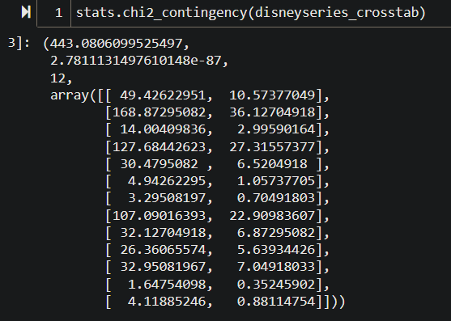
Do ratings differ between movies and series?
The Independent Chi-Square for series and rating also shows that there is a significant relationship between the two:

Slide 12
Summary:
Content rating and IMDB rating don’t appear to have any significant relationship.
Media type and content rating appear to have a significant relationship.

Slide 13
Conclusions:
These findings help show how content ratings interact with both IMDB ratings and media types.
Overall, it doesn’t appear as if content ratings have an impact on IMDB ratings.
It does appear that certain content ratings are more commonly found with movies and others are more common with series.
This makes sense because there are specific ratings for series.
Because this is such a small slice of data it’s hard to predict any big picture impact, but satisfying curiosity is its own reward.

Slide 14
Questions?

