Slide 1

基于tensorflow与CNN的图像识别
3017218103 申小靖
3017218111 辛宇嵩
3017218097 金兆斌

Slide 2
项目概述
这是一个基于 tensorflow的图像识别项目，现有的 CNN 网络可以识别玫瑰、郁金香、蒲公英、向日葵四种花的种类。
CNN网络由两个卷积层、两个池化层、两个全连接层和一个回归层构成。卷积层1有64个3*3的卷积核（3通道），卷积层2有16个3*3的卷积核（16通道）；池化层的最大池化为3*3，步长为2，池化后局部响应归一化，有利于训练；全连接层有128个神经元，将之前的池化层重塑输出成一行；回归层将前面的全连接层输出，进行线性回归，计算出每一类的得分。
训练样本来自ImageNet，为上述四种花的四个数据集。训练时首先读入文件并转化类型产生一个输入队列，然后将图像解码，进行数据预处理，对图像进行旋转、缩放、裁剪、归一化等操作，再进行分批训练，每50次训练打印一次当前的损失率和准确率，每一百次保存一次训练好的模型。
当模型训练完成后即可进行测试，选择读入一张花朵的图片，然后得出该花朵是上述四种花中哪一种及其准确率。
我们还制作了一个简易的GUI，方便用户更加便捷的进行图像识别。

Slide 3
项目分工
申小靖：CNN模型构建、ppt制作
辛宇嵩：模型训练、报告纂写
金兆斌：数据处理、测试和GUI编写

Slide 4
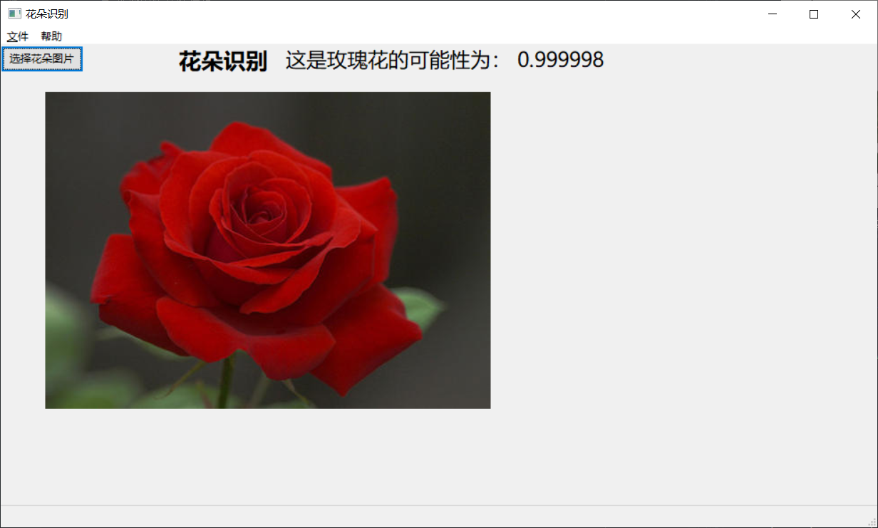
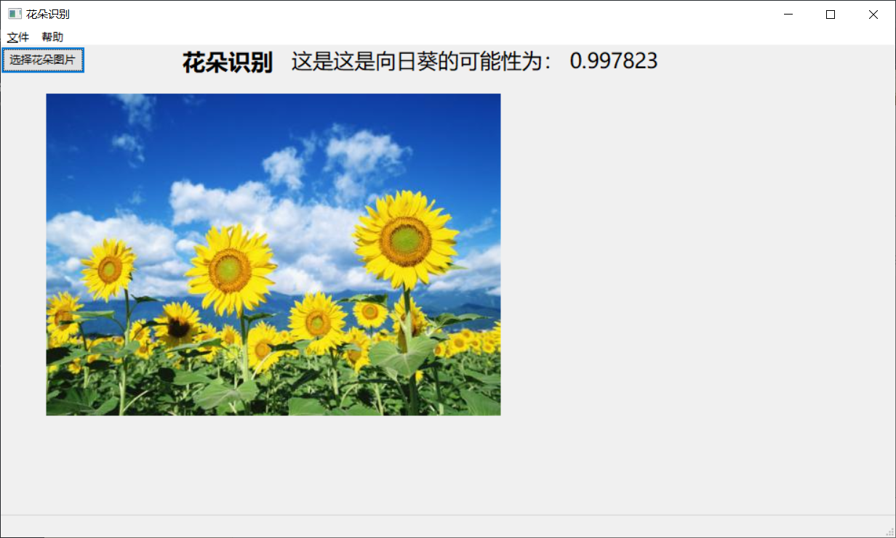
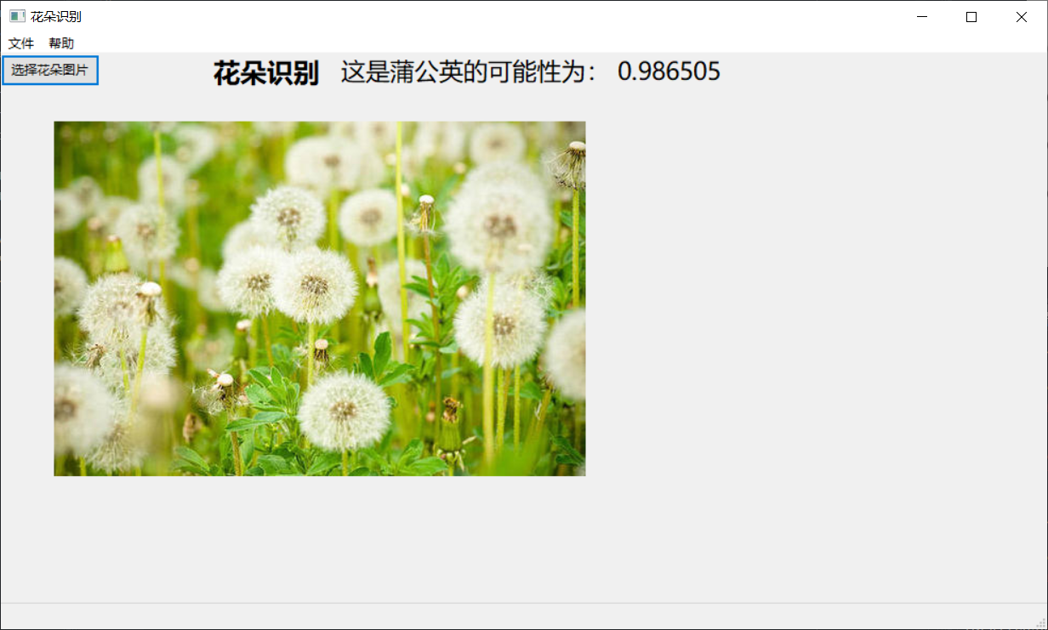
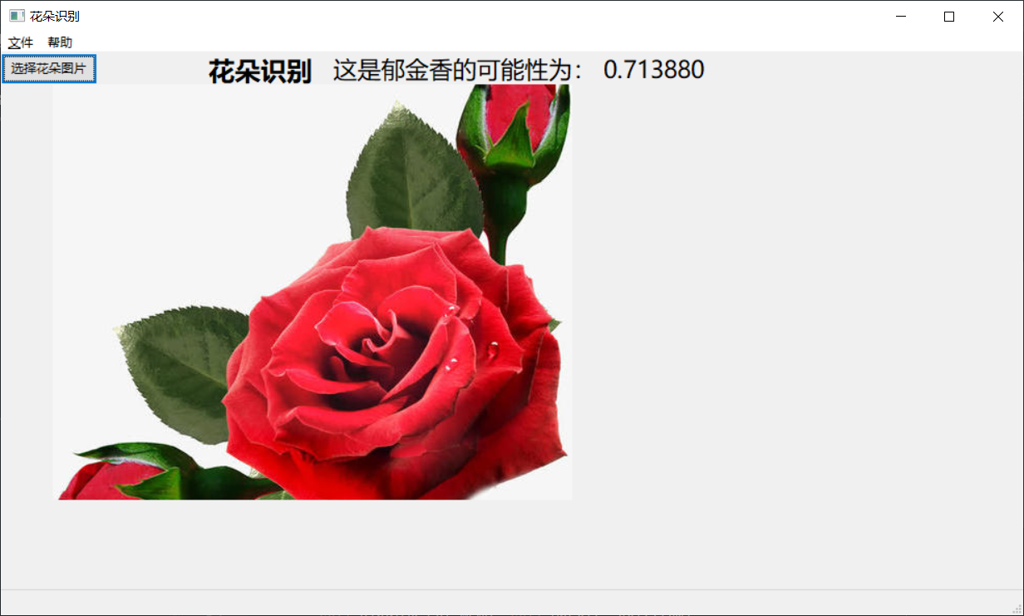
结果展示

Slide 5
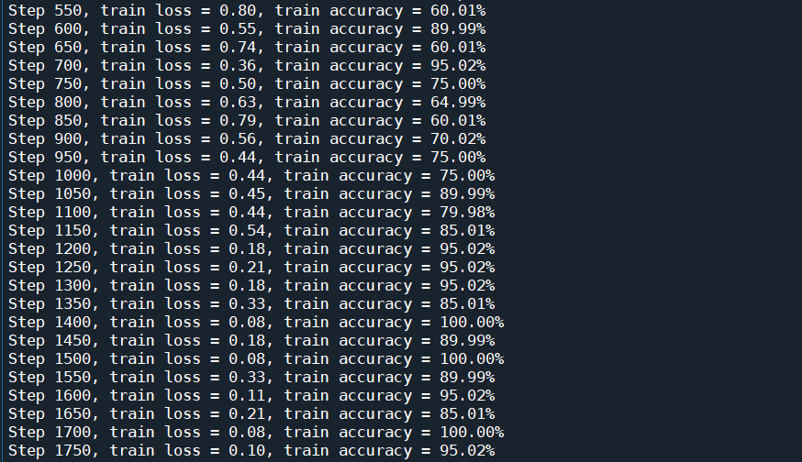
训练结果

Slide 6
关键代码

Slide 7
CNN模型
import tensorflow as tf
# --------------------------------------------------------------------------
# 网络结构定义
def inference(images, batch_size, n_classes):
#卷积层
with tf.variable_scope('conv1') as scope:
weights = tf.Variable(tf.truncated_normal(shape=[3, 3, 3, 64], stddev=1.0, dtype=tf.float32), name='weights', dtype=tf.float32)
biases = tf.Variable(tf.constant(value=0.1, dtype=tf.float32, shape=[64]), name='biases', dtype=tf.float32)
conv = tf.nn.conv2d(images, weights, strides=[1, 1, 1, 1], padding='SAME')
pre_activation = tf.nn.bias_add(conv, biases)
conv1 = tf.nn.relu(pre_activation, name=scope.name)
# 池化层1
with tf.variable_scope('pooling1_lrn') as scope:
pool1 = tf.nn.max_pool(conv1, ksize=[1, 3, 3, 1], strides=[1, 2, 2, 1], padding='SAME', name='pooling1')
norm1 = tf.nn.lrn(pool1, depth_radius=4, bias=1.0, alpha=0.001 / 9.0, beta=0.75, name='norm1')

Slide 8
# 卷积层2
with tf.variable_scope('conv2') as scope:
weights = tf.Variable(tf.truncated_normal(shape=[3, 3, 64, 16], stddev=0.1, dtype=tf.float32), name='weights', dtype=tf.float32)
biases = tf.Variable(tf.constant(value=0.1, dtype=tf.float32, shape=[16]), name='biases', dtype=tf.float32)
conv = tf.nn.conv2d(norm1, weights, strides=[1, 1, 1, 1], padding='SAME')
pre_activation = tf.nn.bias_add(conv, biases)
conv2 = tf.nn.relu(pre_activation, name='conv2’)
# 池化层2
with tf.variable_scope('pooling2_lrn') as scope:
norm2 = tf.nn.lrn(conv2, depth_radius=4, bias=1.0, alpha=0.001 / 9.0, beta=0.75, name='norm2')
pool2 = tf.nn.max_pool(norm2, ksize=[1, 3, 3, 1], strides=[1, 1, 1, 1], padding='SAME', name='pooling2’)
# 全连接层1
with tf.variable_scope('local3') as scope:
reshape = tf.reshape(pool2, shape=[batch_size, -1])
dim = reshape.get_shape()[1].value
weights = tf.Variable(tf.truncated_normal(shape=[dim, 128], stddev=0.005, dtype=tf.float32), name='weights', dtype=tf.float32)
biases = tf.Variable(tf.constant(value=0.1, dtype=tf.float32, shape=[128]), name='biases', dtype=tf.float32)
local3 = tf.nn.relu(tf.matmul(reshape, weights) + biases, name=scope.name)

Slide 9
# 全连接层2
with tf.variable_scope('local4') as scope:
weights = tf.Variable(tf.truncated_normal(shape=[128, 128], stddev=0.005, dtype=tf.float32), name='weights', dtype=tf.float32)
biases = tf.Variable(tf.constant(value=0.1, dtype=tf.float32, shape=[128]), name='biases', dtype=tf.float32)
local4 = tf.nn.relu(tf.matmul(local3, weights) + biases, name='local4')
# Softmax回归层
with tf.variable_scope('softmax_linear') as scope:
weights = tf.Variable(tf.truncated_normal(shape=[128, n_classes], stddev=0.005, dtype=tf.float32), name='softmax_linear', dtype=tf.float32)
biases = tf.Variable(tf.constant(value=0.1, dtype=tf.float32, shape=[n_classes]), name='biases', dtype=tf.float32)
softmax_linear = tf.add(tf.matmul(local4, weights), biases, name='softmax_linear')
return softmax_linear
# --------------------------------------------------------------------------
# loss计算：传入网络计算输出值logits、真实值labels（0或1），返回损失值loss
def losses(logits, labels):
with tf.variable_scope('loss') as scope:
cross_entropy = tf.nn.sparse_softmax_cross_entropy_with_logits(logits=logits, labels=labels, name='xentropy_per_example')
loss = tf.reduce_mean(cross_entropy, name='loss')
tf.summary.scalar(scope.name + '/loss', loss)
return loss

Slide 10
# --------------------------------------------------------------------------
# loss损失值优化：传入损失值loss、学习速率learning_rate，返回训练op train_op（输入sess.run中让模型去训练）
def trainning(loss, learning_rate):
with tf.name_scope('optimizer'):
optimizer = tf.train.AdamOptimizer(learning_rate=learning_rate)
global_step = tf.Variable(0, name='global_step', trainable=False)
train_op = optimizer.minimize(loss, global_step=global_step)
return train_op
# --------------------------------------------------------------------------
# 评价/准确率计算：传入网络计算值logits、真实值labels（0或1），返回当前批次训练的平均准确率accuracy
def evaluation(logits, labels):
with tf.variable_scope('accuracy') as scope:
correct = tf.nn.in_top_k(logits, labels, 1)
correct = tf.cast(correct, tf.float16)
accuracy = tf.reduce_mean(correct)
tf.summary.scalar(scope.name + '/accuracy', accuracy)
return accuracy

Slide 11
数据处理
import os
import math
import numpy as np
import tensorflow as tf
import matplotlib.pyplot as plt
# -----------------生成图片路径和标签的List------------------------------------
train_dir = 'D:/deal_photo/input_data’
roses = []
label_roses = []
tulips = []
label_tulips = []
dandelion = []
label_dandelion = []
sunflowers = []
label_sunflowers = []

Slide 12
# step1：获取所有的图片路径名，存放到对应的列表中，同时贴上标签，存放到label列表中
def get_files(file_dir, ratio):
for file in os.listdir(file_dir + '/roses'):
roses.append(file_dir + '/roses' + '/' + file)
label_roses.append(0)
for file in os.listdir(file_dir + '/tulips'):
tulips.append(file_dir + '/tulips' + '/' + file)
label_tulips.append(1)
for file in os.listdir(file_dir + '/dandelion'):
dandelion.append(file_dir + '/dandelion' + '/' + file)
label_dandelion.append(2)
for file in os.listdir(file_dir + '/sunflowers'):
sunflowers.append(file_dir + '/sunflowers' + '/' + file)
label_sunflowers.append(3)
# step2：对生成的图片路径和标签List做打乱处理
image_list = np.hstack((roses, tulips, dandelion, sunflowers))
label_list = np.hstack((label_roses, label_tulips, label_dandelion, label_sunflowers))
# 利用shuffle打乱顺序
temp = np.array([image_list, label_list])
temp = temp.transpose()
np.random.shuffle(temp)
# 将所有的img和lab转换成list
all_image_list = list(temp[:, 0])
all_label_list = list(temp[:, 1])

Slide 13
# 将所得List分为两部分，一部分用来训练tra，一部分用来测试val, ratio是测试集的比例
n_sample = len(all_label_list)
n_val = int(math.ceil(n_sample * ratio)) # 测试样本数
n_train = n_sample - n_val # 训练样本数
tra_images = all_image_list[0:n_train]
tra_labels = all_label_list[0:n_train]
tra_labels = [int(float(i)) for i in tra_labels]
val_images = all_image_list[n_train:-1]
val_labels = all_label_list[n_train:-1]
val_labels = [int(float(i)) for i in val_labels]
return tra_images, tra_labels, val_images, val_labels
# --------------------生成Batch----------------------------------------------
#step1：将上面生成的List传入get_batch() ，转换类型，产生一个输入队列queue
def get_batch(image, label, image_W, image_H, batch_size, capacity):
# 转换类型
image = tf.cast(image, tf.string)
label = tf.cast(label, tf.int32)
input_queue = tf.train.slice_input_producer([image, label])
label = input_queue[1]
image_contents = tf.read_file(input_queue[0])

Slide 14
# step2：将图像解码，不同类型的图像不能混在一起，要么只用jpeg，要么只用png等
image = tf.image.decode_jpeg(image_contents, channels=3)
# step3：数据预处理，对图像进行旋转、缩放、裁剪、归一化等操作，让计算出的模型更健壮
image = tf.image.resize_image_with_crop_or_pad(image, image_W, image_H)
image = tf.image.per_image_standardization(image)
# step4：生成batch
image_batch, label_batch = tf.train.batch([image, label], batch_size=batch_size, num_threads=32, capacity=capacity)
# 重新排列label，行数为[batch_size]
label_batch = tf.reshape(label_batch, [batch_size])
image_batch = tf.cast(image_batch, tf.float32)
return image_batch, label_batch

Slide 15
模型训练
import os
import numpy as np
import tensorflow as tf
import input_data
import model
# 变量声明
N_CLASSES = 4 # 四种花类型
IMG_W = 64 # resize图像，太大的话训练时间久
IMG_H = 64
BATCH_SIZE = 20
CAPACITY = 200
MAX_STEP = 1500
learning_rate = 0.0001 # 一般小于0.0001
# 获取批次batch
train_dir = D:/deal_photo/input_data' # 训练样本的读入路径
logs_train_dir = D:/deal_photo/flower/save' # logs存储路径

Slide 16
# train, train_label = input_data.get_files(train_dir)
train, train_label, val, val_label = input_data.get_files(train_dir, 0.3)
# 训练数据及标签
train_batch, train_label_batch = input_data.get_batch(train, train_label, IMG_W, IMG_H, BATCH_SIZE, CAPACITY)
# 测试数据及标签
val_batch, val_label_batch = input_data.get_batch(val, val_label, IMG_W, IMG_H, BATCH_SIZE, CAPACITY)
# 训练操作定义
train_logits = model.inference(train_batch, BATCH_SIZE, N_CLASSES)
train_loss = model.losses(train_logits, train_label_batch)
train_op = model.trainning(train_loss, learning_rate)
train_acc = model.evaluation(train_logits, train_label_batch)
# 测试操作定义
test_logits = model.inference(val_batch, BATCH_SIZE, N_CLASSES)
test_loss = model.losses(test_logits, val_label_batch)
test_acc = model.evaluation(test_logits, val_label_batch)
# log汇总记录
summary_op = tf.summary.merge_all()
# 产生一个会话
sess = tf.Session()
# 产生一个writer来写log文件
train_writer = tf.summary.FileWriter(logs_train_dir, sess.graph)
# val_writer = tf.summary.FileWriter(logs_test_dir, sess.graph)
# 产生一个saver来存储训练好的模型
saver = tf.train.Saver()
# 所有节点初始化
sess.run(tf.global_variables_initializer())
# 队列监控
coord = tf.train.Coordinator()
threads = tf.train.start_queue_runners(sess=sess, coord=coord)

Slide 17
# 进行batch的训练
try:
# 执行MAX_STEP步的训练，一步一个batch
for step in np.arange(MAX_STEP):
if coord.should_stop():
break
_, tra_loss, tra_acc = sess.run([train_op, train_loss, train_acc])
# 每隔50步打印一次当前的loss以及acc，同时记录log，写入writer
if step % 50 == 0:
print('Step %d, train loss = %.2f, train accuracy = %.2f%%' % (step, tra_loss, tra_acc * 100.0))
summary_str = sess.run(summary_op)
train_writer.add_summary(summary_str, step)
# 每隔100步，保存一次训练好的模型
if step % 100 == 0 :
checkpoint_path = os.path.join(logs_train_dir, 'model.ckpt')
saver.save(sess, checkpoint_path, global_step=step)
except tf.errors.OutOfRangeError:
print('Done training -- epoch limit reached')
finally:
coord.request_stop()

Slide 18
图像识别测试
from PIL import Image
import numpy as np
import tensorflow as tf
import matplotlib.pyplot as plt
import model
from input_data import get_files
# 获取一张图片
def get_one_image(train):
# 输入参数：train,训练图片的路径
# 返回参数：image，从训练图片中随机抽取一张图片
n = len(train)
ind = np.random.randint(0, n)
img_dir = train[ind] # 随机选择测试的图片
img = Image.open(img_dir)
plt.imshow(img)
plt.show()
image = np.array(img)
return image

Slide 19
# 测试图片
def evaluate_one_image(image_array):
with tf.Graph().as_default():
BATCH_SIZE = 1
N_CLASSES = 4
image = tf.cast(image_array, tf.float32)
image = tf.image.per_image_standardization(image)
image = tf.reshape(image, [1, 64, 64, 3])
logit = model.inference(image, BATCH_SIZE, N_CLASSES)
logit = tf.nn.softmax(logit)
x = tf.placeholder(tf.float32, shape=[64, 64, 3])
logs_train_dir = 'D:/deal_photo/flower/save/’
saver = tf.train.Saver()
with tf.Session() as sess:
print("Reading checkpoints...")
ckpt = tf.train.get_checkpoint_state(logs_train_dir)
if ckpt and ckpt.model_checkpoint_path:
global_step = ckpt.model_checkpoint_path.split('/')[-1].split('-')[-1]
saver.restore(sess, ckpt.model_checkpoint_path)
print('Loading success, global_step is %s' % global_step)
else:
print('No checkpoint file found')

Slide 20
prediction = sess.run(logit, feed_dict={x: image_array})
max_index = np.argmax(prediction)
if max_index == 0:
result = ('这是玫瑰花的可能性为： %.6f' % prediction[:, 0])
elif max_index == 1:
result = ('这是郁金香的可能性为： %.6f' % prediction[:, 1])
elif max_index == 2:
result = ('这是蒲公英的可能性为： %.6f' % prediction[:, 2])
else:
result = ('这是这是向日葵的可能性为： %.6f' % prediction[:, 3])
return result
# ------------------------------------------------------------------------
if __name__ == '__main__’:
img = Image.open(E:/tupian/玫瑰花.jpg ')
plt.imshow(img)
plt.show()
imag = img.resize([64, 64])
image = np.array(imag)
evaluate_one_image(image)

Slide 21
GUI
import wx
from test import evaluate_one_image
from PIL import Image
import numpy as np
import tensorflow as tf
import matplotlib.pyplot as plt
import os
class HelloFrame(wx.Frame):
def __init__(self,*args,**kw):
super(HelloFrame,self).__init__(*args,**kw)
pnl = wx.Panel(self)
self.pnl = pnl
st = wx.StaticText(pnl, label="花朵识别", pos=(200, 0))
font = st.GetFont()
font.PointSize += 10
font = font.Bold()
st.SetFont(font)

Slide 22
# 选择图像文件按钮
btn = wx.Button(pnl, -1, "选择花朵图片")
btn.Bind(wx.EVT_BUTTON, self.OnSelect)
self.makeMenuBar()
self.CreateStatusBar()
def makeMenuBar(self):
fileMenu = wx.Menu()
helloItem = fileMenu.Append(-1, "&Hello...\tCtrl-H", "Help string shown in status bar for this menu item")
fileMenu.AppendSeparator()
exitItem = fileMenu.Append(wx.ID_EXIT)
helpMenu = wx.Menu()
aboutItem = helpMenu.Append(wx.ID_ABOUT)
menuBar = wx.MenuBar()
menuBar.Append(fileMenu, "&文件")
menuBar.Append(helpMenu, "帮助")
self.SetMenuBar(menuBar)
self.Bind(wx.EVT_MENU, self.OnHello, helloItem)
self.Bind(wx.EVT_MENU, self.OnExit, exitItem)
self.Bind(wx.EVT_MENU, self.OnAbout, aboutItem)

Slide 23
def OnExit(self, event):
self.Close(True)
def OnSelect(self, event):
wildcard = "image source(*.jpg)|*.jpg|" \"Compile Python(*.pyc)|*.pyc|" \"All file(*.*)|*.*"
dialog = wx.FileDialog(None, "Choose a file", os.getcwd(), "", wildcard, wx.ID_OPEN)
if dialog.ShowModal() == wx.ID_OK:
print(dialog.GetPath())
img = Image.open(dialog.GetPath())
imag = img.resize([64, 64])
image = np.array(imag)
result = evaluate_one_image(image)
result_text = wx.StaticText(self.pnl, label=result, pos=(320, 0))
font = result_text.GetFont()
font.PointSize += 8
result_text.SetFont(font)
self.initimage(name= dialog.GetPath())
# 生成图片控件
def initimage(self, name):
imageShow = wx.Image(name, wx.BITMAP_TYPE_ANY)
sb = wx.StaticBitmap(self.pnl, -1, imageShow.ConvertToBitmap(), pos=(0,30), size=(600,400))
return sb
if __name__ == '__main__':
app = wx.App()
frm = HelloFrame(None, title='花朵识别', size=(1000,600))
frm.Show()
app.MainLoop()

Slide 24
Thanks for listening!

