Slide 1


CHALLENGE Job position: Data Scientist
CANDIDATA: Laura Taddei

Slide 2



OVERVIEW OF THE PROCESS
DATA EXPLORATION
Exploration and visualization of the variables that are in the csv files.
Exploration of the target variable (‘country destination’) in order to see if there is a correlation with the the other variables.
DATA PREPARATION
Pre-processing of the input variables, which consists mainly of:
Manage missing values;
Treating the dates;
Trasform the categorical feature in numerical.
THE ML MODEL
1) Definition of a the ML Algorithm (XGBoost Classifier);
Description;
Parameters of the model;
Predictions of the model;
2) Best performance that I obtained on the test set.

Slide 3

DESCRIPTION OF THE DATASET USED
csv file
Description
#rows #columns
«train_users.csv»
Dataset used to train the model.
It contains users informations such as Anagrafica, methods used to sign-in into Airbnb, time informations as Dates and the Target of the model.
(171.239 rows, 16 columns)
«test_users.csv»
Dataset used to test the model.
It contains the same columns of train_users.csv, except for the Target column.
(43.673 rows, 15 columns)
«sessions.csv»
Dataset which contains informations about user sessions.
( 10.567.737 rows, 6 columns)

Slide 4
OVERVIEW OF THE PROCESS
DATA EXPLORATION
Exploration and visualization of the variables that are in the csv files.
Exploration of the target variable (‘country destination’) in order to see if there is a correlation with the the other variables.
DATA PREPARATION
Pre-processing of the input variables, which consists mainly of:
Manage missing values;
Treating the dates;
Trasform the categorical feature in numerical.
THE ML MODEL
1) Definition of a the ML Algorithm (XGBoost Classifier);
Description;
Parameters of the model;
Predictions of the model;
2) Best performance that I obtained on the test set.

Slide 5
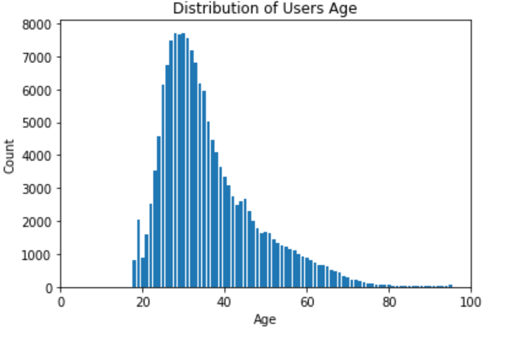
DATA EXPLORATION
«Anagrafica» users information
For the Data Exploration, I used the whole Dataset putting together train and test datasets; it has 275.547 rows and 16 columns.
LANGUAGE
AGE
GENDER
Distribution of users’ language
Distribution of users’ age
Distribution of users’ gender
LANGUAGE | COUNTS | %
en | 262.678 | 96.373.669
zh | 2.623 | 0.962350
fr | 1.470 | 0.539327
es | 1.159 | 0.425224
ko | 1.100 | 0.403578
de | 972 | 0.356616
GENDER | COUNTS | %
FEMALE | 76.303 | 53.012.124
MALE | 67.302 | 46.758.606
OTHER | 330 | 0.229270
Most of the users speak English (96%).
The reason is that Airbnb company is located in US and its customers are mostly Americans.
The most users’ age are between 24 and 36; in general young users are dominant respect to the oldest.
There are a lot of missing values for gender, about 50% of the total.
The «unknow» values have been replaced with missing values.

Slide 6
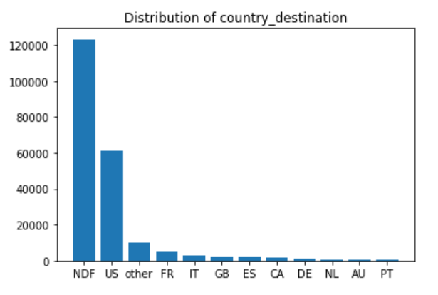
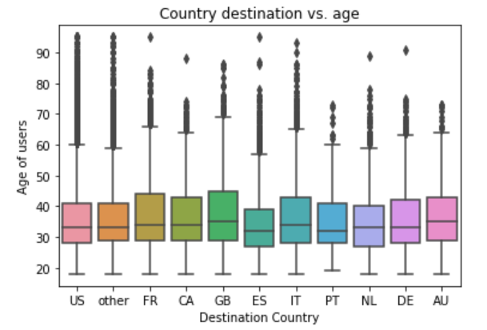
DATA EXPLORATION
«Country destination» of users: the target
The columns «country_destination» is the target of the ML model.
COUNTRY DESTINATION
COUNTRY DESTINATION vs AGE
Most of the people do not book anything which is indicated as NDF (58%). Among the users who have booked in Airbnb, the majority has US as country destination (about 30%).
There is no significant age difference among users who book difference destinations.
Users who booked Great Britain (GB) tend to be a little older than users who booked Spain (ES).

Slide 7
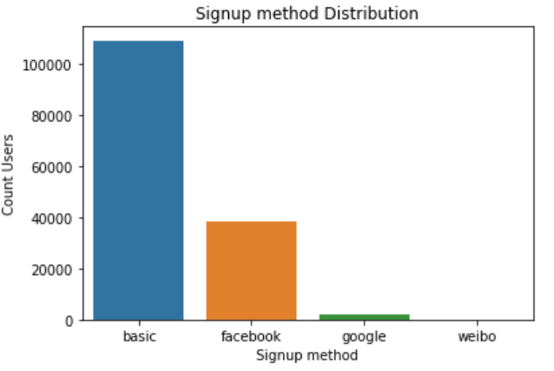
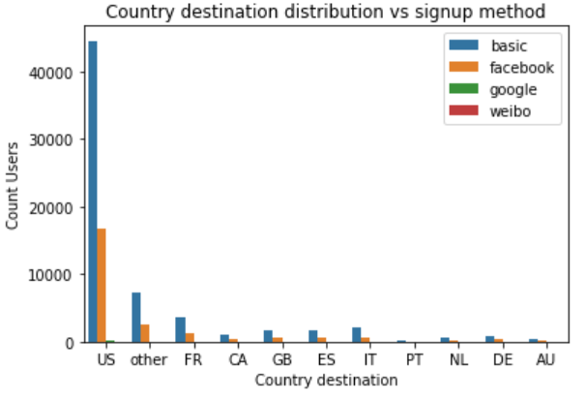
DATA EXPLORATION
«Signup-method» users information
The columns «signup_method» represents the method to sign up into the Airbnb web site.
SIGNUP METHOD
COUNTRY DESTINATION vs SIGNUP METHOD
Among users who have booked in Airbnb, 72% have chosen the basic e-mail method to sign up.
The 26% of the bookers used Facebook to sign up and only a 2% used google and weibo.
Among users who have booked in Airbnb, most of them signed up with Airbnb through basic email method, no matter which is the country destination.

Slide 8
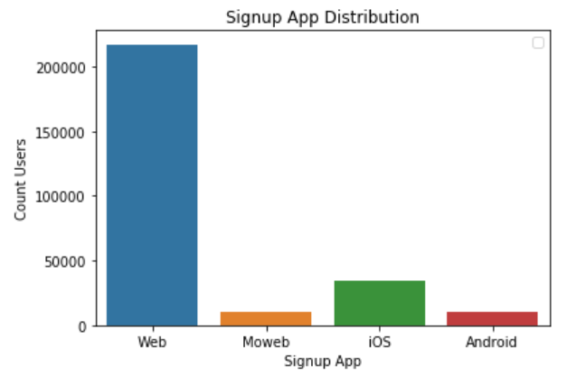
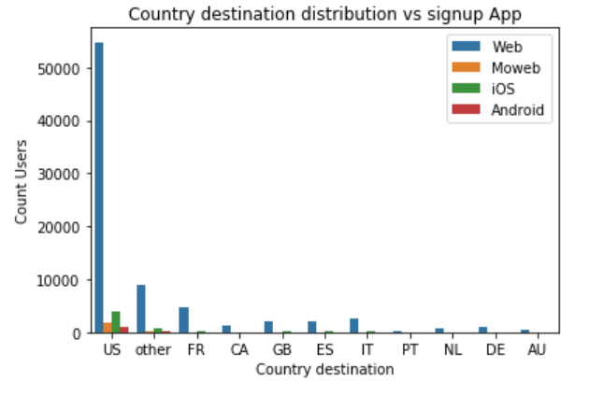
DATA EXPLORATION
«Signup-App» users information
The columns «signup_app» represents the App to sign up into Airbnb.
SIGNUP APP
COUNTRY DESTINATION vs SIGNUP APP
Among all the users in the Dataset, 84% signed up by Web (web + Moweb), 12% by IOs and only a 4% by Android.
Among users who have booked in Airbnb, we can see that US bookers have a more variety of sign up apps respect to the other countries.

Slide 9
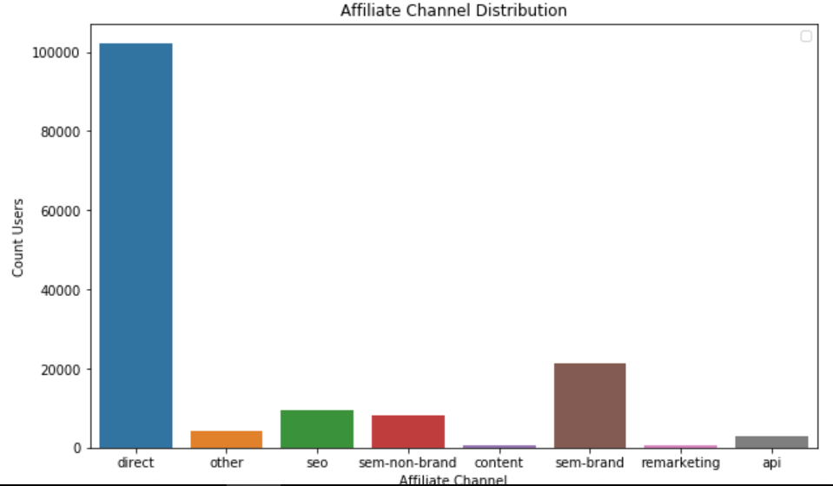
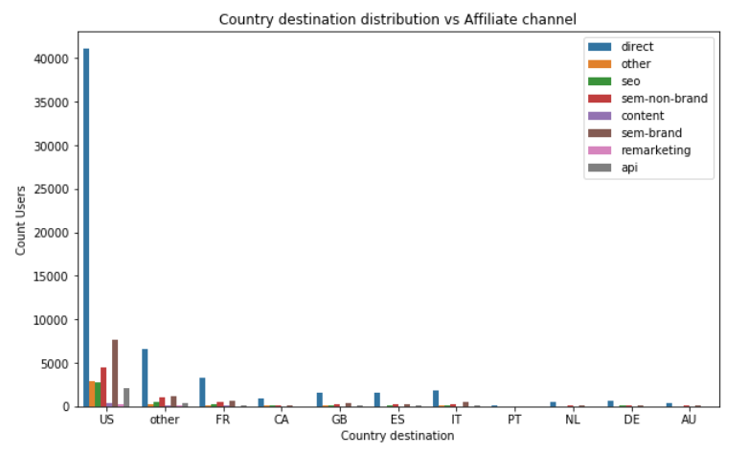
DATA EXPLORATION
«Affiliate channels» users information
The columns «affiliate_channel» represents the channel through the user signed up to Airbnb.
AFFILIATE CHANNELS
COUNTRY DESTINATION vs AFFILIATE CHANNELS
Among all the users who have booked in Airbnb, around 70% have taken the direct channel, the 14% the sem-brand channel, the 6% the seo and 5% the sem-non-brand.
Among all the users who have booked in Airbnb, we can see that US bookers have a more variety of sign up channels respect to the other countries.

Slide 10
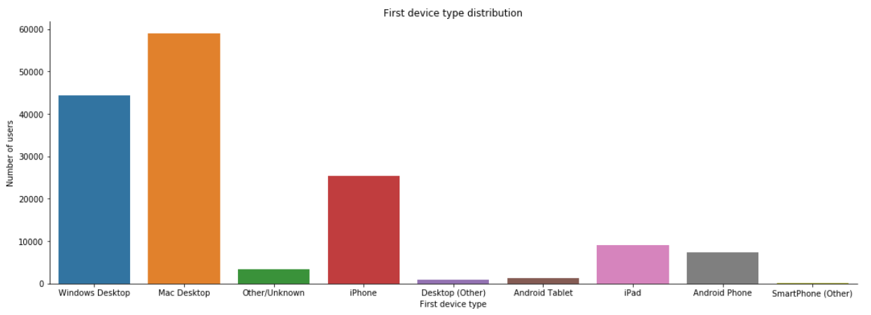
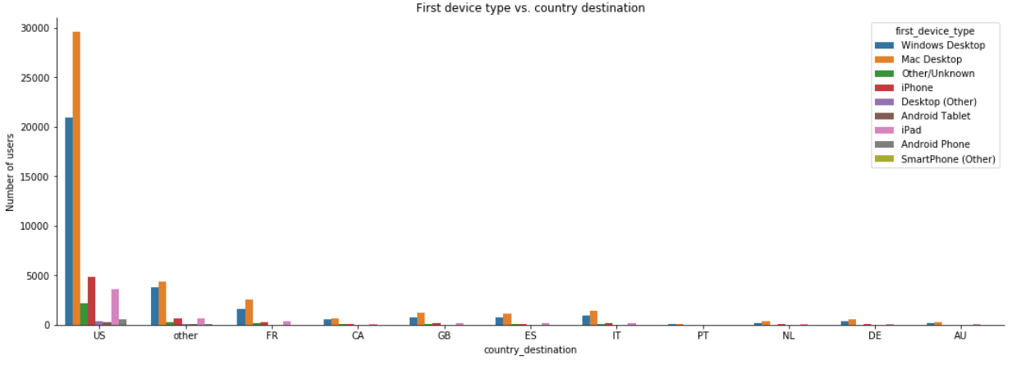
DATA EXPLORATION
«First Device Type» users information
The columns «first device type» represents the first device used to signup to Airbnb.
FIRST DEVICE TYPE
COUNTRY DESTINATION vs FIRST DEVICE TYPE
Among all the users who have booked in Airbnb, around 38% have used Mac Desktop has first device, 30% the Windows Desktop, 17% iphone, 6% iPad and a 5% used Android phone.
Among all the users who have booked in Airbnb, we can see that in the US the percentage of people that use App devices (iPhone and iPad) is more than the other countries.

Slide 11
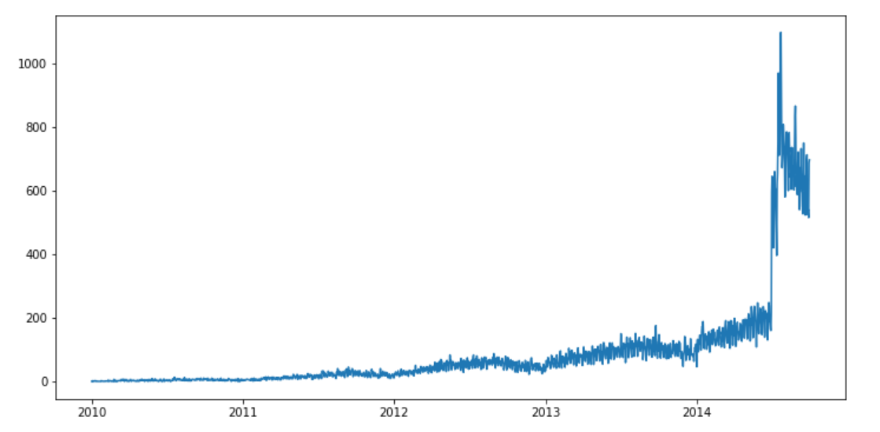
DATA EXPLORATION
«Date account created» users information
The column «date account created» represents the date in which the user sign in into Airbnb.
The line shows that Airbnb has grown a lot in the past few years reaching a peak at the end of 2014.

Slide 12
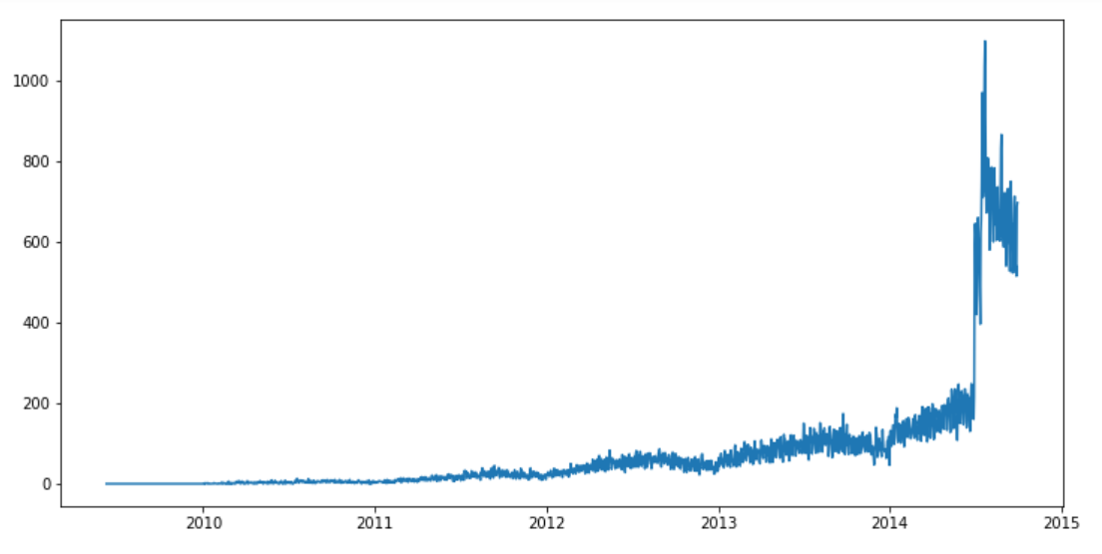
DATA EXPLORATION
«timestamp first active» users information
The pattern looks similar between date account created and timestamp first active.

Slide 13
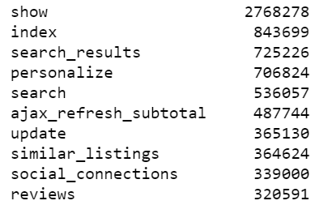
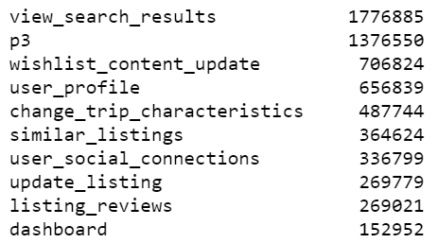
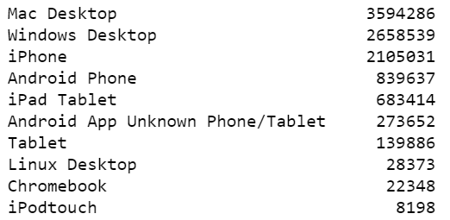
DATA EXPLORATION
«Sessions» users information
«sessions.csv» contains 10 mln of rows, since one user may have done many sessions. The number of distinct users is about 135k.
ACTION
ACTION DETAIL
DEVICE TYPE
The action who is done mainly by users is «show» (26% of the total actions).
The action detail who is done mainly by users is «view search results» (17% of the total action details).
The device who is used by users is «Mac Desktop» (34% of the total actions).

Slide 14
OVERVIEW OF THE PROCESS
DATA EXPLORATION
Exploration and visualization of the variables that are in the csv files.
Exploration of the target variable (‘country destination’) in order to see if there is a correlation with the the other variables.
DATA PREPARATION
Pre-processing of the input variables, which consists mainly of:
Manage missing values;
Treating the dates;
Trasform the categorical feature in numerical.
THE ML MODEL
1) Definition of a the ML Algorithm (XGBoost Classifier);
Description;
Parameters of the model;
Predictions of the model;
2) Best performance that I obtained on the test set.

Slide 15
DATA PREPARATION and PREPROCESSING
TARGET: I have considered only the users who have made at least one booking, so those users who have the target «country_destination» different from NDF.
MISSING VALUES: I remove all the missing values of those features that have them and change the «unknow» values with «NaN».
DATES: I cast date time column to property date time format for the features “first_account_created” and “timestamp_first_action”. Add a new variable which is the difference in days between the first action date and the first account created date.
SESSION DATASET: I transform the values of the features “action”, “action_type”, “action_detail”, “device_type” in columns and assign to it the sum of the seconds that each users spends on.
CATEGORICAL FEATURES: I trasform the 9 categorical features into numerical features.

Slide 16
OVERVIEW OF THE PROCESS
DATA EXPLORATION
Exploration and visualization of the variables that are in the csv files.
Exploration of the target variable (‘country destination’) in order to see if there is a correlation with the the other variables.
DATA PREPARATION
Pre-processing of the input variables, which consists mainly of:
Manage missing values;
Treating the dates;
Trasform the categorical feature in numerical.
THE ML MODEL
1) Definition of a the ML Algorithm (XGBoost Classifier);
Description;
Parameters of the model;
Predictions of the model;
2) Best performance that I obtained on the test set.

Slide 17
THE MACHINE LEARNING MODEL
Split of the Dataset
DATASET
Most of the Data is used to train the model and a smaller portion of the data is used to test the model.
TRAIN SET: is made of data used to train the ML Model.
TEST SET: is made of Data used to estimate the performance of the ML Model.
TRAIN SET
TEST SET
It is about the 70% of the entire Dataset
It is about the 30% of the entire Dataset

Slide 18
THE MACHINE LEARNING MODEL
The Algorithm
SUPERVISED MACHINE LEARNING MODEL
ALGORITHM | XGBoost Classifier
DESCRIPTION | It is a Machine Learning algorithm that uses a Gradient Boosting decision tree framework, designed for speed and high performance. It can be used both for classification (Classifier) and Regression. XGBoost has the tendency to fill in the missing values.
PARAMETERS | thread learning_rate n_estimators eta min_child_weight max_depth max_leaf_nodes gamma subsample colsample_bytree
PREDICTION | The Algorithm predicts the class type (country destination) for each user.

Slide 19
THE MACHINE LEARNING MODEL
Performance of the model
TRAIN SET | TEST SET
0.830798 | 0.827502
0.831046 | 0.827443
0.830498 | 0.827411
0.830089 | 0.827077
0.830001 | 0.826822
The best performance of the test set that I have achived is 0,83.

