Slide 1
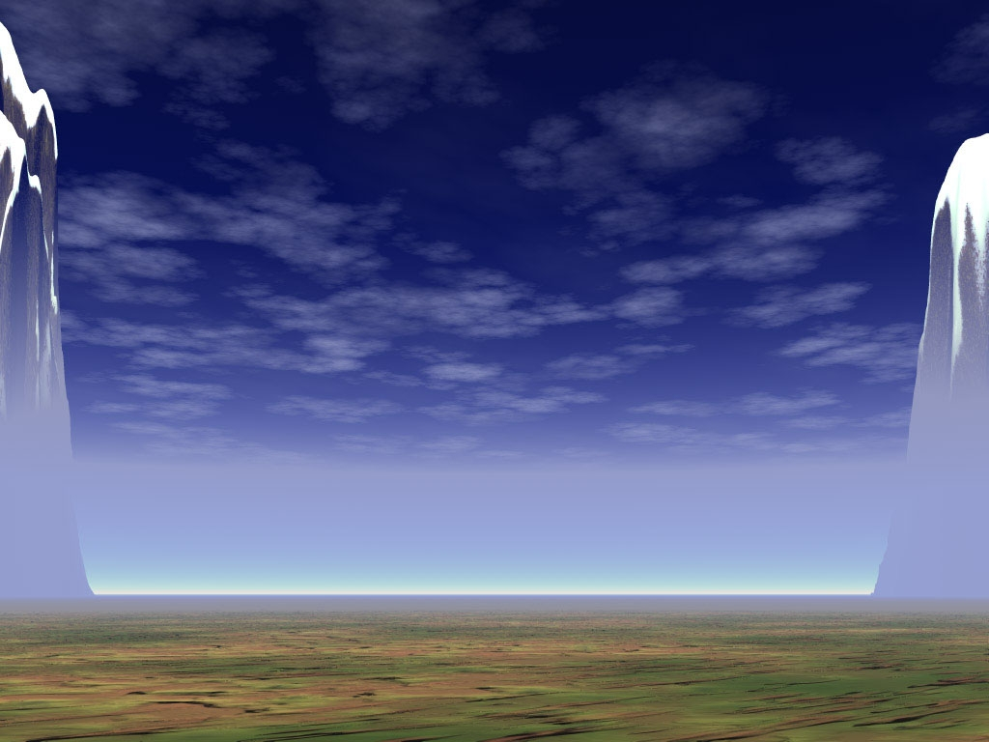
Environmental
Protection
“Our Earth is Our Home”

Slide 2

Our Planet
is in Danger!
Every day we hear about environmental
problems:
Acid rain
Pollution
Climate change
The destruction of rainforests
and other wild habitats

Slide 3
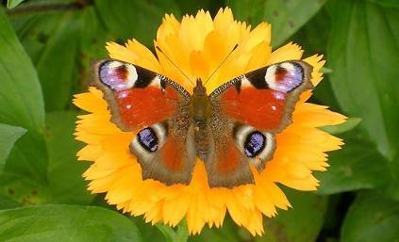
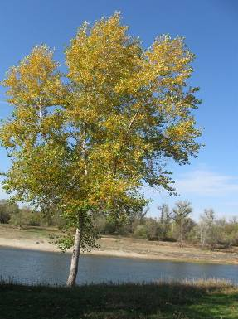
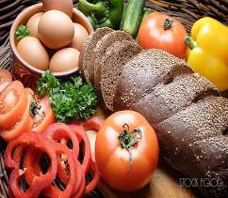
The environment is all the things we need to be able to live - clean water to drink , air to breathe and healthy food to eat.
We can’t live without
plants and animals.
They help to make the
soil, they clean the
water and air, and they give us all our
food.

Slide 4
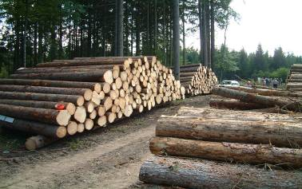
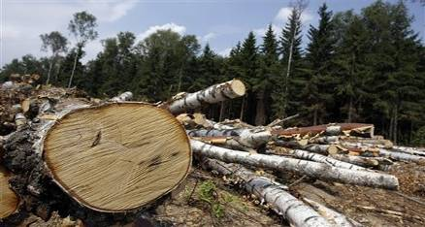
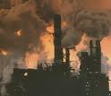
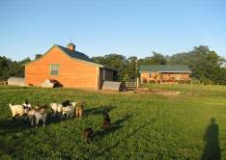
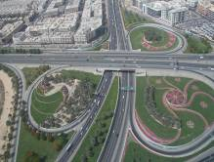
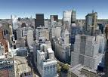
The world is our home and we want to see it clean and
beautiful.
At the same time we take from nature as much as we can.
We cut down forests
        Build farms, houses, roads and
        factories on the land.

Slide 5
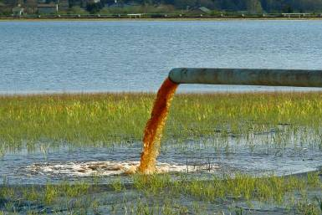
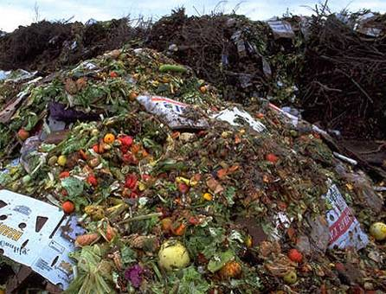

WASTE
Chemical waste pollute river water, killing
wildlife .The pollution affects the health
of people and animals.
We make a lot of waste.
Some of which is TOXIC.
We pour toxic waste into
our rivers, lakes, seas and
oceans.

Slide 6
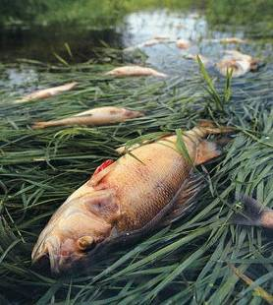
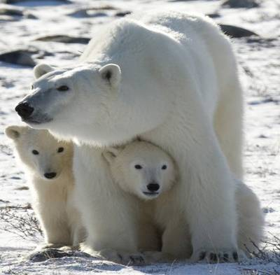
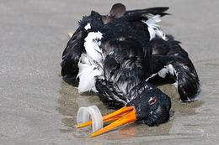
ANIMALS IN
DANGER!
It is necessary to help wild animals.
Many of them are in danger now.
For example, pandas which live in the jungle and white bears which live in the Arctic.

Slide 7
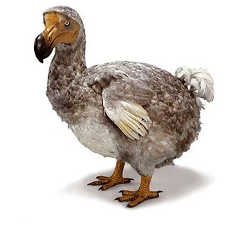
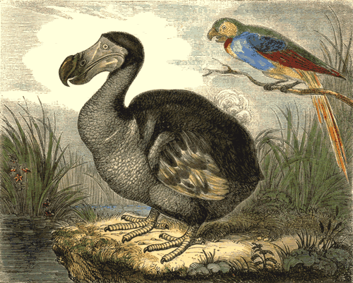
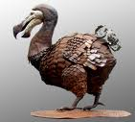
Dodo (Дронт)
The last of these large quiet birds died many years
ago
By the 1690s there were no dodos in the world.

Slide 8
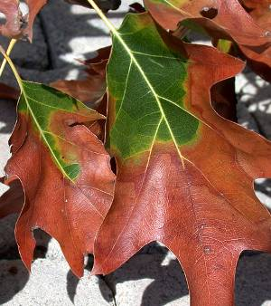

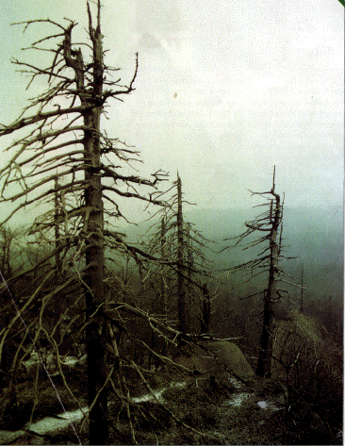
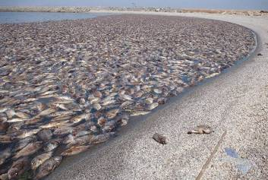
Acid Rains
Acid rains are dangerous for
animals, plants, water and people.

Slide 9
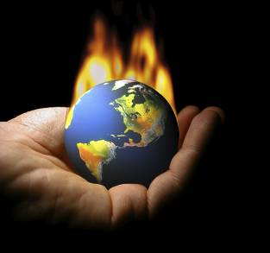
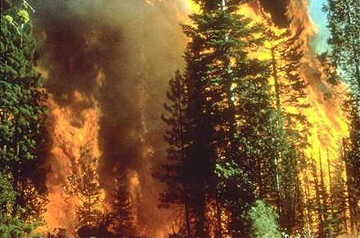
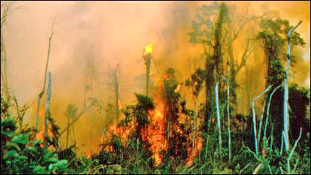
FIRES
Forest fires are one of the greatest natural destroyers
of our forests.
Each year fires burn millions of hectares of forest all over the world.

Slide 10
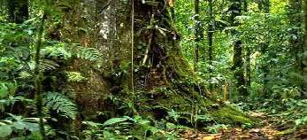
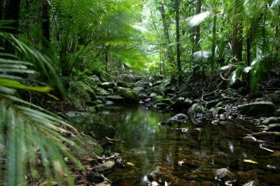
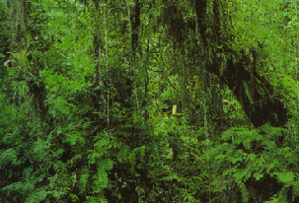
Rainforests
Rainforests are very dense, warm
and wet forests.
Rainforests are found on every
continent across the Earth,
except Antarctica.
They cover only 6% of the Earth’s
surface but yet they contain more
than a half of the world’s plant and animal species.

Slide 11
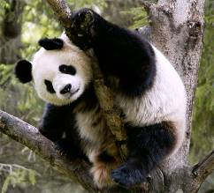
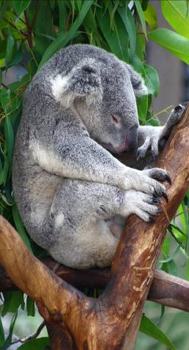
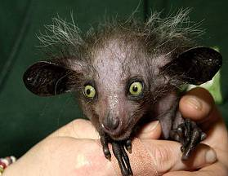
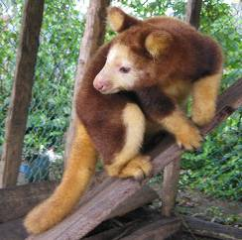
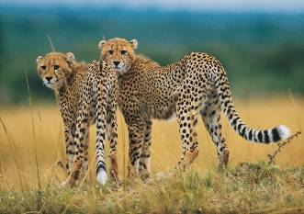
Extinct Animals
They are in danger!

Slide 12
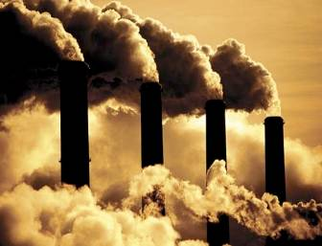
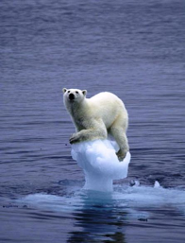
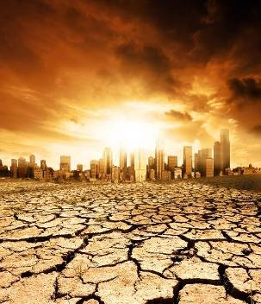

Greenhouse effect
The Earth has been getting hotter because we are producing too many greenhouse gases.
Because the Earth is
getting hotter, ice is melting.
Scientists say that in 2050
some parts of Great Britain
will be under the sea.

Slide 13
What can we
do to protect
nature?
We can recycle newspapers, bottles and metal cans.
We mustn’t cut down trees.
Feed birds in winter.
Protect wildlife, plants and trees. Keep all water
clean.
Don’t use aerosol sprays.
Don’t use chemicals in the garden.
Turn off the light when you leave the room.
Don’t cut wild flowers.
Try to avoid buying plastic. It’s hard to recycle.

Slide 14

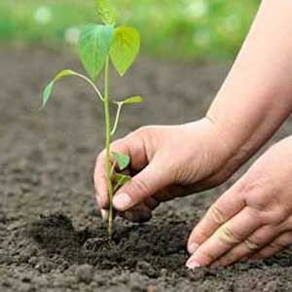
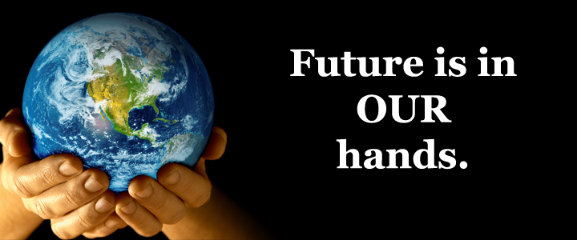

Slide 15
Данную презентацию выполнила:
Аввакумова Татьяна Игоревна
учитель английского языка
Петра-Дубравская средняя школа
Волжского района
Самарской области
1 квалификационная категория
Значок -Почётный работник
общего образования

Slide 16
Список источников используемых материалов
1.en.wikipedia.org
2.www.projectbritain.com
3.www.alleng.ru
4.Видео фрагменты с Youtube от пользователя WatchMojo
и Bibigon.ru

