Slide 1
Ecological Problems
Pollution and protection of our environment

Slide 2
Ecology is a science. Many sciences have such prefix.
What does it mean “Eco”?
“Eco” means “home" in Latin language. It’s a science about our mutual home – about nature.
Science, which teachers us to treat very carefully to our homeland.
Environment – is surroundings we live in.

Slide 3
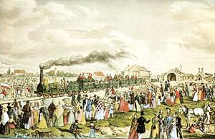
People have always polluted their surroundings. Even in ancient times people admitted that their health was depending on the state of surroundings. But only in XX century humanity, in full measure, realized , that many diseases are closely connected with the air and water pollution and inferior products.

Slide 4
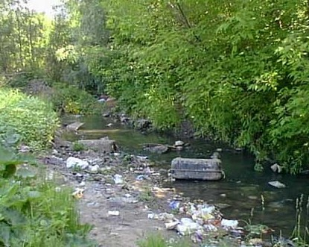
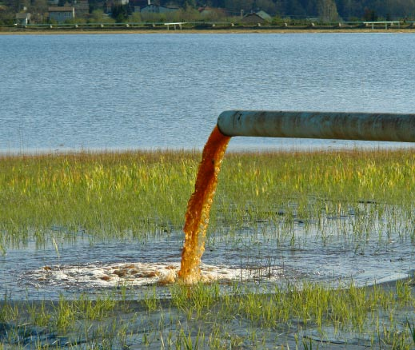
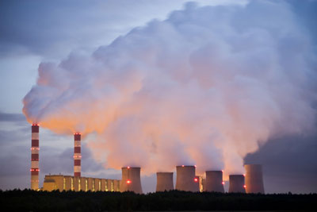
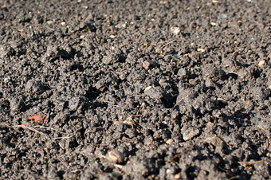
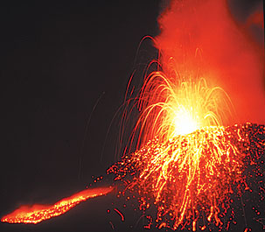
Ecological problems
air pollution
water pollution
soil pollution

Slide 5
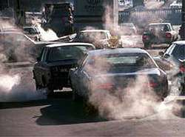
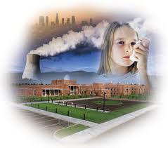
Air pollution.
Air pollution is a very serious problem, because polluted air can cause illness and even death. Every year world industry pollutes the atmosphere with about 1500 million tons of dust and other harmful substances. Many cities suffer from smog, the oxygen balance upsets. Cars are polluting the air by exhaust gases and other dangerous chemicals.

Slide 6
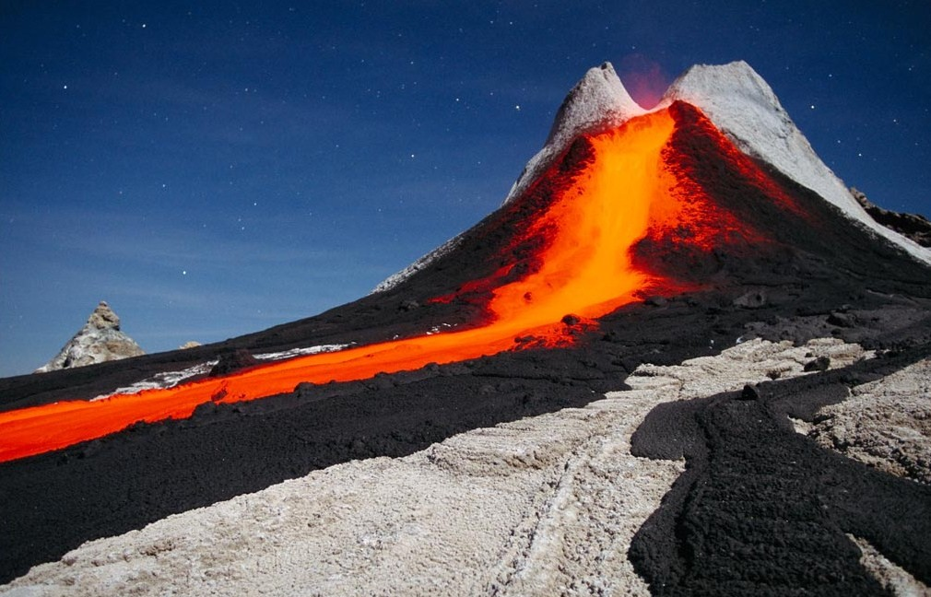
Virtually not only human beings pollute the air but nature itself can cause damage,for example volcanic eruptions.
But the consequences after volcanic eruptions aren’t so harmful as human beings , in contrast to human activities, these processes are always reversible – thought after a while the atmosphere will recover in former structure.

Slide 7
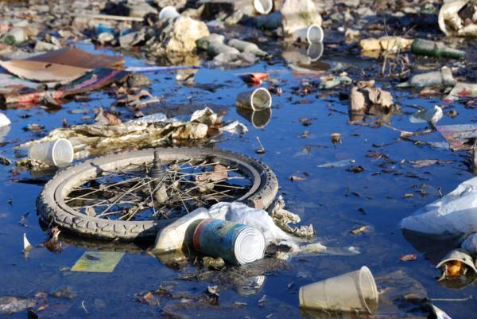
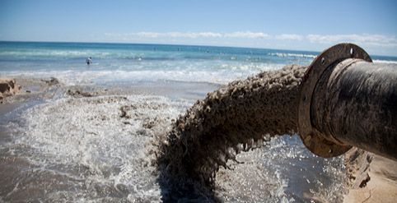
Water pollution
Water recourses is one of the main factor of existing life in our planet.
People use fresh water for their needs. It is more than 2% of hydrosphere volume.
First of all water pollution is the result of industrial, agricultural and everyday necessities discharge of wastes into rivers, lakes and seas.
The main part of water pollution plays a large number of oil industry wastes.

Slide 8
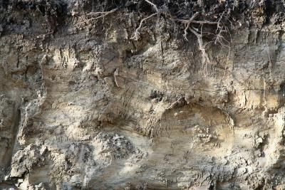
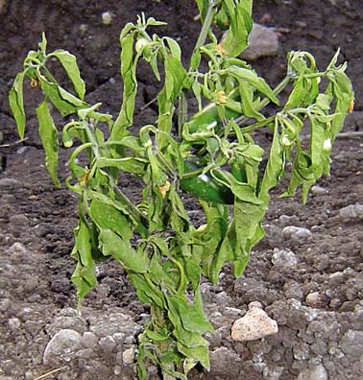
Soil pollution
The main component of the Earth biosphere represents topsoil.
Soil is polluted by: litter, wastes, heavy metals, pesticides, radioactive elements.
Sinking aerosol may contain heavy poisonous metals and it may lead to plants’ ruin.

Slide 9
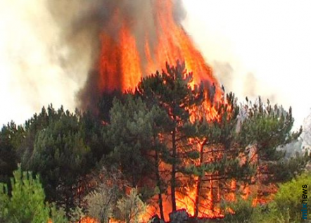
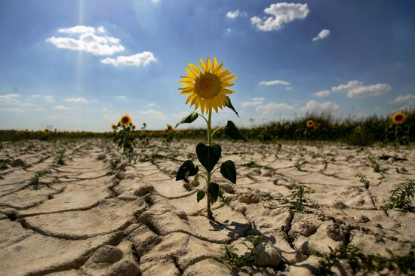
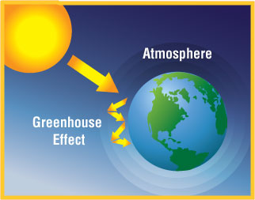
Modern ecological problems
greenhouse effect

Slide 10
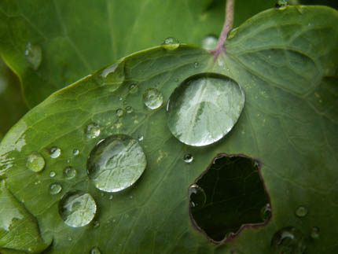
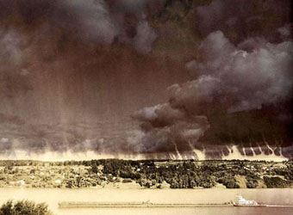
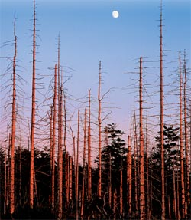
acid rains

Slide 11
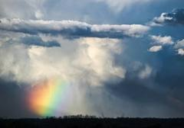
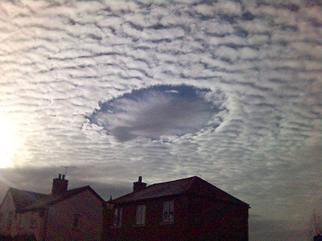
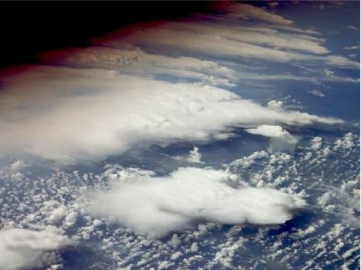
ozon layer

Slide 12
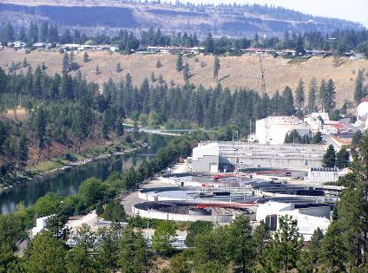
Ways of solving ecological problems
Creation of different kinds of purification plants;
Recycling.

Slide 13
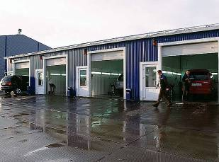
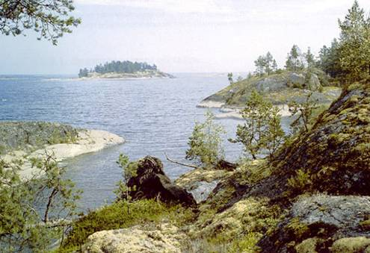
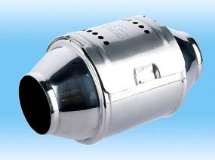
III Using of conservation technologies and rational distribution of industry.
Creation of purification territorial systems.

Slide 14
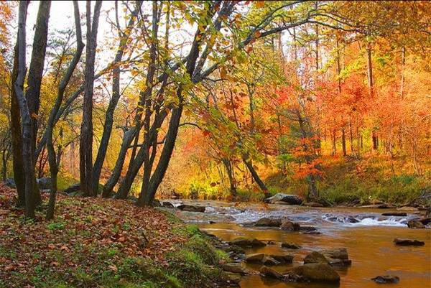
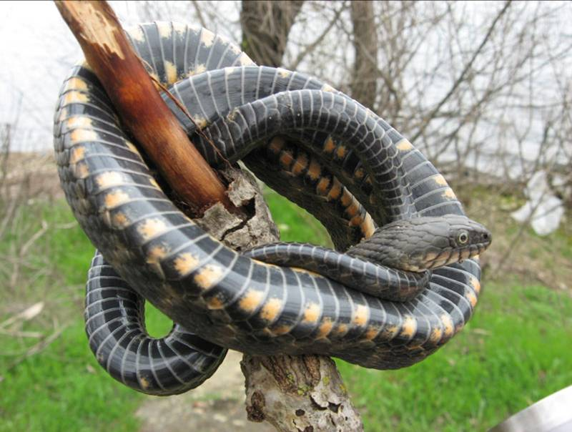
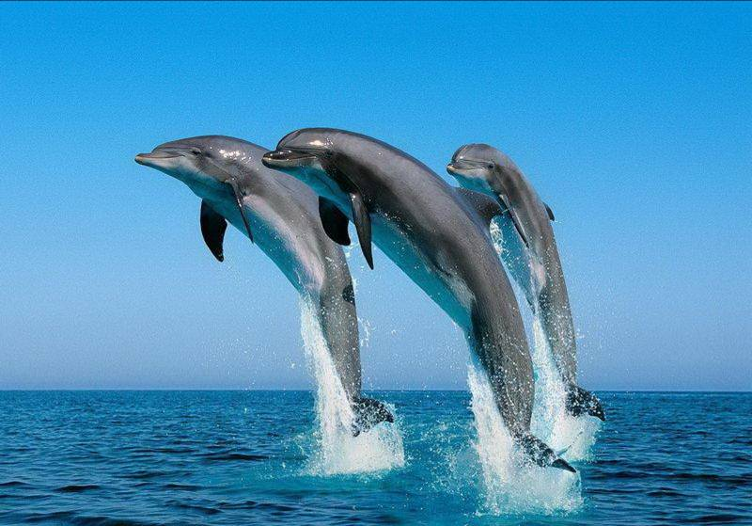
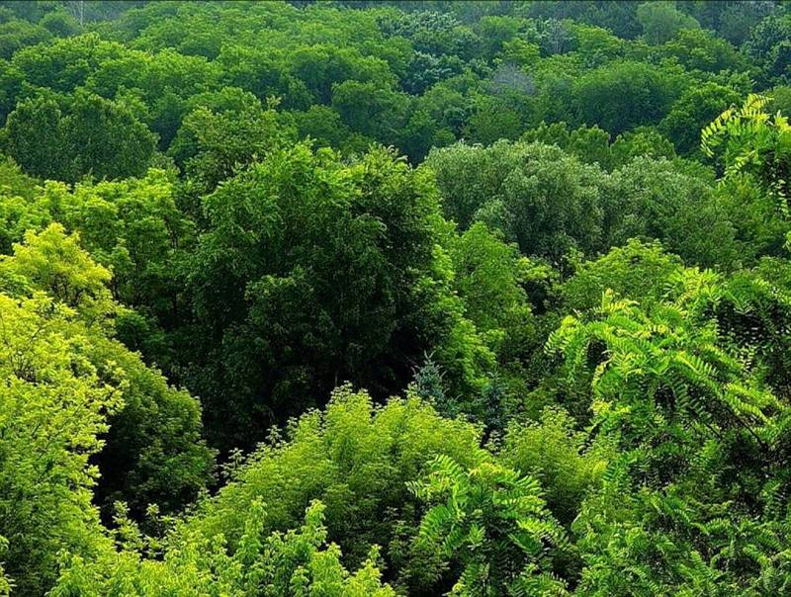
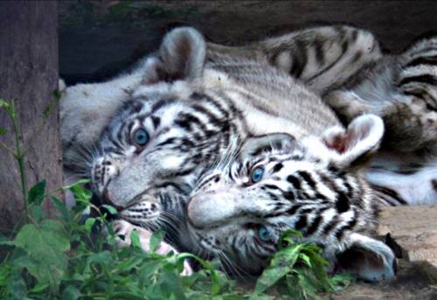
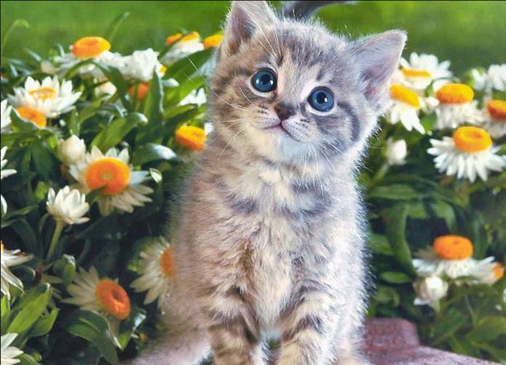
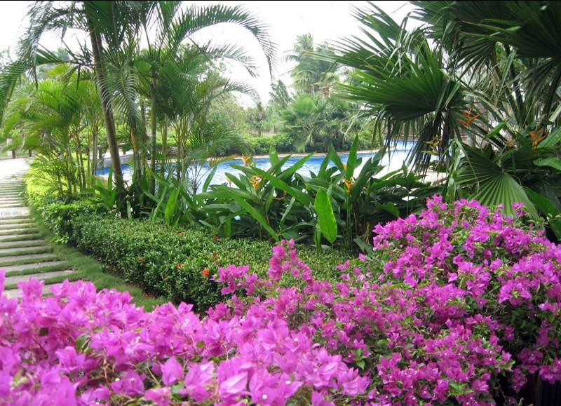
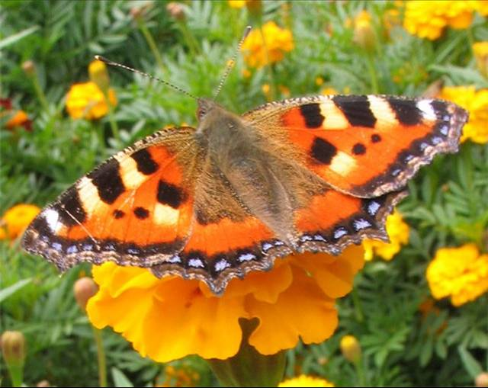
Look
how beautiful
our planet
can be

