Slide 1
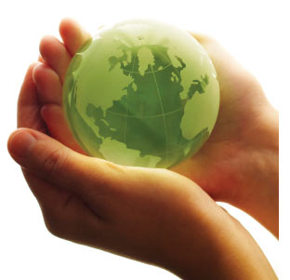
Opening lesson: ”Ecological problems in our days ”.
Our future depends only on us.
16/05/2012 the 6th and the 10th forms
English teacher Pechckurova H.

Slide 2
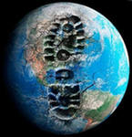
Цель урока:
“If you don’t think about the future, you won’t have it”,
said the famous English writer J. Galsworthy.
развитие учебно-коммуникативных умений по теме: ”Ecological problems in our days ” на английском языке.

Slide 3
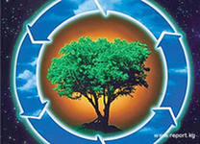
Практические задачи:
Образовательные:
- формирование интереса к экологическим проблемам и умение высказываться по-английски по теме ”Ecological problems in our days ”;
- актуализация лексики по теме ”Ecological problems in our days ”.
- активизация лексики по речевым видам деятельности –говорение, аудирование,
- подготовка учащихся к устному высказыванию по теме «”Ecological problems in our days ”.
- обучение учащихся работе в сотрудничестве, в коллективе.
Развивающие задачи:
- развитие умения монологической речи;
- развитие логического мышления, памяти, внимания;
- развитие умение сопоставлять, давать оценку, выражать своё мнение на английском языке.
Воспитательные задачи:
воспитывать чувство ответственности за сопричастность
к проблемам экологии;
воспитывать интерес к экологическим проблемам,
бережное отношение к окружающей среде;
-воспитывать умение выслушивать собеседника,
вежливому реагированию в различных ситуациях общения;

Slide 4
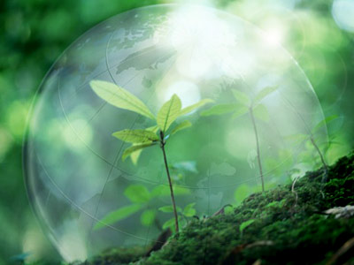
Our future depends only on us.
The question about the state of environment should worry everybody. Our health depends on its state. Environment is water that we drink, the air which we breathe. Caring about the world we care about ourselves. Вопрос о состоянии окружающей среды должен волновать каждого. Наше здоровье зависит от её состояния. Окружающая среда – это вода, которую мы пьём, воздух, которым мы дышим. Заботясь о природе, мы заботимся о себе самих.

Slide 5
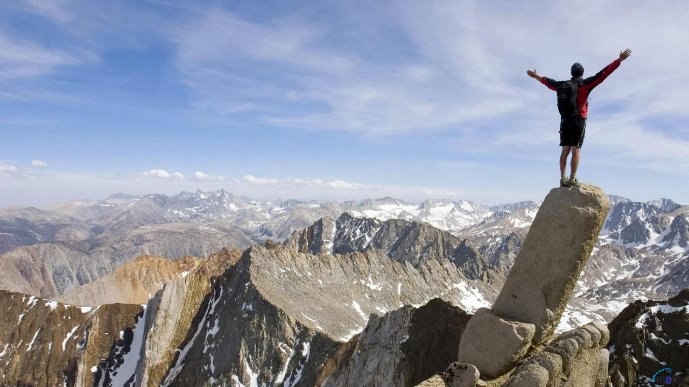
People and nature People are the part of nature. As our civilization develops, people become stronger than nature.
Люди - это часть природы.
В результате развития цивилизации человек стал сильнее природы.

Slide 6
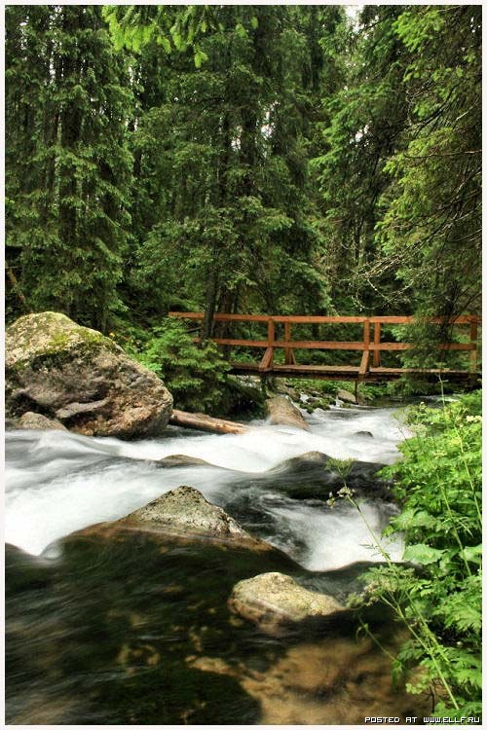
People and nature
But it`s not so simple. People learned to influence our environment. They create different household items, medicines, food…
Но не все так просто. Люди научились изменять окружающую среду, создавая предметы быта, лекарства, пищу…

Slide 7
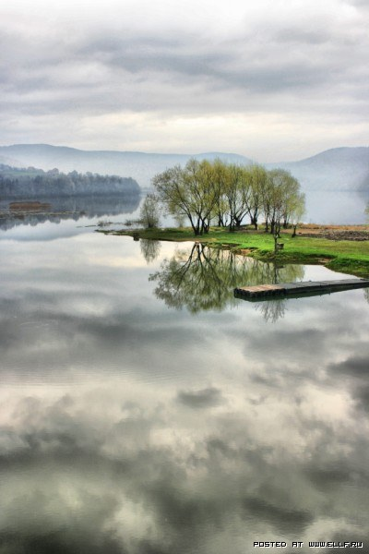
People and nature
So, they pollute the atmosphere. There are even ozone holes. People are not careful. They burn forests, pollute rivers.
Таким образом, они загрязняют атмосферу. Появились даже озоновые дыры. Люди неосторожны. Они сжигают леса, загрязняют реки.

Slide 8
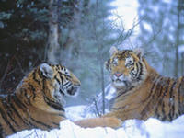
People and animals
People have hunted and killed many animals. People have cut down many trees and therefore there are no many forests for animals nowadays. Modern life is bad for animals. The air is not fresh. The water is not clean. They don’t often have good things to eat and space to live.

Slide 9
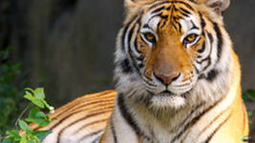
Why do people kill tigers?
Tigers can kill domestic animals and sometimes they can also kill men. That’s why people kill them to save their domestic animals and their lives.
People kill tigers not only to save domestic animals, but also for fun and for their beautiful skin.
There are few Indian tigers on the Earth now.
They hide from people in deep, dark forests.

Slide 10
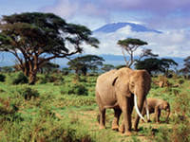
Many wild animals are in danger nowadays.
Some animals are in danger because people have hunted for many years.
African elephants are among them. Because people have hunted and killed lots of elephants in Africa.
Now there are few of them. It’s a pity!
Elephants can help people.
People must take special care of animals.

Slide 11
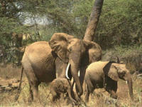
the problem of disappearing animals
Well, you see that the problem of disappearing animals is very important nowadays.
We must really understand this problem.
You must tell about disappearing animals to your friends, parents.
And, of course, you must take special care of animals.

Slide 12
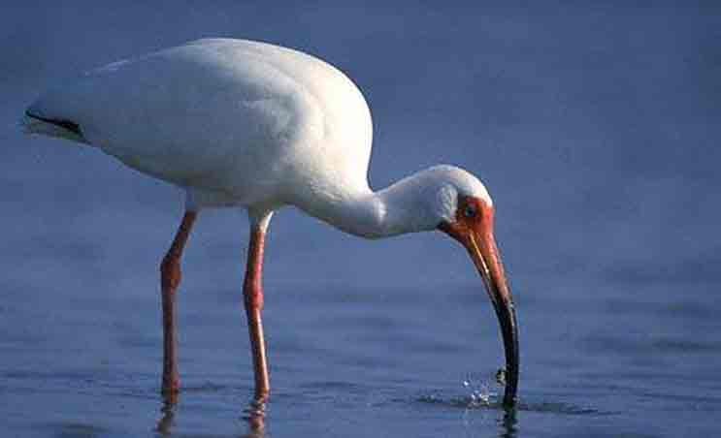
birds are also disappearing from our planet
Some birds are also disappearing from our planet and in danger.
And we can’t see them and animals in the forests because the forests are very dirty. The air, soil and rivers are not clean.
We can find the names of some birds, animals and fish in the Red Book.

Slide 13

Our future depends only on us.
Let’s plant trees. Our future depends only on us. Let’s make it happy and bright.
Давай сажать деревья. Наше будущее зависит от нас. Давайте сделаем нашу жизнь счастливой и яркой!

Slide 14
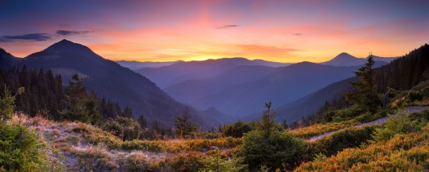
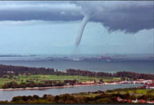
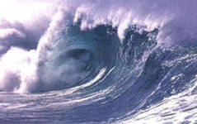
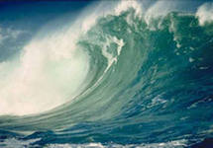
Thank you for your attention!

