Slide 1





APEX integration with Spotify, Discogs, Jira, LinkedIn, etcetera – all at once!
André van der Put
11-4-2025

Slide 2



About me
Software developer at Open-Fine
Oracle developer since 1997
APEX developer since 2009
a.v.d.put@open-fine.nl
linkedin.com/in/andrevanderput/

Slide 3
Overview
Use case
OAuth 2, Authorization Code Flow
APEX Social Sign-in, custom code using APEX API packages
Demo’s

Slide 4

Original use case
I have a record collection stored in Discogs
I want to have that same collection available in Spotify
I want to use my favorite developer tool… APEX
Both Discogs and Spotify do have a REST API, APEX can do REST calls,
so that should be no problem?

Slide 5
Original use case
But…
Discogs does not use OAuth2, but OAuth 1.0a
My first REST call gives
An internal server error occurred (code: db0aedd587d742f1a618e29f8945746b)
My support request has not been answered (yet)

Slide 6
Alternative use case
I have a task list in Jira
I want to add one of my Spotify playlists as a task
I want to use my favorite developer tool… APEX
Both Jira and Spotify do have a REST API, APEX can do REST calls,
so that should be no problem?

Slide 7
OAuth 2.0
Spotify, Jira, LinkedIn, Google, Facebook and many others support the OAuth 2.0 protocol
To access general data (like Spotify artists) the Client Credentials flow can be used.
To access personal data (like my own Spotify playlists) the Authorization Code flow must be used.

Slide 8
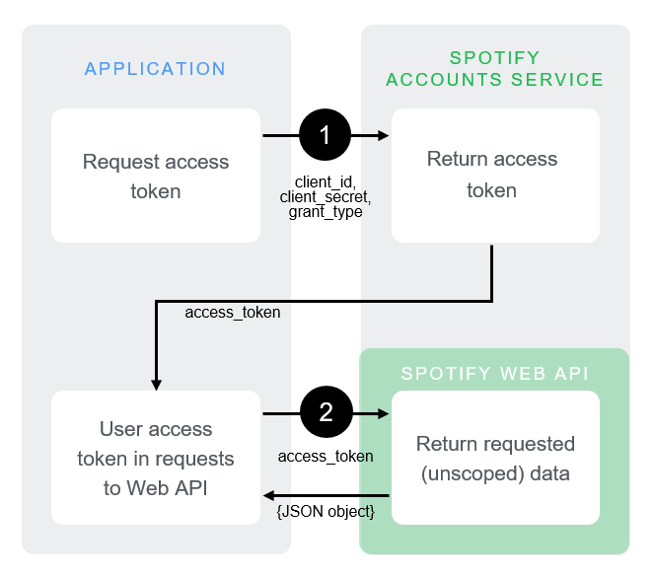
Client Credentials flow

Slide 9
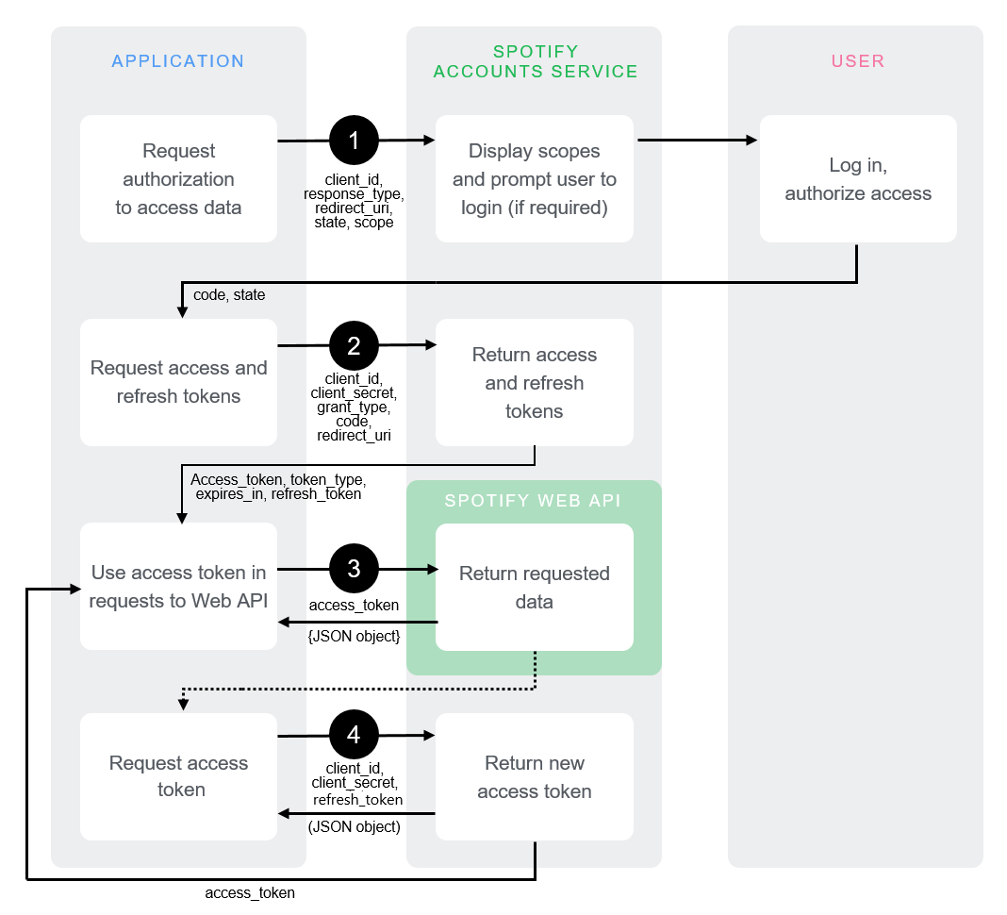
Authorization Code flow

Slide 10
OAuth 2.0
APEX only supports the Client Credentials flow, not the Authorization Code flow
But… does it not?
In Social Sign-in the Authorization Code flow mechanism is used.
callback: APEX_AUTHENTICATION.CALLBACK

Slide 11
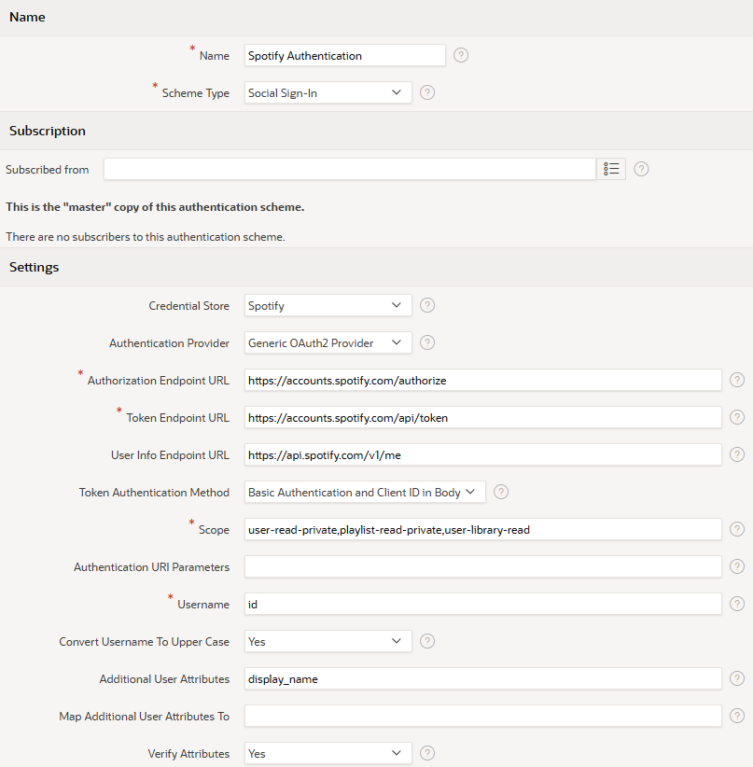
Social Sign-in

Slide 12
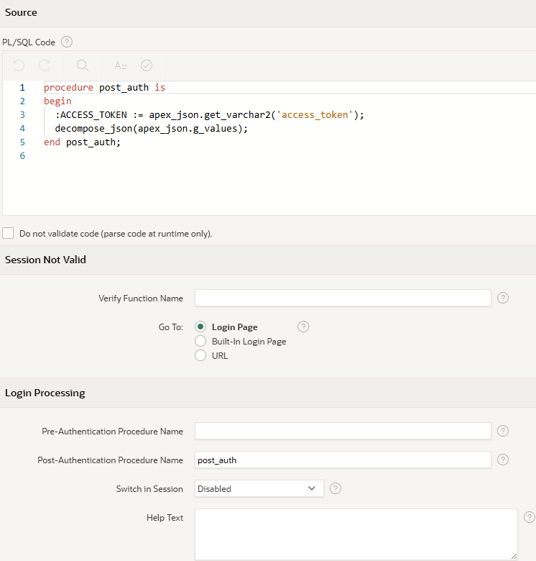
Social Sign-in

Slide 13
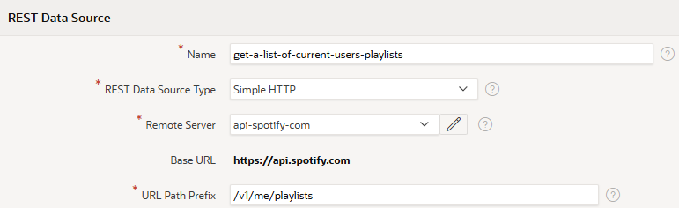
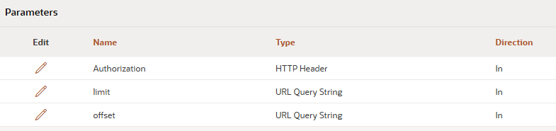
Spotify - REST Data Source
Get current users playlists, endpoint /v1/me/playlists

Slide 14
Social Sign-in
Demo 1
That works, but…
APEX session length is limited to token lifetime (1 hour)
No refresh token, new login is new APEX session
Only 1 sign-in per session

Slide 15
DIY Authorization Code flow
create table auth_code_flow(
id number generated always as identity not null
, name varchar2(100) not null
, authorization_url varchar2(1000)
, token_url varchar2(1000)
, user_info_url varchar2(1000)
, client_id varchar2(1000)
, client_secret varchar2(1000)
, scope varchar2(1000)
, extra_parameters varchar2(1000)
, username_field varchar2(1000)
, constraint acw_pk primary key (id) using index
, constraint acw_uk1 unique (name) using index
);
Custom table
PL/SQL code to
redirect to authorization endpoint
from callback, redirect to APEX session
with returned code, get token

Slide 16
DIY Authorization Code flow
Callback procedure
REST enabled PL/SQL?
should redirect to a page in the APEX session
parameters: code, state, error
state could contain
REST endpoint identification
APEX session ID

Slide 17
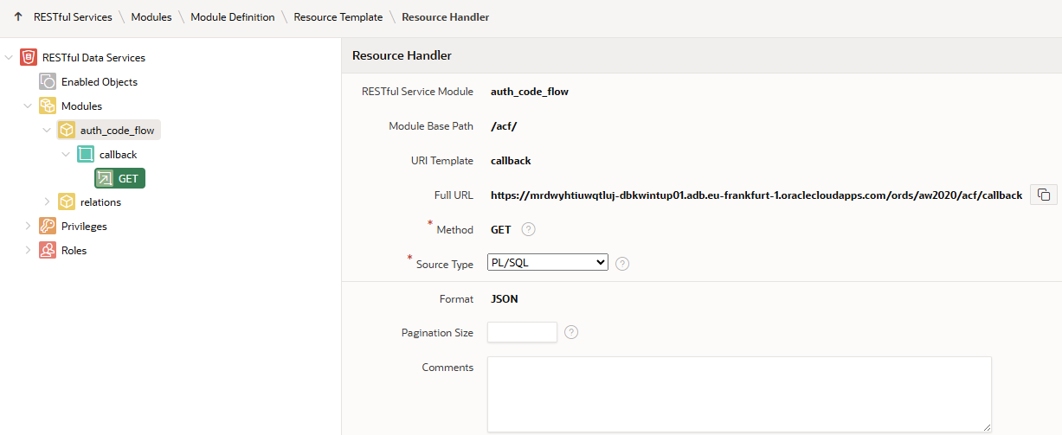

DIY Callback
Options include:
Collection Query - Executes a SQL query and transforms the result set into an ORDS Standard JSON representation. Result Format: JSON
Collection Query Item - Executes a SQL query returning one row of data. Result Format: JSON
PL/SQL - Executes an anonymous PL/SQL block and transforms any OUT or IN/OUT parameters into a JSON representation. Result Format: JSON
Media Resource - Executes a SQL Query conforming to a specific format and turns the resultset into a binary representation with an accompanying HTTP Content-Type header identifying the internet media type of the representation. Typically used for media objects, such as images.
l_redirect_url := 'f?p=125:1:'||state||'::::P1_CODE:'||code;
owa_util.redirect_url(l_redirect_url, true)
<body onload="document.location.href='l_redirect_url'"></body>

Slide 18
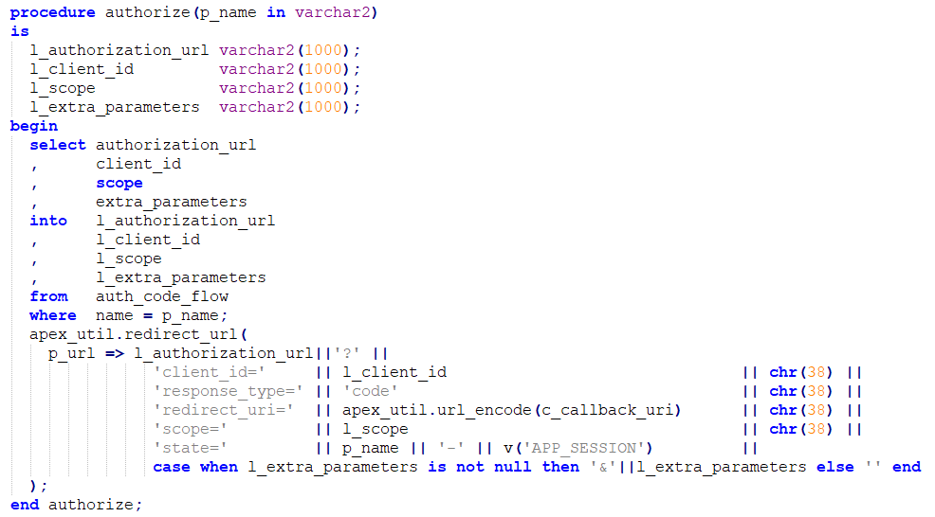
PL/SQL code - authorize

Slide 19
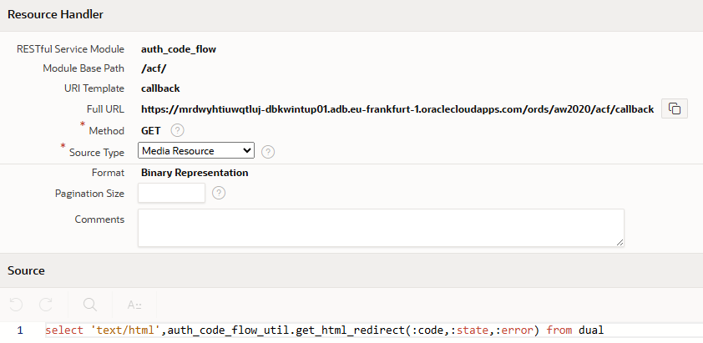
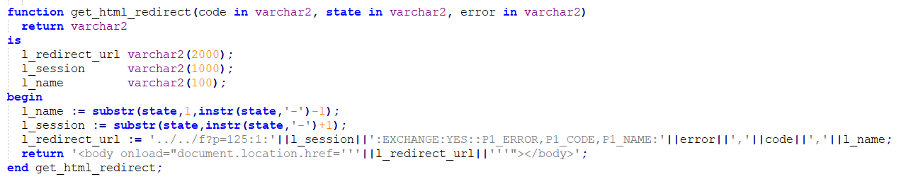
PL/SQL code - callback

Slide 20
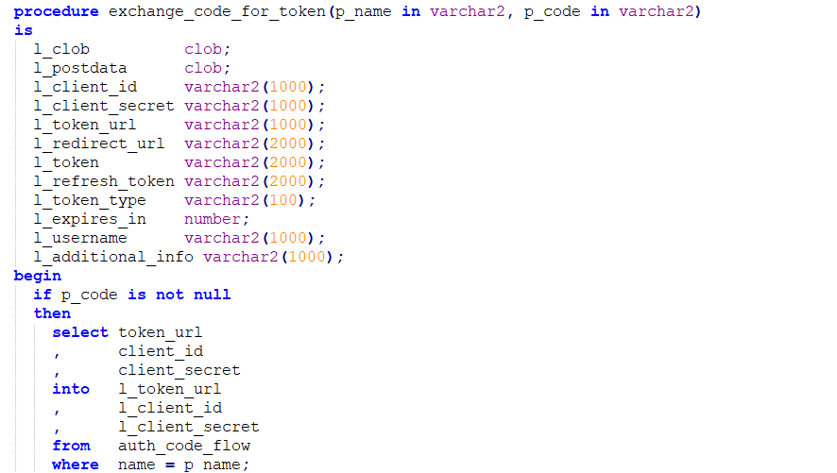
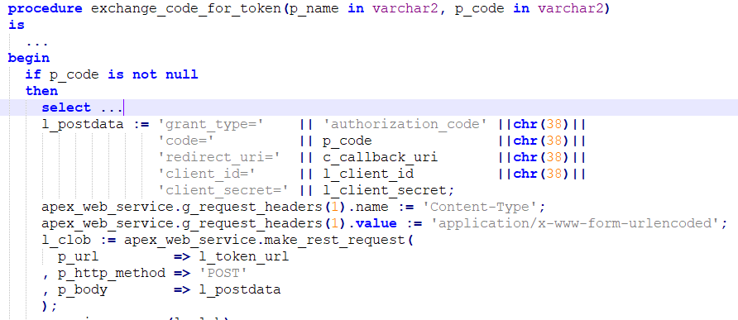
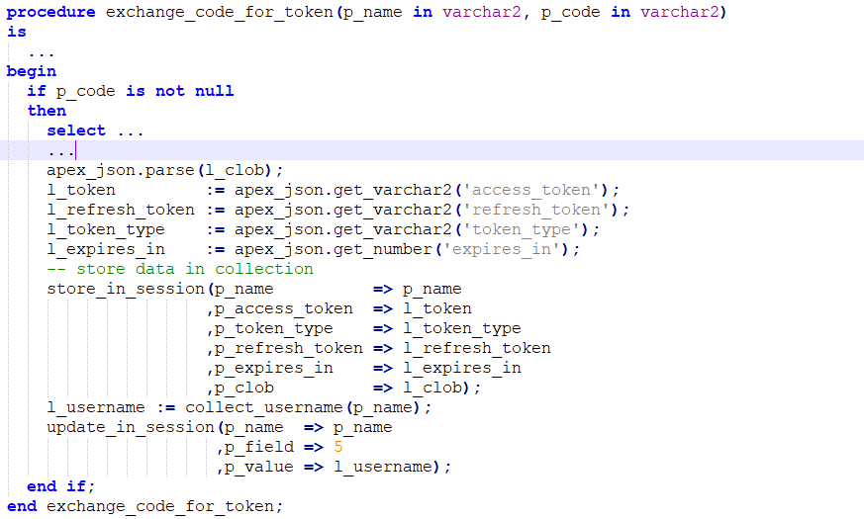
PL/SQL code - exchange code for token

Slide 21
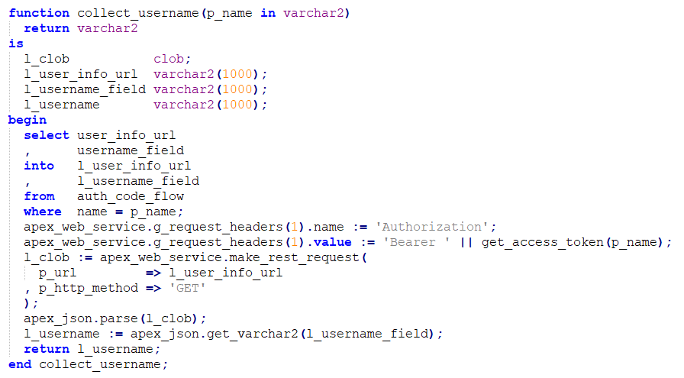
PL/SQL code – collect username

Slide 22
Demo 2 - Spotify

Slide 23
Jira
In principle like before
Some additional steps necessary:
Get the cloudid for your site
Construct the request URL using the cloudid
Call the API, using the access token and request URL

Slide 24
Jira - table
create table auth_code_flow(
id number generated always as identity not null
, name varchar2(100) not null
, authorization_url varchar2(1000)
, token_url varchar2(1000)
, user_info_url varchar2(1000)
, client_id varchar2(1000)
, client_secret varchar2(1000)
, scope varchar2(1000)
, extra_parameters varchar2(1000)
, username_field varchar2(1000)
, additional_info_url varchar2(1000)
, additional_info_field varchar2(1000)
, constraint acw_pk primary key (id) using index
, constraint acw_uk1 unique (name) using index
);

Slide 25
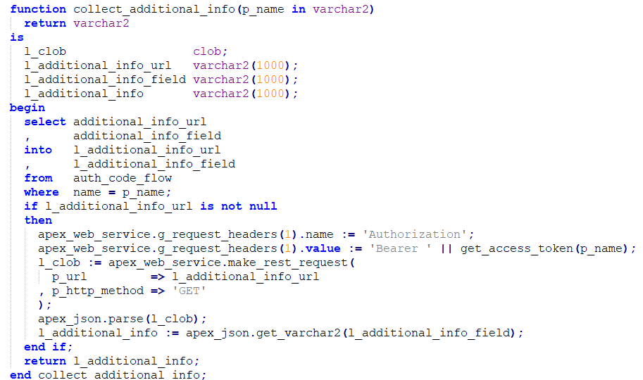
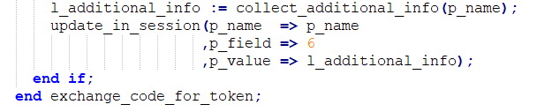
Jira - PL/SQL code
https://api.atlassian.com/oauth/token/accessible-resources
[1].id

Slide 26
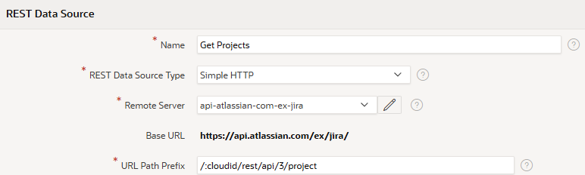
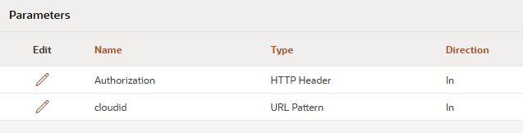
Jira - REST Data Source
Get Projects, endpoint /rest/api/3/project

Slide 27
Demo 3 - Jira

Slide 28
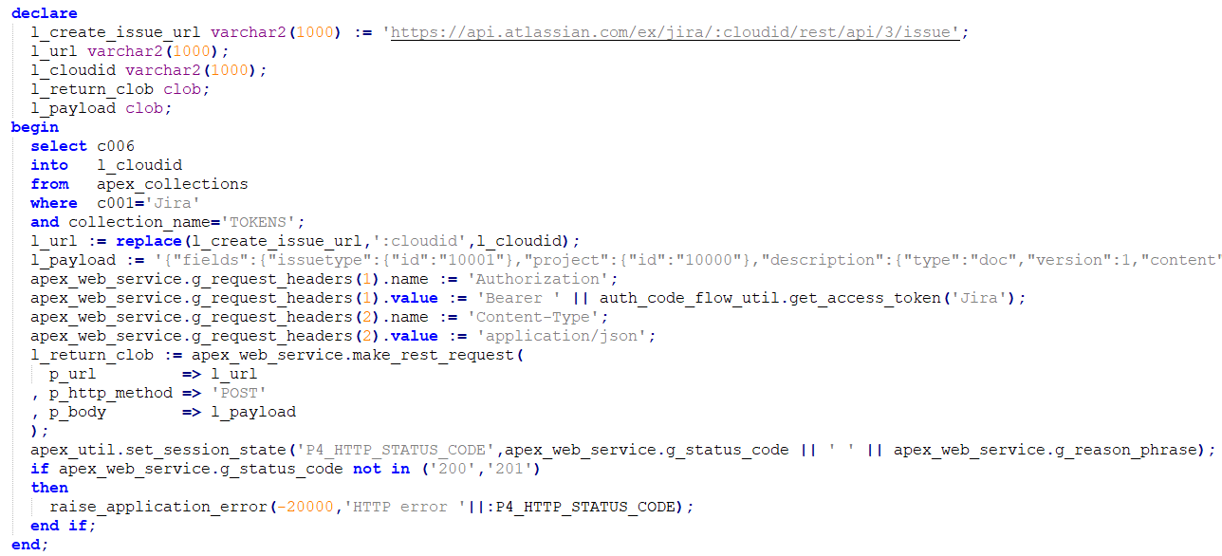
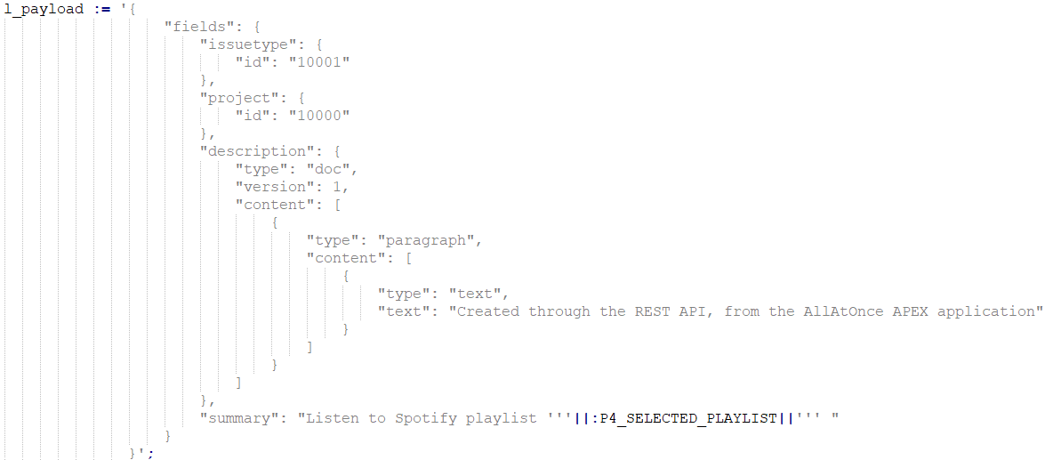
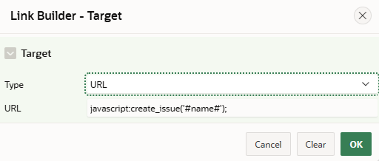
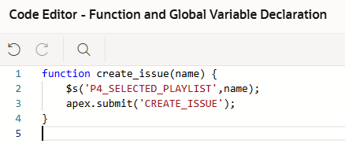
Create Jira issue from Spotify playlist

Slide 29
Demo 3 continued - Spotify and Jira

Slide 30
Demo 4 - LinkedIn

Slide 31
Refresh tokens
Access tokens are generally valid for 1 hour (3600 seconds).
Request new access token using refresh token
Client ID and Client Secret BASE64 encoded in Header
e.g. create job to call refresh token endpoint at token collection, to start at 59 minutes from now

Slide 32
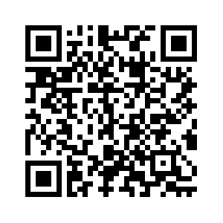
Github
Demo code is available at github.com:
https://github.com/avanderput/demoos/tree/master/DEMO_ALLATONCE

Slide 33

Questions?

