Slide 1
Computer Networks Project Client-Server Chat Application
Group 7
Adam Vandolder

Slide 2
Features
Terminal-based client-server chat application
Supports a variety of features inspired by IRC
Allows users to connect to central server
Users can set nicknames, join specific channels, direct message other users, etc.

Slide 3
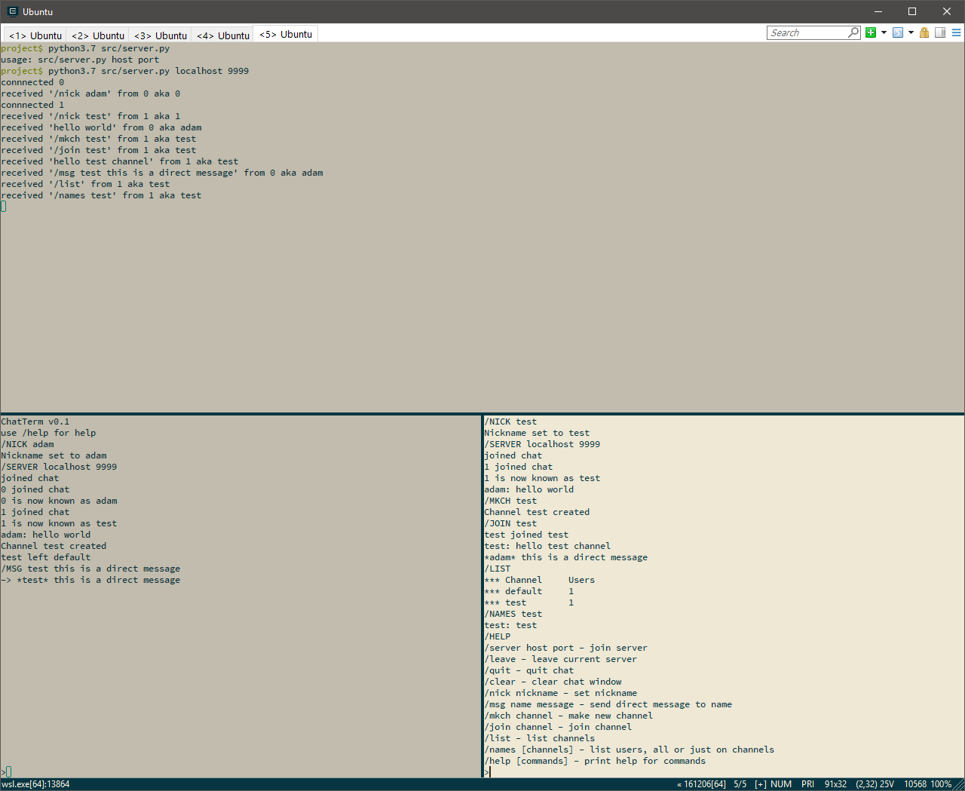

Slide 4
Implementation
Written in Python
Utilizes the socket, threading, curses libraries
Server consists of multi-threaded TCP connection handler
Client is single-threaded application with a TUI made with curses
Makes use of type annotations (typing library) and mypy
git was used for version control

Slide 5
Conclusion
Project functions as initially desired
Learned a lot about socket programming and multi-threading
Thanks for listening

