Slide 1

Customer Shopping Behaviour Analysis
Insights and recommendations from 3,900 customer purchases
Notes:
Introduce the project: an end-to-end analysis of customer shopping behaviour using Python, SQL and Power BI, ending in business recommendations.

Slide 2

Subscriptions are our biggest growth opportunity
3,900
$59.76
3.75 / 5
customers analysed
average purchase amount
average review rating
Only 7.3% of customers subscribe, and none of them are women.
Clothing leads revenue, age groups are balanced, and five actions can lift subscription and loyalty.
Notes:
Lead with the headline: the business is healthy on spend and categories, but the subscription programme is small and reaches only male customers.

Slide 3





An end-to-end pipeline from raw CSV to dashboard
1. Python
2. SQLite
3. SQL
4. Power BI
Load, profile, clean and engineer features with pandas
Store cleaned data in table customer_behaviour
Answer 10 business questions with CTEs and window functions
Interactive dashboard with KPIs and slicers
Notes:
Walk through the four stages. Each stage feeds the next: pandas for cleaning, SQLite as the single source, SQL for analysis, Power BI for presentation.

Slide 4




Clean data: 3,900 rows, 18 columns, no duplicates
Filled 37 missing ratings
Category median, so no rows are lost
The dataset
One row per customer purchase
Ages 18–70, mean 44
2,652 male, 1,248 female
25 items in 4 categories
50 US states
Created 4 age groups
Equal-size bands with pd.qcut
Made frequency numeric
Weekly = 7 days … Annually = 365
Dropped promo_code_used
Identical to discount_applied
Notes:
Data quality was good: only 37 review ratings were missing (under 1%). Mention the two engineered features and the redundant column that was removed.

Slide 5
Not one female customer has a subscription
0 of 1,248
female customers subscribe, although women are 32% of the customer base
What this means
Subscription revenue comes only from men
The offer is not reaching or appealing to a third of customers
92.7% of all customers are still available to convert
Notes:
This is the key finding. Every subscriber is male. Ask the client: is the subscription offer designed or marketed with women in mind?

Slide 6
Clothing leads on revenue and units sold
Values read from the Power BI dashboard and rounded.
Notes:
Clothing is the core of the business on both revenue and volume. Outerwear is the weakest category and worth a range and pricing review.

Slide 7
Young adults lead, but every age group matters
Under 15%
gap in revenue between the highest and lowest age group
Young adults also make the most purchases, just over 1,000. Campaigns should prioritise them without neglecting older groups.
Values read from the Power BI dashboard and rounded.
Notes:
Age groups are four equal-size bands. Young adults lead slightly on revenue and purchases, but the spread is narrow.

Slide 8
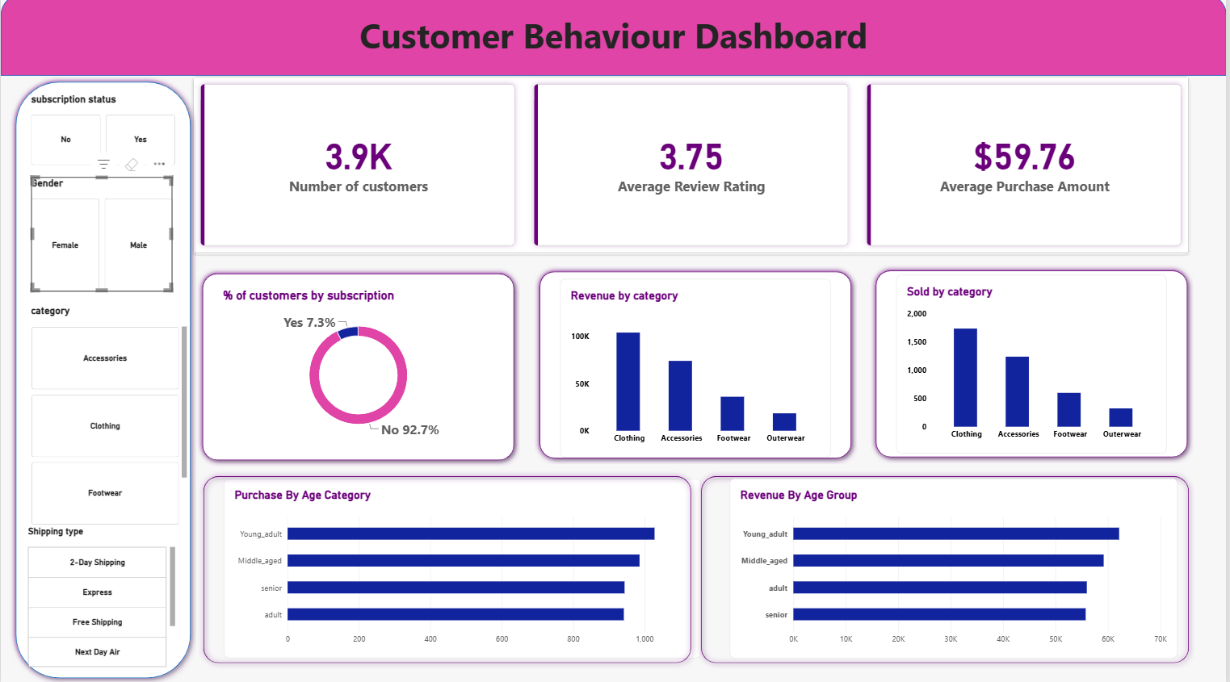
The Power BI dashboard puts it all on one page
Filter by
Subscription status
Gender
Category
Shipping type
Shows
KPI cards
Category and age charts
Notes:
If presenting live, switch to Power BI here and demonstrate the slicers, for example filter Gender = Female and show subscribers drop to zero.

Slide 9




Ten SQL questions in four business themes
Revenue and spend
Products
Q1 Revenue by gender
Q2 Discount users above average
Q4 Standard vs Express spend
Q5 Subscriber vs non-subscriber
Q3 Top 5 rated products
Q6 Most-discounted products
Q8 Top 3 items per category
Loyalty
Demographics
Q7 New, Returning, Loyal
Q9 Do repeat buyers subscribe?
Q10 Revenue by age group
Notes:
Techniques used: aggregations, subqueries, CASE logic, CTEs and ROW_NUMBER window functions. Queries are in expense.sqbpro.

Slide 10






Six actions to grow subscriptions and loyalty
Win female subscribers
Boost subscriptions
Loyalty programme
Survey women and test benefits aimed at them
Promote exclusive subscriber benefits
Reward repeat buyers to move them to Loyal
Review discounts
Product positioning
Targeted marketing
Balance sales lift against margin
Feature top-rated, best-selling items
Focus on high-revenue ages and Express users
Notes:
The highlighted card is the top priority: a subscription offer that wins female customers. The other five are the broader recommendations from the analysis.

Slide 11

Next step: design a subscription offer for women
Questions and discussion
Notes:
Propose next steps: survey female customers, pilot a targeted subscription offer, and track subscription rate by gender on the dashboard.

