Slide 1
Welcome to The R Workshop
Alex VanHelene

Slide 2

This Workshop Will Introduce You to R Programming
What is R?
R is a programming language
Used for:
Data wrangling
Statistical analyses
Data visualization
Why should you learn R?
Unlock data analysis tools
Bioinformatics, statistics, ect.
Create publication quality figures
Notes:
R logo: https://www.google.com/url?sa=i&url=https%3A%2F%2Fwww.r-bloggers.com%2F2024%2F05%2Fr-meets-hardware%2F&psig=AOvVaw1edXkxzNAQMK2IqHYeBTTy&ust=1757939772730000&source=images&cd=vfe&opi=89978449&ved=0CBkQjhxqFwoTCNDjs4-i2I8DFQAAAAAdAAAAABAM

Slide 3
In This Workshop You Will Learn…
…How to set up R/Rstudio on your computer
…Basics of R syntax
…Using Large Language Models (LLMs) for coding/troubleshooting
…Data wrangling with tidyverse
…Data visualization with ggplot2
…Single-cell analysis with Seurat
…Web app development with R Shiny

Slide 4
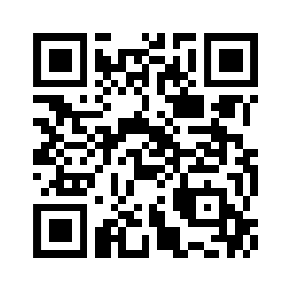
Download the Tutorial Scripts and Files From Github
https://github.com/avanhelene/BGSA_R_workshop

Slide 5
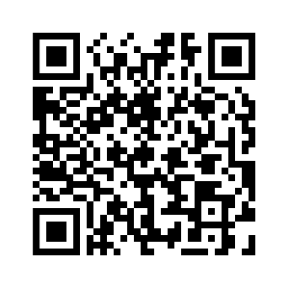
Set Up Your R Environment
Follow this tutorial
https://rstudio-education.github.io/hopr/starting.html

Slide 6
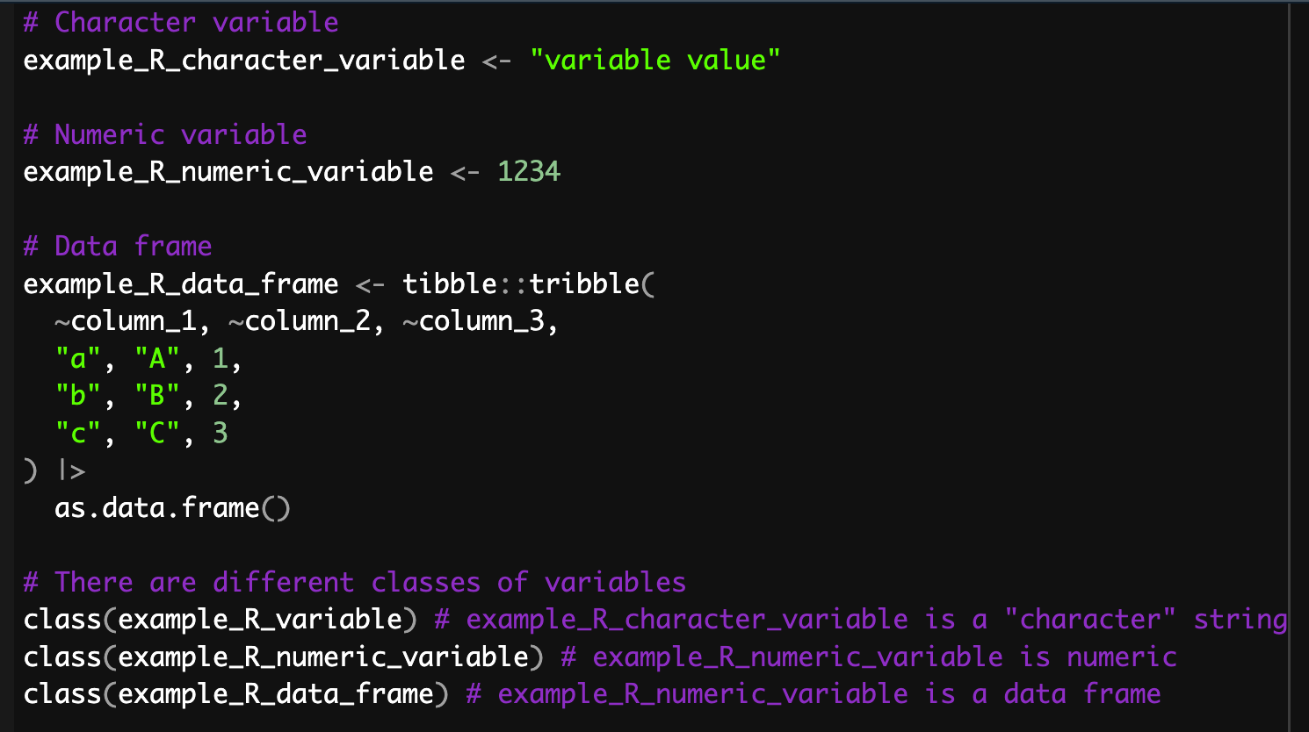
Basics of R Syntax

Slide 7
Coding Hack: Use Large Language Models (LLMs) to Write Code
LLMs are very good at writing code from scratch
LLMs are also helpful for troubleshooting
https://chatgpt.com

Slide 8
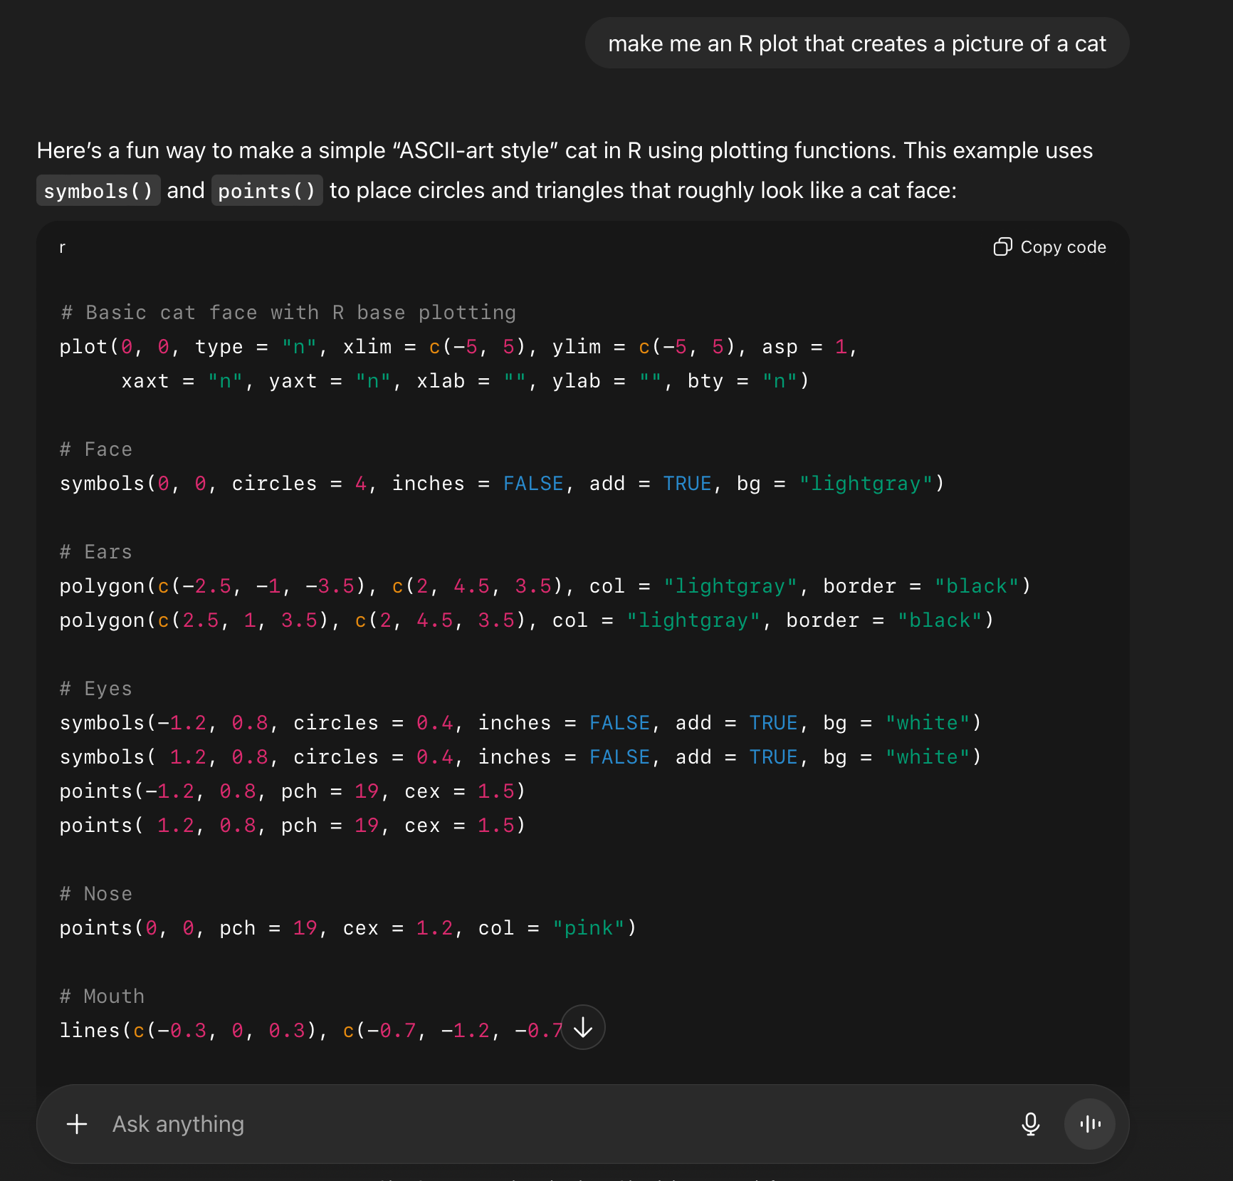
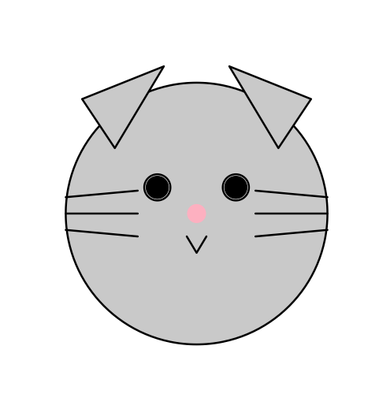
LLMs Are Better at Coding than Most People…

