Slide 1
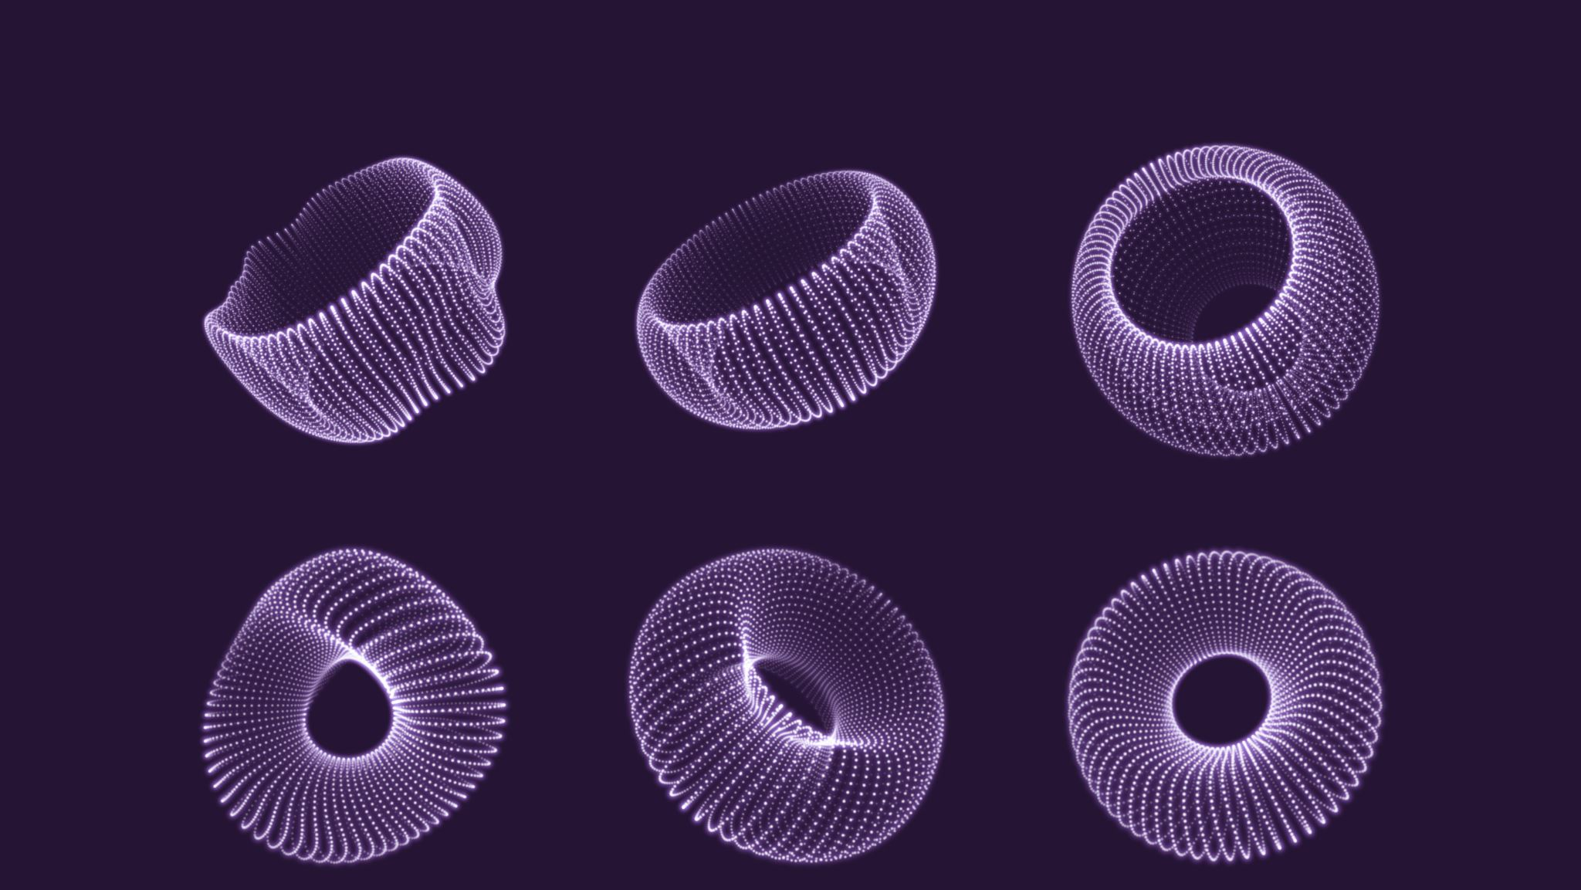
Prediction of Cell Growth in Bioreactors
Avani Bhojwani
Data Scientist

Slide 2
Agenda
Bio
Project Context
Defining the Problem
Data Source & Summary
Exploratory Data Analysis
Modelling
Summary and Next Steps
Appendix: list of supporting documents

Slide 3
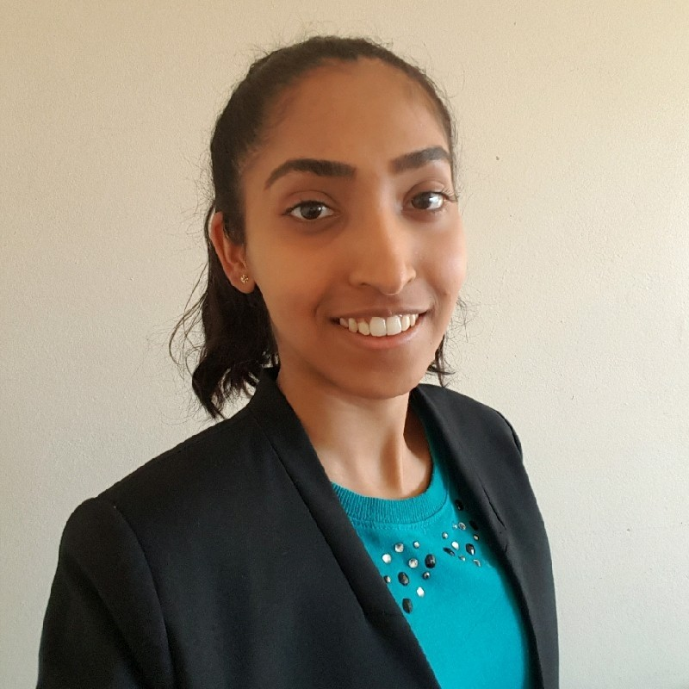
Bio
Education
Bachelor of Biomedical Science (Honours)
Professional Certificate in Data Science & AI
Experience
2 years in biotechnology start-up
Research and development
Skills
Machine learning
Data visualisation
Data analysis

Slide 4
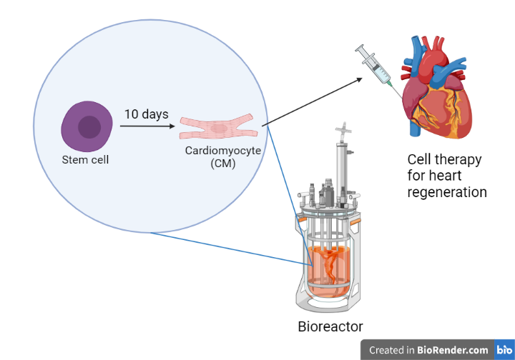


Challenges of Optimising a Biological Process
Time consuming
Costly

Slide 5



Cell manufacturing must occur at scale for commercialisation
Bianca Williams – A researcher who aims to commercialize her research on cardiomyocyte production
57 000 Australians suffer a heart attack every year
Clinicians need 1 billion cells for each patient
Notes:
https://www.ncbi.nlm.nih.gov/pmc/articles/PMC4600677/
https://www.heartfoundation.org.au/activities-finding-or-opinion/key-statistics-heart-attack
https://www.hri.org.au/health/learn/cardiovascular-disease/heart-attack
Heart attacks are responsible for almost 1 in 20 deaths
$680 million is spent on health care services related patients hospitalised for heart attacks

Slide 6
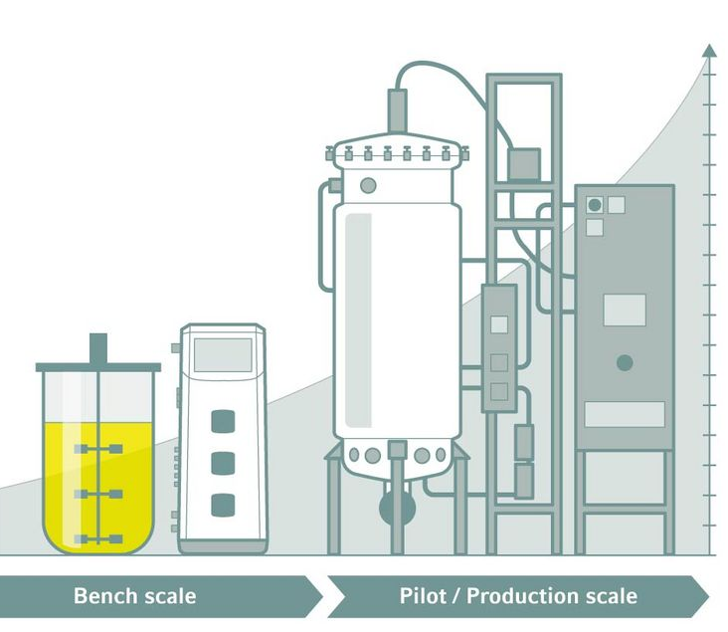
Cell manufacturing must occur at scale for commercialisation
Stakeholder:
Bianca Williams – A researcher who aims to commercialize her research on cardiomyocyte production
Current scale of production:
10 billion CMs produced in 1 L bioreactor
1 billion cells needed for 1 patient
Scale of heart disease in Australia:
57 000 Australians suffer a heart attack every year
https://handling-solutions.eppendorf.com/cell-handling/bioprocess/processes-and-applications/detailview/news/its-a-matter-of-volume-bioprocess-scalability/

Slide 7
Defining the Problem
Business question:
How can we save time and costs associated with optimising the process of cardiomyocyte production?
Data question:
How can we predict whether an experiment will produce insufficient cardiomyocyte content?
Insufficient is when less than 90% of stem cells have become cardiomyocytes.
Predict outcome of day 10 from data up to day 7.

Slide 8
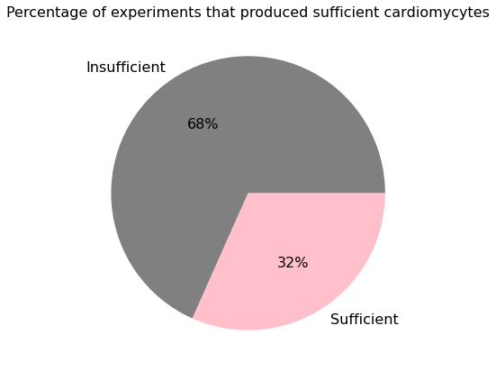
Data Source
Source:
Williams, Bianca, et al. "Prediction of human induced pluripotent stem cell cardiac differentiation outcome by multifactorial process modeling." Frontiers in bioengineering and biotechnology 8 (2020): 851.
60 experiments
Training: 42 experiments
Test: 18 experiments
Notes:
Data source:
https://www.frontiersin.org/articles/10.3389/fbioe.2020.00851/full#B10

Slide 9
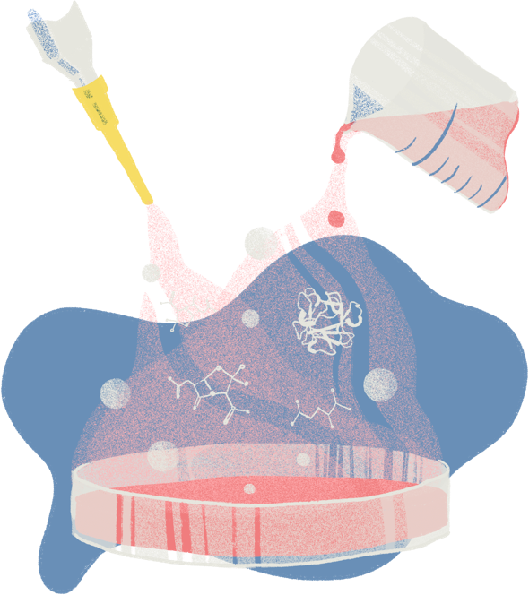
Business Value
2 hours of researchers’ time saved every time a bioreactor is stopped early
6 out of 10 bioreactors stopped early per fortnight → 12 hours saved per fortnight
156 bioreactors stopped early per year → 312 hours saved annually
Research Assistant $33/hour → $10 562 saved annually
https://www.vowfood.com/what-we-do
Notes:
Cost of 1L of CDM3 medium = $66.26
$45.66 for 1 L RPMI if we buy 6 L for $274.00 https://www.sigmaaldrich.com/AU/en/product/sigma/r8758?gclid=EAIaIQobChMIxI_QpKTx8wIVS0NgCh3RNghSEAAYAiAAEgJgmfD_BwE
$28.33/L if buying large amounts but that may not be a good idea because it can expire
$16 for 0.5g recombinant human albumin http://www.richcoreindia.com/products-info/5f4324cca0fb3174989110d9/4
$4.60 for 0.2112g of LAA2P https://www.sigmaaldrich.com/AU/en/product/sigma/a8960
If testing at small scale:
100 mL of media required per bioreactor between day 7 and day 10
10 bioreactors runs performed in parallel per fortnight
1 L of media costs ~$66
If 6 out of 10 bioreactors stopped early: $39.60 saved fortnightly
26 fortnights in 1 year → $1029.60 saved annually
If testing at large scale (using 1L bioreactors):
1L of media costs ~$49
~$7644 saved annually

Slide 10
Data summary
Automatically collected
Dissolved oxygen (DO)
pH
Manually collected
Cell density (cells/mL)
Aggregate size (μm)
Glucose concentration
Lactate
Preculture conditions
Engineered features
DO/cell density
Cell density gradient
Aggregate size gradient
DO concentration gradient
2nd derivative of DO concentration
94 variables total
48 measured variables
46 engineered features

Slide 11
Project Pipeline
Define
Source Data
Explore Data
Business question
Data question
Feature engineering
Manual and automatic measurements
Visualise
Model
Evaluate
Compare
Implement
Deliver
Summarise
Advise
Feature selection

Slide 12
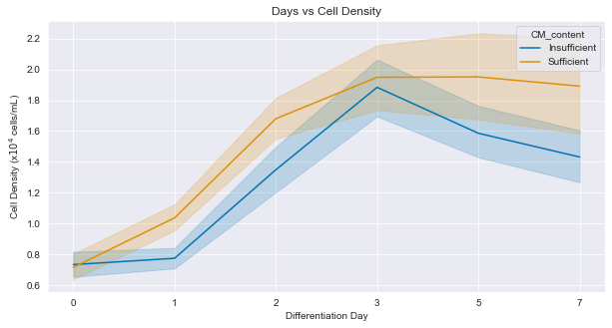
Top 3 Features Correlated to Day 10 CM Content
Feature | Correlation
Day 1 cell density | 0.54
Day 7 cell density | 0.45
Day 5 cell density | 0.44
Cell density tends to be higher when sufficient CM content is produced

Slide 13
Modelling
Features were selected using the Random Forest model
Model | Accuracy (Proportion of labels that match true labels) | Precision (Not to label a sufficient experiment outcome as insufficient) | Recall (Find all the insufficient experiments)
Random Forest (all features) | 0.89 | 0.92 | 0.92
Random Forest (36 features) | 0.72 | 0.75 | 0.92
Bagging Decision Trees (36 features) | 0.67 | 0.73 | 0.85
AdaBoost (36 features) | 0.72 | 0.90 | 0.69
Notes:
Time taken to train models

Slide 14
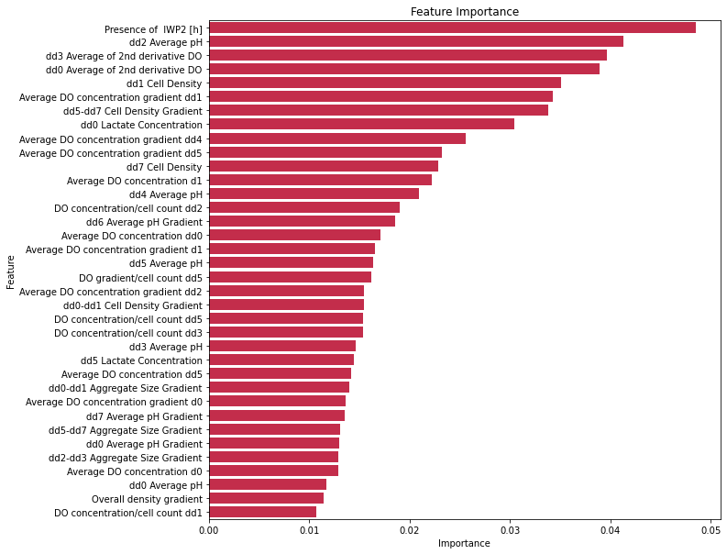
Feature Importance
IWP2 time was always 48 h for ‘sufficient’ outcome
Notes:
N-(6-Methyl-2-benzothiazolyl)-2-[(3,4,6,7-tetrahydro-4-oxo-3-phenylthieno[3,2-d]pyrimidin-2-yl)thio]-acetamide

Slide 15
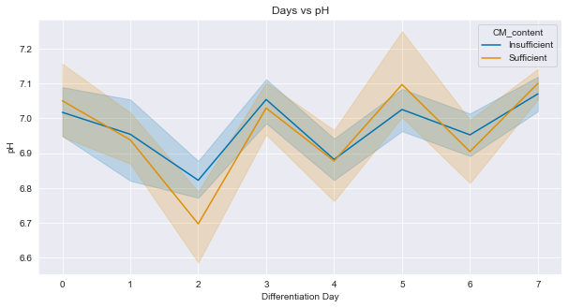
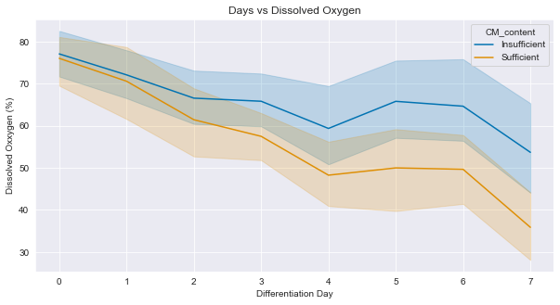
Most Important Features for Model Prediction
On average, day 2 pH was lower in ‘sufficient’ experiment runs
Dissolved oxygen tends to be lower on day 3 for ‘sufficient’ outcome

Slide 16
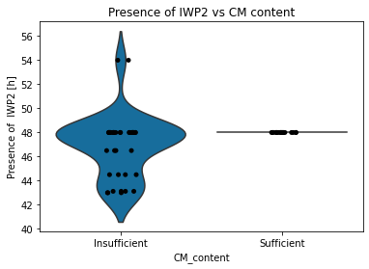
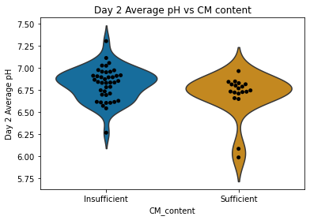
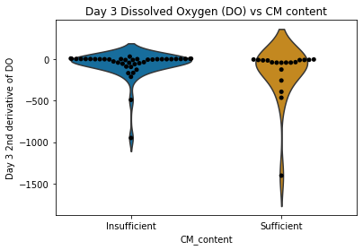
Top 3 features important for model prediction

Slide 17
Summary
Using Random Forest Classifier, we can predict whether the CM content will insufficient with 89% accuracy and 92% precision.
This can save over $10 000 and 312 hours annually.
Top 3 important features for the model to predict outcome:
Presence of IWP2 (hours)
Day 2 pH
Day 3 dissolved oxygen
Cell density is correlated to day 10 CM content
Days 1, 5, and 7
Notes:
Limitations:
Cannot predict yield
Cannot predict how functional cells will be

Slide 18
Next Steps
Deployment onto Heroku using Flask App
Data from more experiments should be incorporated
Try to predict day 10 outcome earlier – at day 5, rather than day 7
Notes:
Additional nutrient concentrations can be measured throughout the process

Slide 19
Appendix
Data source:
https://www.frontiersin.org/articles/10.3389/fbioe.2020.00851/full
Other resources:
https://www.ncbi.nlm.nih.gov/pmc/articles/PMC4600677/
https://www.heartfoundation.org.au/activities-finding-or-opinion/key-statistics-heart-attack
https://www.hri.org.au/health/learn/cardiovascular-disease/heart-attack
Code and documentation:
https://github.com/avani-bhojwani/Institute_of_data/tree/main/Capstone

