Slide 1
VOXELNET
End-to-End Learning for Point Cloud Based 3D Object Detection

Slide 2
Topics to be covered
Object Detection in 3D space
VoxelNet Architecture
Loss Function
Car Detection Example
Results

Slide 3
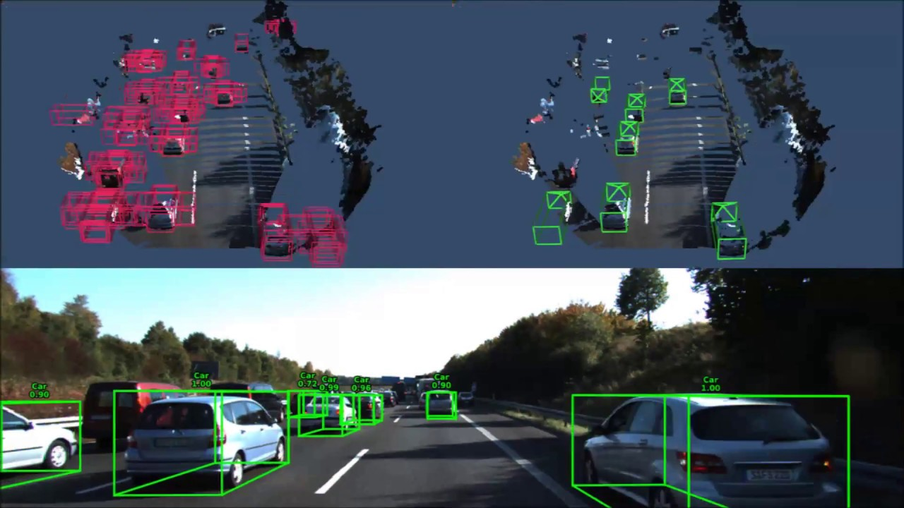
Object Detection in 3D Space

Slide 4
Object Detection in 3D Space
The task is to identify the 3D objects in a scene and put a bounding box around them.
Also, predict a probability score map for each of the bounding box.
Idea is to initialize a set of “Anchors” and then refine them to get a bounding box with highest IOU among them.
In this module, we will use point cloud representation of the 3D scene.

Slide 5
VoxelNet
VoxelNet was developed by Yin Zhou and Oncel Tuzel in 2017.
Three main parts:
Feature Learning Network
Convolutional Middle Layers
Region Proposal Network
Key feature of the architecture is VFE (Voxel Feature Encoding) layer.

Slide 6
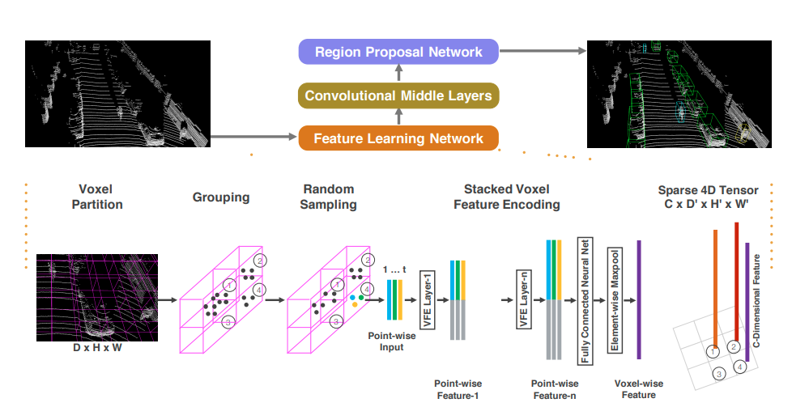
VoxelNet Architecture

Slide 7
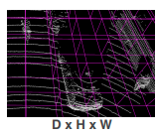
VoxelNet Architecture
Feature Learning Network
Voxel Partitioning :
Suppose point cloud encompasses the 3D space with range D, H, W along the Z, Y, X axis respectively.
Define voxel size as v_{D} , v_{H} and v_{W}.
Sub-divide the 3D space into equally spaced
voxels.
The resulting 3D voxel grid is of dimensions :
( D’ = D/v_{D} , H’ = H/v_{H}, W’ = W/v_{W} )

Slide 8
VoxelNet Architecture
Feature Learning Network
Grouping :
3D points are grouped based based on the voxel they reside in.
Due to LiDAR scanning, point cloud is sparse and has highly variable point cloud density.
Therefore, voxels will contain different number of points. Some voxels might be empty.
Random Sampling :
Randomly sample T points from each voxel (if voxel contains more than T points).
Benefits? 1. Computational Savings 2. Reduction in imbalance of points among voxels.

Slide 9
VoxelNet Architecture
Feature Learning Network
Stacked Voxel Feature Encoding :
Key innovation is chain of VFE layers, which hierarchically perform feature encoding process for a voxel.
Denote V = { p_{i} = [x_{i}, y_{i}, z_{i}, r_{i}]^{T} 𝝐 R⁴ }_{i = 1,2,.....t} as a voxel which contains t<=T points.
Compute the mean (v_{x}, v_{y}, v_{z}) of all poits in V.
Input feature set V_{in} = { p_{i}’ = [x_{i}, y_{i}, z_{i}, r_{i}, x_{i}-v_{x}, y_{i}-v_{y}, z_{i}-v_{z}]^{T} 𝝐 R⁷ }_{i = 1,2,.....t}

Slide 10
VoxelNet Architecture
Feature Learning Network
Stacked Voxel Feature Encoding :
Each p_{i}’ is transformed through the Fully Connected Network into a feature point f_{i} 𝝐 R^{m}
This FCN is composed of a linear layer, and a batch norm layer with ReLu activation function.
Then, Maxpooling is applied element-wise to get a locally aggregated feature f’ 𝝐 R^{m} for the voxel V.
Define f ^{out} = [ f_{i}^{T}, f’^{T} ]^{T} 𝝐 R^{2m}
V_{out} = { f_{i}^{out} }_{i = 1,2,.....t}

Slide 11
VoxelNet Architecture
Feature Learning Network
Stacked Voxel Feature Encoding :
VFE-i(c_{in}, c_{out}) is the i-th VFE layer which transforms input features of dimension c_{in} into output features of dimension c_{out}.
The linear layer learns a matrix of size c_{in} x (c_{out}/2)
The output of VFE-n is transformed into R^{C} using an FCN and applying Maxpooling. (C is the dimension of voxel-wise feature)

Slide 12
VoxelNet Architecture
Feature Learning Network
Stacked Voxel Feature Encoding :
VFE-i(c_{in}, c_{out}) is the i-th VFE layer which transforms input features of dimension c_{in} into output features of dimension c_{out}.
The linear layer learns a matrix of size c_{in} x (c_{out}/2)
The output of VFE-n is transformed into R^{C} using an FCN and applying Maxpooling. (C is the dimension of voxel-wise feature)
Sparse Tensor Representation :
The list of voxel-wise features can be represented as a sparse 4D tensor of size
C x D’ x H’ x W’.
This sparse tensor reduces the memory usage.

Slide 13
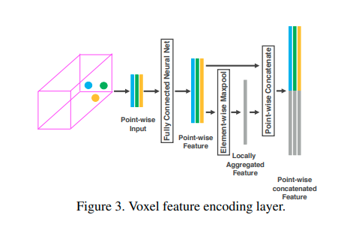
VoxelNet Architecture
Feature Learning Network

Slide 14
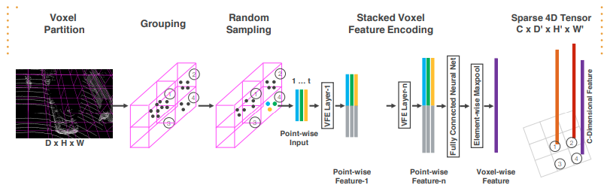
VoxelNet Architecture
Feature Learning Network

Slide 15
VoxelNet Architecture
Convolutional Middle Layers
ConvMD( c_{in}, c_{out}, k, s, p) an M-dimensional Convolutional Operator, where c_{in} and c_{out} are the number of input and output channels.
Each convolutional layer applies 3D convolution, Batch Norm, and ReLu sequentially.

Slide 16
VoxelNet Architecture
Region Proposal Network
The input to RPN is the feature map provided by final convolutional layer.
The RPN has 3 blocks of fully convolutional layers.
The first layer of each map downsamples the featue map by half via a convolution with a stride size of 2.
It is followed by the convolutions of stride 1.
✕q means applying the filter q times.
Then, BN and ReLU is applied.
Output of each block is then upsampled to a fixed size and concatenated to form a feature map.
Finally, this feature map is mapped to the desired learnings: 1. Probability score map & 2. Regression map.

Slide 17
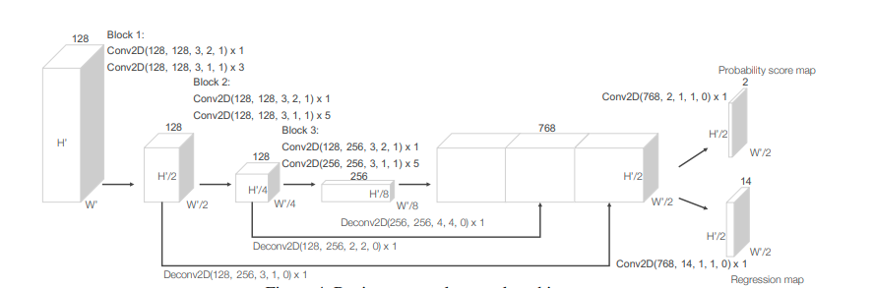
VoxelNet Architecture
Region Proposal Network

Slide 18
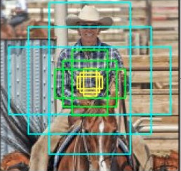
Loss Function
Anchors

Slide 19
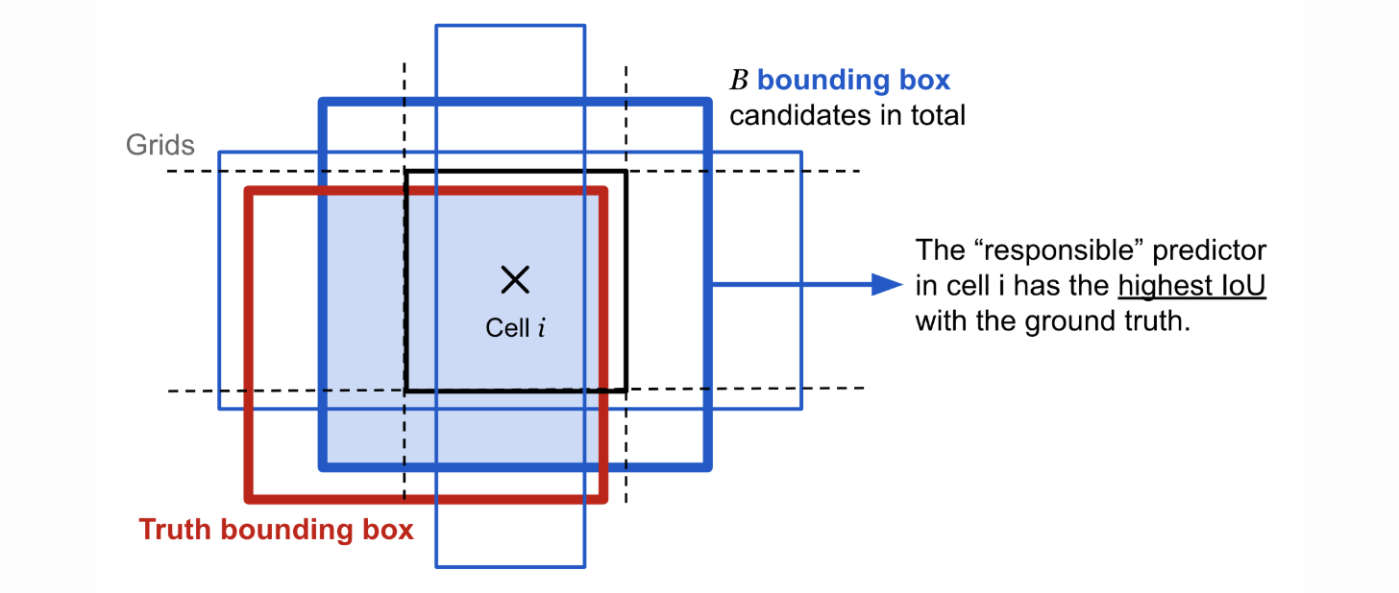
Loss Function
Anchors

Slide 20
Loss Function
Formulation
Let { a_{i}^{pos} }_{i = 1,2,.....Npos} be the set of N_{pos} positive anchor boxes.
Similarly, let { a_{i}^{neg} }_{i = 1,2,.....Nneg} be the set of N_{neg} negative anchor boxes.
3D ground truth bounding box is parametrized as ( x_{c}^{g}, y_{c}^{g}, z_{c}^{g}, l^{g}, w^{g}, h^{g}, θ^{g} ).
Anchors is parametrized as ( x_{c}ª, y_{c}ª, z_{c}ª, lª, wª, hª, θª ).
Define a residual vector u* 𝝐 R⁷, u* = [𝚫x, 𝚫y, 𝚫z, 𝚫l, 𝚫w, 𝚫h, 𝚫θ]^{T}.

Slide 21
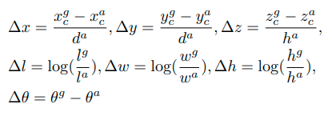

Loss Function
Formulation
(diagonal of the base of the anchor box)

Slide 22
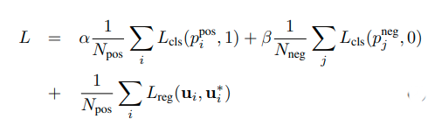
Loss Function
Formulation
L_{cls}is the binary cross entropy loss.
L_{reg} is the L1 loss.

Slide 23
Car Detection
Point clouds are within the range [-3,1] x [-40,40] x [0,70.4] metres along Z, Y and X axis respectively.
v_{D} = 0.4, v_{H} = 0.2, v_{W} = 0.2
D’ = 10, H’ = 400, W’ = 352
T = 35
Two VFE-layers VFE-1(7,32) and VFE-2(32,128)
FCN maps VFE-2’s ouptu to R¹²⁸
Generated sparse tensor is of dimension 128 x 10 x 400 x 352

Slide 24
Car Detection
3 Conv3D layers are used :
Conv3D( 128, 64, 3, (2,1,1), (1,1,1) )
Conv3D( 64, 64, 3, (1,1,1), (0,1,1) )
Conv3D( 64, 64, 3, (2,1,1), (1,1,1) )
Output is 64 x 2 x 400 x 352, which is reshaped into 128 x 400 x 352 and feeded to RPN.
Only one anchor size is used : lª = 3.9, wª = 1.6, hª = 1.56 metres
𝝰=1.5, 𝝱=1

Slide 25
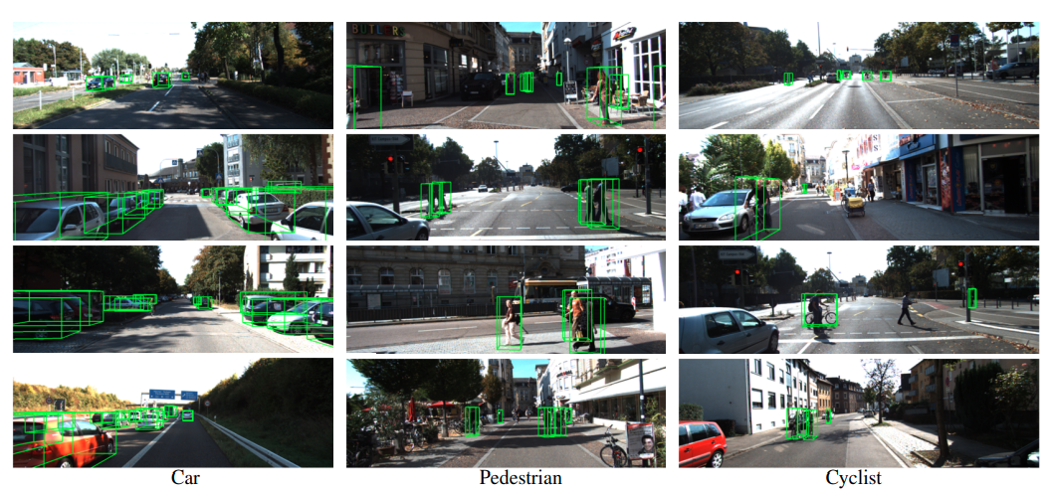
Results

Slide 26
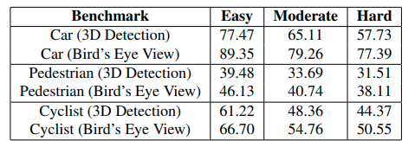
Results

