Slide 1
From voxels to pixels and back:
Self-supervision in natural-image reconstruction from fMRI
Avani Gupta(2019121004), Jalees Jahanzaib(2018101001), Mayank Goyal(2018101002)

Slide 2
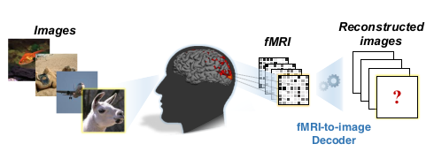
Problem statement:
Reconstructing observed images from fMRI brain recordings.
Brain Machine Interfaces
Reconstructing dreams
Study Consciousness

Slide 3
Challenges:
Restricted by lack in “labelled” training data
Poor Spatio-temporal resolution
Low Signal to Noise ratio(SNR)
Domain adaptation

Slide 4
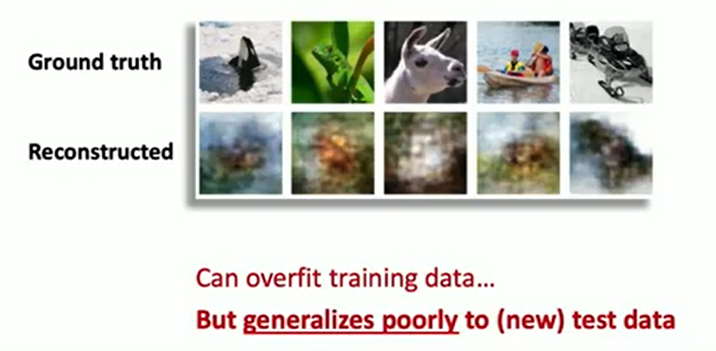
Prior Work:
Linear regression between fMRI data and handcrafted image-features.
Linear regression between fMRI data and Deep image-features.
End-to-end supervised Deep Learning models.
All these methods are supervised (less data , poor results)

Slide 5
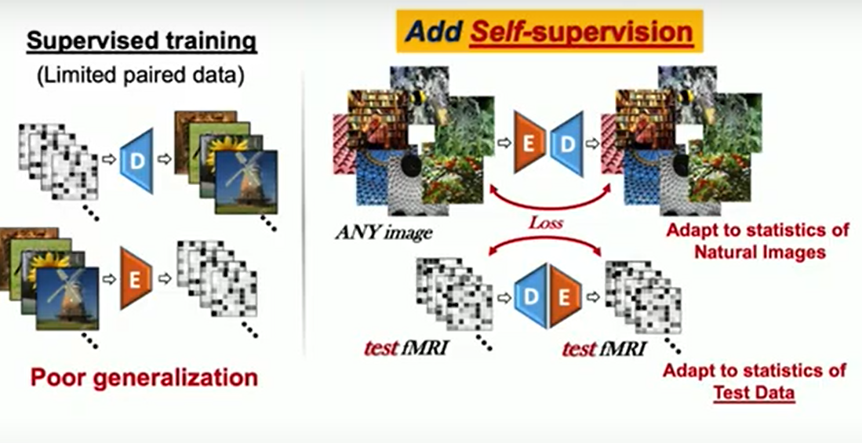
Self-Supervision:
Self-supervision using unlabelled data.

Slide 6
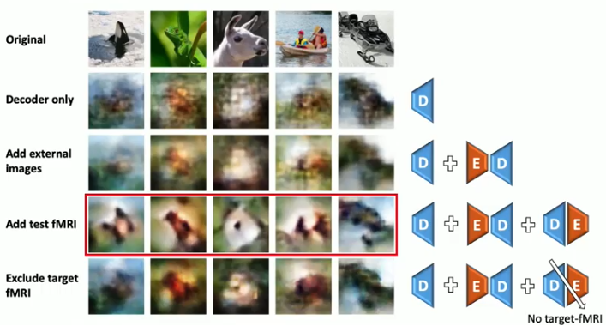
Self-Supervision effect:
Training on these unlabeled test-fMRI (without their images) is the key feature.

Slide 7

Dataset Used: fMRI on imagenet
for Supervised training: fMRI on imagenet
1250 distinct ImageNet images from 200 categories.
1200 for training, 50 for testing.
for SSL: 50K unlabeled natural images from ImageNet validation data

Slide 8
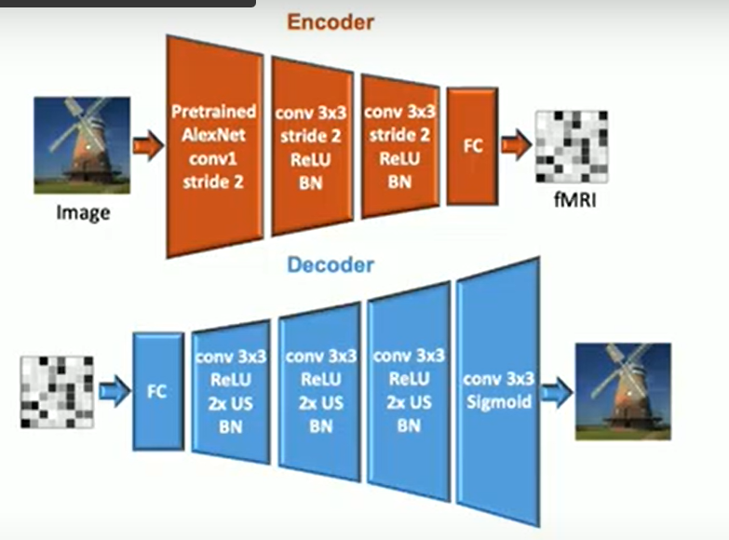
Method Overview:
Two Deep Models: Encoder and Decoder

Slide 9
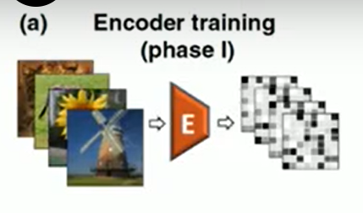
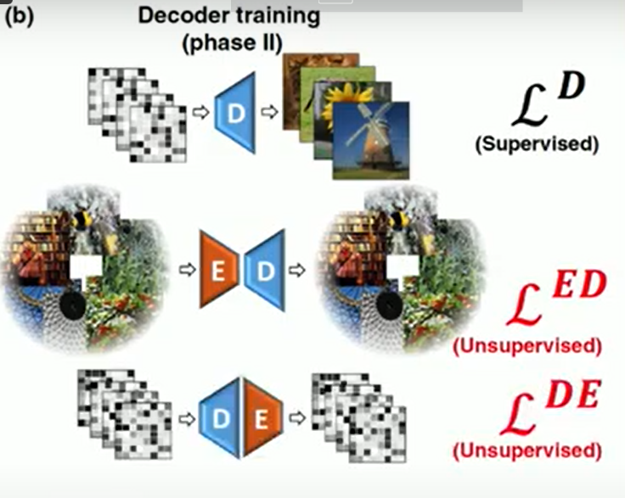
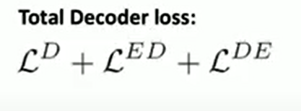
Method Overview:
Phase 1: Training the Encoder
Phase 2: Training Decoder on three types of batches
labeled image-fMRI pairs
unlabeled natural images
unlabeled fMRI

Slide 10

Encoder (Images -> fMRI)
fMRI loss

Slide 11

Decoder D (fMRI -> Images)
The training loss of our decoder consists of three main losses

Slide 12



Training Loss
Decoder Supervised Training

Slide 13
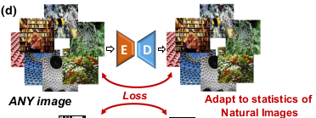

Training Loss (contd)
Encoder-Decoder training on unlabeled Natural Images:

Slide 14



Training Loss (contd)
Decoder-Encoder training on unlabeled test fMRI:

Slide 15
Training details
We train encoder(image to fMRI) for 80 epochs.
Froze it then train decoder(fMRI to image) for 150 epochs.
Decoder is trained jointly on a mix of labelled and unlabelled data with 48 paired and 16 unpaired samples in a batch.
We have a training time of 15-20 mins for encoder(on 1 1080 RTX GPU) and nearly 1-2 hours for decoder on 2 1080 RTX GPUs)

Slide 16
Training details
Encoder is trained using SGD optimizer with an initial learning rate of 0.1, with a predefined learning rate scheduler.
Decoder is trained for 150 epochs using Adam optimizer with an initial learning rate of 1e-3, and 80% learning rate drop after every 30 epochs

Slide 17
Results

Slide 18
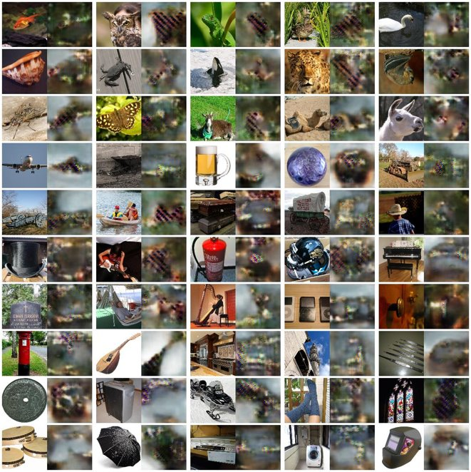
Results
When SSL training on 600 images

Slide 19
Results
When SSL training on 50k images

Slide 20
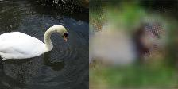
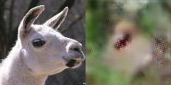
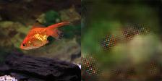
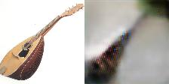

Slide 21
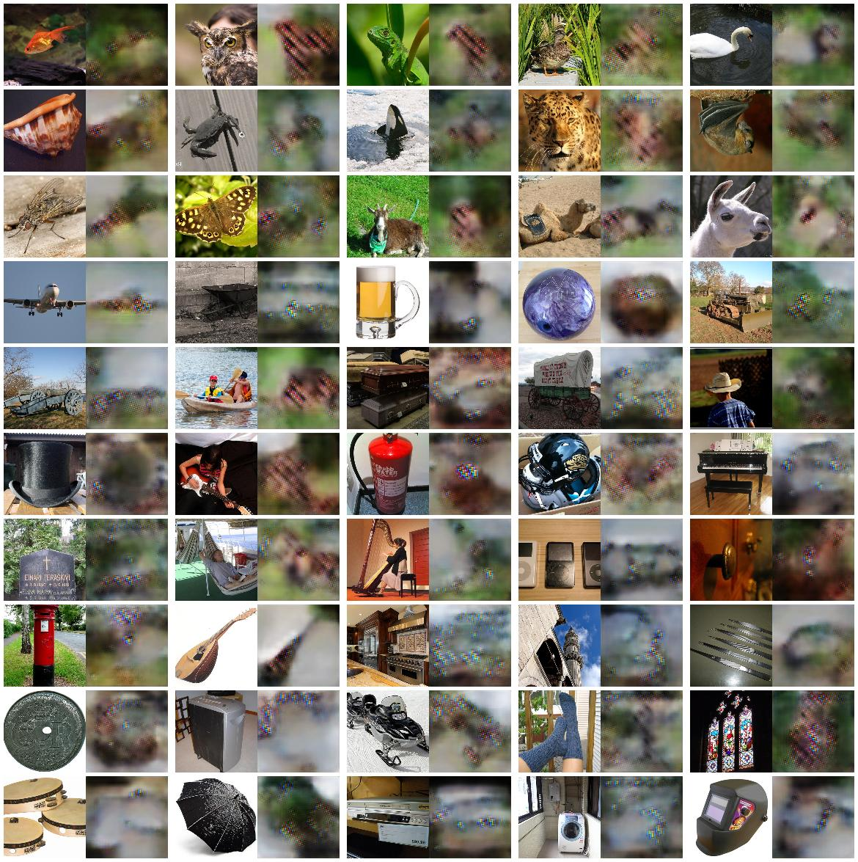
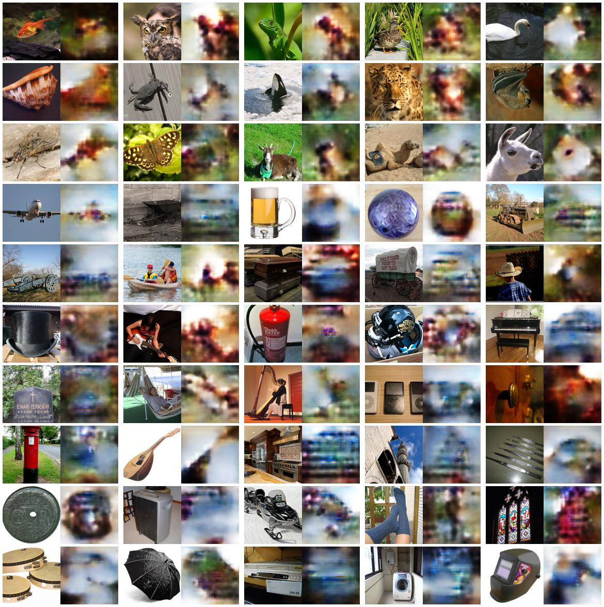
Comparison with paper
Ours
Paper

Slide 22
Evaluation Metric
Correct Identification Accuracy

Slide 23
Correct Identification Accuracy
For each reconstructed image, the task is to identify its ground truth image among n candidate images (n= 2, 5 or 10).
Correct Identification accuracy is calculated as follows:
Given Prediction image, choose 10 random images
Now find pearson correlation(corr) between Prediction and random images.
The one with highest corr is identified as matching image.
Check if matching image is GT, if yes, correct, else wrong.
Calculate Accuracy

Slide 24
CIA comparison
 | 2-way | 5-way | 10-way
Ours | 79.8 | 60.3 | 48.6
Paper | 83.1 | 66.4 | 51.2

Slide 25
Thanks !

