Slide 1
DATA VISUALIZATION PROJECT

Slide 2
Team Int-elligence
MEMBERS
VIPUL CHHABRA 2019121001
AVANI GUPTA 2019121004

Slide 3
01
02
DATA SET USED
ABOUT VISUALIZATION
03
04
DEMO
CONCLUDING REMARKS

Slide 4
Datasets Used

Slide 5


Main Data : For analysis
Annual Rainfall of India
Greenhouse Gas Emissions
We use the dataset of state wise Annual Rainfall of India available on data-world
Annual Greenhouse gas emission data of every state available on GHC platform India
Notes:
add another .shp one
means?

Slide 6
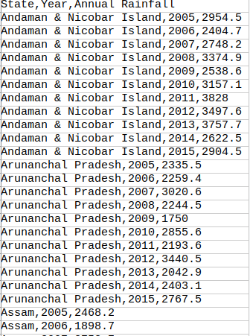
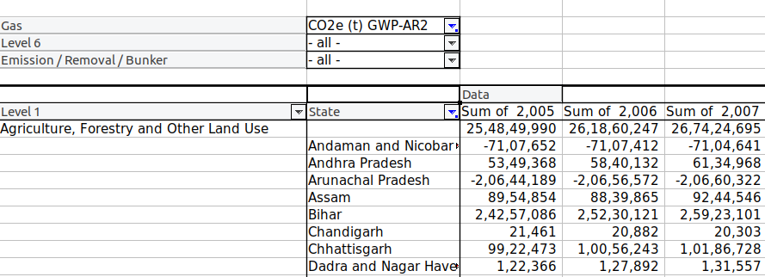
Emissions
Annual Rainfall

Slide 7
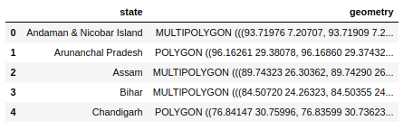
Secondary data
For mapping states:
India states Boundary - coordinates dataset

Slide 8
Preprocessing
We did preprocessing and removed null values, combined Indian State coordinates dataset with our Rainfall and Emissions dataset to get our final dataset

Slide 9
02
ABOUT VISUALIZATION

Slide 10
PURPOSE OF THE VISUALIZATION
To draw the correlation between greenhouse gas emissions and annual rainfall in each state of India
Also analyze the condition of states(declining or improved) over the years.
This will help the governments of respective states to analyze the situation and regulate the number of industries and other pollutants to maintain the ecological balance.

Slide 11
PLANS FOR VISUALIZATION
The visualization was required to analyse the situation of all the states simultaneously and also to draw relation between emission of greenhouse gases and rainfall.
For this we plan to have the map of india showing the intensity of rainfall . More darker the colour more is the Rainfall this helps to bring an top overview of the whole nation also the comparison between states in terms of rainfall
To bring the overall comparison of various parameter for a particular state and for chosen time frame, we planned to provide the user with area graph on the hover so that user can also analyze the correlation between different greenhouse gases and rainfall.
To provide the comparison of years we planned to provide the user an option to change the years so that comparison can be made for each states in terms of year too.
To bring the comparison of particular parameter between each state for a particular year, we plan to have a bar graph linked to the same slider.

Slide 12
DEMO TIME !
03

Slide 13
04
CONCLUDING
REMARKS

Slide 14
Concluding remarks
We presented the main map showing statewide rainfall trends with the intensity of color showing the category of the rainfall.
To draw a better conclusion between various emissions like Carbon, No2, CH4, and Rainfall we presented the data from 2005 to 2015 for each state on hover on that state.
With the use of a slider, the user can change the years and check the comparison of rainfall between states.
There is a linked bar chart for the rainfall and Nitrogen, CH4 emission, etc.
Users can have a better comparison with map and bar charts of different emissions.
We have written functions assuming a general dataset and our code can be used for plotting and analysing any data on Indian Map.
Our work can be also be extended to any map

Slide 15
THANKS!

