Slide 1
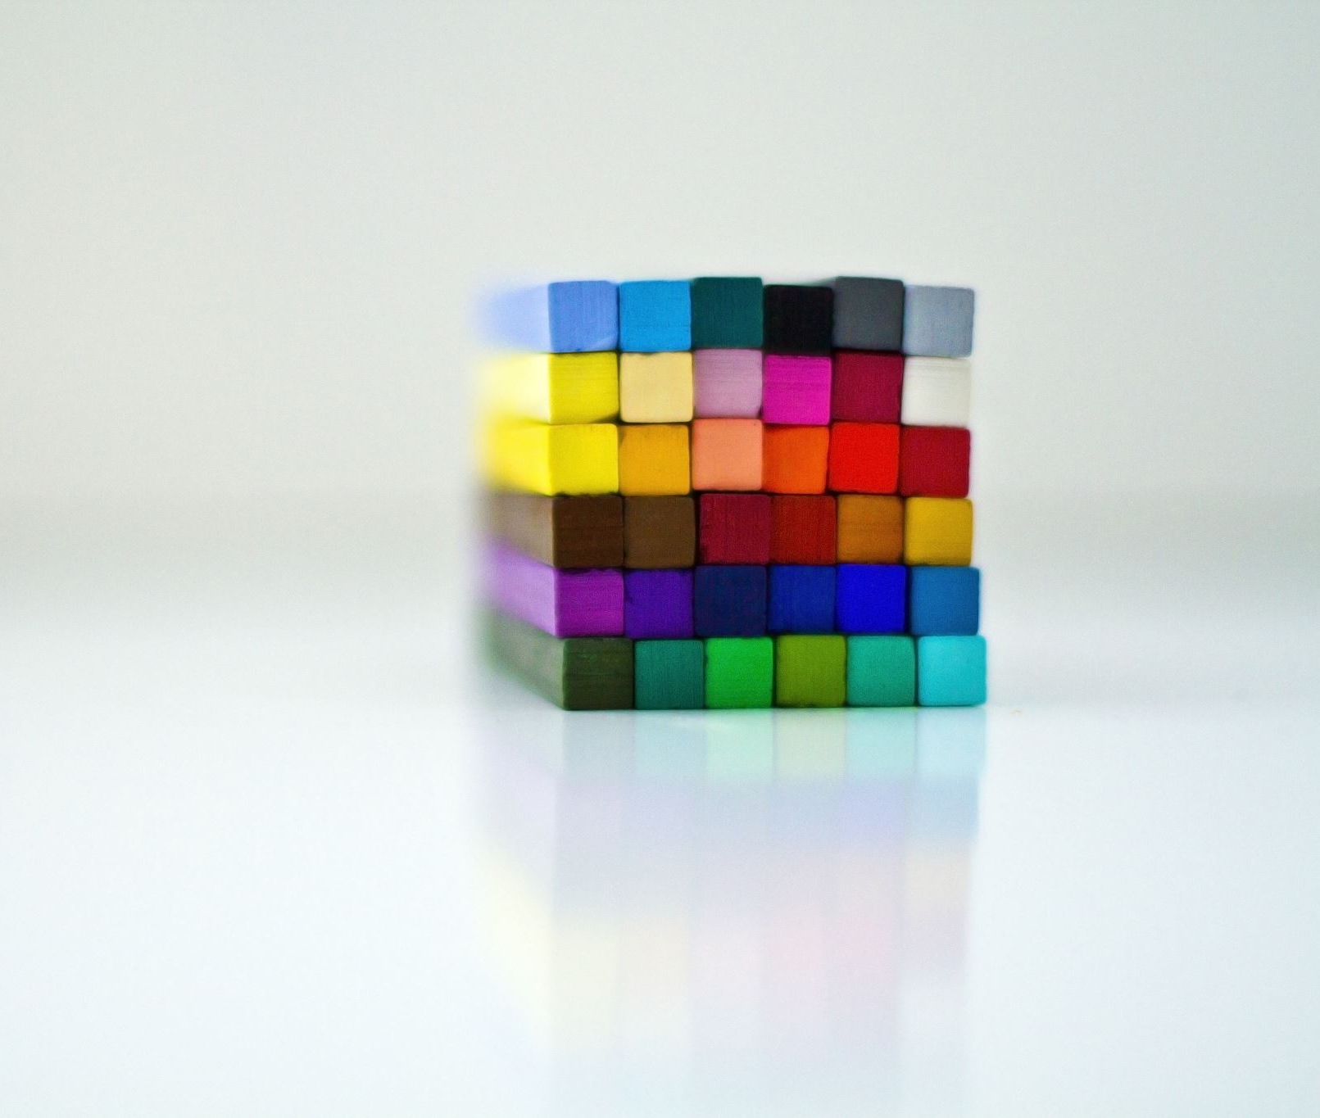
Poisson Matting (ID: 25)
Ansh Puvvada 2018102035
Avani Gupta 2019121004
Jayati Narang 2018101066
Kajal Sanklecha 2019801006
Team: Made Online

Slide 2
Main Goal
Matting for natural images in complex scenes by calculating the gradient of matte from image.
Solving Poisson equation.
Integrating user's knowledge and calculating matte in semi-supervised way(global and local matting)

Slide 3
Image matting
Image matting in our setting refers to foreground extraction from any given image.
A new image can be blended from a background image and foreground image with its "alpha matte".
I = ɑ(x, y)F (x, y) + (1 − ɑ)B(x, y) − − − −> (1).
In natural image matting: α, F and B need to be estimated.

Slide 4
Work Done till now ..
Implemented Global Matting.
Implemented efficient version for finding alpha matte.

Slide 5
Steps Involved (Global Matting)
Step 1
Find approximate foreground and background using an alpha.
Step 2
Find the Poisson Equation for this image.
Step 3
Apply Gauss Siedel Iteration to find a good approximate for alpha.
Step 4
Use this alpha to get the final new image.

Slide 6
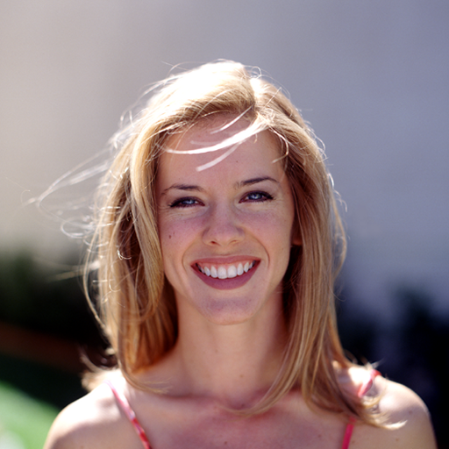

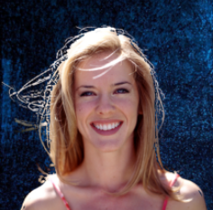
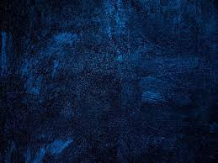

Results
Image
New Background
Alpha blending
I = α F + (1 − α )B
Image with new bg
Estimated matte
Trimap

Slide 7
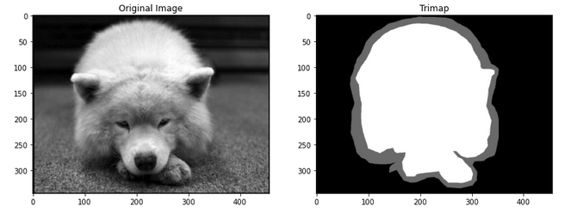
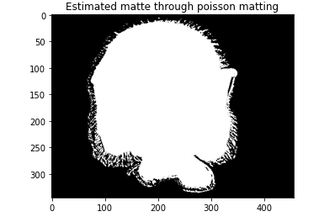
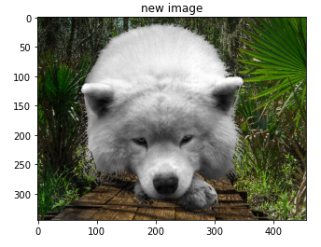
Example

Slide 8
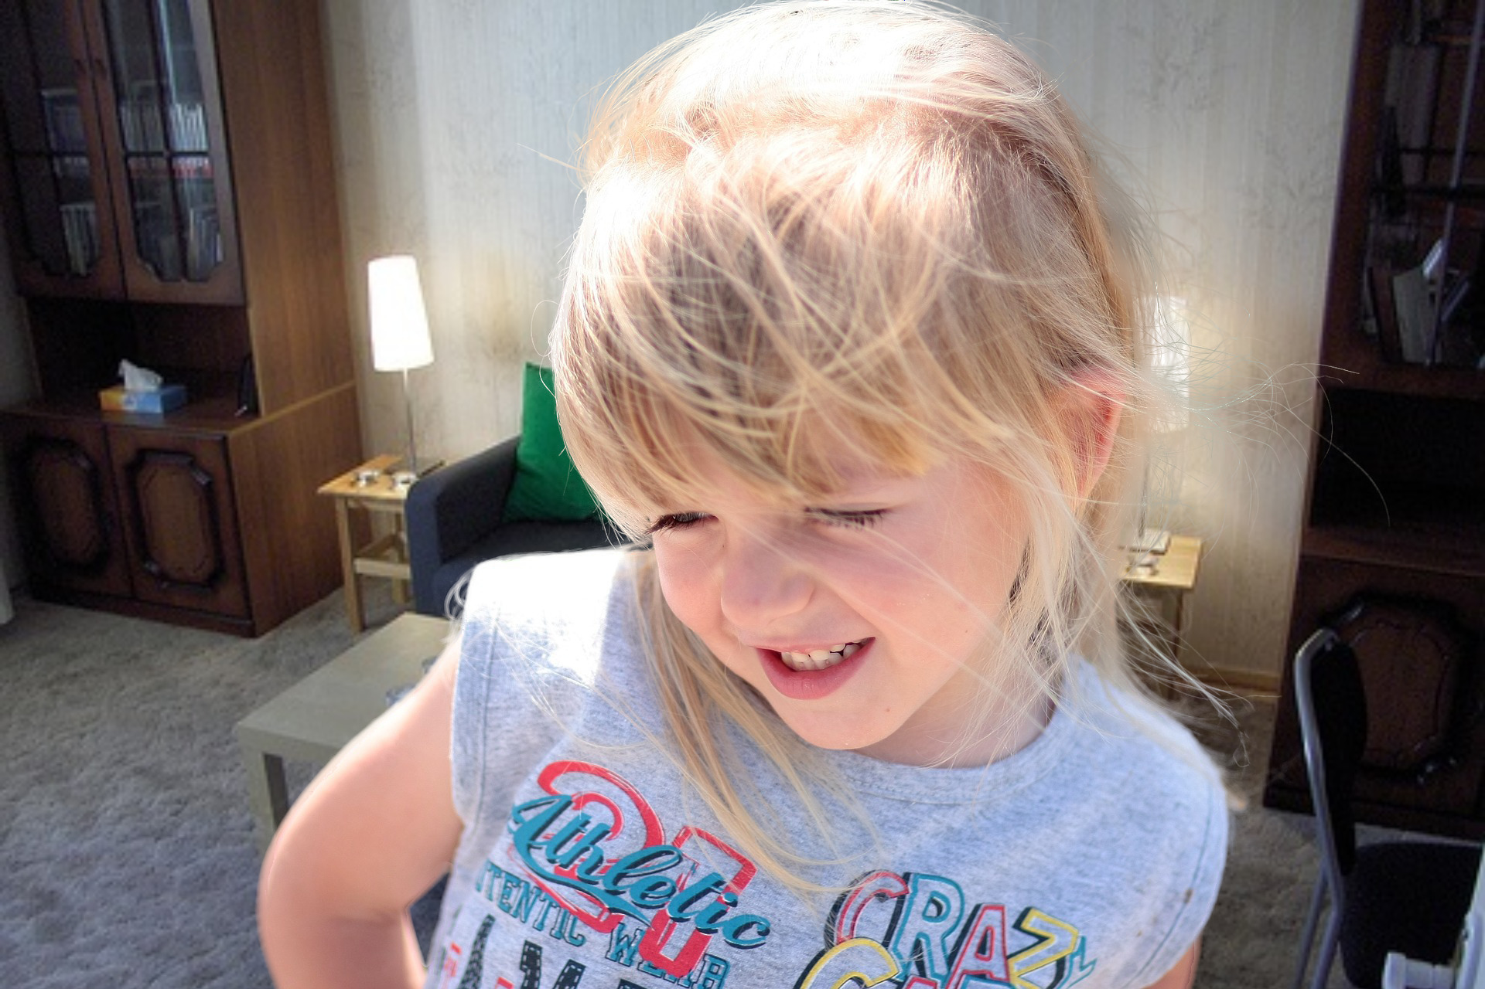
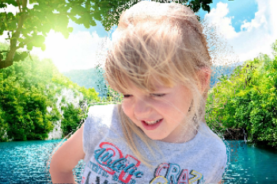
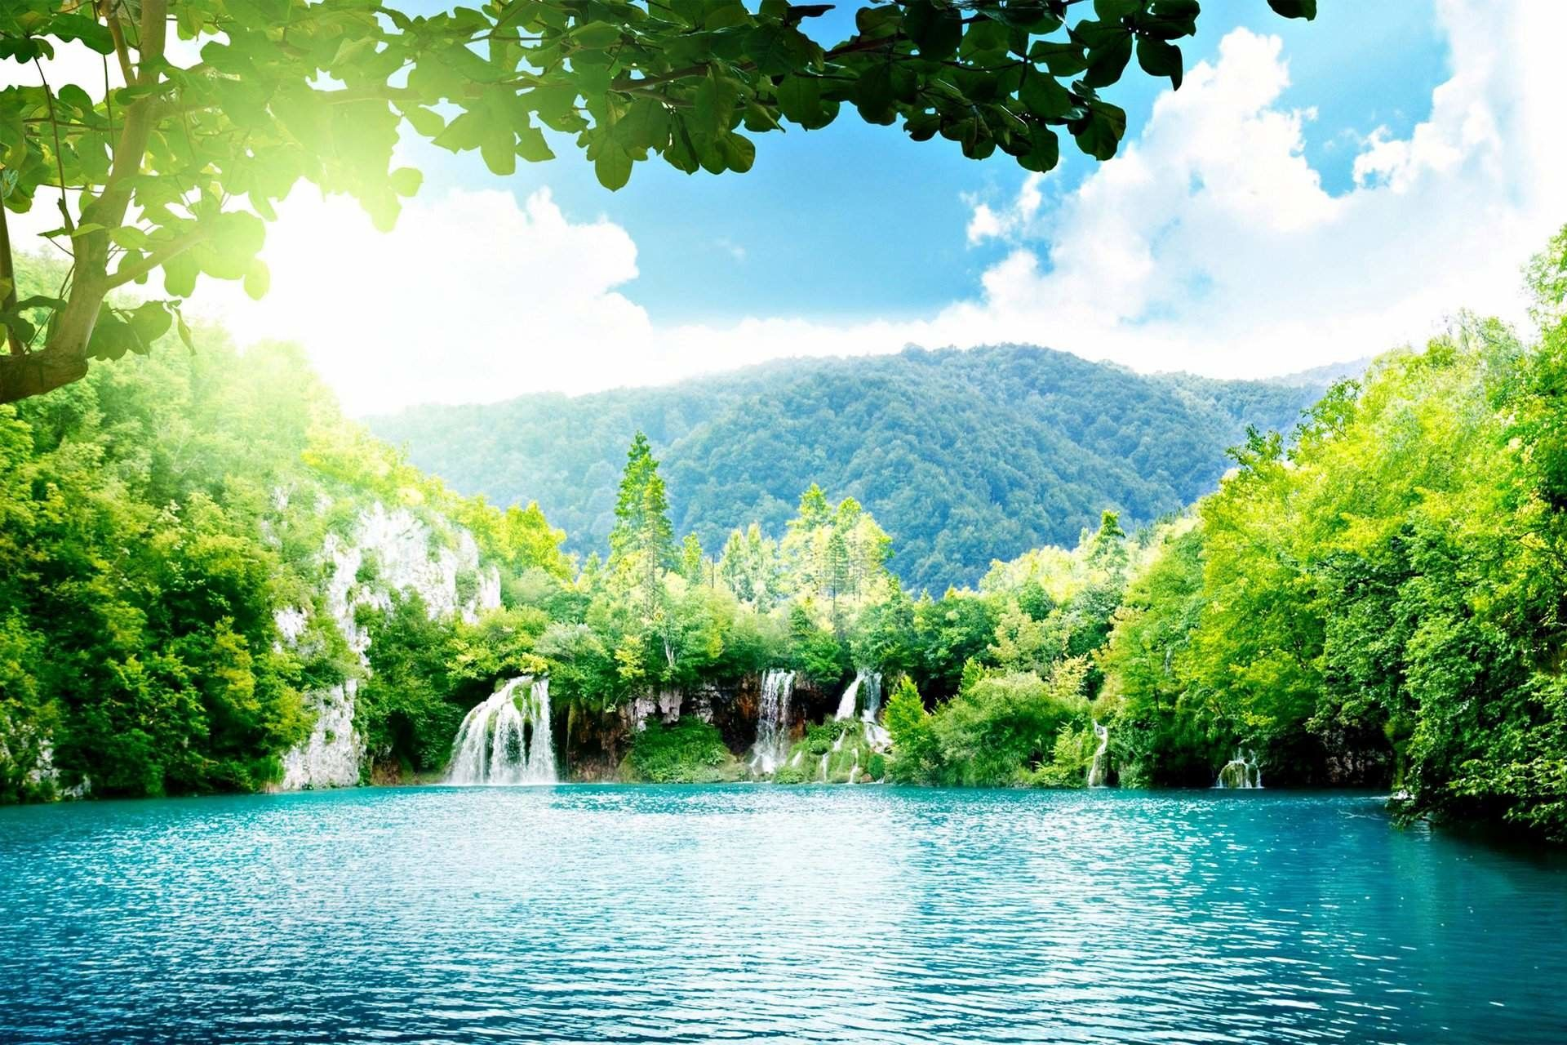

Results
Here global matting is not able to cover the fine details of hair, hence there is a need of a better algorithm, local matting.
+
=
Image
New Background
Image with new bg
Estimated matte

Slide 9
Results comparison with efficient algorithm
For the image on right side following results time was taken
Slow algorithm :
39.6 s ± 138 ms per loop (mean ± std. dev. of 7 runs, 1 loop each)
Efficient algorithm:
272 ms ± 22.4 ms per loop (mean ± std. dev. of 7 runs, 1 loop each)

Slide 10
Tasks for next evaluation
Implement Local Matting
Poisson matting on multiple backgrounds
De-fogging(tentative)

