Slide 1
DSP PROJECT: WIRELESS PPG SIGNAL FOR ACTIVITY MONITORING
Group Member name: Avani Paresh Gajallewar, Krishna Agrawal
Supervisor name: Prof. Anurag Singh
Date:09/04/2024
International Institute of Information Technology, Naya Raipur

Slide 2
CONTENT
Introduction
Objectives
Related work
Methodology/ Our Model
Results
Conclusion
*
International Institute of Information Technology, Naya Raipur
2

Slide 3
INTRODUCTION
•Photoplethysmography is a non-invasive technique used to detect volumetric changes in the microvascular bed of tissues.
•It uses optical approach that make measurements at the surface of the skin.
•It provides valuable information about the blood pressure, respiratory rate from which cardiovascular diseases, aging etc. can be concluded.
•PPG signal graphs contain a lot of insight that can be used to access the patterns related to heart.
*
International Institute of Information Technology, Naya Raipur
3

Slide 4
OBJECTIVES
There are various applications of ppg signal, especially in the medical domain.
We are focusing on activity monitoring using the ppg signal.
Basically, the signal is acquired, pre-processed and then sent to an ml model to classify the work being done.
There are a lot of challenges in processing the signal and retaining the most accurate features out of it.
By use of filters and signal processing techniques we aim to achieve refined ppg that can be used for further monitoring processes.
*
International Institute of Information Technology, Naya Raipur
4

Slide 5
RELATED WORK
[1] Comparison of Different Machine Learning Techniques for the Cuffless Estimation of Blood Pressure using PPG Signals uses ppg signals for estimating the blood pressure. Use of filters (chebychev-II) to reduce noise. Features are extracted and then fed to different ml models for estimation.
[2] Cuff-less Blood Pressure measurement from Wireless ECG and PPG signals extracts ECG and PPG time domain features acquired through wireless hardware system. Using SVM, model of blood pressure estimation is trained.
[3] A Survey on Denoising Techniques of PPG Signal discusses various kind of noise that can occur in a ppg signal and methos to remove it to acquire features of ppg signal.

Slide 6
OVERVIEW
Acquiring a ppg signal is challenging task due to presence of various types of noise associated with it.
Motion Artifacts: movement of subject causes fluctuations in the signal. It is basically due to sensor displacement, muscle movement etc. These can be removed by using PMAF Periodic moving average filter which uses 8th order butterworth LPF and adaptive filters like Least Mean Square Filter.
Baseline Wander: It comes in the category of low-frequency noise. Changes in sensor contact with the skin or other environmental factors are a major cause. The isoelectric line of PPG signal gets affected and makes estimation inaccurate . It can be removed by use of detrending (inbuilt function)
Power line interference noise: Power line interference is the high-frequency artifact caused by instrumentation amplifier ambient electromagnetic signals and power source obstruction. It can be removed by Independent Component Analysis (blind source separation) which removes AWGN noise.

Slide 7
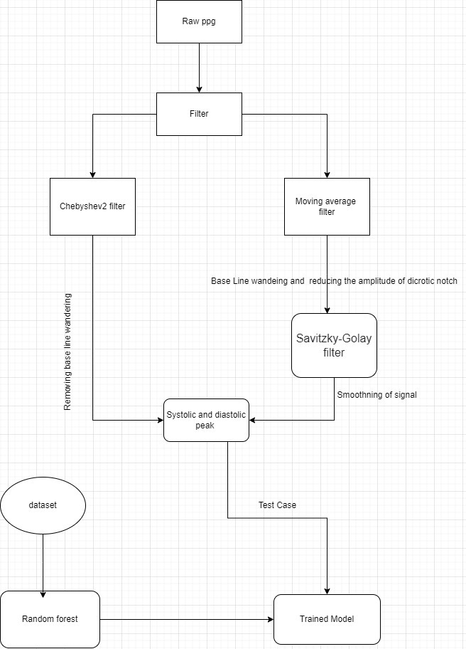
METHODOLOGY

Slide 8
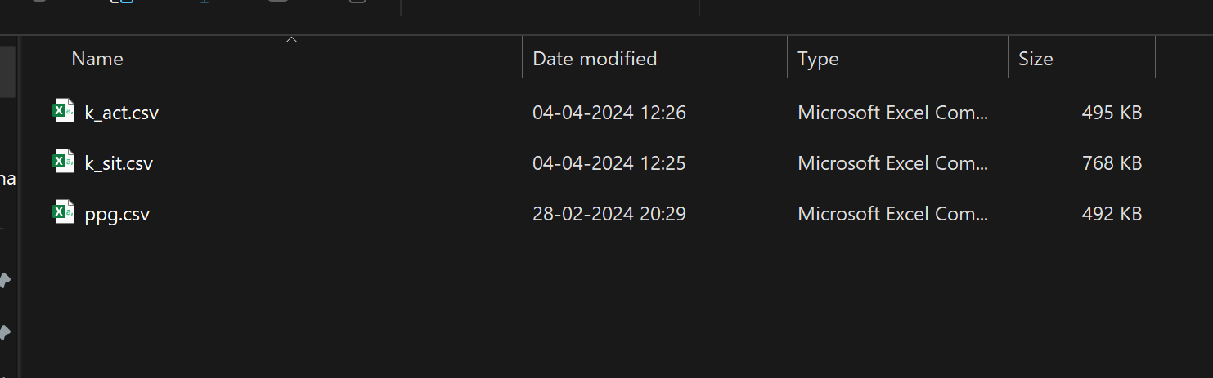
DATASET
PPG Signal is acquired from OpenSignal Application in the form of a txt file and converted into csv for easy processing

Slide 9
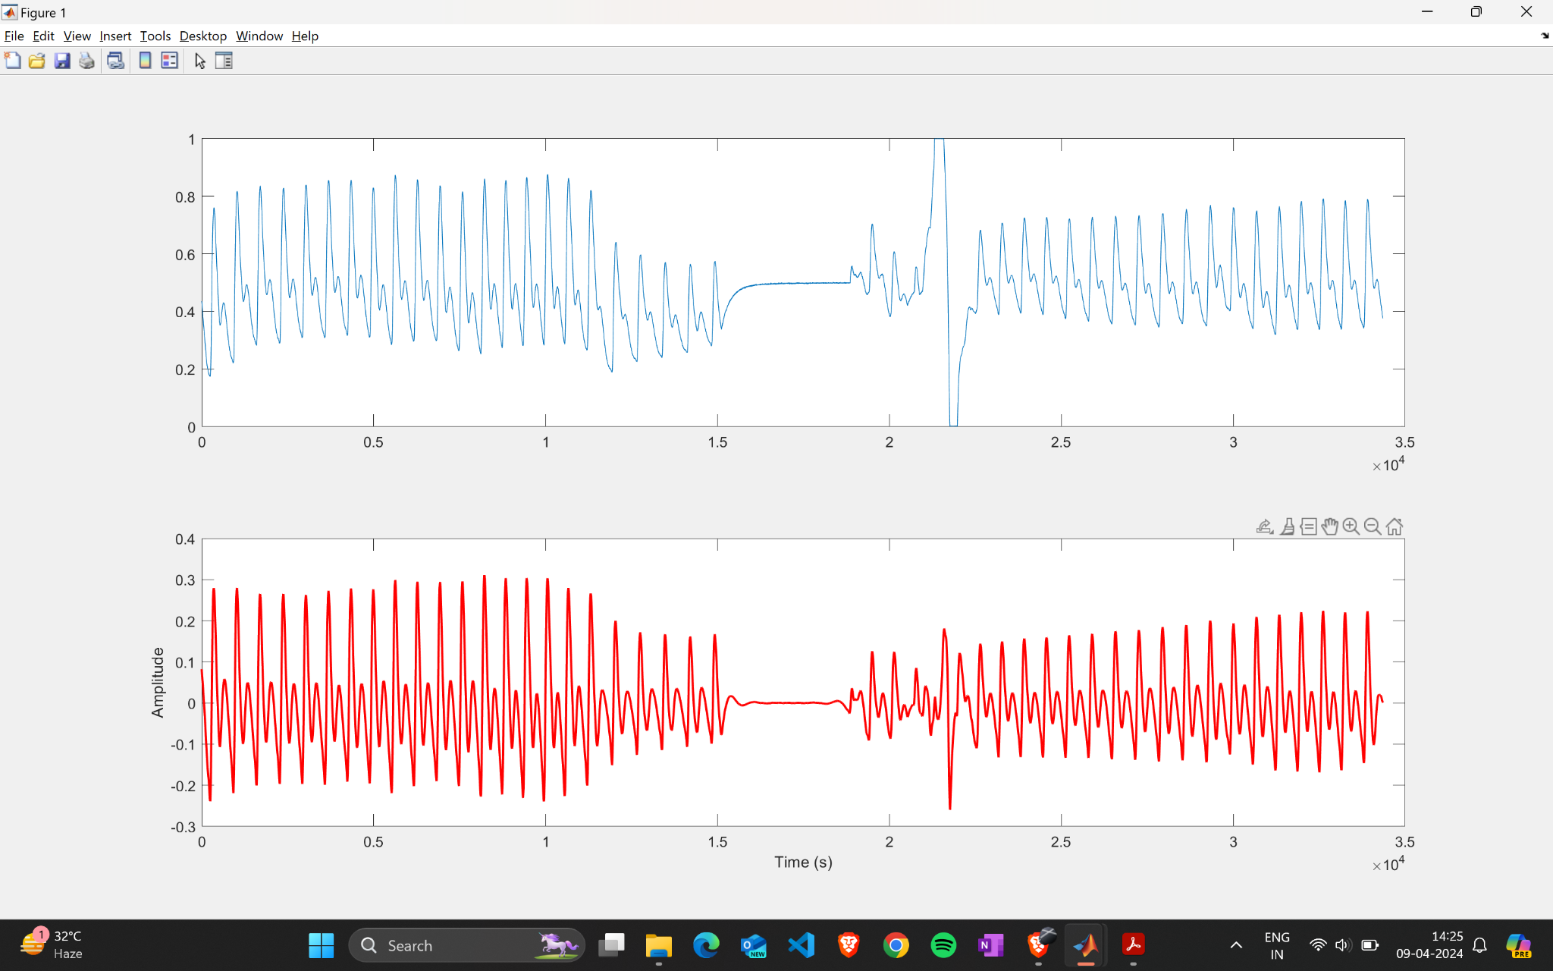
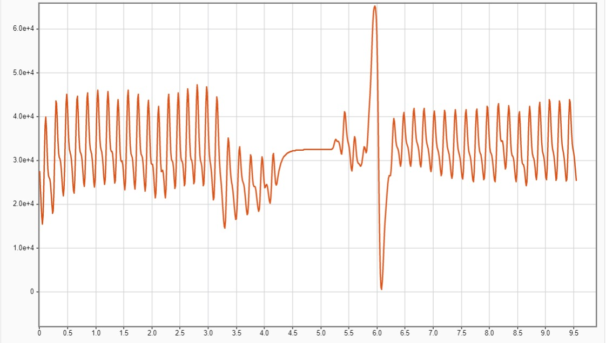
RESULTS
using chebychev II filter of order 4

Slide 10
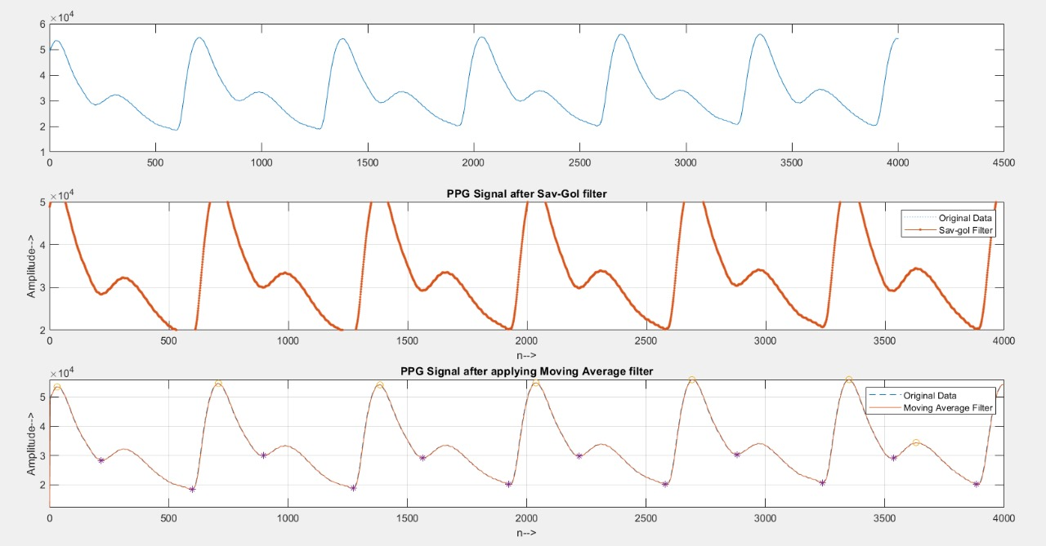
RESULTS

Slide 11
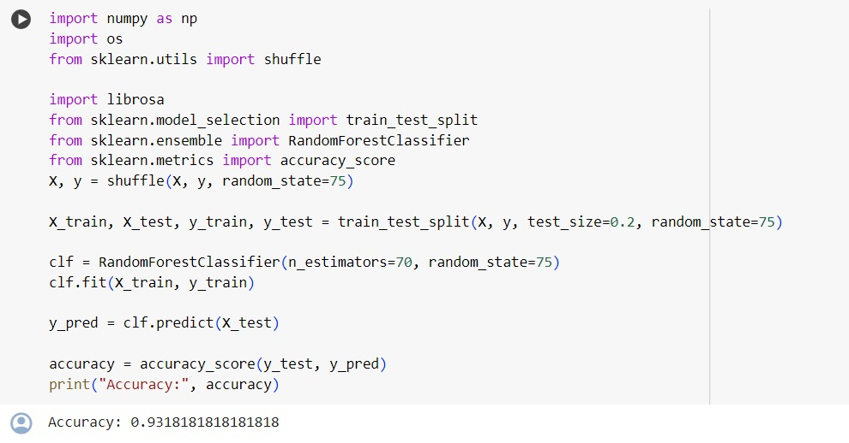
RESULTS

Slide 12
CONCLUSION
Signal Preprocessing is performed successfully by de-noising the signal to some extent that might hinder the signal analysis.
We have trained an ML model using Random Forest algorithm and gained accuracy of about 91%.
*
International Institute of Information Technology, Naya Raipur
12

Slide 13
REFERENCES
[1] https://ieeexplore.ieee.org/document/9152602 - Comparison of Different Machine Learning Techniques for the Cuffless Estimation of Blood Pressure using PPG Signals
[2] https://ieeexplore.ieee.org/document/9701068 - Cuff-less Blood Pressure measurement from Wireless ECG and PPG signals
[3] https://ieeexplore.ieee.org/abstract/document/9298358

Slide 14

Thank You
..
Dr. Shyama Prasad Mukherjee International Institute of Information Technology, Naya Raipur
*
International Institute of Information Technology, Naya Raipur
14

