Slide 1
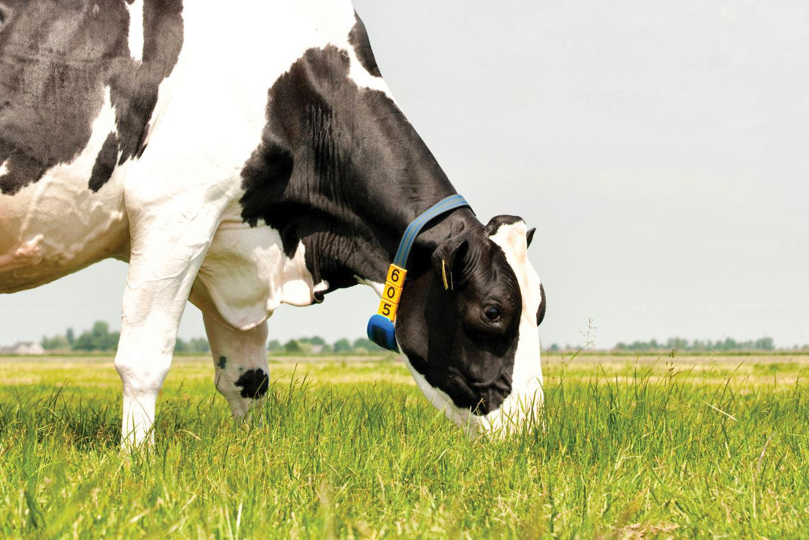
ThermoCollar+
Smart Livestock Monitoring for Early Heat-Stress Detection
NIRMAAN 2026 — AgriTech Track
Team Triple Espresso
Avani Kollur — Team Leader
Manya M Poojari — Team Member
Ananya S K — Team Member
Nitte Meenakshi Institute of Technology (NMIT), Bengaluru
Smart Collar Prototype
Team Triple Espresso • NMIT Bengaluru • NIRMAAN 2026
1

Slide 2
The Problem & Our Solution
Why early heat-stress detection matters, and how ThermoCollar+ responds
The Problem
Our Solution — System Flow
Farmers often notice heat stress in cattle only after visible symptoms appear, by which time productivity and health are already affected.
Heat stress silently reduces milk yield, fertility and overall herd health, especially during summer months.
Small and marginal farmers rarely have access to affordable, real-time physiological monitoring tools.
Existing livestock trackers mostly focus on GPS location rather than actual heat-risk physiology of the animal.
DHT22 Sensor Reading
↓
ESP32 Processing
↓
THI Calculation
↓
Risk Classification
↓
RGB LED + Buzzer Alert
↓
Streamlit Farmer Dashboard
Local alerts give the animal immediate protection; the dashboard gives farmers herd-level visibility and recommended action.
Team Triple Espresso • NMIT Bengaluru • NIRMAAN 2026
2

Slide 3
Turning Sensor Data into Heat Risk
Rule-based Temperature-Humidity Index (THI) classification, on low-cost hardware
THI Formula
Low-Cost Wearable Hardware
THI = (1.8T + 32) − ((0.55 − 0.0055·RH) × (1.8T − 26.8))
ESP32 DevKit V1 — main controller
DHT22 — temperature & humidity sensor
RGB LED — visual status indicator
220Ω resistors — LED current limiting
Buzzer — local audible alert
SIM800C GSM module — optional SMS communication
Battery / power source
Collar enclosure for on-animal mounting
T = temperature (°C) RH = relative humidity (%)
Prototype Risk Thresholds
THI < 68
SAFE
68 ≤ THI < 79
CAUTION
THI ≥ 79
HIGH RISK
Note: classification is rule-based on THI thresholds; no trained ML model is used in the current prototype.
Flow: Sensor → Controller → Local Alert → Optional Remote Communication
Team Triple Espresso • NMIT Bengaluru • NIRMAAN 2026
3

Slide 4
Working Prototype & Real-Time Detection
The physical collar prototype and its three live-detection states
ESP32
DHT22
RGB LED
Buzzer
GSM Module
Power + Collar
SAFE
CAUTION
HIGH RISK
THI < 68 · Green LED · Buzzer OFF · Temperature normal
THI 68–79 · Blue LED · Early warning stage
THI ≥ 79 · Red LED · Buzzer ON · Farmer attention required
States were validated through controlled heat simulation and live sensor readings on the physical prototype.
Team Triple Espresso • NMIT Bengaluru • NIRMAAN 2026
4

Slide 5
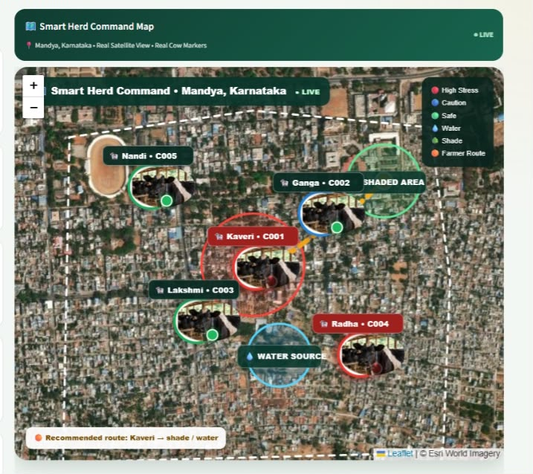
From Collar Data to Farmer Command Center
Streamlit dashboard for herd monitoring, and a prototype herd-location view
Smart Farmer Dashboard
Smart Herd Map — Locate → Respond → Recover
Herd overview with live sensor data per animal
Temperature, humidity and THI readouts
RGB LED status and buzzer status per collar
Communication (GSM) status indicator
Individual animal profiles
Herd-level map, alerts and recommended actions
Available in English and Kannada for farmer accessibility
Prototype / Simulated GPS — Mandya, Karnataka (no physical GPS module in current hardware)
Team Triple Espresso • NMIT Bengaluru • NIRMAAN 2026
5

Slide 6
Automatic Response, Farmer Alerting & Testing
The system guides the farmer's response, not just raises an alarm
1. DETECT
→
2. ALERT
→
3. LOCATE
→
4. RESPOND
→
5. RECOVER
Detect heat stress via THI → Alert via RGB+buzzer+dashboard → Locate animal on herd map → Provide water, shade & cooling → Continue monitoring until safe.
THERMOCOLLAR+ ALERT — Prototype / Demo
Prototype Testing & Validation
HIGH HEAT-STRESS DETECTED
Test 1
Normal environmental condition
Green — Safe
Kaveri (C001)
Temperature: 38.4°C Humidity: 76% THI: 84.0
Action: Provide water and move Kaveri to shade.
Test 2
Temperature & humidity increased
Blue — Caution
The GSM (SIM800C) module is designed to push this alert as an SMS from the dashboard to the farmer's phone. In testing, network registration was not consistently reliable, so live carrier delivery is not yet guaranteed; cloud push notification is a planned alternative.
Test 3
High-heat simulation
Red — Buzzer — High Risk
Validated through controlled heat simulation and live sensor readings on the working prototype.
Team Triple Espresso • NMIT Bengaluru • NIRMAAN 2026
6

Slide 7
What Makes ThermoCollar+ Different
Low-cost, wearable hardware built for real deployment
Live THI-based heat-risk detection, not just location tracking
Immediate animal-side RGB + buzzer alert, no network dependency
Farmer dashboard with herd-level visualization
Bilingual support — English and Kannada
Action-oriented recommendations, not just raw data
Full workflow: Detect → Alert → Locate → Respond → Recover
Future Scope
Real GPS hardware integration
Reliable GSM/SMS or cloud push notifications
Historical THI database & trend analytics
ML model trained on field-collected data
Panting / acoustic stress detection
Multi-collar farm-scale deployment with vet & dairy cooperative integration
“ThermoCollar+ turns invisible heat stress into an actionable warning — before it becomes an emergency.”
Thank You
Team Triple Espresso • Avani Kollur, Manya M Poojari, Ananya S K • NMIT Bengaluru • NIRMAAN 2026
Team Triple Espresso • NMIT Bengaluru • NIRMAAN 2026
7

