Slide 1

SLEEPIFY
AL23421 – Machine Learning Laboratory
ML-Driven Sleep Recovery Engine
Department of CSE (AI & ML)
Rajalakshmi Institute of Technology
Shifting the perspective from
"Sacrificing Sleep" → "Optimizing Recovery"
Academic Year 2025 – 2026 | Semester IV
Faculty In-Charge: Mrs. M. Divya
😴 Sleep Debt
Tracked
🎯 Recovery
Targeted
⭐ Star Personas
4 Icons
Sleepify | Mini Project Presentation

Slide 2






AGENDA
What We'll Cover Today
1
2
Problem & Introduction
Goal & Approach
Why sleep debt is a crisis for our generation
Personalized recovery using ML regression
3
4
Algorithm & Equations
Implementation
Linear regression with age-based baselines
Python + CustomTkinter GUI with Star Personas
5
6
Live Demo Screenshots
Results & Future Work
Login, Dashboard, Persona switching in action
Current outcomes and upcoming enhancements

Slide 3
PROBLEM
The Sleep Crisis
😴 Sacrifice Culture
62%
Students skip sleep for exams, deadlines & entertainment — thinking it's optional.
of students report sleeping
less than 7 hours per night
📱 Engagement Gap
Existing apps are too clinical. Gen-Z needs gamification, not charts.
"Sleep debt is real —
and it compounds daily."
🎂 No Personalization
Most tools ignore age. A 19-year-old needs different recovery than a 65-year-old.

Slide 4



GOAL
What Sleepify Aims to Do
Personalized Recovery
Actionable Insights
Calculate age-adjusted recovery sleep targets using cumulative debt tracking via linear regression.
"Think Engine" translates numbers into plain-language counseling, bedtime tips, and lifestyle guidance.
Gamified Consistency
Cultural Engagement
Star personas (Rajini, Vijay, Kamal, Ajith) deliver iconic dialogues to keep users logging daily.
500-song database across 5 music directors recommends relaxing Tamil music for sleep priming.

Slide 5
ALGORITHM
ML Algorithm — Linear Regression Logic
Equation 1: Sleep Debt
Age-Based Baselines
Debt_total = Σ (Baseline_age − Hours_actual)
Age Group
Baseline
Child (6–12)
10 hrs
Equation 2: Recovery Target Tonight
Teen (13–18)
9 hrs
Target = Baseline_age + (Debt_total × 0.2)
Adult (19–64)
8 hrs
Recovery coefficient 0.2 ensures gradual repayment.
Over-sleeping causes grogginess — so we repay slowly.
Senior (65+)
7 hrs

Slide 6
EXAMPLE
Step-by-Step: A 19-Year-Old's Recovery
1
2
3
4
Step 1
Step 2
Step 3
Step 4
User Input
Debt Calculation
Recovery Target
Star Output
Age: 19 (Adult)
Baseline: 8 hrs
Actual sleep: 4.5 hrs
Deficit = 8 − 4.5 = 3.5 hrs
Total Debt = 3.5 hrs
(saved to profile)
Target = 8 + (3.5 × 0.2)
= 8 + 0.7
= 8.7 hrs
Rajini: "Kanna! Go sleep
8.7 hrs tonight!"
+ Music recommendation

Slide 7
DATASET
Dataset & Implementation Stack
Dataset Name
Sleepify_Behavioral_Logs
Domain
Healthcare & Personal Analytics
Objective
Regression — Predict Recovery Duration
Data Source
Synthetic — generated from user interactions
Features (Input)
Age, Sleep Hours, Cumulative Debt, Persona
Target Variable
Recovery Duration (hours)
Data Type
Tabular (JSON)
License
Proprietary — No third-party license required
Python 3.x
CustomTkinter
JSON Storage
PIL / Pillow
React-Icons
Tech Stack

Slide 8
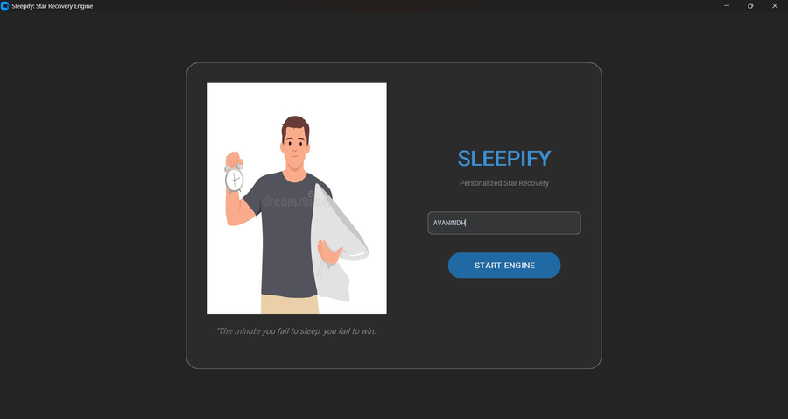
OUTPUT
Application Output — Login Screen
Attractive login overlay with hero image
Random motivational sleep quote on each load
Name-based personalization — persistent profile
"START ENGINE" launches the dashboard
Login UI

Slide 9
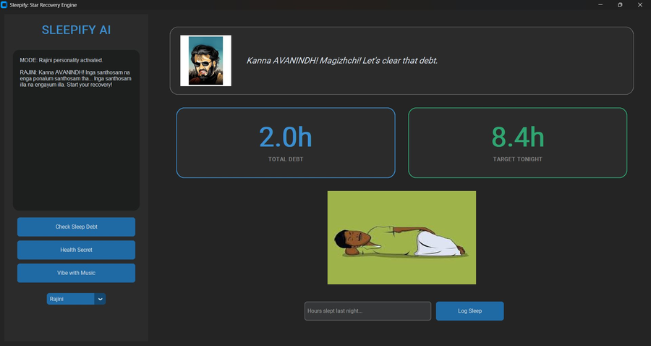
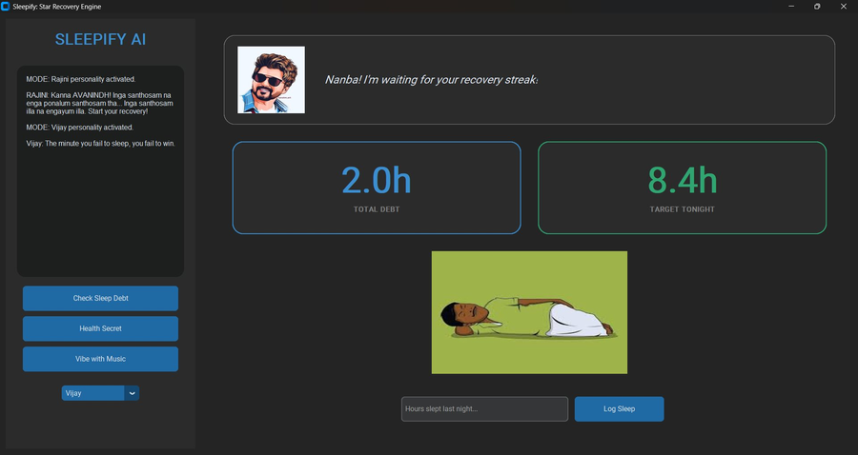
OUTPUT
Application Output — Main Dashboard
Rajini Mode — Initial Login
Vijay Mode — Star Switch
TOTAL DEBT
TARGET TONIGHT
STAR PERSONAS
Cumulative hours owed — persisted across sessions
Regression output: Baseline + (Debt × 0.2)
Switch between 4 icons; each gives unique dialogue

Slide 10

RESULTS
Results & Performance
Persistent Sessions
User debt survives app restarts via JSON profiles.
Age-Accurate Targets
Distinct baselines for child, teen, adult, senior.
Real-Time Updates
Dashboard refreshes instantly on each sleep log entry.
500-Song Library
Music recs from Ilayaraja, ARR, Anirudh, Harris, Yuvan.

Slide 11

FUTURE
Future Enhancements
AI Counseling Module
IoT Wearable Integration
CBT-I therapy exercises and psychiatrist agent powered by large language models for psychological sleep coaching.
Smartwatch sensors replace manual logging — auto-detect REM / deep / light sleep stages in real time.
Predictive ML Model
Mobile Application
Train supervised regression on collected profiles to predict future debt patterns and send pre-emptive advisories.
Cross-platform Flutter/React Native app with push notifications, streak tracking, and social leaderboards.

Slide 12
THANK YOU
"The best way to start tomorrow is to sleep well tonight."
SLEEPIFY
ML-Driven Sleep Recovery Engine | AL23421 Machine Learning Laboratory
Rajalakshmi Institute of Technology | Mrs. M. Divya | 2025–2026

