Slide 1

Team Details
Team name: ARchitects
Team leader name: Avanish Kasar
Problem Statement: Homeowners and designers often struggle to visualize and plan interior spaces before actual implementation. Traditional tools are static, expensive, and time-consuming, leading to poor design decisions, budget overruns, and lack of spatial awareness. There's a need for an accessible, interactive, and intelligent platform that empowers users to design, visualize, and optimize their spaces with confidence — before lifting a single brick.

Slide 2

Brief about your solution:
ARchitect is an all-in-one intelligent design platform that merges 3D visualization, AI-based budgeting, and augmented reality to offer an immersive experience for designing spaces. From planning a room layout to testing furniture placement in real-time through your camera,
ARchitect helps users explore, create, and finalize their vision confidently. The AI assistant 'Gemini' guides users with suggestions on design, layout, and budgeting. It simplifies space planning while offering advanced, interactive tools accessible to everyone.

Slide 3
Opportunities
a.How different is it from any of the other existing ideas?
Absence of free, interactive, user-friendly platforms for personal space planning.
Growing demand for DIY design tools powered by AI.
Lack of real-time AR-based interior design tools.
b.How will it be able to solve the problem?
Offers a 3D room planner, AI-based budget planner, AR furniture preview, and AI assistant Gemini for intelligent design suggestions.
c.USP of the proposed solution
Combines AI, AR, and 3D in one web platform.
Real-time AR preview using a simple HIRO marker.
AI assistant that helps with budgeting, layout, and furniture suggestions.
100% free-to-use with no paid tools or subscriptions.

Slide 4
List of features offered by the solution
3D Room Designer:
Drag-and-drop interface with isometric layouts
Realistic furniture textures and materials
Wall decor, lighting, and flooring preview
AI Budget Planner:
Enter project essentials, get instant cost estimates
Smart optimization tips to reduce costs
AR Furniture Preview:
Print and scan a HIRO marker with your camera
Demo shows a red box rendered on the marker
Future updates will include real furniture items (tables, chairs, etc.)
Gemini - AI Design Assistant:
Offers design advice and layout feedback
Helps pick budget-friendly furniture
Available 24/7 within the platform

Slide 5
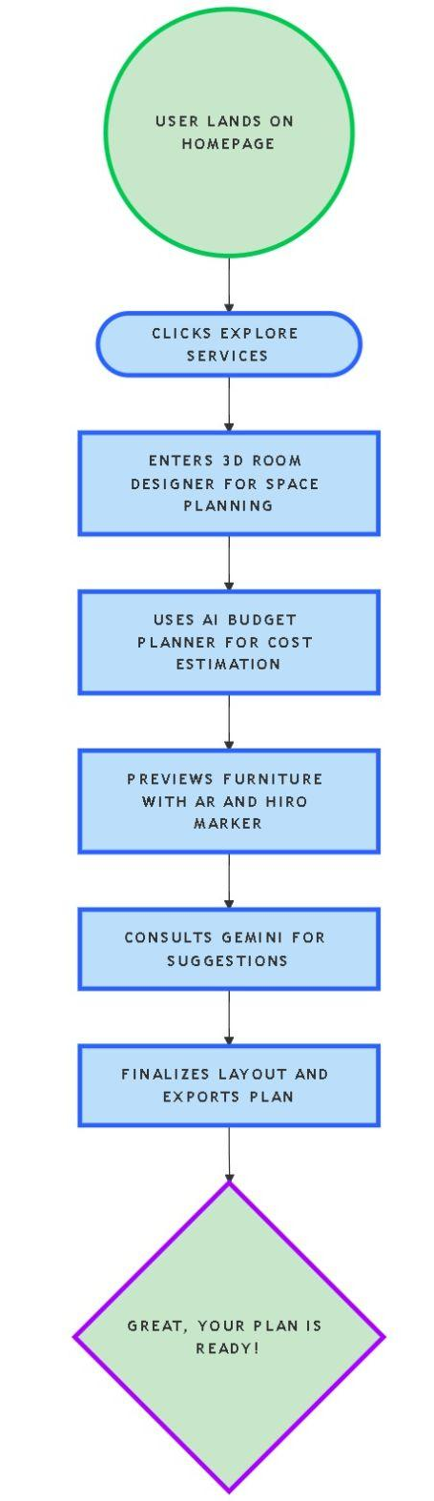
Process flow diagram or Use-case diagram
User opens the ARchitect platform
Begins designing using the 3D room planner
Inputs budget requirements into the AI Budget Planner (Design must be uploaded by the user)
Tests furniture placement using AR and HIRO marker
Gets expert guidance from Gemini AI assistant
Finalizes layout and shares/export the plan

Slide 6
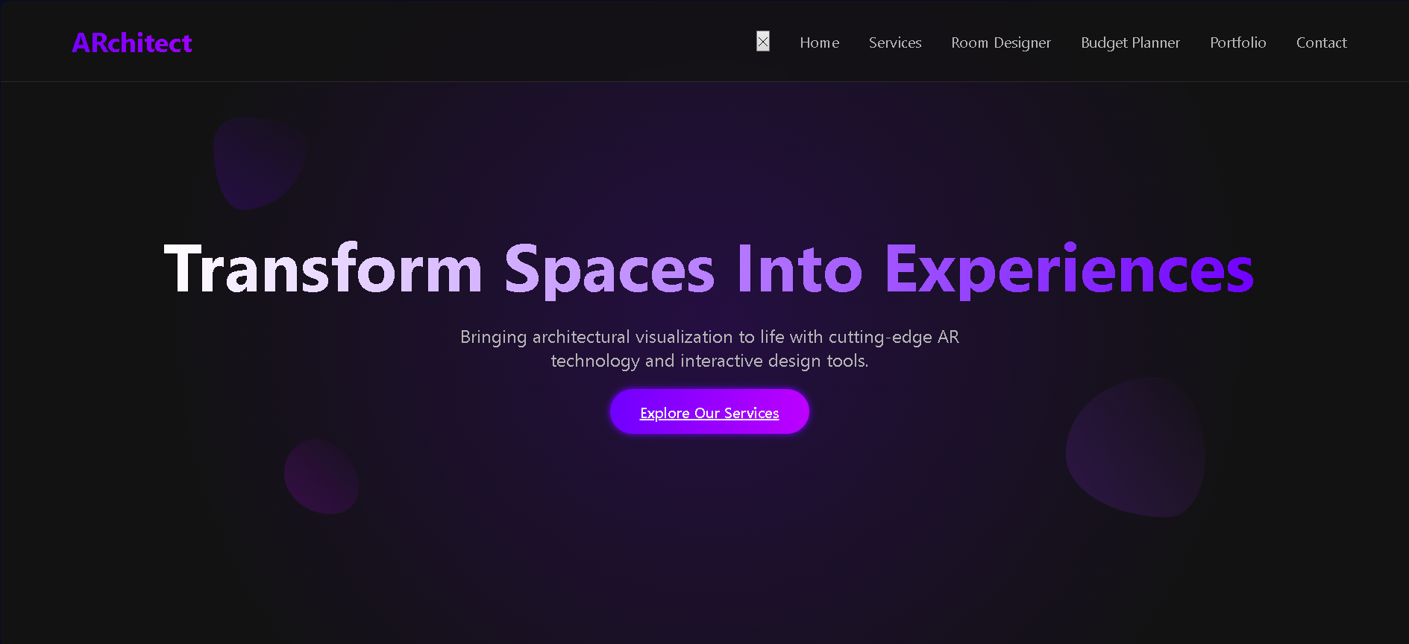
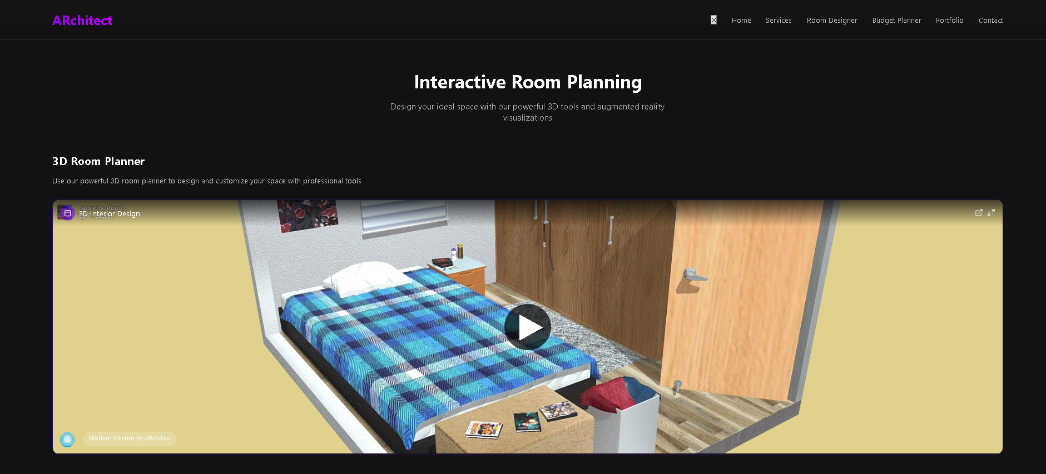
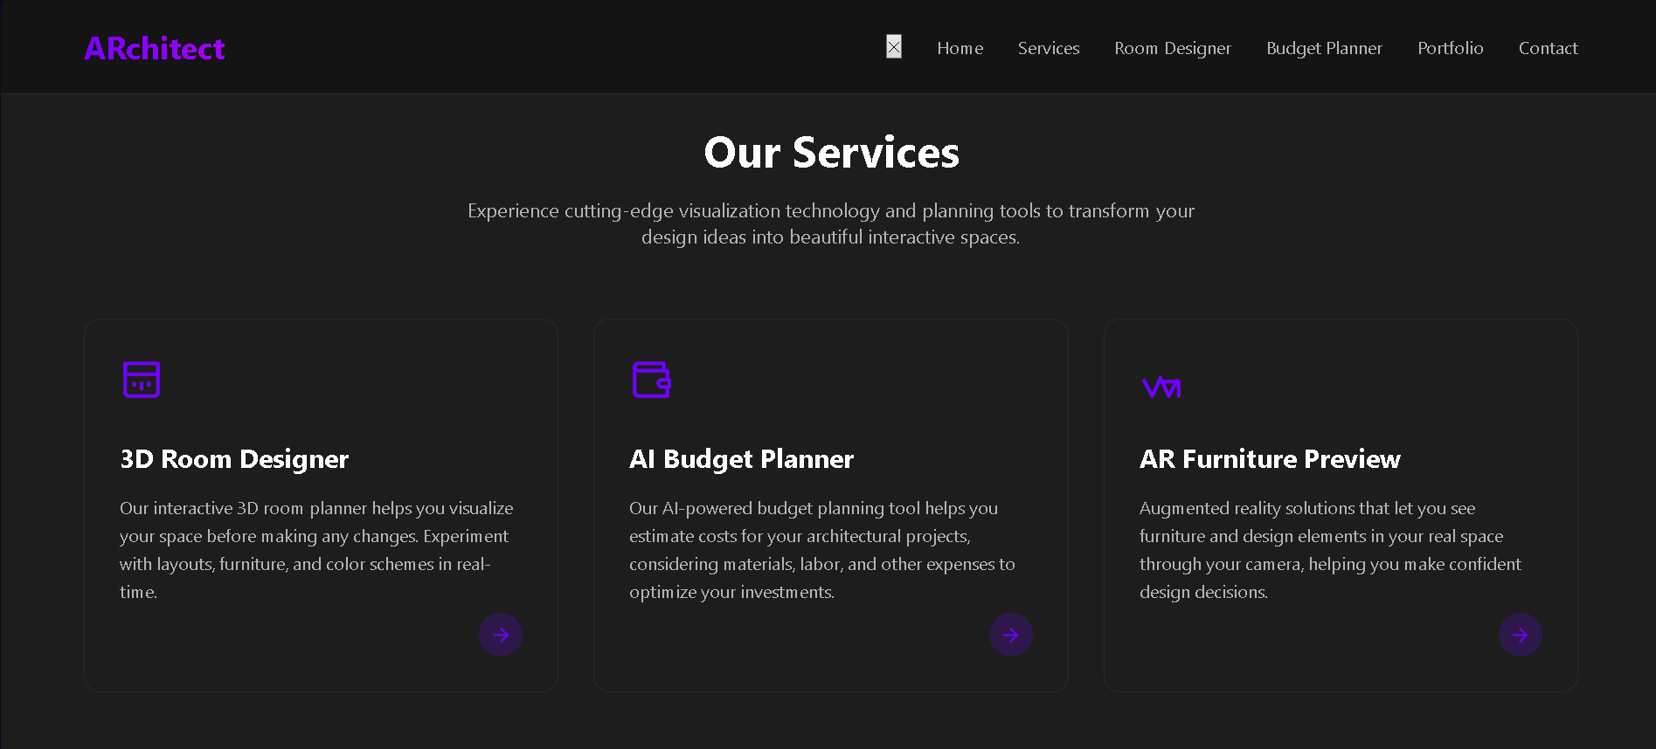
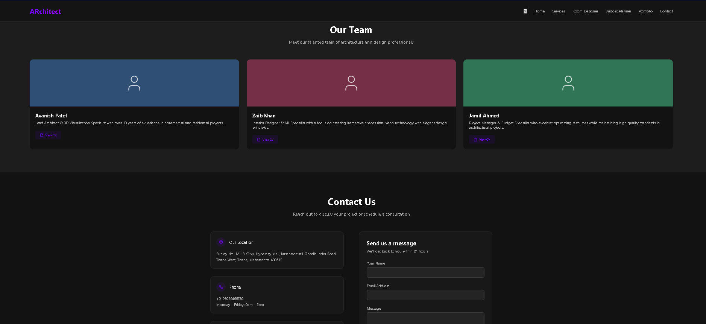
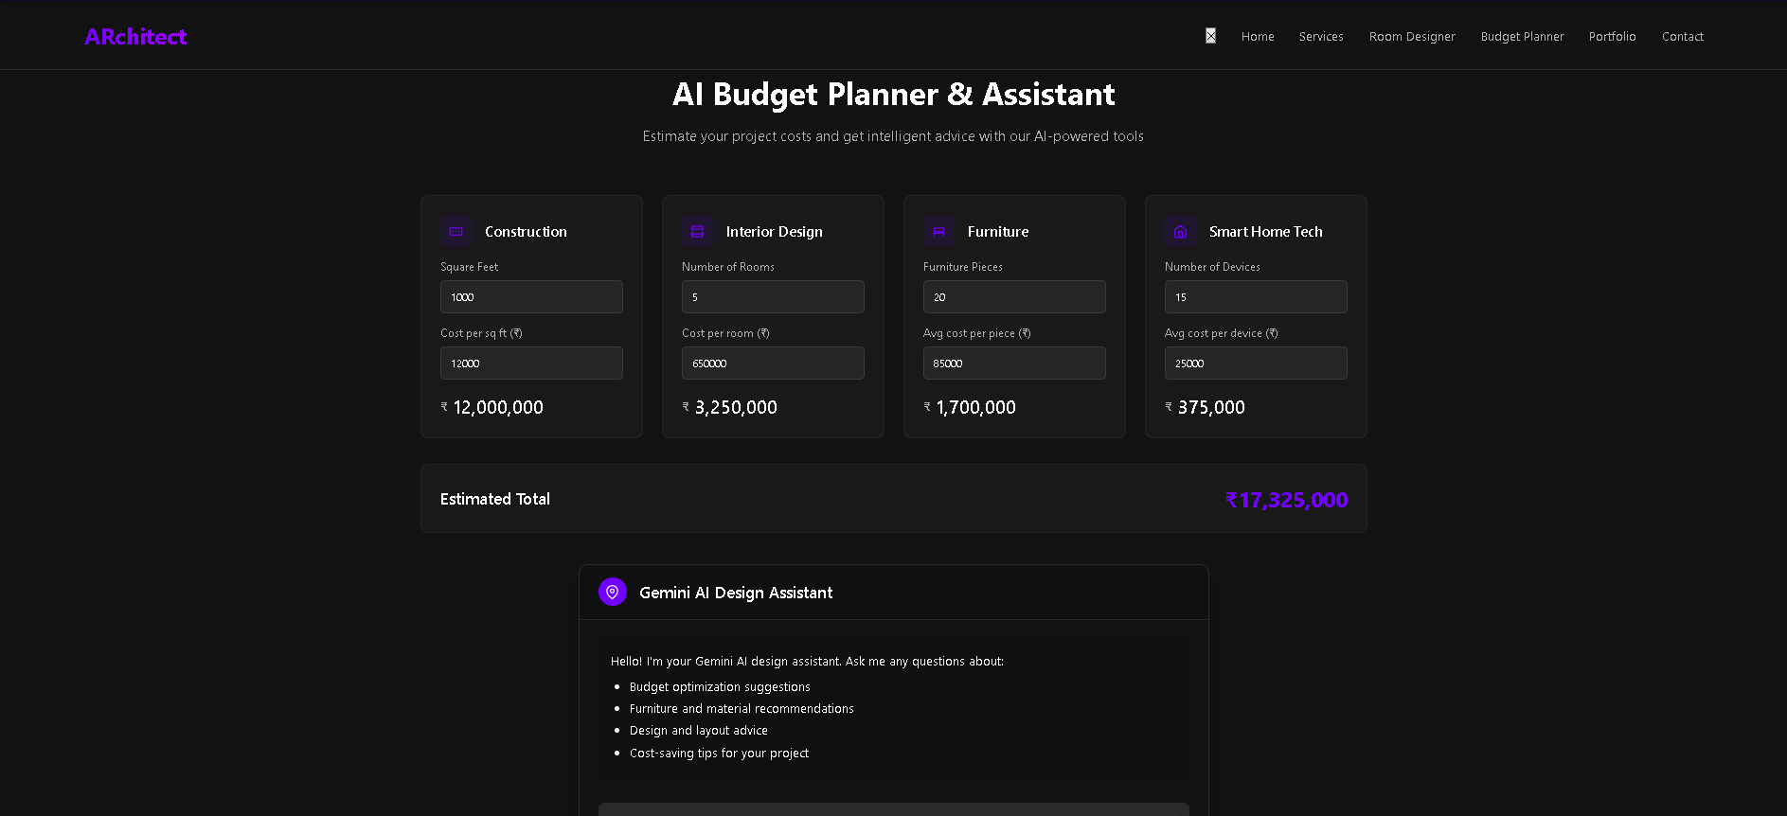
Wireframes/Mock diagrams of the proposed solution

Slide 7
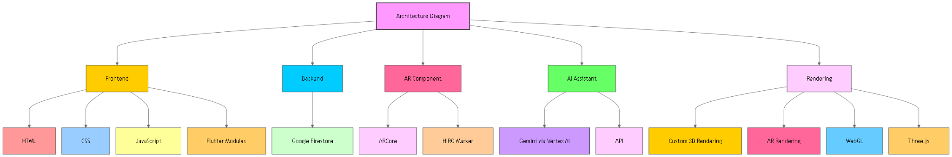
Architecture diagram of the proposed solution

Slide 8
Technologies to be used in the solution
Google ARCore – for augmented reality
HIRO Marker – marker-based AR rendering
Google ML Kit – for object detection (future update)
Vertex AI / Gemini – for smart assistant
Firestore – cloud-based backend
Flutter – partial UI component integration
HTML/CSS/JS – main web stack

Slide 9
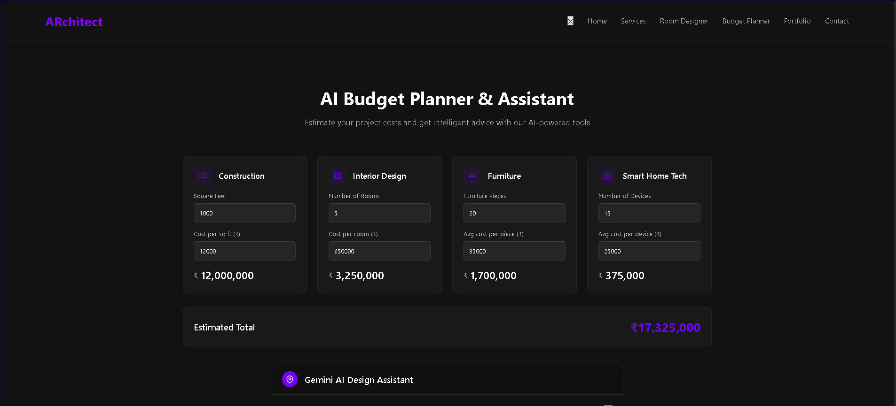
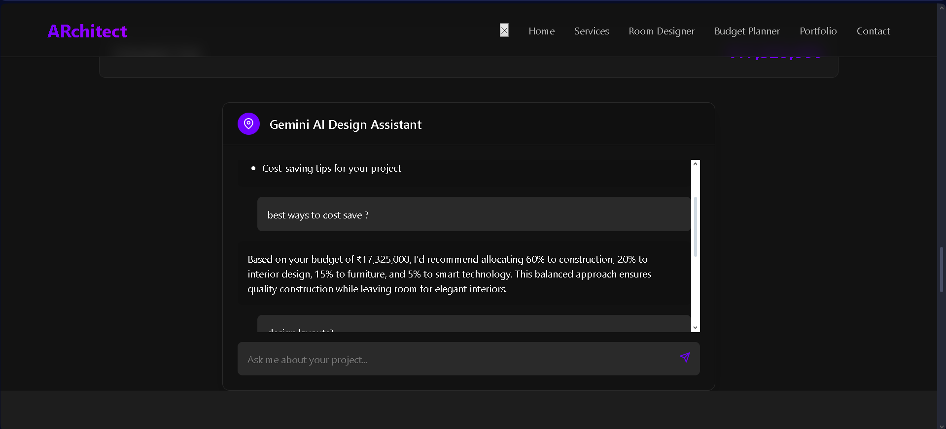
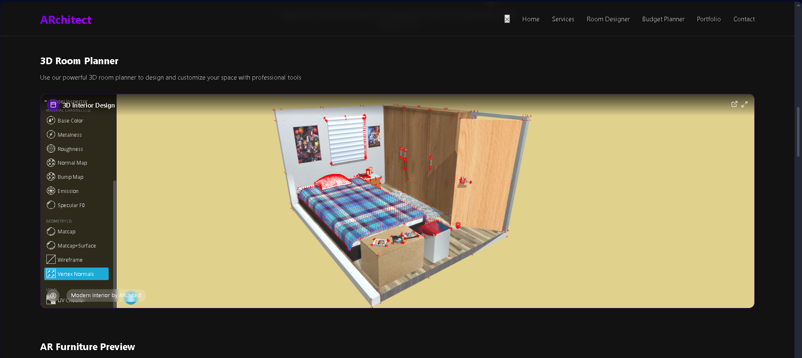
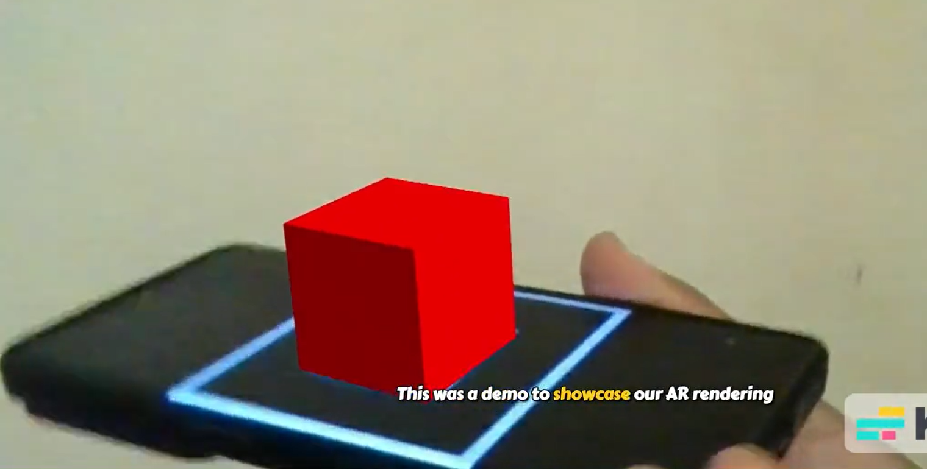
Snapshots of the MVP

Slide 10
Additional Details/Future Development
Real Furniture Rendering in AR: Tables, chairs, sofas, etc.
AR Object-on-Hand Visualization: Place decor items directly on your palm using AR.
Sustainable Design Mode: Suggest eco-friendly materials and vendors.
Move to Google IDX: Transitioning our full development workflow to Google Project IDX for seamless cloud-based collaboration and deployment.
Gemini API Integration: Real-time integration of Gemini via Vertex AI to power the assistant with actual smart API responses.
Voice Assistant Capabilities: Ask design or budget questions using your voice and get instant AI help.
User Account & Project Saving: Save and return to your design layouts anytime.
Community Gallery: Share designs and get inspiration from others.

Slide 11
Provide links to your:
GitHub Public Repository
https://github.com/avanishkasar/WEB_3.0
Demo Video Link (3 Minutes)
https://github.com/avanishkasar/WEB_3.0/blob/Presentation-Media/Full%20Video.mp4
MVP Link
https://github.com/avanishkasar/WEB_3.0/blob/main/WEB_3.0.html

Slide 12


