Slide 1

Team Name : SentinelReg
Team Leader Name : Avanish Kasar
Team Size : 1
Problem Statement : Risk, Fraud & Regulatory Intelligence Copilot (BFSI)

Slide 2

1. Problem Brief
Risk, Fraud & Regulatory Intelligence Copilot (BFSI)
A
Real business problem
B
Target user / persona
Banks and NBFCs must report suspicious activity to the FIU within 7 days of being satisfied it is suspicious (RBI KYC Master Direction).
Alert volumes, scattered evidence and hand-written SARs make filings slow and inconsistent, and hard to defend to an examiner.
AML / compliance analyst triages alerts, investigates, drafts the SAR.
Principal Officer / MLRO reviews and files with the regulator.
Internal audit & examiners need proof of who decided what, when, and on which evidence.
C
Pain point today vs. with SentinelReg
D
Industry / domain context
TODAY
WITH SENTINELREG
BFSI: AML / CFT compliance for banks and NBFCs.
Regulators set different clocks: 7 days (RBI STR) vs 30 days (FinCEN SAR). Both come from the same regulatory corpus.
Sources: RBI KYC Direction, FATF 40 Recommendations, Basel AML guidance, FinCEN BSA/AML manual.
Alerts reviewed one at a time, in separate tools
Regulation searched by hand in PDFs
Related alerts never linked
SAR typed in Word, citations unverified
No tamper-proof decision trail
Queue ranked by severity and live filing clock
Ask in plain English: SQL + cited clause
Network view links alerts into one scheme
AI-drafted SAR; fake citations stripped
Hash-chained audit trail

Slide 3
2. Architecture: system design & data flow
All compute runs inside Snowflake · data never leaves the platform
DATA SOURCES
SNOWFLAKE
INTELLIGENCE LAYER
STREAMLIT APP
OUTPUTS
STRUCTURED
CUSTOMERS
ACCOUNTS
TRANSACTIONS
AML_ALERTS
ML_RISK_FEATURES
Seed: 13 cust · 18 acct · 29 txn · 5 alerts
SNOWFLAKE
Rule engine
5 typologies: structuring, velocity, round-trip, cash, fan-out
Overview
Triaged alerts
with live filing clocks
Tables & clauses
7 tables incl. AML_AUDIT_LOG; plain SQL / ILIKE
Alert Triage
Snowpark ML
gradient-boosted model → COMPUTED_RISK_SCORE
Investigation Copilot
Cited answers
SQL + clause ID
Semantic model
aml_risk_model.yaml on @MODELS stage
Cortex Analyst
natural language → SQL, SQL shown to user
Entity 360
Network Intelligence
SAR PDF + evidence zip
SHA-256 manifest
UNSTRUCTURED
RBI KYC Master Direction
FATF 40 Recommendations
Basel AML guidance
FinCEN BSA/AML manual
→ REGULATORY_DOCS_CHUNKS (13 clauses)
Cortex COMPLETE
drafts SAR narrative from case facts
Regulatory Library
Snowpark session
SENTINEL_REG_ROLE · SENTINEL_REG_WH · bound params
SAR Generator
Audit log
hash-chained, tamper-evident
Citation guardrail
strips any clause ID not in REGULATORY_DOCS_CHUNKS
Audit Trail
write-back: dispositions · SAR filed · audit events
COCO CLI SKILLS (.coco/skills + AGENTS.md)
DATA FLOW
investigate-aml-account
Investigation Copilot · Entity 360 · Network
1
Ingest: structured + regulatory text land in Snowflake
generate-sar-report
SAR Generator (narrative, PDF, evidence zip)
2
Detect: rules + Snowpark ML score raise alerts
score-fraud-risk
Snowpark ML tab · Alert Triage reason codes
3
Ask: Cortex Analyst turns questions into SQL
4
Report: COMPLETE drafts → guardrail → PDF
AGENTS.md gives CoCo CLI the repo map, conventions and the rule: never fabricate a citation.
5
Audit: every action SHA-256 chained
Modular: utils/data.py is the single data layer (live Snowflake ⇄ offline demo snapshot, same shapes) · detectors, narrative, PDF, network and audit are independent modules · 25 automated tests

Slide 4
3. Impact Statement
What changes for the compliance team
4 of 5
0
5
7d / 30d
demo alerts linked into one fund-flow network
fabricated citations; guardrail removes unknown clauses
typologies re-run live; uncovered patterns flagged
filing clocks read from the cited clause (RBI / FinCEN)
Measurable outcomes
Scalability potential
Beyond the demo
SAR assembly: hours of copy-paste to minutes (our estimate; to be validated in a pilot)
Triage: queue ranked by severity and time left; overdue cases surface first
Accuracy: every regulatory statement traces to a clause ID
Audit: 100% of decisions logged; any edit breaks the SHA-256 chain
Compute in Snowflake: scales with the warehouse, data stays in place
New data: add tables or columns in the semantic model YAML
New typology: documented checklist, setup → ML → semantic model → rule
New regulator: add clause rows and a filing rule
Real feeds: core-banking data via Snowpipe / Streams
Automation: schedule detection and ML scoring with Tasks
Governance: role-based maker-checker approval before filing
Coverage: regional regulator packs added to the corpus

Slide 5
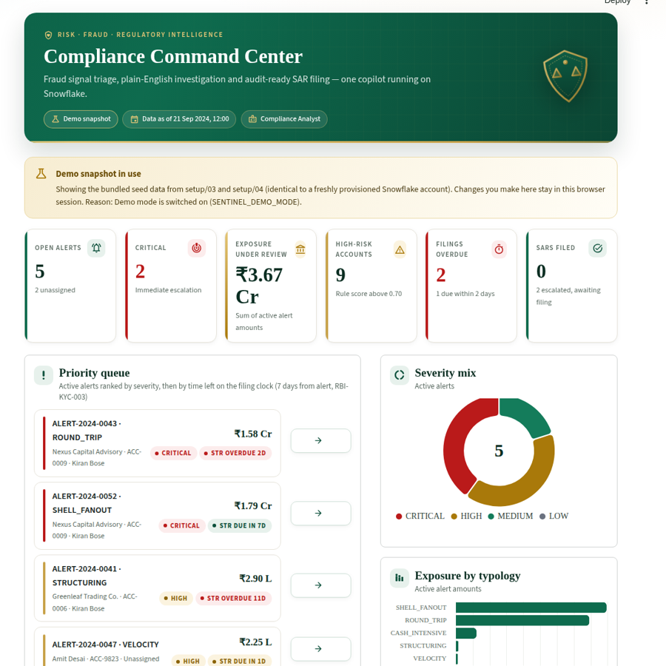
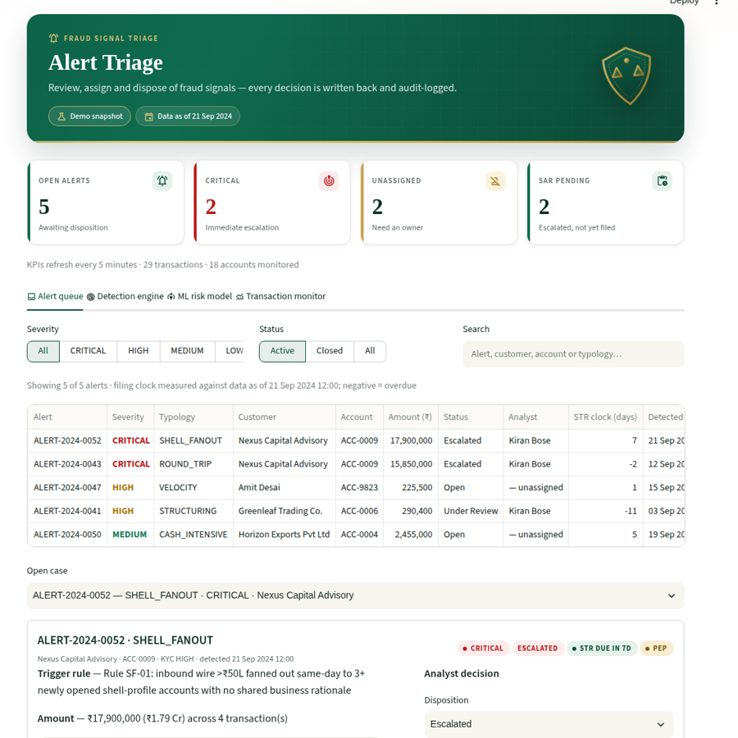
Prototype / MVP Brief
Working app, deployed and tested
What is built
Overview
KPIs, priority queue, filing clocks
Alert Triage
dispositions written back; rules + ML tabs
Investigation Copilot
Cortex Analyst Q&A with SQL shown
Entity 360
KYC, accounts, risk drivers, 2-hop flow
Network Intelligence
fund-flow rings link alerts
Regulatory Library
ranked search over 13 clauses
Prototype deployed link
https://coco-cli-kfjwzafq5ousz6uqd7r6vc.streamlit.app
SAR Generator
Cortex narrative, PDF, evidence zip
Code: github.com/avanishkasar/coco-cli
Audit Trail
SHA-256 chain with tamper check
25 automated tests: every page renders, triage → SAR → audit flow, tamper detection, live SQL path
Offline demo mode keeps the app working without Snowflake credentials
Demo uses synthetic seed data
Stack: Snowflake · Cortex Analyst · Cortex COMPLETE · Snowpark ML · Streamlit · CoCo CLI skills

Slide 6


