Slide 1

AI-Powered IT Helpdesk Ticket System
Intelligent ticket classification, automated routing, and supervisor oversight powered by Azure OpenAI and multi-agent resolution workflows
Team Name: Kodzone
Team Members:
Geetika Shekhawat (1405965)
Avanish Raj Singh (1406040)

Slide 2
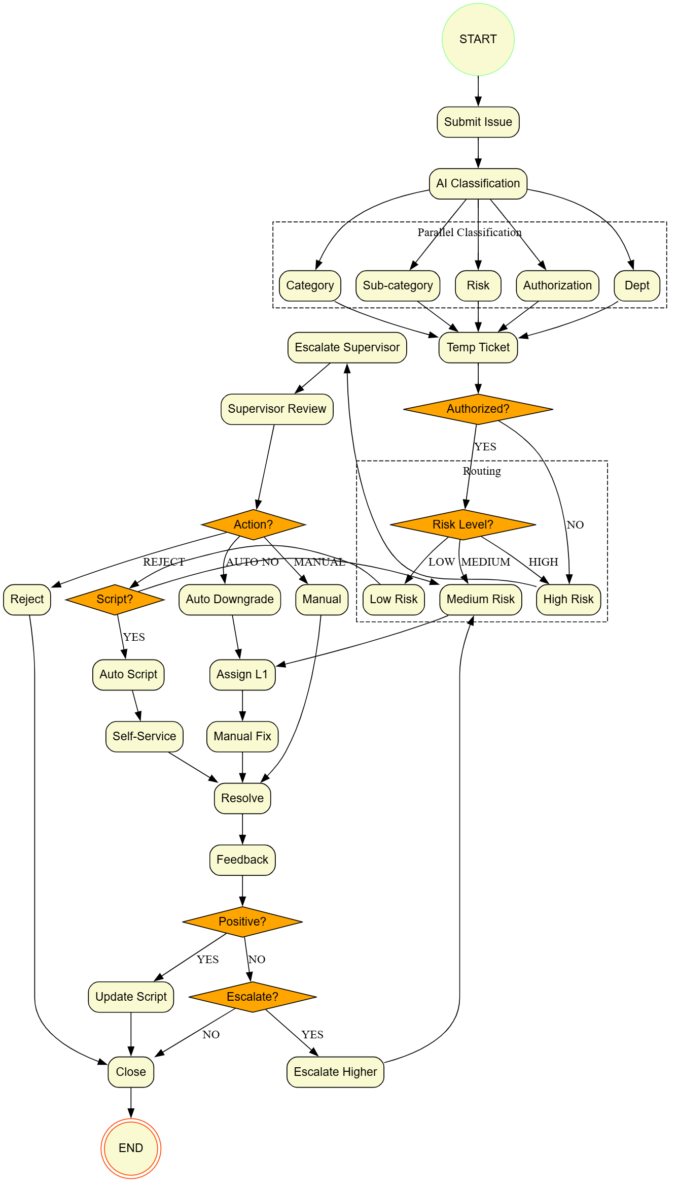



System Architecture Overview
Built on FastAPI and LangGraph, our system leverages Azure OpenAI GPT-4o to deliver intelligent ticket processing with human oversight where it matters most.
AI Classification Engine
Multi-Agent Resolution
Automated category detection, semantic sub-category matching, and risk assessment based on business impact analysis
The three-tier agent system routes tickets based on risk level and authorization, ensuring optimal resource allocation
Supervisor Dashboard
Real-time oversight for high-risk tickets with approval workflows, manual override capabilities, and complete audit trails

Slide 3
Four-Phase Workflow Process
Query Processing
Agent Routing
AI analyzes user input to determine category, sub-category, risk level, and authorization status with confidence scoring
Tickets route to Low, Medium, or High Risk agents based on authorization and script availability
Supervisor Review
Resolution & Feedback
High-risk tickets require supervisor action: auto-resolution, manual override, or rejection with justification
User feedback drives script rating updates and escalation logic for continuous improvement
Resolution Paths by Risk Level
Low Risk: Automated script solutions with self-service steps
Medium Risk: Human resolver assignment for manual troubleshooting
High Risk: Supervisor dashboard routing for approval workflows

Slide 4
Technical Stack & Key Components
Backend Architecture
Frontend Interfaces
FastAPI: High-performance web server with async capabilities
Chat Interface: Conversational ticket creation with AI assistant
LangGraph: Workflow orchestration for multi-agent coordination
Supervisor Portal: High-risk ticket review with action modals
Azure OpenAI: GPT-4o for NLP and semantic embeddings
Real-time Feedback: Interactive rating and escalation system
JSON Storage: Lightweight data persistence (database-ready)
80%
3
100%
Automation Rate
Agent Tiers
Audit Coverage
Tickets resolved without human intervention through intelligent routing and script availability
Risk-based routing system ensuring right-sized response for every ticket type
Complete transparency with full history of actions, decisions, and supervisor approvals

Slide 5

Business Impact & Future Roadmap
Efficiency Gains
Quality Improvements
Governance & Control
Instant classification eliminates manual categorization delays. Smart routing delivers tickets to the right resolver immediately based on skill and location matching.
AI-driven risk assessment removes human bias while knowledge base integration ensures best practices. Script ratings enable continuous learning and optimization.
Supervisor oversight protects critical operations with built-in authorization controls. Complete audit trails provide transparency for compliance and security reviews.
Next-Generation Enhancements

