Slide 1

Behavioral Analysis on Mall Culture
L.D. College of Engineering
Computer Department
Final Year Project
Final Year UDP Project By:-
Shah Pinalben P.(140280107087)
Shah Sukruti R.(140280107089)
Shukla Avani M.(140280107096)
Faculty Guide – Prof. Pragnesh G. Patel

Slide 2
Project Demo
E:\ProjectDemo.avi

Slide 3
Introduction to Problem
Malls and shopping marts face problem of maintaining products and their location due to this demand and profit of the brand is affected.
To resolve this problem we are using behaviour analysis on customers using machine learning.

Slide 4
Aim of the Project
Make a web application to automatically recognize the expressions on the faces of the customers or visitors.
Make a machine which gives results according to the expression detection.
Make use of image processing, machine learning to accomplish the goal

Slide 5
Project Plan
Observation and Ideation
Literature Review
Analysis
Design
Coding
Testing

Slide 6
Analysis
Functional Requirements
The system should allow admin to add staff Members.
The system should allow staff members and admin to login.
It should redirect them to respective pages after verifying.
Admin and staff should be allowed to add and delete the product according to analysis given by the system.
Admin should be allowed to categorize(subcategorize) the products according to the tendency of customer.
The system should generate a report of the analysis of products.
Admin and staff should be allowed manage videos of each products for the analysis.
The system should manage result of analyzed videos and store graphical representation of result.

Slide 7
Analysis
Non Functional Requirements
Reliability
Maintainability
Security
Quick Analysis
Availability
Performance

Slide 8
Benifits
Mall owner or brand owner can get the idea of the current trend of the customer mindset.
They can increase the production of trending items in order to increase the profit.
Also they can attract more customers by putting trending items on catchy places like entrance.
If more customers are attracted to particular product, and not buying it, there might be issue of cost. One can decrease the profit margin of that product and increase selling.

Slide 9
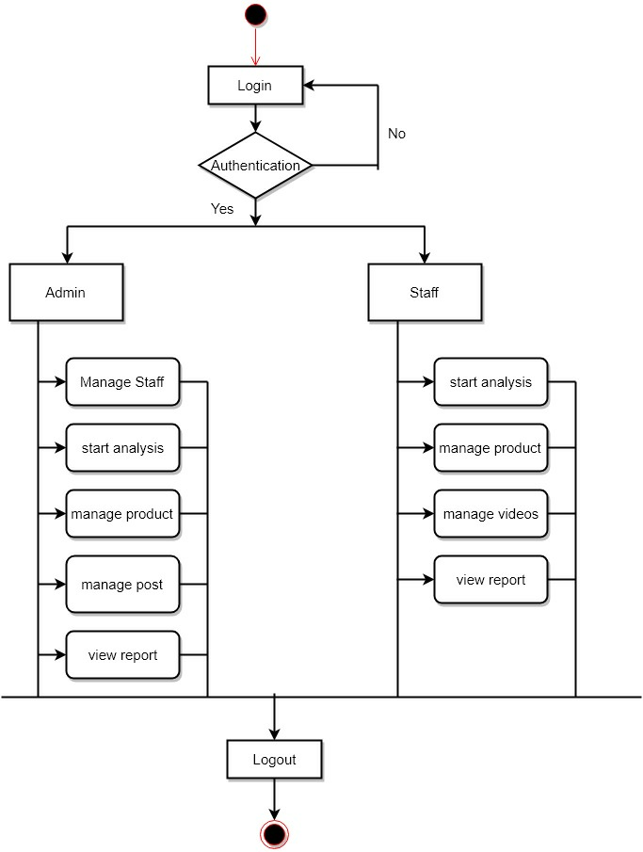
Activity Diagram

Slide 10
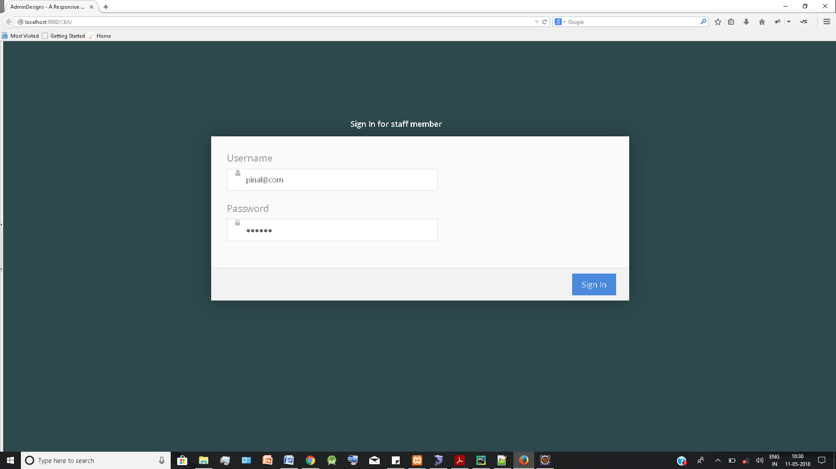
Login Page

Slide 11
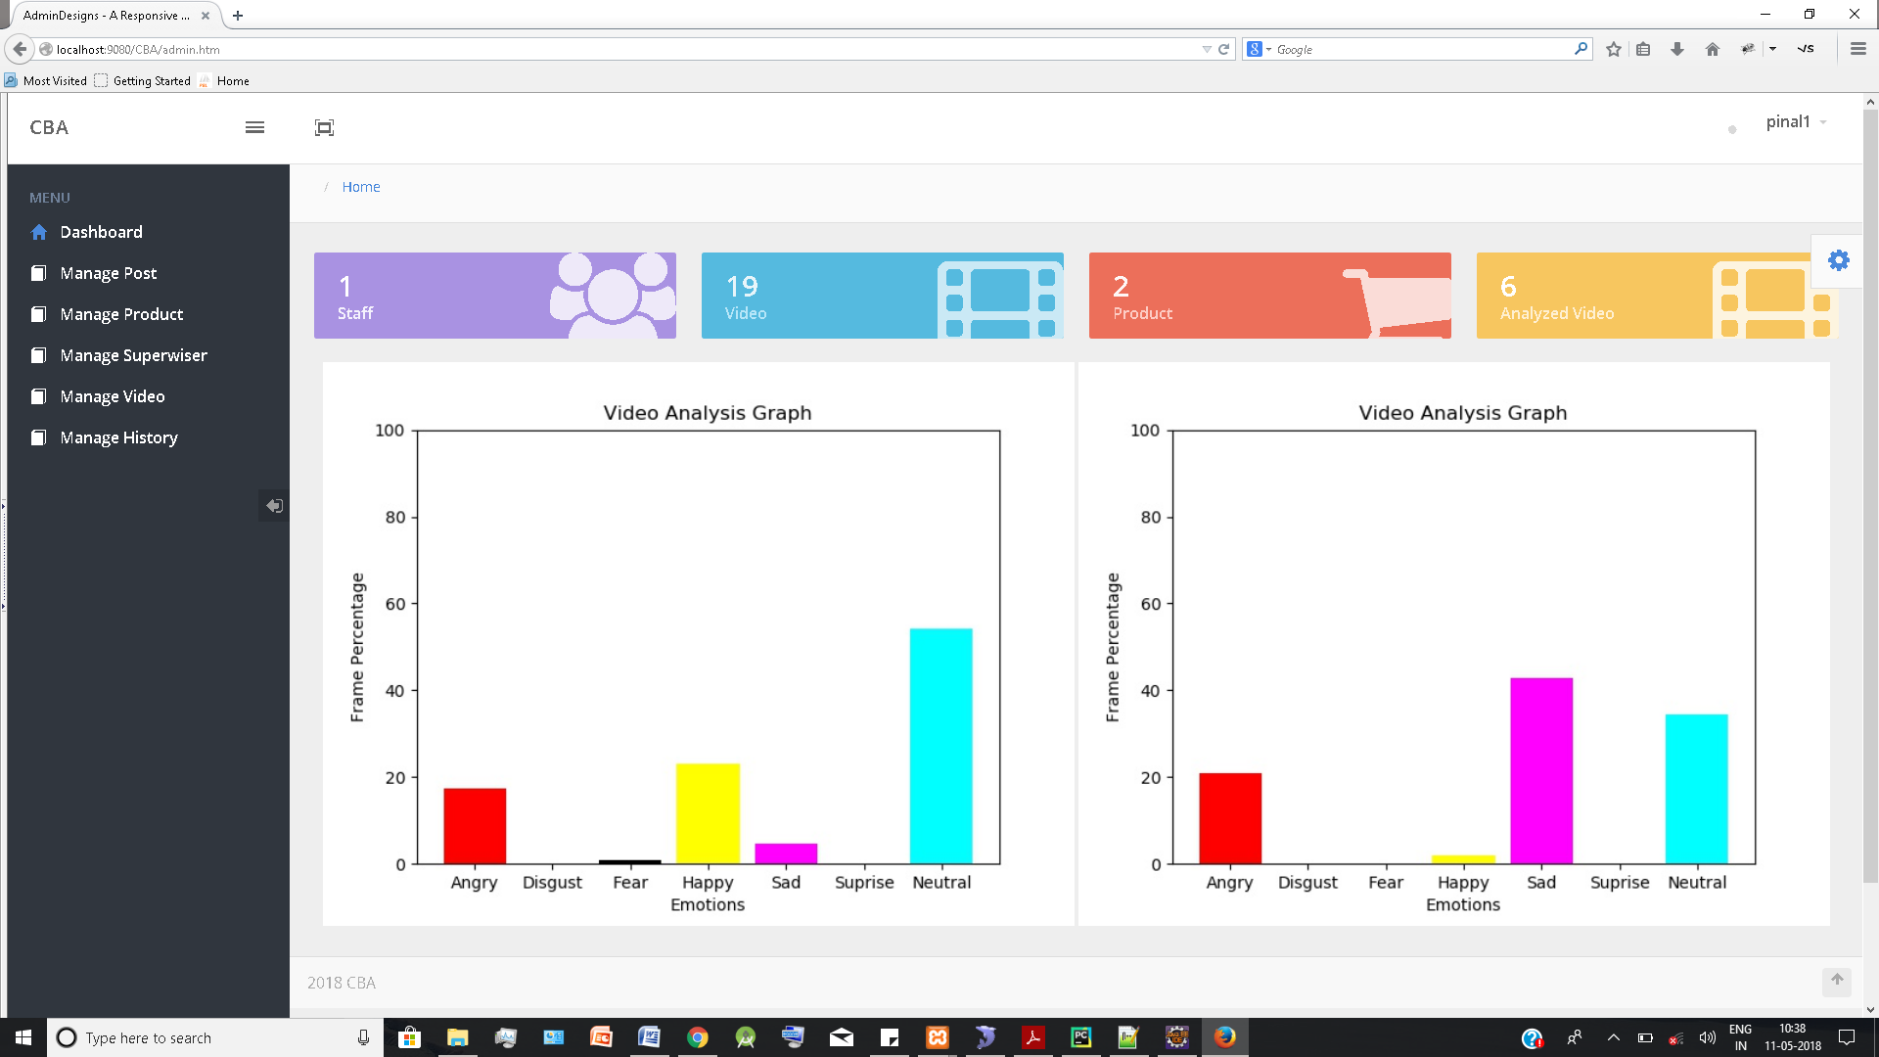
Dashboard for admin

Slide 12
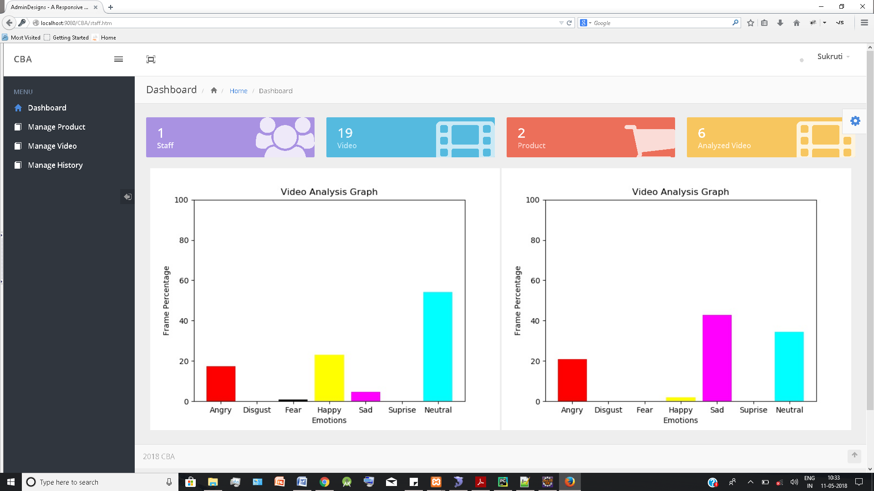
Dashboard for staff

Slide 13
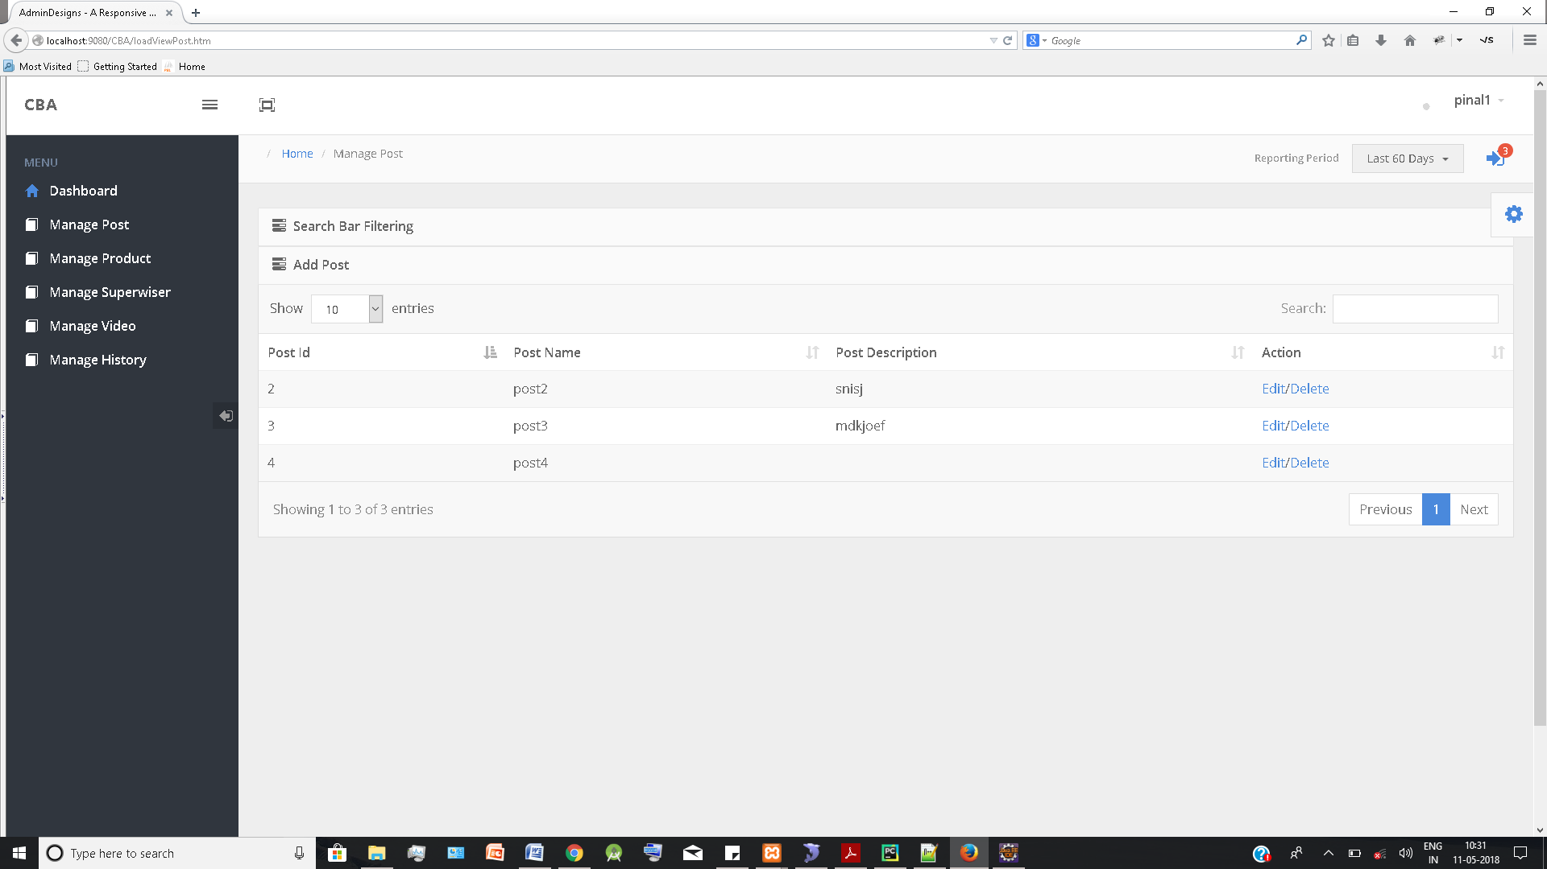
Manage Post

Slide 14
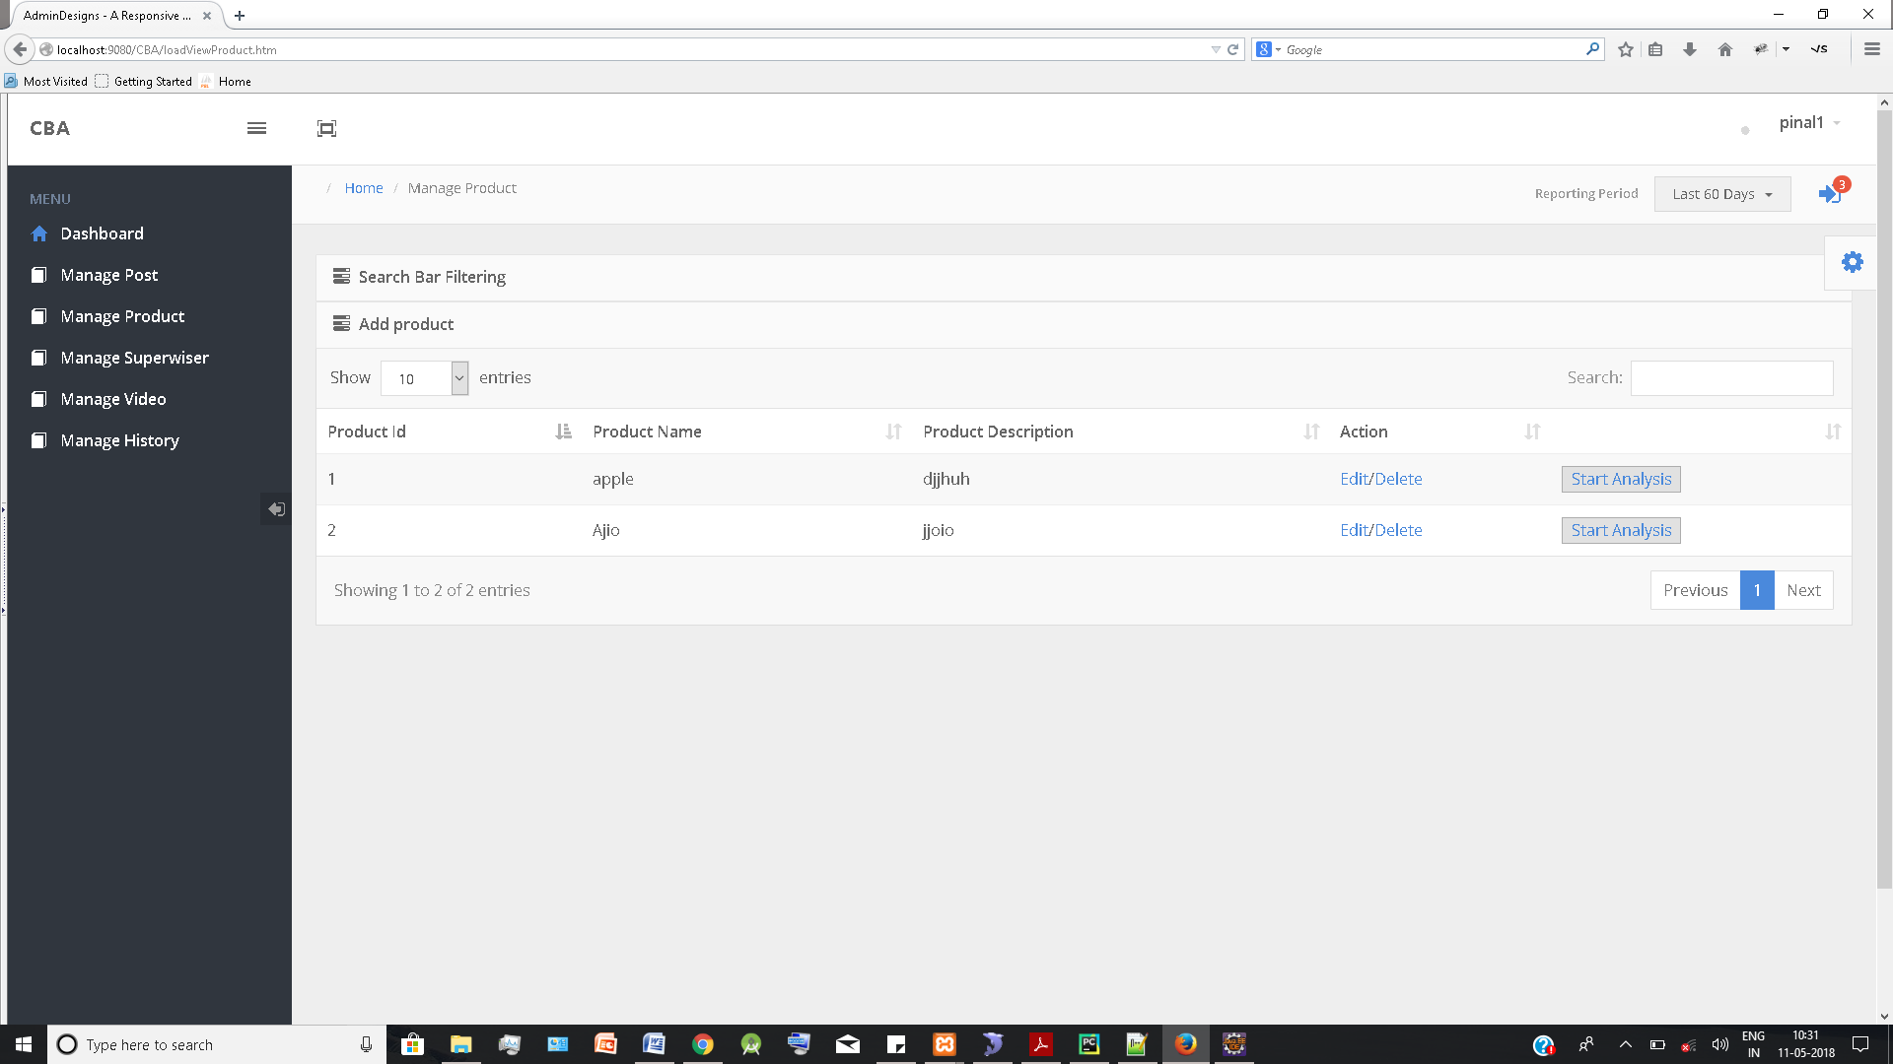
Manage Product

Slide 15
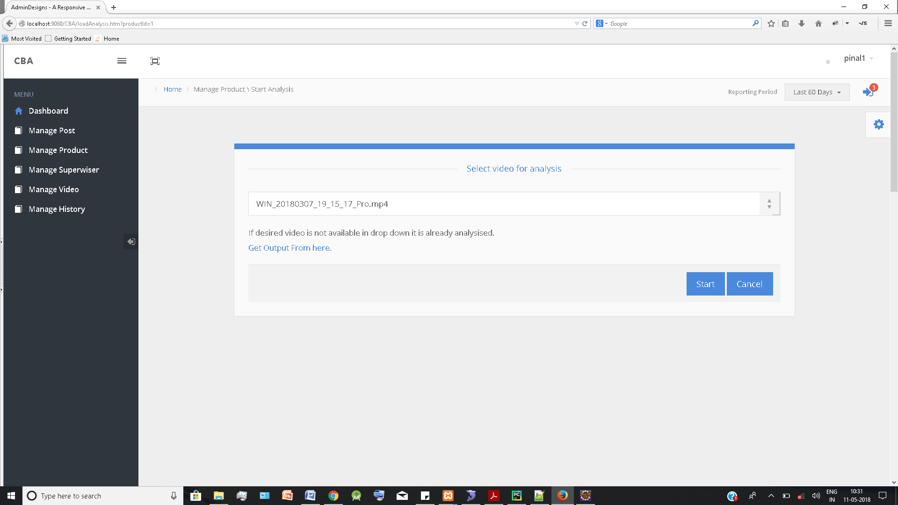
Select video for analysis

Slide 16
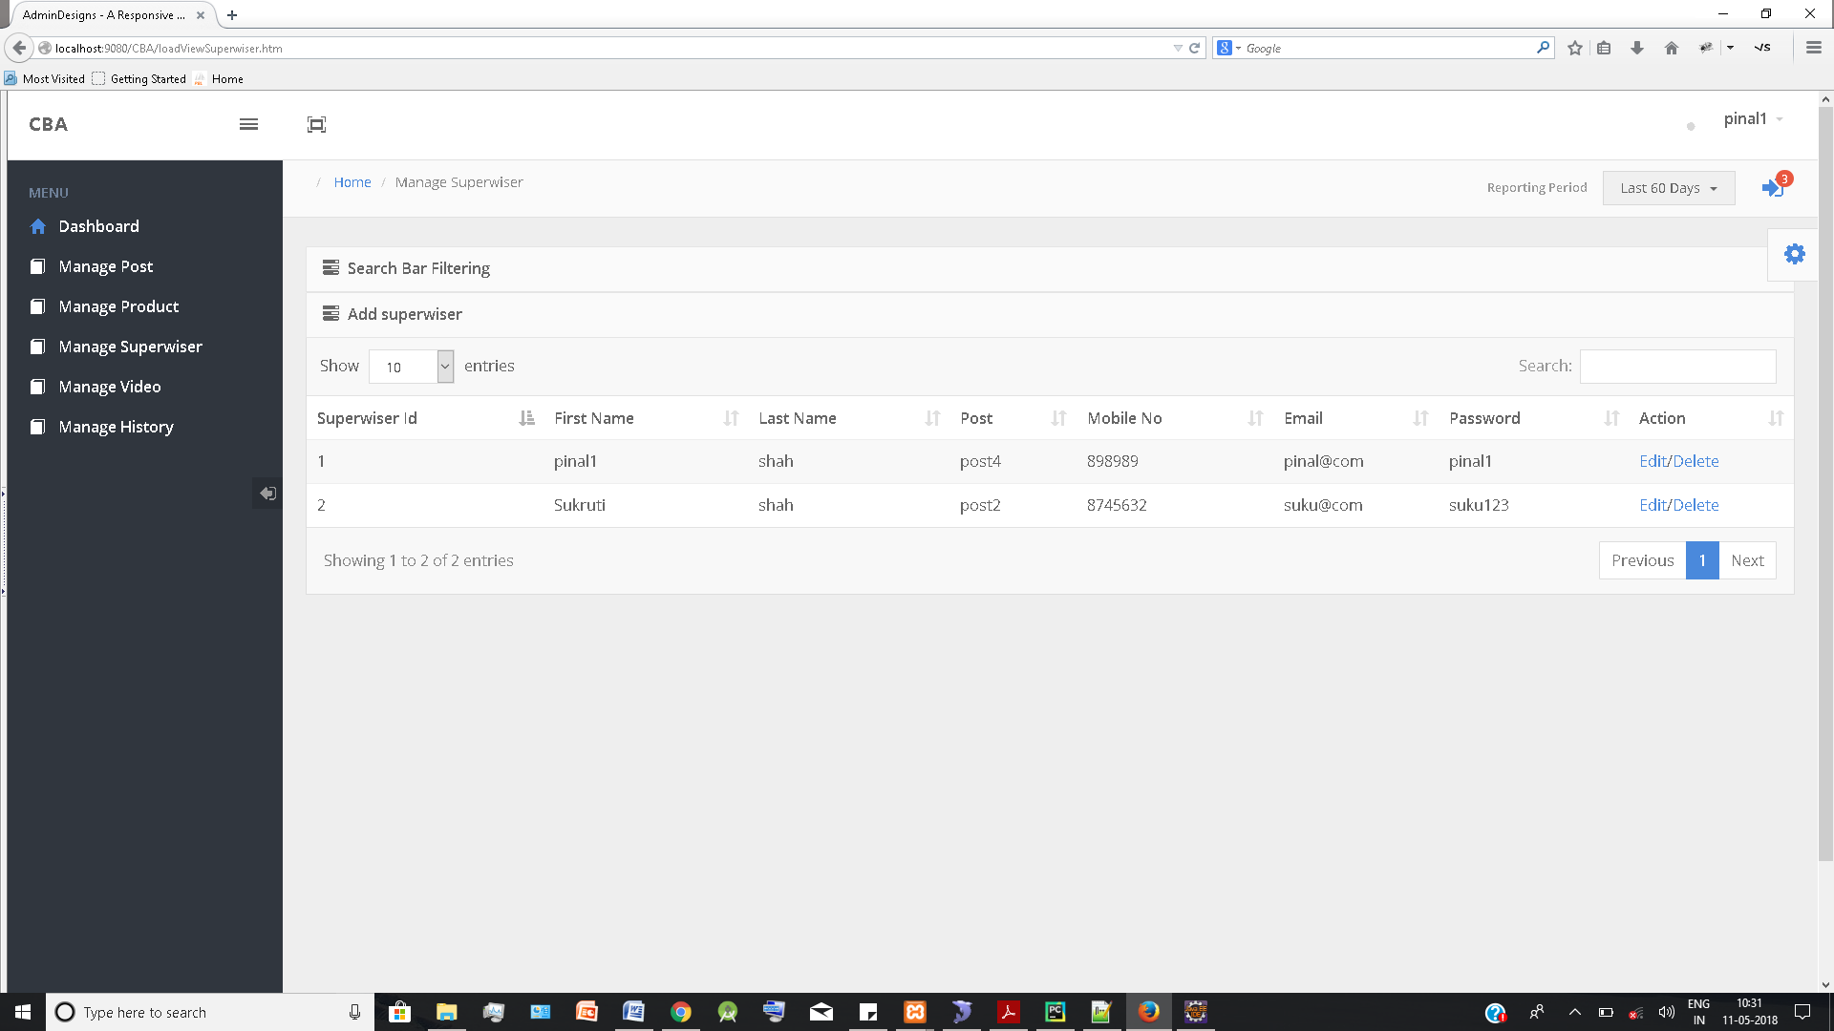
Manage Superwiser

Slide 17
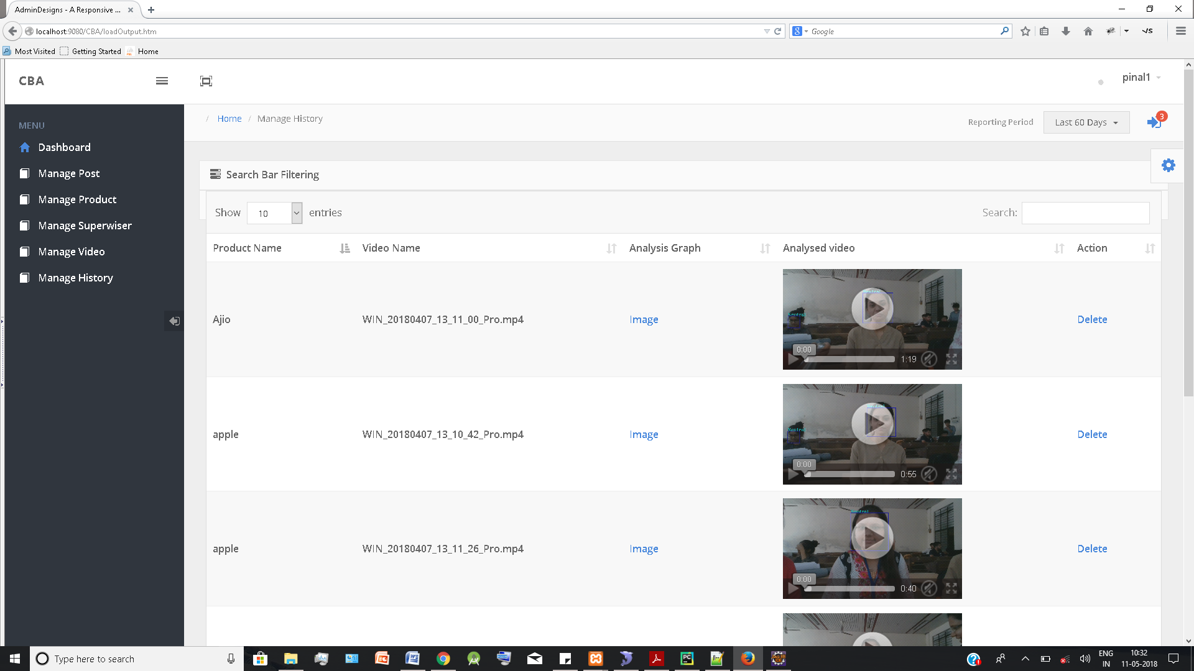
Analysed Videos

Slide 18
Future Scope
If we have super computing capabilities, we can provide bigger dataset in order to get more accuracy in the output.
Also we can feed the output of the video analysis as the training dataset and get more accurate model.
Also we can combine the statistics available at the selling counter with the output of the analysis and increase the accuracy of the result.

Slide 19
References
Patents
US7908237 by Robert Lee Angell, James R. Kraemer
US20080303902 A1 by Kevin Douglas ROMER, Shuhai SHEN, Amber Marsel HEROLD
US20130004016A1 by Kenneth M. Karakotsios, Volodymyr V. Ivanchenko
US9569786 B2 by George Shaw, KushelRaiBellipady
US9536072 B2 by Isaac David Guedalia, Adam Schwartz
Books
Object-Oriented Modeling and Design with UML by Rumbaugh, James
software engineering: A practitioner approach by Pressman, Roger
Introduction to computation and programming using Python by John Guttag.
Websites
https://en.wikipedia.org/wiki/Software_requirements_specification
https://www.edrawsoft.com/types-software-diagrams.php

Slide 20
Thank You

