Slide 1
Intro to containers: functor, applicative, monad
Copyright © 2018
By André van Meulebrouck
All Rights Reserved Worldwide
vanmeule@roadrunner.com

Slide 2
quote
“When you really understand a problem, solutions often become forced options.”
Author
Options forced on us by reality itself:
Are better than arbitrary designs decisions.
I.e. Elegant versus ad hoc
Haskell’s category theory based approach to containers:
Is the best solution I’ve ever come across
Notes:
I want to start with a quote from yours truly: “When you really understand a problem, solutions often become forced options.”.
The decisions forced on us by Mother Nature wind up being much more elegant than anything the contorted mind of man can come up with.
Haskell’s category theoretic approach to containers is the best solution to programming problems I’ve ever found.

Slide 3
Containers: motivation
Communicate absence
Similar to 0 in arithmetic
Get rid of null reference errors
Express computations that can fail
Incorporate the idea of failure into the type system
Soft errors instead of panics
Lift partial functions to total functions
Division by zero
i.e. number -> number -> Maybe number
Quarantine things that don’t fit neatly fit into functional model
But still allow composing them
Notes:
The motivation for containers is to group things, and to have the ability to communicate absence. This is similar to the notion of 0 in arithmetic.
Containers also help us get rid of null reference errors: which is a pax on civilization.
Containers can be used to model computations that can fail, and to incorporate failure into the type system so we can avoid throwing errors, which is tantamount to a panic.
Another thing we can do with containers is to lift partial functions into total functions: for example, in division, there is no mapping in the codomain for divisors that are 0. So, we can instead return a wrapped result and take a number to a Maybe number, where Maybe is a container; that way the result of division by zero is well defined, it’s Nothing, which is an empty container.
Yet another use for containers is to quarantine things that don’t fit neatly into the functional model, while still allowing us to compose them. When software fails, it usually in code that does i/o or mutates existing state.

Slide 4
Early containers
Low ceremony containers since λ-calculus days:
Lists
Pairs
Notes:
We’ve always had containers in some fashion or another; lists and pairs are examples of low ceremony containers.

Slide 5
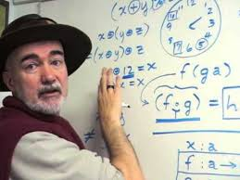
Containers: basic concepts
Axiom:
Composition is the best way to control complexity.
Arity:
A container can have 0 or more wrapped elements
Emptiness:
Checks should be in callee, never caller.
Empty checks in caller would make composition difficult
Members:
Wrap (lift):
Take a raw value and wrap it inside a container.
Map (apply):
Apply a (potentially wrapped) function to a (potentially wrapped) value.
Compose (bind):
Ability to compose wrapped values with other wrapped values.
[Brian Beckman]: composition!
Notes:
Brian Beckman has a video entitled “don’t fear the monad” in which he asserts “composition is the best way to control complexity”. I heartily agree. While he isn’t the only one saying that, he presents the case in a very eloquent manner.
So, when we create containers, we want to make sure we don’t lose composition: we’ll want to be able to compose containerized entities.
A container can have 0 or more wrapped items; and I think of that as the “arity” of the container.
Checks for empty containers should be born by callees, not by callers; otherwise composition and reliability would suffer.
When we come up with containers, we’ll want 3 basic functions: a wrapping function to “lift” wrap raw types to container types, a map function to apply a function to all items in the container, and a compose function to bind or compose containers with other containers of the same type.

Slide 6
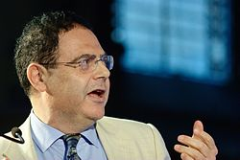

Bertrand Meyer: contracts
Contracts and responsibilities:
Caller versus callee
FP applies this principle better than OOP.
OOP missed most obvious application of principle!
Check for empty container:
Not in caller!
Makes it hard to pipe and compose
Null reference errors possible
Move to callee
No more null references
[Bertrand Meyer]: contracts!
[Regan]
Notes:
Bertrand Meyer raised a simple, but brilliant question: contracts. What is the responsibility of the caller, and what is the responsibility of the callee?
However, the OOP world didn’t come up with good answers to that question like the FP community did.
An obvious application of this principle is to tuck the checks for empty containers into callees rather than callers.

Slide 7

Empty container checks
Typical (unreadable!) legacy code:
if container is not empty then
if nested container is not empty then
{run function on container}
else
{return a different type}
else
{return a different type}
When call sites test for empty containers:
Inconsistent checks mean ugly surprises at run time.
Both branches of if tests should return same type!
Otherwise we lose type coherence
Good solution: if the container is empty, just return it.
Conclusion: don’t chain if tests, chain functions!
Notes:
Here’s some typical legacy code that demonstrates a kind of tunnel vision: call sites are littered with defensive checks for empty containers.
Worse yet, these if tests are chained to also check for nested containers being empty.
But wait, it gets even worse than that: some callers don’t do these checks, or do them differently; which can result in ugly surprises at run time.
And it gets even worse: when containers are empty, bad decisions are made. Sometimes an error is thrown, which is way too big of a hammer for such a situation. Sometimes a different type is returned in the else clause, which means the if test isn’t type coherent. To be type coherent, both branches of an if should return the same type.
I think the most reasonable thing to do when a container is empty is to return the empty container.

Slide 8


Scheme
1st class citizenship
All entities in a programming language must able to participate equally in all activities sanctioned by the language.
[SICP]: the “Wizard” book
[Gerald Jay Sussman]: 1st class citizens!
Notes:
Does anyone remember the Scheme community? They made some important contributions to the evolution of FP. One noteworthy concept was 1st class citizenship: all entities in a programming language must be able to participate equally in all activities sanctioned by the language.
Otherwise, we have discrepancies that introduce an ad hoc lack of uniformity.
Applying that principle here: if we can wrap data, we must be able to wrap functions too!

Slide 9
Make empty containers first class!
If empty containers were first class:
We could put them through the same computations as non-empty containers.
Example (F#):
//let (|>) x f = f x
let pipe =
Some 3
|> Option.map id
|> Option.map ((+) 1)
|> Option.bind (fun _ -> (None : int option)) //return empty container
|> Option.map id
|> Option.map ((+) 2)
|> Option.map (fun x -> x * 5)
Notes:
I want to obsess about this if issue a bit more, this time from the 1st class citizenship perspective.
The problem we saw with if tests at call sites was due to empty containers not being first class citizens.
If empty containers were first class, we’d be able to put them through the same computation chains that non-empty containers can be put through.
Here’s an example: we return an empty container, yet the computation chain continues the same as it would for non-empty containers. The callees simply punt on applying the functions they’re asked to apply.

Slide 10
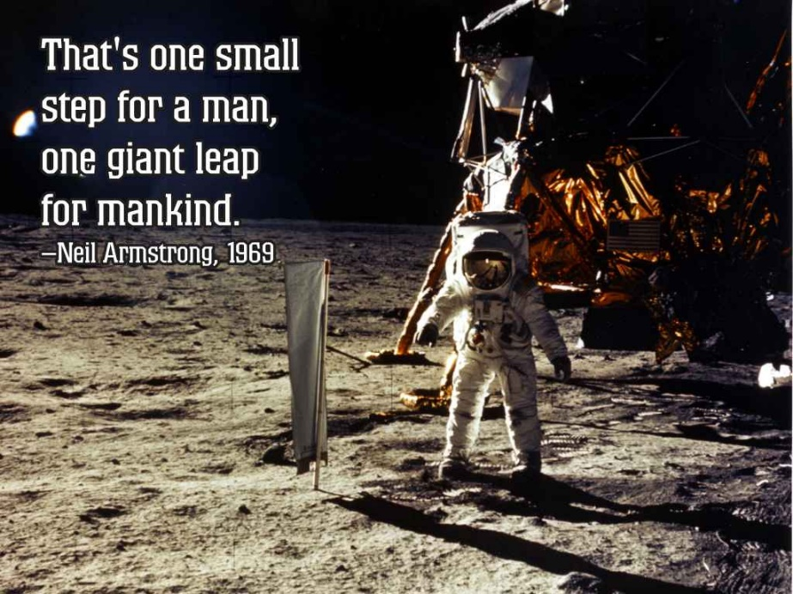
One small step…
Small steps that result in big payoffs
Helps to avoid null reference problems
[Neil Armstrong]: one small step!
Notes:
The way we refactored if tests by pushing them into the callees is a small step to make, but it has profound ramifications.

Slide 11
f x
λfx.fx
Notes:
Let’s start with the most basic type of function call in lambda calculus: f applied to x.

Slide 12
Wrap x
f x
functor
Notes:
If we wrap the data argument, we have a functor.

Slide 13
1st class citizenship: functions
If we can wrap data, we must be able to wrap functions too!
Can have absence:
Of data
Or function to apply to it
Notes:
If we can wrap data, we should be able to wrap functions too! Otherwise, they aren’t first class in the world of containers.
Just as we can have an absence of data, we can also have an absence of a function to apply.

Slide 14
Wrap f
f x
applicative
Notes:
When we wrap both the function and the data argument, we have an applicative.

Slide 15
Confusing terminology?
Applicative:
Conjures strict versus non-strict
Example: “applicative-order” versus “normal-order”
Terms for wrapping (or lifting):
pure (applicative)
Conjures debate of pure versus impure.
return (monad)
Conjures the notion of explicit (rather than implicit) return keyword.
Notes:
When we have a container, one of the first things we’ll need is a way to create them; be it a constructor, or a function that allows wrapping (or “lifting”) a raw type to a container type.
While I like the way Haskell codified containers, I think the choice of terminology is a bit confusing in this area.
The wrapping function for applicatives is called “pure” which is very confusing. Pure conjures a debate about purity versus impurity; but in this case we’re in an entirely pure world with referential transparency.
The wrapping function for monads is return; which conjures the notion of an explicit return (rather than implicit returns). I think this is especially confusing for those coming from an imperative programming background.

Slide 16
functor
Apply a function to a wrapped value
fmap, <$>
Contract: map a function across all items in a container
Important: can’t change arity of container!
Prelude> (+ 1) <$> [1, 2, 3]
[2,3,4]
Prelude > show <$> [1,2,3] --can return container of different type
["1","2","3"]
Prelude > (+ 1) <$> Just 2
Just 3
Prelude > (\ _ -> Nothing) <$> Just 3 --can't return empty container
Just Nothing
Notes:
Let’s take a look at functors. Functors apply a function to a container. If the container has multiple values, the function will be applied successively to each item, and the results will be returned in a new container of the same type.
The function that does this is called fmap, and it has an operator that looks like a dollar sign embedded in angle brackets.
Note what happens when you try to return Nothing from the fmap function. It will get wrapped so that it is Just Nothing, which is not the same thing.
In fact, it’s not possible to change the arity of the container using fmap!
To do that we’ll need the bind function that monad provides.

Slide 17
applicative
Wrap function and value
Wrap: pure
Apply: <*>
Allows applying function to multiple wrapped values
Prelude> (+) <$> Just 2 <*> Just 3 --result of functor is a wrapped partially evaluated function
Just 5
Prelude> pure (+) <*> Just 2 <*> Just 3 --lifted/wrapped function
Just 5
Prelude> Just (+) <*> Just 2 <*> Just 3 --wrapped function (via constructor)
Just 5
Notes:
Applicative applies a wrapped function to a wrapped value or values. If a function wants to consume multiple values, just use the apply function for each wrapped value.
The first example you see here uses a functor to apply addition. That will result in a wrapped partially applied function that then requires an applicative to consume the last argument needed by the addition function.
The second example shows a lifted function that is then applied to 2 wrapped values using applicative operators. Compare the first and second examples. They are similar; but to use only applicatives, the addition function needed to be lifted using the pure operator.
The last example shows the application a wrapped function to multiple arguments using only applicative operators.

Slide 18

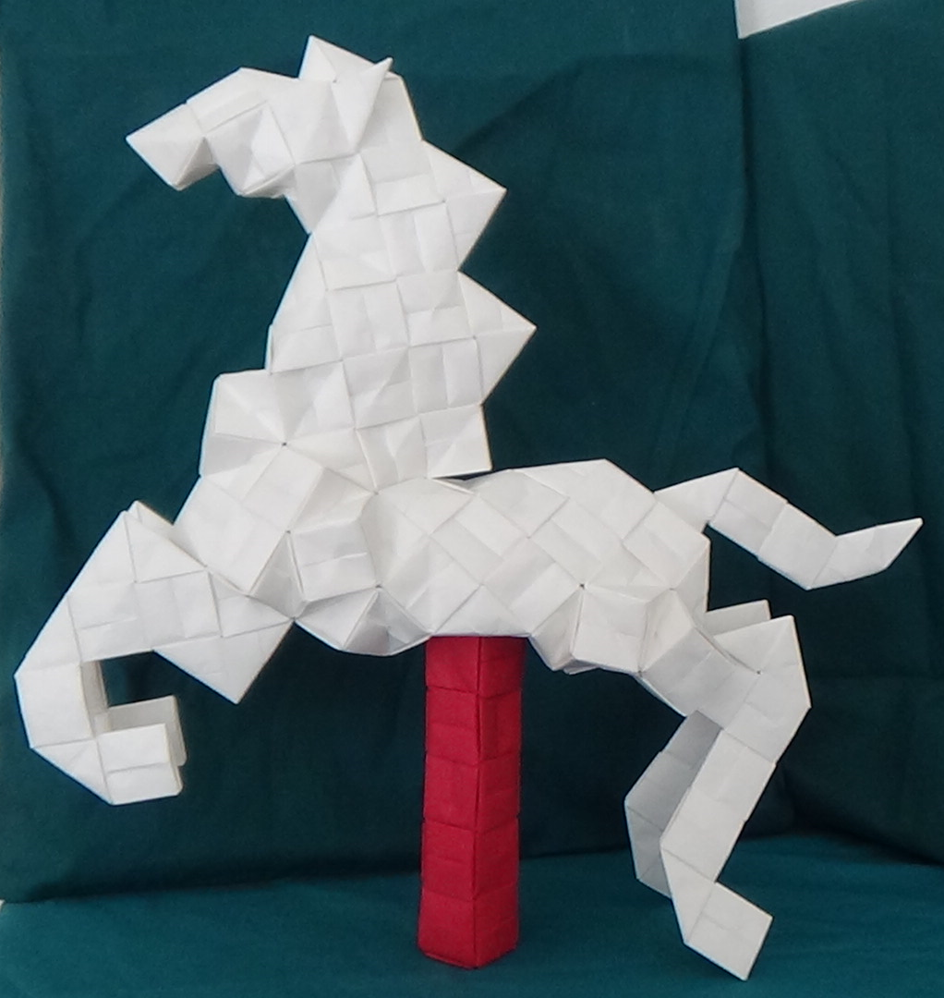
Desideratum: returning an empty container
Scenario:
You’re drilling into optional XML nodes…
want to return an empty container
if the optional node isn’t present.
Can’t do this with fmap!
Functor:
fmap can’t return a container with a different arity
Foldable:
can return an empty container
Monad:
bind can return an empty container
[author] unit origami: fold + composition
Notes:
The examples so far have been a bit contrived; so let’s bring this relate this to a real world scenario to help visualize what’s going on.
Let’s say you’re drilling through optional XML nodes. Since the node may or may not be there, it makes no sense to throw a panic error in the event of a non-existent optional node. Instead, we’ll want to return an empty container to signal to the caller that the node being searched for isn’t there.
We can’t do this with a functor because functor can’t return a container with a different arity from the input container.
Using monad’s bind function, we can do this; hence we can think of monads as functors that add a relaxed version of fmap that can return a container with a different arity.

Slide 19


monad
Wrap: return
Bind (composition): >>=
More flexible than fmap
Can change arity of container!
Quarantine: “sin bin” (Simon Peyton Jones)
i.e. anything that doesn’t fit functional model
i/o
Effects (behind the scenes), i.e. time function
Things that violate referential transparency
Functions that aren’t total
Composable:
Bind allows composition
Composition is the best way to control complexity
[Phillip Wadler]: monads for FP
[Simon Peyton Jones]: sin bins
Notes:
Let’s take a look at monad now.
Monads were introduced to functional programming by Phillip Wadler.
Simon Peyton Jones characterizes monads as “sin bins” for things that don’t fit well into the typical functional paradigm. Even purely functional scenarios where we have a non-total function and want to lift it to a total function can benefit greatly from monads: this is why Maybe is so useful.
If all you ever do is quarantine computations that have effects or are involved in I/O, that’s a step in the right direction; because it is in those type of computations that things are most likely to go wrong as compared with pure computations.
However, if these “sin bins” couldn’t be composed, we’d then lose composition; and composition is the best way to control complexity.
Using bind, we can compose monads with other monads of the same type.
Before the advent of monads, functional programming wasn’t really viable for real world programming. Now it is; hence I see monads as one of the greatest advances in computer science within my lifetime.

Slide 20
Map wraps, bind doesn’t
Prelude> Just 3 >>= (\ x -> Nothing)
Nothing
Prelude> :set +m
Prelude> do
Prelude| x <- Just 3
Prelude| Nothing
Prelude|
Nothing
Input:
fmap and bind will unwrap for you
Result:
fmap will wrap result
bind won’t:
You have to wrap the result
But this gives you the opportunity to return an empty container!
<pun alert> bind gets us out of a bind
In a sense...
Monads are functors with a liberalized fmap function
Notes:
I mentioned previously how there are some scenarios that can’t be solved with a functor, but by adding the bind function they can be solved.
I want to show what this looks like, in particular for a container that has arity 1 or 0.
Map wraps, but bind doesn’t. This might seem like a small difference, but it can make a huge difference in expressive power.
Because bind doesn’t wrap the result, you have to do it; and that gives you the opportunity to return an empty container when the input wasn’t empty.
Here’s an example show the Maybe monad returning Nothing. Below that you see the use of do notation to express the same thing.

Slide 21
Either
data Either a b = Left a | Right b
Problem:
Empty containers don’t explain why failures happened.
Scenario:
Need to know when and how failure happened.
Want to log cascading failures.
ROP = railway oriented programming
Scott Wlaschin (F# author)
Either monad:
Sum type with left and right alternatives
Left for failure path
Can create stack trace reports of failures
Right for success path
Notes:
Empty containers let us know that a failure occurred but they don’t tell us why or where it happened.
If you’re writing a compiler or interpreter; you’ll want to be able to pinpoint where and why a failure happened, and what the cascading effects of it were.
This is what Scott Wlaschin calls ROP = railway oriented programming. We have two paths possible at every juncture: the success path and the failure path. Either is an OR type that records information about the path we’re on.

Slide 22
suggestions
Some containers are members of multiple type classes.
Maybe is a functor, applicative, and a monad
By understanding Maybe, IO will make more sense.
Use the lightest tool for the job (in order):
functor, applicative, monad
Prefer fmap over bind
If you don’t need to change the arity of the container:
use fmap
it will do the wrapping of the result for you
Notes:
Since many containers are members of multiple type classes, you can appeal to them as any of the types of the type classes they participate in.
For instance, Maybe is a functor, applicative, and a monad. Maybe is a good container to master; once you see how it behaves as a monad, you’ll feel much more comfortable working with the I/O monad.
I think it’s generally a good idea to use the lightest tool for the job. In order of lightness, we have functor, applicative, and then monad.
If fmap will work for your purpose, I think it’s better to use than rather than to use bind. Bind is more powerful, since it can return a container of a different arity than it was handed. This is due to the fact that map wraps for you, but bind doesn’t; and that allows you to return empty containers.

Slide 23
“wrap up”
Containers are useful:
Communicate absence
Express failure
Lift non-total functions to total functions
Wrapping of both values and functions
Need:
Empty container checks in callee, not caller
Wrapper (lift) function
Application function
Composition function
Composition is the best way to control complexity
Once we containerize, we need a way to compose the containers
Monads make FP feasible in the real world
give us a way to handle things that don’t fit a pure functional paradigm.
Notes:
I hope I’ve convinced you that containers are useful and that Haskell codifies them in a particularly elegant way.
Containers can communicate absence, or lift non-total functions into total functions.
We can wrap both functions and data to indicate a lack of a function to apply, or a lack of data.
We want to have empty container checks inside callees rather than callers; in order to expedite piping, chaining, and composition.
Once we have containers, we need a function to wrap (or lift) a raw type into a container type, an application function to apply a function to contained items, and a bind function to allow composition of containers.
Composition is the best way to control complexity; so being able to compose containers is important.
Monads make FP feasible in the real world, by giving us a good way to handle things that don’t fit neatly into a pure functional paradigm.

Slide 24

Questions?
Notes:
Questions?
[Note: at PCOC 2017, there was time left over for folding 1 pixel unit.]

Slide 25
References
[author] Kasahara sonobe horse folded using pixel units by André van Meulebrouck
[Bertrand Meyer] https://hu.wikipedia.org/wiki/Bertrand_Meyer
[Brian Beckman] https://www.youtube.com/watch?v=ZhuHCtR3xq8
[Gerald Jay Sussman https://en.wikipedia.org/wiki/Gerald_Jay_Sussman
[Neil Armstrong] https://lovequoteswiki.com/one-small-step-for-man-quote/one-small-step-for-man-quote-success-quote-thats-one-small-step-for-man-one-giant-leap-for/
[Phillip Wadler] http://homepages.inf.ed.ac.uk/wadler/
[Regan] http://www.thecomicstrips.com/subject/The-Regan-Comic-Strips.php
[SICP] https://en.wikipedia.org/wiki/Structure_and_Interpretation_of_Computer_Programs
[Simon Peyton Jones] http://www.bath.ac.uk/corporate-information/professor-simon-peyton-jones-oration/
Notes:
Here are links to the pictures I used in the presentation.
Note that I haven’t obtained formal permission for use. I hope that I’m covered under the rubric of “reasonable academic use”.
Images not cited are believed to be free to use.

