Slide 1
Monoids on Steroids: a brief history of functional programming
Copyright © 2012, 2019
by André van Meulebrouck
All Rights Reserved Worldwide
vanmeule@roadrunner.com

Slide 2
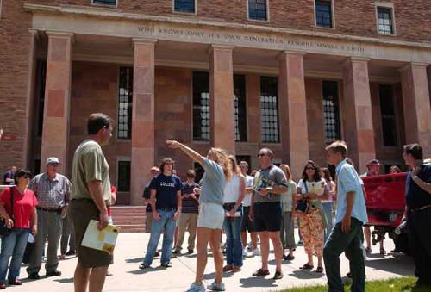
Quote
“Who knows only his own generation remains always a child.” Dr. George Norlin
Norlin Library, Colorado University @ Boulder
Notes:
This is a quote from my alma mater: Colorado University at Boulder. It’s from the guy the library is named after: Norlin. I like this quote because it is basically suggesting that it’s a good idea to know about your predecessors and what they did, so that you can build on what they accomplished rather than spending your time reinventing what they already figured out.

Slide 3
No Mutation
Functional = no mutation
  Same input, same output
  Composition
    Best way to control complexity
Implications:
  Thread safe
  Bindings
    Single assignment
  Recursion
Quarantine IO:
  IO is dangerous!
  Monads are “sin bin”
mutation
Notes:
I’m going to cut right to the chase now and give you my definition of what the word “functional” means as it pertains to the subject of my talk today, which is functional programming.
I think the word functional can be a bit misleading in English, because functional often means “practical”, “utilitarian”, or “serviceable”. So, perhaps the term “functional programming” is regrettable because some might think that’s what it means in this context, but that’s not even close to the real meaning here.
Functional really just means “no mutation”. That’s it. All other definitions are really forced consequences of deciding that we are not going to mutate existing state. That really forces the use of functions, and recursion, and all the terms you typically hear associated with functional programming.
There’s a good reason for avoiding mutation. Most programming mistakes occur in code where you use mutation, or interact with the outside world: be it printers, servers, mechanical hard drives, and so forth.
A function is supposed to give you the same result for the same input no matter how many times you call it. That property of being able to rely on the same output every time, for a given input, is called “idempotence”. Once you lose idempotence, it becomes very difficult to reason about program correctness and how a program will behave.
This has huge ramifications for threading and parallel processing because mutation free programming is automatically thread safe, and is much easier to evaluate in parallel.
Some amount of interaction with the real world is unavoidable, but we can at least quarantine I/O and separate it from “pure” code that doesn’t do any mutations. This makes it much easier to track down failures. I/O can only be done in monads. They are a sort of sin bin. When things do go wrong, you know where the likely points of failure will be. The compiler can then do all kinds of optimizations and verifications that it otherwise couldn’t do.

Slide 4
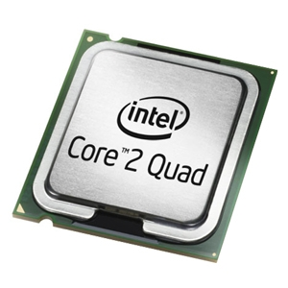
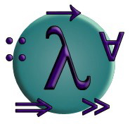
Where are we?
Cheap multi-core hardware
Haskell:
  WinGHCi
    Interop via p-invoke
.Net 4.0
  Generational gc
  TPL (task parallel library), LINQ, lambdas, lazy, bignums, etc.
  F# in VS 2010
    Computation expressions (monads)
    No designers for WPF
.Net 4.5
  Compilers as a service
  C#: Async via CPS (continuation passing style)
Notes:
So where are we know in this endeavor to achieve purity in programming?
We’re actually better off than I might have guessed we’d be some years ago. We made some mistakes along the way, but we’re in a great position now to make up for lost time.
We now have really cheap multi-core hardware and conventional programming languages can’t leverage them very well because they are too stateful in their approach. Functional programming is now Johnny-on-the-spot to fill this unique niche.
We have open source Haskell compilers that achieve some degree of interoperability via p-invoke.
.Net features generational scavenging garbage collectors, and that technology came directly from Symbolics Lisp machines.
.Net 4.0 has TPL (task parallel library), LINQ (language integrated query), lambdas, lazy evaluation, infinite precision math, and other facilities that came from FP either directly or indirectly.
Visual Studio 2010 has F# built-in as a first class language in .Net; that means it has instant interop with all other .Net languages (like C# and VB.Net).
In .Net 4.5 we will have compilers as a service: that means user code will have direct access to compilers, which will be a boon for tool makers. C# will have asynchronous processing wherein the compiler will be using a technique directly from FP: CPS (continuation passing style).

Slide 5

How did we get here?
Are we there yet?
  Well, not quite!
Who contributed?
Lessons learned?
Did we achieve:
  A calculus for the algebraic-like manipulation of computer code?
Notes:
So, how did we get here?
And, are we there yet? Well, not quite!
And, who contributed? What are the lessons learned?
Did we achieve “a calculus for the algebraic-like manipulation of computer code”?
I’ll try to answer those questions, and shed some light on what functional programming is all about along the way.

Slide 6
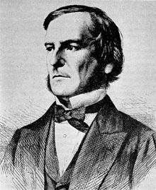
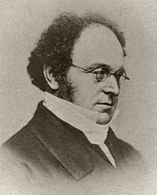
1847: Propositional Logic
George Boole
  Mathematical Analysis of Logic
  Ex: x ∨ (y ∧ x) = x
DeMorgan’s Law
  ¬(P ∧ Q) ⇔ (¬ P) ∨ (¬ Q)
  ¬(P ∨ Q) ⇔ (¬ P) ∧ (¬ Q)
George Boole
Augustus DeMorgan
Notes:
I’m going to start my story in 1847, when propositional logic was invented by George Boole. This is where we got Boolean Algebra from; but it would take almost a hundred years before some one would realize the importance of this discovery, and know how to apply it.
From a programming perspective, I love the way Boolean algebra gives us a way to verify whether our boolean logic in software is correct or not, and to transform it into equivalent expressions, or simpler expressions.
It would be nice if we could manipulate all computer code in a similar algebraic way; not just our Boolean logic.

Slide 7
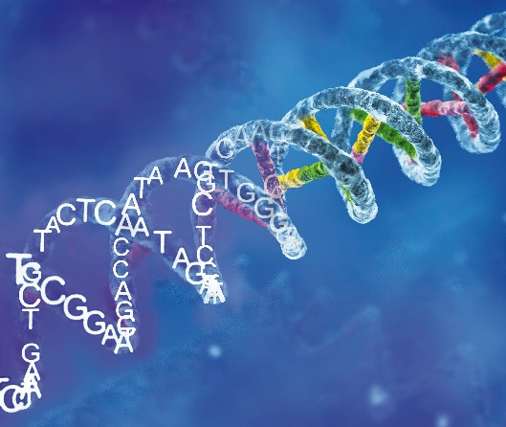
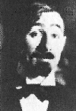
1924: Combinatory Logic
S, K, I
  Ix = x
  Kxy = x
  Sxyz = xz(yz)
X
  Example: (XX) (X (X (XX) (X (XX))))
  X = λf.((f S)K)
  I = (XX), K = (X(X(XX))), S = (X(X(X(XX))))
Moses Schönfinkel *
Шейнфинкель
* papers were burned by his neighbors for heating
Notes:
Out of all my slides today, perhaps this is my very favorite. And perhaps this is the greatest hero of today’s story.
This is Moses Schönfinkel. He was a German Jew who lived in the erstwhile Soviet Union.
In 1924, well before the advent of digital computers, he invented combinatory logic. The reason why this is so near and dear to me is because I believe this is exactly how Mother Nature herself does her programming! She controls complexity by composition, using only a handful of primitives. Do the letters CTAG mean anything to anybody? These are the primitives from which DNA sequences are built.
Moses proved that everything that is computable can be expressed using only 3 combinators: S, K, and I. Actually, we don’t even need I: it can be derived from S and K. Then later, the question naturally arose: is it possible to conjure just one combinator, from which all other functions can be derived? The answer is yes. All we need to do is prove that S can be derived from K, and then it’s “quod erat demonstrandum”. And we can figure out what that X combinator must look like by combining K’s until we arrive at an S.
Naturally these combinators must have some very special properties to allow them to be so composable. For a function to be a combinator, it must not have any free variables. Here’s what that means. If I’m a function and I reference a variable I own, that’s called a “bound variable”. But if I reference a variable I don’t own, that’s called a “free variable”, and it means I’m stuck in my defining context. However if I can be abstracted so as not to require my parental scope, I would then be free to move about and combine freely with other combinators. I’ll come back to that concept when I talk about lambda calculus, because I think the best way to understand combinators is to look at them in lambda calculus.
This isn’t just theory by the way. In FP there are “combinator libraries” for various things, like parsing. These are of great interest because of the cleanness with which we can combine them to solve very complicated programming problems.

Slide 8
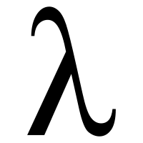
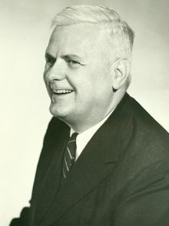
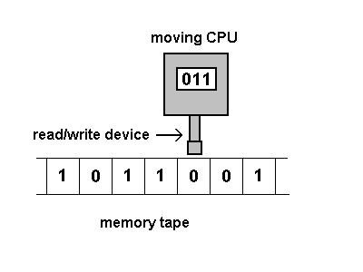
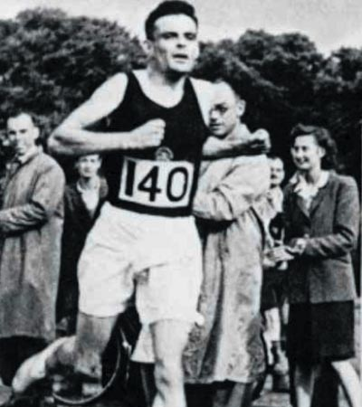
30s: λ-calculus
untyped lambda calculus
  Lambda terms: v, λv.E, (E1 E2)
  Ex: λh.((λx.h (x x)) (λx.h (x x))) g
Turing complete
Alonzo Church
Alan Turing
Notes:
In the 30s Alonzo Church invented lambda calculus.
The best way to understand lambda calculus is to imagine a minimalist game in which we ask the question: what is the smallest and simplest programming language that we can possibly invent that will still be powerful enough to express everything that is computable.
The answer to that question is “lambda calculus”. Lambda calculus is so thrifty, it doesn’t even have numbers. You must fabricate them from anonymous functions known as lambdas. That’s all you have to work with. A lambda function can return a bound variable, a lambda abstraction, or apply an expression to another expression. That’s all you have to work with; yet logicians in the 30s were doing a form of programming in their heads and on paper long before the advent of computers.
Lambda calculus was then proven to be “Turing complete”, which means “capable of computing anything that is computable”.
They did all this in an attempt to arrive at a unifying foundation for mathematics; however in that mission they utterly failed, and Gödel put a final nail in the coffin when he proved the notion of incompleteness. That is to say, there are things we know are true, but which can’t be proven true in our formal systems because all formal systems are inherently incomplete.
However, this exercise did lay the foundation for programming languages; and we have not been able to come up with a better foundation for programming languages than lambda calculus and combinators.
And if you think this is all just theory, let me remind you that even C# now has “lambdas” and they are very powerful and concise. FP languages are basically just extended lambda calculus! In fact, programming in Haskell is very much like programming directly in typed lambda calculus.
Let’s take a look at some lambda expressions now on the white board.
[true, if, tuples, currying]

Slide 9
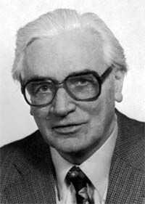
1936: Z1
Konrad Zuse
Z1:
  1st computer
  Binary
  Electro-mechanical
1939:
  Funded by Nazis
1941:
  Z3: Turing complete
  Vacuum tubes
Konrad Zuse
Notes:
In 1936, Konrad Zuse invented what would soon become the first electrical computer that was Turing complete.
He was funded by the Nazis, and that didn’t bother him in the slightest. He felt that technical people need to make Faustian deals with the devil in order to practice their craft. Hence, no apologies are necessary.

Slide 10
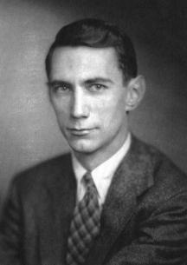
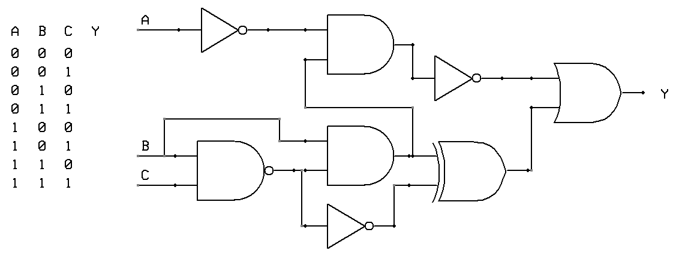
1937: Boolean Algebra
MIT Master’s student
Thesis:
  Boolean Algebra useful
    For logic circuits
    End of vacuum tubes
Claude Shannon
Notes:
In 1936 Claude Shannon, for his MIT Master’s thesis showed how Boolean algebra could be useful in designing logic circuits.
That began the demise of vacuum tubes.
And you have to admire people like Boole, who did their duty without knowing if or when their labors would ever bear fruit, nor how these technologies could be applied. Yet, they still persevered.

Slide 11
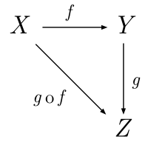
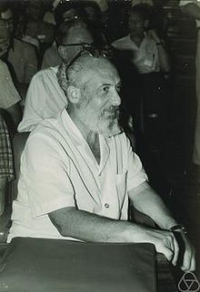
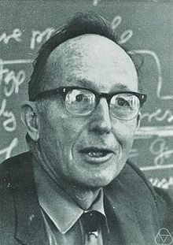
1942: Category Theory
Abstract Set Theory
Allows:
  Proof
  Verification
  Refactoring
Lists:
  monoids
Monads:
  monoids on steroids
Samuel Eilenberg
Saunders Mac Lane
Notes:
In 1942 Category Theory was born.
Category theory is basically a very abstract form of set theory. It was discovered that many domains behave like sets, but only to some extent. Category theory is very flexible and lets you use any objects you want instead of sets. For physicists, the objects might be vector spaces. For computer scientists, the objects are typically types.
Category theory gives us ways to verify, prove, and refactor things.
How many of you think you know what a monoid is? Actually I think you all do. You learned about them in grade school; but you might not realize that they are called monoids. If you every studied group theory, you would have heard of monoids, and they mean basically the same thing in Category theory that they meant in Group theory. In fact, much of group theory survived intact in Category theory.
Here’s what a monoid is: it is a binary operator that has an id function, is composable, and is associative. So, addition is a monoid, but subtraction is not (because it’s not associative).
It turns out that lists, which are perhaps the primordial data structure of FP, are also monoids.
That means they have special properties that we can rely on, and this is important when we start to manipulate computer code in algebraic-like ways.
It will also turn out that monads, the “sin bin” of I/O, are essentially also monoids, but they have an additional context; hence they are basically monoids on steroids. And it turns out that monads are the star of the show because FP really didn’t have a good answer to the problem of I/O and state manipulation until the advent of monads. Monads make FP viable and feasible as a general purpose programming language, and they help greatly in solving very difficult programming problems.
The programming language Haskell is based very directly on Category theory, and it shows through very clearly in the terminology of Haskell. Haskell has a type class for monoids, monads, functors; etc.. These are all directly from Category theory. We’re going to see what a type class looks like in Haskell very soon.

Slide 12
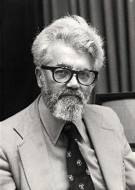

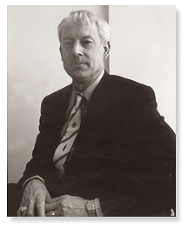
1958: LISP
Untyped λ-calculus
S-expressions
  Ex: (car (cdr (cons ‘a ‘(b c)))) => b
  Great for embedded languages
    Simple parser
Rejected!
  lives on in the genes of other things
  .Net gc came from Lisp community
John McCarthy
Henry G. Baker, Ph.D.
Notes:
In 1958, LISP was born. It was based on untyped lambda calculus.
LISP has the simplest syntax of any programming language, and all data and programs are described in terms of it: s-expressions (standing for “symbolic expressions”).
LISP was also based on recursion theory.
Unfortunately the world would reject LISP, especially its syntax (which was rejected even by latter generations of FP languages).
Curiously enough, LISP’s syntax was never intended to be s-expressions. S-expressions were merely a useful intermediate language to be used by interpreters and compilers. It was intended that later on, a more human friendly syntax would be conjured for LISP, but that never happened; because people liked s-expressions so much they just decided to make that the official syntax of the language.
I actually love the elegant simplicity of s-expressions and prefix notation: it makes LISP the perfect language for embedded systems because the simple syntax and uniform semantics of LISP makes it really easy to write parsers, interpreters, and compilers for it. Also, a lot of code will never be seen by human eyes, because it is intended to be consumed by other code. For code that consumes code, you want the simplest and most uniform syntax possible.
While LISP has been rejected by the mainstream, LISP does live on in the genes of other things; in particular .Net got its generational scavenging garbage collector from LISP.

Slide 13
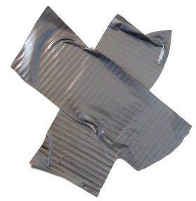
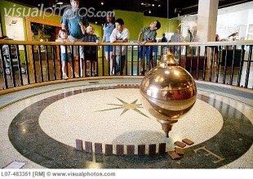
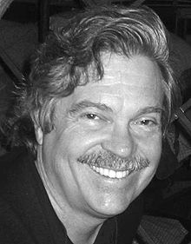
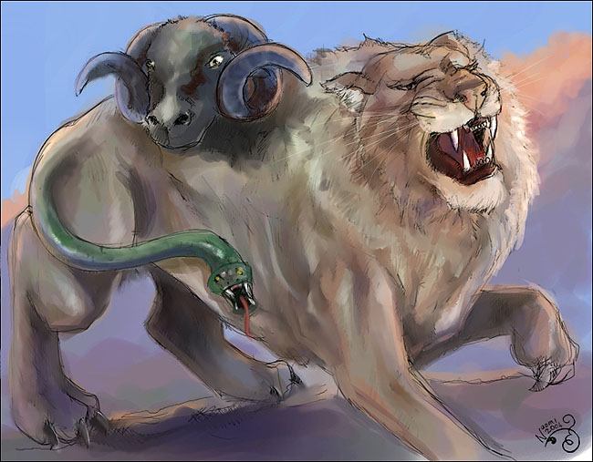
1970s: OOPs!
Incoherent type system:
  “everything is an object”
  functions are orphans
  subtypes, covariance, contravariance
  Reference, Value, Enum types
  WPF dependency properties
Implementation inheritance
  Multiple inheritance
    Which method gets run?
Encapsulation:
  Too early => no method extraction
Generics:
  No inheritance chain
Chimera:
  OOP + FP
Alan Kay
Chimera (Greek Mythology)
Notes:
OOPs! In the 70s, we not only got disco, we also got OOP.
Alan Kay, inventor of Smalltalk, is a scientist I deeply admire. That said, I think OOP is a niche paradigm that is actually inappropriate for general purpose programming.
Trends are like pendulums. They swing one way, then the other way. I remember a book on OOP in the early days written by a zealot who insisted that nirvana would only be attained when all those pesky databases (that are based set theory and relational calculi) get replaced with OO databases!
No, everything is not an object. In OOP, functions become orphans because you have to create a special class just to house them since they aren’t first class citizens.
Another thing that really bugs me about OOP is that the paradigm is really a confederation of ideas that don’t need to be coupled together in the first place. The only thing about OOP that is truly peculiar to OOP is implementation inheritance. That’s it! All the other aspects that people normally name as tenents of OOP, actually have nothing whatsoever to do with OOP. If you want encapsulation, FP provides far better facilities for it than OOP could ever even imagine. And encapsulation, as it exists in OOP, is actually a bad thing rather than a good thing because it is done far too early. You should encapsulate only very late in the game; otherwise you lose reusability of your verb space. In pure OOP, FP style verb reuse is referred to as “method extraction” and it’s strictly forbidden.
Multiple inheritance is a catastrophe, because it’s hard to tell what method will ultimately get run in many situations.
The truth of the matter is that the best way to control complexity is via composition and delegation, not inheritance. If you really want reuse implementations, there are many better ways to obtain it rather than through inheritance.
OOP is showing its age now, because there aren’t any more “pure” OOP languages. All supposed OOP languages now are really a hodgepodge, or chimera of duct taped paradigms, most of which are coming from FP to bale out the limitations of OOP. For instance generics are straight out of FP and have nothing to do with inheritance chains.
Here’s the bottom line: FP subsumes OOP. Hence, it makes sense to implement OOP in FP, but it’s a disaster to try to implement FP in OOP.

Slide 14

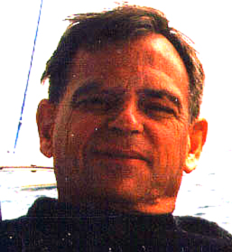

1972: Prolog
5th Generation Project:
  Japanese
Unification
  Found home in type inference
  Example: takeWhile :: (a -> Bool) -> [a] -> [a]
Haskell: extremely sophisticated type sytem
  Logic errors typically transgress type system!
Alain Colmerauer
Notes:
In the 80s, the Japanese made Prolog the cornerstone of their “5th Generation Project”.
I could’ve told them it wasn’t going to go anywhere as a general purpose programming language, even while I remain deeply enthralled by Prolog.
Prolog is a niche language. It’s really good at doing “backward chaining” via Horn clauses and the unification algorithm. It’s as if it tries to answer the question: “Here I am, but how did I get here? What has to have been the case for me to have arrived at this state?”. Prolog is very goal directed. If the problem you’re trying to solve fits that domain, Prolog might be just the thing you need.
Prolog also taught us a lot about declarative programming, creating runnable specifications, and describing code in terms of equations. We’re going to actually take a look at some Prolog code later on.
Needless to say, the Japanese were wrong in betting so heavily on Prolog. It really never became the next big thing like they thought it would.
However, Prolog wound up playing an unexpected role akin Rudolph the Red Nosed Reindeer. It turned out that FP was in search of a type system, and Prolog turned out to be the missing puzzle piece in attaining the dream of type inference.
It’s very difficult to create programming languages that are smart enough to spot logic errors, but in Haskell, we are getting very close to attaining that seemingly impossible dream.
Here’s why: it turns out that it’s actually very difficult to create logic errors in your code without simultaneously transgressing the type system! While your logic errors might not be spotted, the type inference engine can definitely spot your inappropriate usage of the type system!
Prolog essentially gives us an artificially intelligent type inference engine that can not only tell you when you’ve stomped on the type system; it can even tell you exactly why your usage of types is illogical. These are very helpful diagnostics.
Here’s an actually example of where the type inference engine helped me spot a very bad bug in my code; and it was able to tell me exactly what went wrong at compile time to spare me from potential embarrassment at run time!

Slide 15
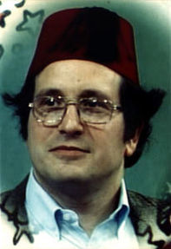

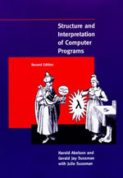
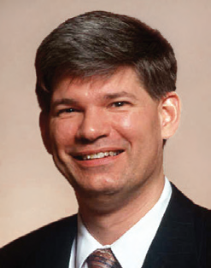
1975: Scheme
MIT’s dialect of LISP
Higher Order:
  Pass or return functions as values
1st class citizenship
call/cc, CPS
  But no monads
Not lazy
  Mutation and lazy don’t mix!
Gerald Jay Sussman
“Wizard” book
Guy Steele
Notes:
Scheme is MIT’s dialect of LISP with a heavy emphasis on elegant simplicity and purity.
Scheme in some ways was a reaction to divergent trends within the Lisp community. Lisp machines were using Common Lisp, and Common Lisp had a lot of historical and evolutionary baggage in it that began to complicate what was originally a very simple language. This spawned a “get back to basics and remember our roots” movement, which culminated in Scheme.
Scheme had a stress on LISP as a functional language with a small core. The idea was to provide programmers with few, but powerful primitives and combining forms. The user could then conjure anything desired, and relegate domain specific extensions to libraries (rather than continuing to enlarge and complicate the core language).
Scheme had a stress on higher order functions. In order for a language to have higher order functions, it must be able to treat function definitions like ordinary data; that is to say you must be able to pass them as arguments or return them as results.
In Scheme, everything returns a value, even if it does have a side affect. Scheme came up with the concept of “first class citizenship”. For a language to be first class, it must allow all citizens of the language to participate equally in all activities sanctioned by the language. That means, for instance, if you can stick numbers into arrays, you must also be able to stick functions into arrays. Scheme took this to great extremes with the advent of call/cc, which is the shortened name of the more verbose call-with-current-continuation. Scheme is the language that came up with the idea of continuations, and CPS (continuation passing style). Every computation has a future, or a continuation. That future must be first class and storable in data structures. This essentially meant being able to package up an entire call chain, including the stack, and stuff it into a data structure; then later to call that continuation (or replace it with some other future). With this, it then became possible to create a multitasking operating system from a high level language!
Scheme pioneered many concepts that are now incorporated into typed functional languages, like tail recursion optimization. This allows tail recursive calls to run in constant space so that recursive calls can run in constant space to avoid stack overflows.
Scheme is basically untyped lambda calculus, with a ruthlessly consistent s-expression syntax; but unlike lambda calculus it is not lazy, and I think the lack of laziness was an unfortunate mistake that ultimately lead to monads being invented in lazy languages like Haskell instead of Scheme.

Slide 16

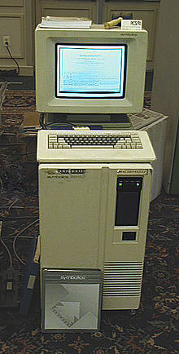

1983: Symbolics
Lisp machines:
  Latent (dynamic) typing
  Tagged architectures
FP:
  Static type inference means:
    No more tags.
    No more surprises at run time!
    No more (expensive!) exotic hardware.
    No type discovery overhead at run time.
Symbolics Lisp machine
Notes:
In the early 80s Symbolics started selling Lisp machines.
These machines are immortalized in Stephen Levy’s book “The Hackers” as the ultimate machine for programmers.
Everything on the Lisp machine was written in Lisp; from the Lisp-like FEP (front end processor) to the Genera operating system itself. And, of course, all programming languages and applications were written in Lisp.
It featured a generational scavenging garbage collector, which now lives on in the genes of .Net’s generational scavenging garbage collector.
The Lisp machine also featured the most advanced OOP system that had ever been invented up to that time, and some might argue that it still offers the ultimate in OOP: CLOS (the Common Lisp Object System). It featured multiple inheritance and dynamic dispatch. Flavors and mixins were invented on the Symbolics Lisp machine.
The Lisp machine had a tagged architecture to codify type information to enable fast recuperation of type information at run time. But this required extra long address registers so that the tags did not eat into the address space that the machine could address. Needless to say, a tagged architecture required special hardware and current CPU makers had no interest in supporting such architectures.
Meanwhile, the more purist elements of the FP community departed from the s-expression syntax of Lisp, macros, and latent typing. They opted instead for a more human-centric syntax that is indentation sensitive, and opted for a sophisticated type system and static type inference.
Symbolics went out of business, having largely been rejected by the mainstream. It’s hard to say exactly why this happened, but I think history would have been very different if Lisp had instead become mainstream. I believe we’d be technologically far ahead of where we are now.
One thing is certain however: static type inference allowed a latter generation of FP languages to work on stock hardware. No more tags. No more surprises at run time. No more performance hits due to type discovery at run time.
There are many things I miss from Symbolics Lisp machines that we still don’t have today. One example is version numbers on files. The full pathname for every file included a version number which appeared at the end as a number delimited by a semicolon. This was a nice form of version control. It was considered bad taste to ever overwrite an existing file; instead you created a new version. This was also very safe. You could adjust purge rules to favor safety or space. I would love to have that feature in Windows, but I’m not holding my breath on that one!
In fact, I often joke “I wish they’d stop inventing Lisp hubcaps, and just steal the whole CAR.”. Does everyone understand my geeky pun, or do I need to go back a few slides and review the basic LISP primitives car, cdr, and cons? Incidentally, the terms car and cdr are historical artifacts of implementation: car stands for “contents of the address register” and cdr stands for “contents of the decrement register”.
I tend to think that Symbolics was too far ahead of its time to be understood and appreciated in its own time.

Slide 17
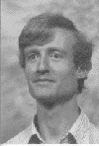
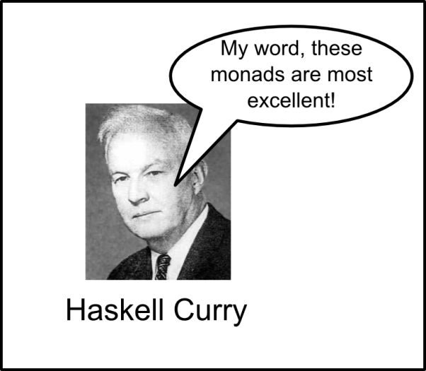
1987: Haskell
Typed λ-calculus
  Type inference
Pattern matching
  Discriminated unions
Based on category theory
  Category based on types!
  Monads
No mutation
  Not even in monads!
Lazy
  [1..] => 1 to infinity
Haskell itself written in Haskell
  Using monads!
Simon Peyton Jones
Notes:
Haskell is based on typed lambda calculus and category theory.
It features type inference and the most sophisticated type system ever created.
It features pattern matching that is reminiscent of Prolog except that it combines 3 things at once: binding, destructuring, and matching.
Haskell also has discriminated unions, which are essentially enumerations wherein some or any of the enumerations are capable of carrying a payload along with the enumeration.
Haskell has type classes which are constraints on interfaces based on reliable traits.
Haskell has monads, which are a key feature of the language that make it feasible as a general purpose programming language. Before the advent of monads, FP really didn’t have a good solution to the problem of dealing with the impurities of I/O and stateful programming.
Haskell is the purest programming language, featuring no facilities for mutation (not even in monads); with the exception of an array type that allows in place updates (but those could easily be simulated using functional arrays if you don’t mind the performance hit).
Haskell is lazy, just like lambda calculus. Because of that, Haskell can handle infinite data structures because it only evaluations the portions demanded, as they are demanded (in a streaming fashion). This also allows you to define if. Most languages don’t allow you to define if (it must be provided as a primitive instead) because if is inherently lazy, and you have no access to lazy evaluation mechanisms.
Haskell is written in Haskell using monads.

Slide 18
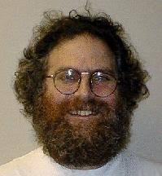
1992: monads
Wadler: The essence of functional programming
POPL '92 Proceedings of the 19th ACM SIGPLAN-SIGACT symposium on Principles of programming languages
Phil Wadler

Slide 19
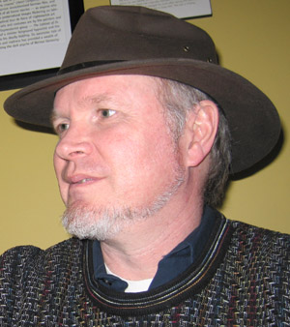
1998: XML
XML language:
  More verbose than s-expressions
S-expression:
  (a b)
XML equivalent:
  <list>
  <symbol>a</symbol>
  <symbol>b</symbol></list>
Tim Bray
Notes:
XML was invented in the 90s.
Lisp programmers yawned at the invention, saying that XML is really just a more verbose form of s-expressions.
That is true, but XML can also be considered a more type safe version of s-expressions. For instance, a closing list tag cannot be used to close a symbol; whereas right parens in s-expressions can close any type of list.
I actually like XML: it’s capable of expressing tree structures and hierarchical data structures or relationships.

Slide 20
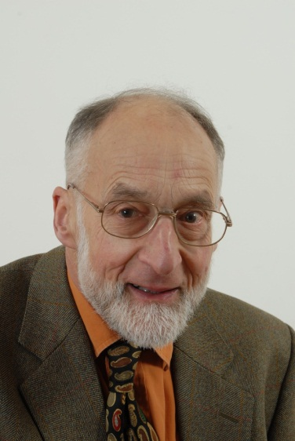
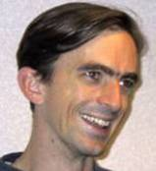
2005: F#
ML -> OCaml -> F#
  Type inference
  Not lazy
.Net Interop
No GUI designers
  Soln: code, or leverage C#
Immutable by default
Subsumes OOP
Computation Expressions:
  Flexible form of monads
Bug in my embedded Scheme interpreter
  Rewriting in Haskell using monads
Robert Milner
Don Syme
Notes:
In 2005, F# was implemented by Don Syme.
F# is based on OCaml which came from ML (which stands for “meta language”).
F# has advantages over Haskell, even while F# is not lazy and is less pure; in particular it allows instant interop with the fullest API ever created: .Net.
Everything in F# is generic (by default) unless you annotate it to constrain type inference (which is a useful technique in debugging to find out where type inference is going wrong).
Everything in F# is immutable by default, but you can annotate types to make them mutable.
F# nicely subsumes OOP, and features the best and cleanest OOP system I’ve ever seen.
F# does in fact have a flexible form of monads called “computation expressions”.

Slide 21
FP
“everything is a value”
  Objects are composites of values
Composition:
  the best way to control complexity
Monads:
  Quarantine IO, interaction, state
No mutation
  Parallel and concurrent
Multiple cores
  Moore’s law hit a wall
Notes:
You now should have some idea of what FP is all about, so here are some summarizing comments.
In FP, “everything is a value”, and objects are composites of values.
Composition is the best way to control complexity.
Monads give us a way to quarantine the pernicious affects of I/O, interaction, and stateful computations from pure (functional) code (that is much less likely to cause errors).
By favoring single assignment bindings in lieu of mutation, code is automatically thread safe and amenable to parallel or concurrent execution.
Moore’s law hit a wall. They can’t keep giving us faster processors, but they can give us more cores, if we can program them. Conventional languages are too stateful to work well in a multi-core environment; but FP is a natural fit.

Slide 22
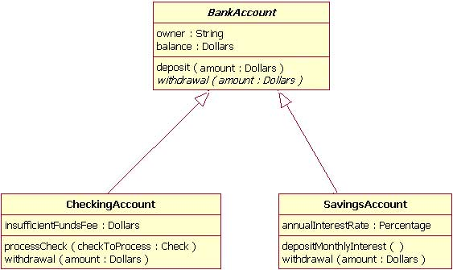
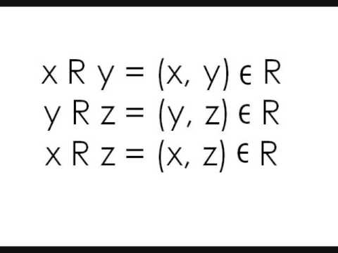
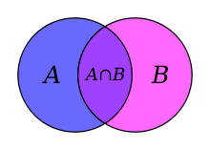
Impedance mismatch
OOP vs. databases
  Gap difficult to span
  ORMs (Object Relational Mapper)
OOP is toxic
  Doesn’t dovetail with:
    Sets
    Relational calculus
FP is synergistic
Notes:
OOP causes an impedance mismatch between OOP oriented code and the set/relational world of databases.
ORMs (object relational mappers) were created to try to bridge this gap, but they are less than compelling. OOP just doesn’t dovetail with set theory and relational calculi, whereas it is a natural fit with FP.
In fact, databases are becoming more functional, and that is making them more powerful and conflating the gaps (rather than creating more) between the world of code and database.

Slide 23
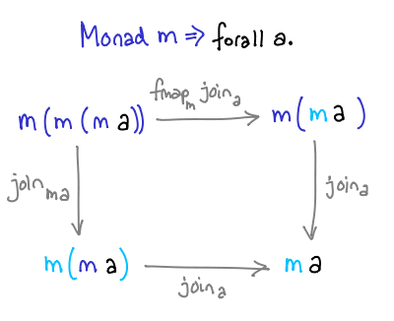
Monads
Modularity at the micro level
Minimalist game on impurities:
  Asynch
  IO
  Error handling
Preserve composition
No mutation
  Single assignments
Notes:
Monads are a form of modularity at the micro level (rather than the macro level).
OOP code is often very deviant from OOP ideals at the micro level, and that adds to its complexity.
Monads are like a minimalist game for impure aspects of programming that are most likely to go wrong. In other words, they are perhaps the smallest possible unit that can be conjured that are still capable of handling all impure aspects of functional programming; like I/O, asynchronous computing, computations that can fail, and error handling.
Although stateful programming can be naturally expressed in monads, it is being simulated through single assignments. In other words, no mutation is possible, even in monads; though they do provide a lot of syntactic sugar to make programming look more imperative for those cases where a stateful style of expressions seems more natural.

Slide 24
Rosetta Stone
Scheme:
  (define gcd
  (lambda (a b)
  (cond ((= a b) a)
  ((> a b) (gcd (- a b) b))
  ((else (gcd (- b a) a)))))
Prolog:
  gcd(A,B,G) :- A = B, G = A.
  gcd(A,B,G) :- A > B, C is A-B, gcd(C,B,G).
  gcd(A,B,G) :- B > A, C is B-A, gcd(C,A,G).
Haskell:
  gcd' :: Int -> Int -> Int
  gcd' a b
  | a == b = a
  | a > b = gcd' (a - b) b
  | otherwise = gcd' a (b - a)
Notes:
Here is a Rosetta stone programming example to highlight the similarities of 3 languages: Scheme, Prolog, and Haskell.

Slide 25
Typeclasses
gcd in prelude
  gcd :: (Integral a) => a -> a -> a
  gcd 0 0 = error "Prelude.gcd: gcd 0 0 is undefined“
  gcd x y = gcd' (abs x) (abs y) where
  gcd' a 0 = a
  gcd' a b = gcd' b (a `rem` b)
Typeclasses:
  Interfaces on steroids
  Constraints based on traits:
    Comparable, orderable, showable, readable
Notes:
You might have noticed in the Rosetta stone examples that these are toy examples that would not work for negative numbers.
Haskell is very keen on making sure functions are defined for all elements in a given type class. Here is the actual definition of gcd from the Haskell prelude. It features a type class.
Basically a type class is tantamount to interfaces on steroids. Or, interfaces meet contracts.
A type class is a set of attributes or rules that must be adhered to. This makes it very easy to manipulate code algebraically, because we know what manipulations are safe to do based on the type classes of the code involved.
Lists, for instance, are part of the monoid type class. Monads are a type class which are essentially monoids with an extra context, or monoids on steroids.
Type classes feature traits that can be relied on like enumerability, comparability, well ordering, showable, readable, etc..

Slide 26
Discriminated Unions
Enumerations w/ payloads
  data Token =
  LeftParen |
  RightParen |
  Symbol String
  deriving (Eq, Show)
OOP code more powerful
  When translated to discriminated unions
Can add members
Notes:
Discriminated unions are basically enumerations that are capable of taking payloads.
Here’s an gutted example from my parser for a embedded lazy Scheme interpreter.

Slide 27
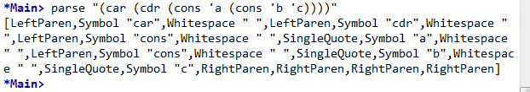
Haskell example
parse :: String -> [Token]
parse [] = []
parse s = parse' parseFunctions s [] where
parse' :: [String -> (Maybe Token, String)] -> String -> [Token] -> [Token]
parse' [] s tokens = error $ "unparsable expression: " ++ s
parse' parsers [] tokens = reverse tokens
parse' parsers s tokens =
let tup = (head parsers) s in
case (fst tup) of
Nothing -> parse' (tail parsers) s tokens
Just x -> parse' parseFunctions (snd tup) (x : tokens)
Notes:
Here’s an example from my parser for an embedded lazy scheme interpreter.
Notice the use of the maybe monad.
Notice the type signatures; which are in fact one of the best forms of documentation for a function, and one of the best ways to make sure the compiler understands your code in the same way you think about it. (That’s why it is a good idea to start coding by writing your type signatures, and why you should never let the type inference engine work out your types for you.)

Slide 28

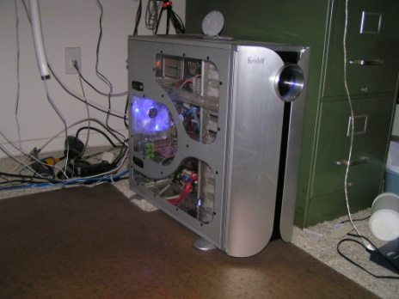
Plotting and Scheming
Plot program:
  (80s) Apple //e (Applesoft Basic)
  Macintosh (Scheme)
  Symbolics (Common Lisp)
  Home built Windows machine:
    Dr. Scheme (Rice University)
    C#
    F# w/ embedded lazy Scheme interpreter
    Haskell (now in progress)
Apple //e
current machine
Notes:
My foray into FP ran alongside my interest in plotting mathematical functions and other forms of visualization.
How do you change an equation at run time without having to recompile your code (or without having access to source code)? An embedded lazy Scheme interpreter fits the bill nicely.
My “plotting and scheming” system started on an Apple //e in the early 80s, then migrated to MacScheme on a Macintosh. Parts of it lived for a time on Symbolics Lisp machines.
Then I began building my own Windows machines and using Dr. Scheme (which is now called “Racket”; don’t ask me why! ;-) .
I then converted it to C#, then to F#.
I’m now trying to convert it to Haskell, but currently there is no good way to create a GUI in Haskell on Windows machines.

Slide 29
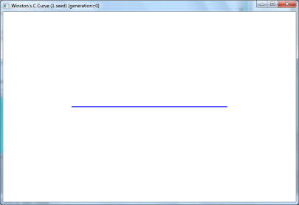
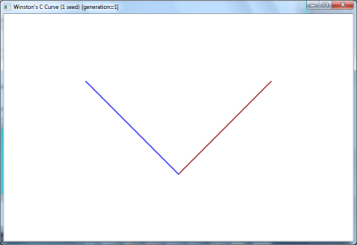
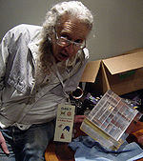
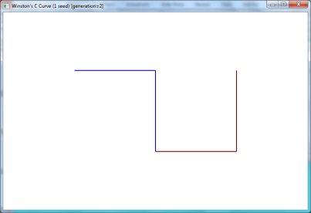
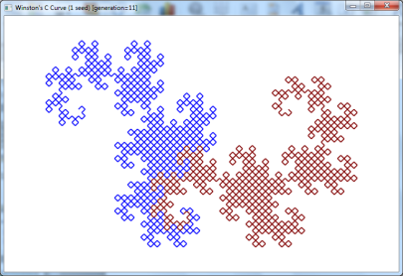
Vector Fractals
Generational
Vector based
Recursive
1 seed, gen=0
1 seed, gen=1
1 seed, gen=2
1 seed, gen=11
Bill Gosper
Notes:
One of the earliest of my fractal explorations is due to what I call vector fractals. Pictured is the growth of one of them that was described by Bill Gosper.

Slide 30
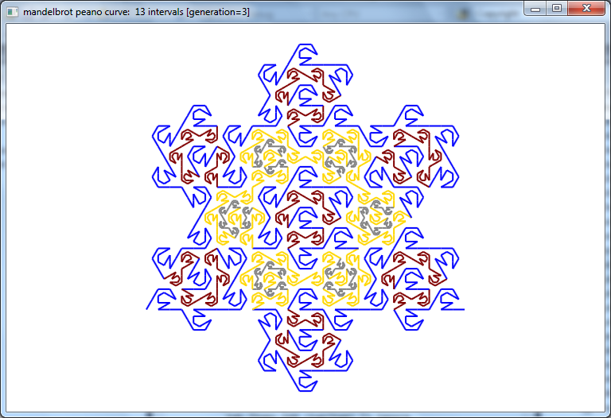
Mandelbrot Peano Curve
Notes:
Since I had a lot of Scheme descriptions for vector fractals, and a Scheme function to render them, I didn’t want to manually translate each one to F#. I liked the idea of having a Scheme function that could take abstract descriptions of vector fractals in order to render them.
The only way to achieve the same modularity in F# was to create an embedded Scheme interpreter. Since I think Scheme should have been lazy when it was first defined as a language, I am using this project as an opportunity to explore what Scheme would look like had it been invented as a lazy language from the onset.
This fractal was created by my embedded lazy scheme interpreter, and it is not visibly slower than the hard coded F# version against which I benchmark it.

Slide 31
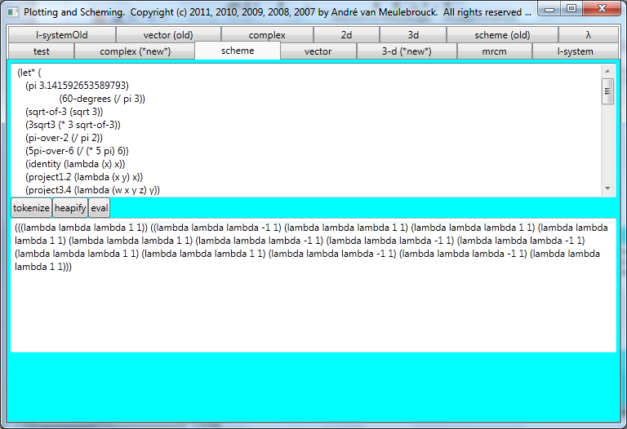
eval
Notes:
Here is the Scheme evaluator evaluating the actual Scheme code of the fractal you just saw. This evaluation pane allows interactive development of Scheme code before attempting to run them through the embedded Scheme interpreter as part of an XML description of a vector fractal. The XML allows Scheme code nodes; but uses XML for all other parameters of the description.

Slide 32
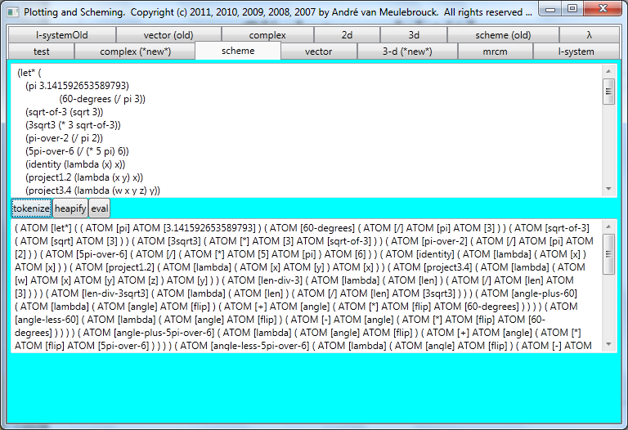
tokenize
Notes:
I expose my tokenizer as a way to easily verify that it is working.

Slide 33
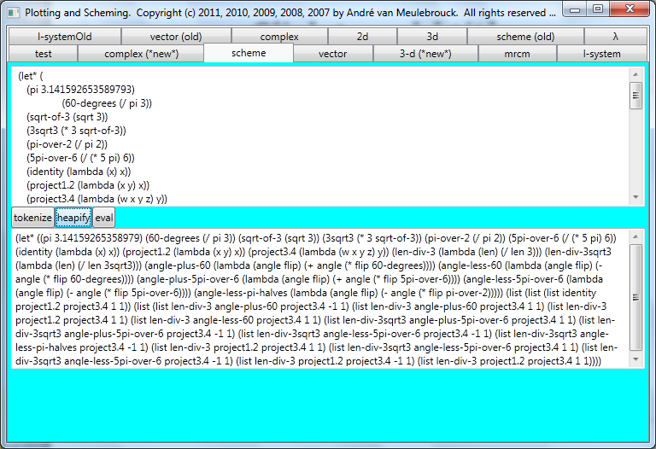
heapify
Notes:
I also expose the heapifier. The heapifier builds AST (abstract syntax trees) out of tokenized Scheme code.

Slide 34
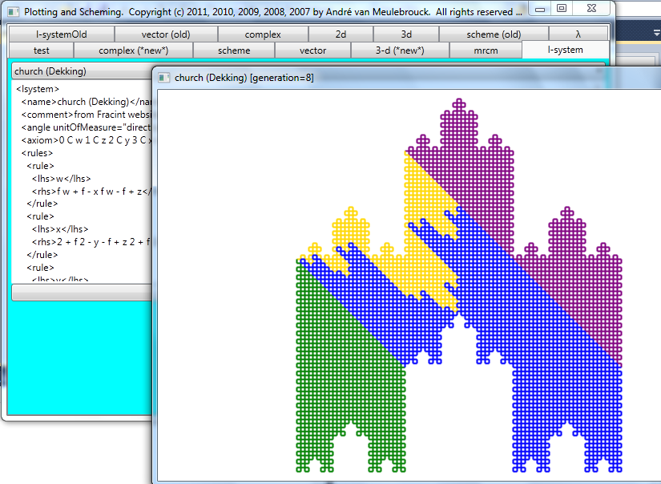
L-system
Notes:
Here is an l-system fractal. These are similar to vector fractals, but use a grammar to specify drawing rules.

Slide 35

L-system
Notes:
Here’s another favorite l-system plot.

Slide 36

Polar hearts
Notes:
This is a polar plot of an equation I discovered while taking Calculus. One day I’ll reveal the equation.
It keeps growing to infinity; but I only show a limited growth of it here.

Slide 37



Complex plane
Notes:
These are complex plane fractals. Julia sets are the most interesting. Biomorphs preserve more information and also look more interesting.

Slide 38



Complex plane

Slide 39



Complex plane

Slide 40

Conclusions
Haskell:
  Upside: most expressive
  Downside: interop?!? GUIs?!?
F#:
  Upside: instant interop
  Impure, not lazy
WPF:
  Retained graphics like gc!
Scheme:
  Perfect for embedded languages
Notes:
In conclusion, there’s no free lunch. We’re not there yet, but we’re making up for lost time.
Haskell is my favorite language, but it doesn’t have interop yet.
F# has interop but isn’t as pure.
WPF is the way of the future for graphics and UI design. Retained graphics (versus immediate mode graphics) means you don’t have to write repaint events. You can use XAML to describe UIs, 100% code, or a combination.
WPF is very compositional and does a lot to do an end run around OOP limitations.
Scheme is perfect for embedded languages, even while I wouldn’t want to use it to write a compiler.

Slide 41

Where are we going?
FP is the way of the future
  Monads: Greatest advance within my lifetime
Quote:
  “Those who cannot remember the past are condemned to repeat it.” George Santayana
Notes:
I think FP is the way of the future; but legacy technologies won’t go away overnight.
The good news is that those who want to evolve faster than the slower evolutionary path that the masses choose to take are free to do so.
I started with a quote and I’ll end with a quote that is a counterpart to the quote I opened with. This quote is more often misquoted than quoted correctly. Here is the correct quote: those who cannot remember the past are condemned to repeat it. George Santayana.
Change is coming. Embrace it and help usher it in!

Slide 42
Addendum
F#
  Needs type classes!
Haskell
  Mutation necessary for speed
Web:
  Juggernaut crushing desktop technologies
What’s the future?
  Alan Kay: “The best way to predict the future is to invent it.”.

