Slide 1
Internal Working Model Tasks

Slide 2
Emotional false memory paradigm
Encoding phase
Participants shown a series of photographs depicting 9 everyday events (e.g. going on a date, going on a hike, bike riding) in a continuous sequences
  13 photographs for each event
  Each photo presented for 2s followed by a 2s delay
For each event, consequences/effects of unseen actions
    Negative (n = 3) – example: girl rejecting boy during date
    Positive (n = 3) – example: couple kissing
    Neutral (n = 3) – example: girl gives boy book
Notes:
From Soloman et al 2019 JAP
Everyday parent-child scenarios
Mealtime
Going to the park
School pick up / school drop off
Bedtime
Backyard – playing/hanging out
Homework
Chores
Morning routine – parent leaves
Parent leaves at night to go out
Playground
Amusement park
Grocery store
Library / reading
Bike riding
Beach
Snowy day
Mall / shopping center / toy store
Restaurant

Slide 3
Emotional false memory paradigm
Test phase
Surprise recognition test 15-minutes later
Have you seen this picture before? yes/no
Shown 45 previously viewed photos and 45 new (i.e. lure) photos
Three types of lures per episode
  Gap-filling lure - potential peripheral details
  Causal lure – non-presented, but plausible cause of an effect scene
  Inconsistent lure - unrelated to episodes
Notes:
There are three potential gap-filling lures per episode where the lure photographs depict potential peripheral details of the episode that were not presented during encoding, one causal lure per episode where the lure photograph depicts an erroneous cause of an effect scene (e.g., a newly presented car hitting the biker, when the studied episode only included an ambulance taking the biker to the hospital although the original scene did not contain an explicit cause for the trip), and nine total inconsistent lures that present photographs that are not related to the episodes.

Slide 4
Notes:
From Mirandola et al 2019
Schematic depiction of the emotional false memory task.
The seen photographs show an emotionally valenced scripted series of events.
The unseen photographs depict lure scenes not included in the encoding phase, but included in the recognition task.
Gap-filling errors are those in which the unseen photograph lures are script-consistent, but have never been viewed. For example, as shown here, this includes a photograph of the man from the mountain climbing scene adjusting some ropes, although this script-consistent action was not shown during the encoding phase of the task.
Causal errors are those in which the unseen photograph lures are script-consistent but have not been shown as causal of the other photographs. For example, as shown here, this includes a photograph of the man from the mountain climbing scene moving into position to climb the rocks that will cause him to reach the top of the mountain.
Inconsistent photograph are those that have not been seen before and are not script-consistent. For example, as shown here, this includes a woman sitting on a park bench next to her bike, which is not part of this or any other scene.

Slide 5
Emotional false memory paradigm
Dependent variables
Hit rates (correct recall of previously seen photos) for total and negative, positive, and neutral scenarios
False alarm rates for photos that are scene-consistent and also
  Gist-consistent gap-filling for positive, negative, and neutral episodes
  Gist-consistent causal lures for positive, negative, and neutral episodes
Error rates for photos that are scene-inconsistent
Sensitivity index (d’) = Z(hit rate) – Z(false alarm rate) for scene-inconsistent photos; measure of task performance
Notes:
Dependent variables investigated, which all are based on performance during the test phase of the task, include hit rates (correctly remembering previously seen photographs) for total and emotional versus neutral scenarios, false alarm rates on photographs that are scene-consistent, error rates on photographs that are scene-inconsistent, and a sensitivity index (d′), which is calculated as Z(hit rate) – Z(false alarm rate) for scene-inconsistent photographs. We refer to this d′ as a measure of task performance. Scene-inconsistent photographs are used to calculate this measure of task performance to assess a general memory ability to discriminate old from familiar apart from the influence of stimuli predisposing participants to make false alarms. False alarm rates on gist-consistent gap-filling, and causal lures also are computed for positive, negative, and neutral episodes to assess the relative probability of forming memory illusions as a function of event valence and error type

Slide 6
Potential everyday parent-child scenarios
Mealtime
Going to the park
School pick up / school drop off
Bedtime
Backyard – playing/hanging out
Homework
Chores
Morning routine
Nighttime routine
Playground
Amusement park
Grocery store
Library / reading
Bike riding
Beach
Snowy day
Mall / shopping center / toy store
Restaurant
Notes:
Attachment categories
Separation followed by reunion
Getting angry at kid followed by resolution
Parent not noticed kids needs
They didn’t realize and came back and resolved it
Mix up the order – sometimes
Could have neutral with still shots

Slide 7
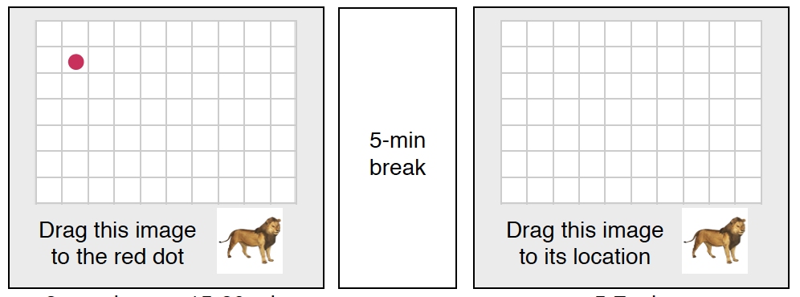
Internal Working Model Structure:
Image-Location Association Task
Encoding
Retrieval
Confidence Rating
How sure are you?
Forgot Guessed A Little Very
Sure Sure
Encoding-Retrieval Stimuli: 68 GIFs (2s)
(parent-child; create our own with fribbles/scenes vs. existing)
25 positive (responsive caregiver, hugs, etc.)
25 negative (unresponsive caregiver, mean, etc.)
18 parent-child separation – kind of ambiguous / neutral
Notes:
Task adapted from Tompary, A. & Thompson-Schill, S. (2020). Semantic influences on episodic memory disortions. PsyArXiv.
Goal: operationalize prior knowledge in a rich dimensional structure.
Procedures:
Participants encode and retrieve image-location associations on a 2-D grid.
Encoding instructions:
Drag each image to the dot, then click mouse or press “enter” when image presented over dot.
Try and remember each image’s location for a later memory test.
Then, 2 practice trials following encoding instructions.
Encoding Task:
Participants encode each image location by dragging the image onto a red dot marking its location.
See GIF for 2-3s and then can drag – each trial is self-paced.
Go through 3x in separate blocks, with order randomized.
After a 5-minute break, participants retrieved the location of each image.
Retrieval Instructions:
Drag the image to its location.
Make your best guess if you forgot.
Make confidence ratings??? (very sure, a little sure, guessed, forgot)
Positive Pokemon GIF
https://giphy.com/gifs/pokemon-hug-love-8tpiC1JAYVMFq

Slide 8
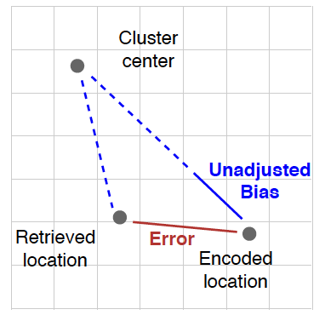
Internal Working Model Structure:
Image-Location Association Task
Sample Image Locations
Outcome Measures
Neutral
Error = Euclidean distance b/t encoded & retrieved locations
Higher scores = worse memory
0 = perfect memory
Bias = unadjusted bias / error
Scores 0-1, retrieval is biased toward the image’s cluster center
Scores -1-0, retrieval is biased away from cluster center
Positive
Positive
Positive
Positive
Negative
*
Positive
Positive
Neutral
Negative
Neutral
Negative
Negative
*
Negative
Negative
Negative
Positive
Neutral
Negative
Positive
* category cluster center
60-70% spatially consistent (n = 42)
30-40% spatially inconsistent (n = 18)
18 parent-child separation
Notes:
Locations associated with the images were determined by emotional valence, such that most members of the same category (e.g. negative, positive, neutral) were located near each other (60%), but some category members were in random location (40%). This configuration allows participants to learn that images from a certain category tend to be located in a certain area as they encode the locations of specific images.
The center of each category’s cluster was derived by computing the mean x and y coordinates over all images belonging to that cluster.
We used a continuous retrieval measure to disentangle biases driven by semantic knowledge from errors due to forgetting:
Error and bias could vary independently, such that memory for an image could be biased towards or away from category neighbors at the same level of accuracy.
We used these measures to quantify the influence of knowledge about a category’s general location when retrieving the locations of each image.
Error – Euclidean distance between encoded and retrieved locations
Unadjusted bias = (Euclidean distance between retrieved location and cluster center) – (Euclidean differences between encoded location and cluster center)
Bias = unadjusted bias / amount of error for each image

Slide 9
Internal Working Model Structure:
Image-Location Association Task Hypotheses
Negative parent-child cluster will have better memory performance than positive parent-child cluster
ECA youth will have poorer general performance than non-ECA youth, especially for spatially consistent memories
Participants rely on prior knowledge (e.g. internal working models) when memories for specific locations is weak
  ECA youth will have greater bias toward negative (vs. positive) for spatially inconsistent memories than non-ECA youth, especially for low confidence memories
  For separation stimuli (atypical exemplars), there will be greater bias toward positive (vs. negative) in ECA youth
Notes:
Memory for the locations of typical category members was less accurate and more biased than memory for locations of atypical category members, perhaps because their locations were less deeply encoded.
INFANT DATA – PREDICTION ERROR WHEN IT IS INCONSISTENT WITH THEIR SCHEMA; LOOK AT IT LONGER
- INCLUDE ONLY ENCODING AND RETRIEVAL IN 2 PHASES
Expectation violation – do we see violations in predictions as a function of early life adversity; BJ had a violation of expectations go-nogo tasks – false alarms and reaction times
Getting a
How does working model structure influence new memory formation
Narrative structure of internal working models

Slide 10
Old

Slide 11
Internal Working Model Structure:
Image-Location Association Task - version 2
Encoding
Retrieval
Novel Categorization
Encoding-Retrieval Stimuli: 70 interpersonal GIFs
(parent-child)
30 negative (e.g. crying)
30 positive (e.g. hugging)
10 neutral (e.g. walking)
Novel Categorization Stimuli: 36 parent-child GIFs
Mimic baby oval events w/ fribbles/shapes and scenes?
12 parent-child separation
12 parent responsive to crying
12 parent unresponsive to crying
OR could put the in image in the location and ask whether it’s correct? Some consistent / some inconsistent …
Notes:
Task adapted from Tompary, A. & Thompson-Schill, S. (2020). Semantic influences on episodic memory disortions. PsyArXiv.
Goal: operationalize prior knowledge in a rich dimensional structure.
Procedures:
Participants encode and retrieve image-location associations on a 2-D grid.
Encoding instructions:
Drag each image to the dot, then click mouse or press “enter” when image presented over dot.
Try and remember each image’s location for a later memory test.
Then, 2 practice trials following encoding instructions.
Encoding Task:
Participants encode each image location by dragging the image onto a red dot marking its location.
See GIF for 2-3s and then can drag – each trial is self-paced.
Go through 3x in separate blocks, with order randomized.
After a 5-minute break, participants retrieved the location of each image.
Retrieval Instructions:
Drag the image to its location.
Make your best guess if you forgot.
Make confidence ratings??? (very sure, a little sure, guessed, forgot)
Positive Pokemon GIF
https://giphy.com/gifs/pokemon-hug-love-8tpiC1JAYVMFq

Slide 12
Internal Working Model Content:
Modified DRM Paradigm
Encoding – in or out of scanner? Post encoding rest?
  Watch 20s parent-child video clips (or view photos)
  DIFFERENT ROOMS – things happening in different rooms; refer to rooms and really seeing
  Possibly to measure something online during learning? assess whether something is consistent or inconsistent with schema after viewing each clip
    Like you? Like parents? Or affect ratings on a VAS scale
    Or do a what happens next? Then outcome …then ask how expected?
    Or is this clip similar to the previous clip?
Free recall – possible to do if we assign names to stimuli that they see?
Recognition task + confidence ratings – in scanner
  True
  Lures
  False unrelated
Representational similarity analysis – can do this for schema similar vs schema dissimilar, as well as true vs lures vs false unrelated … ALSO compare perceptually similar vs conceptually similar
Notes:
Modified DRM paradigm – presented of positive, negative, and neutral words, then complete a free recall and recognition memory task comprised of true, lures, and false unrelated
Video version of DRM might be fun
Add some online measure during learning … clips, impossible to do; with pictures, it would be possible … measure something that’s consistent or inconsistent with the schema (association task)
https://www.ncbi.nlm.nih.gov/pmc/articles/PMC5266749/
Think more about someone like Simona or Tracy as soft collaborators … maybe someone else.

