Slide 1
Housing Affordability Crisis
Presented by Adam van Omme

Slide 2
Problem Statement
• Housing prices are increasing at a rate much faster than income levels.
• This gap makes homeownership challenging for many citizens.
• A data-driven approach can help understand the severity of the issue.

Slide 3
Why This Matters
• Rising housing prices impact affordability for young professionals.
• The economy is affected by unaffordable housing.
• Understanding trends can influence policy changes.

Slide 4
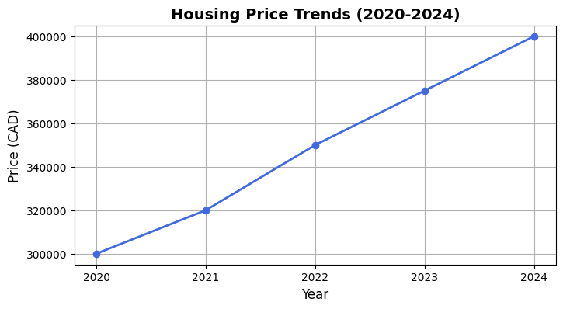
Housing Price Trends (2020-2024)

Slide 5
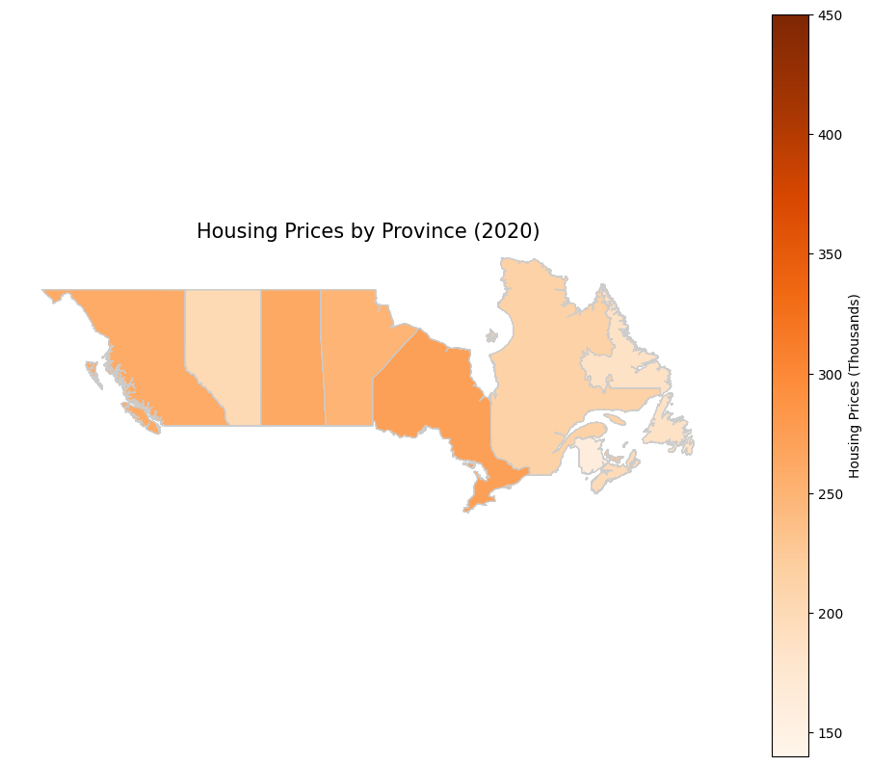
Housing Prices by Province (2020)

Slide 6
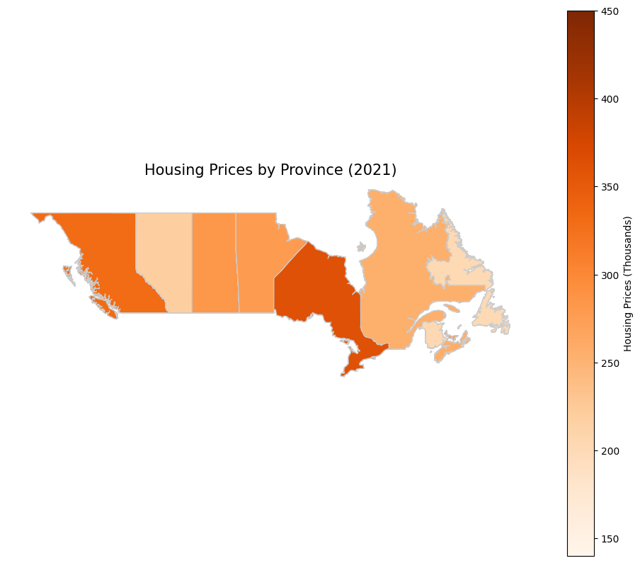
Housing Prices by Province (2021)

Slide 7
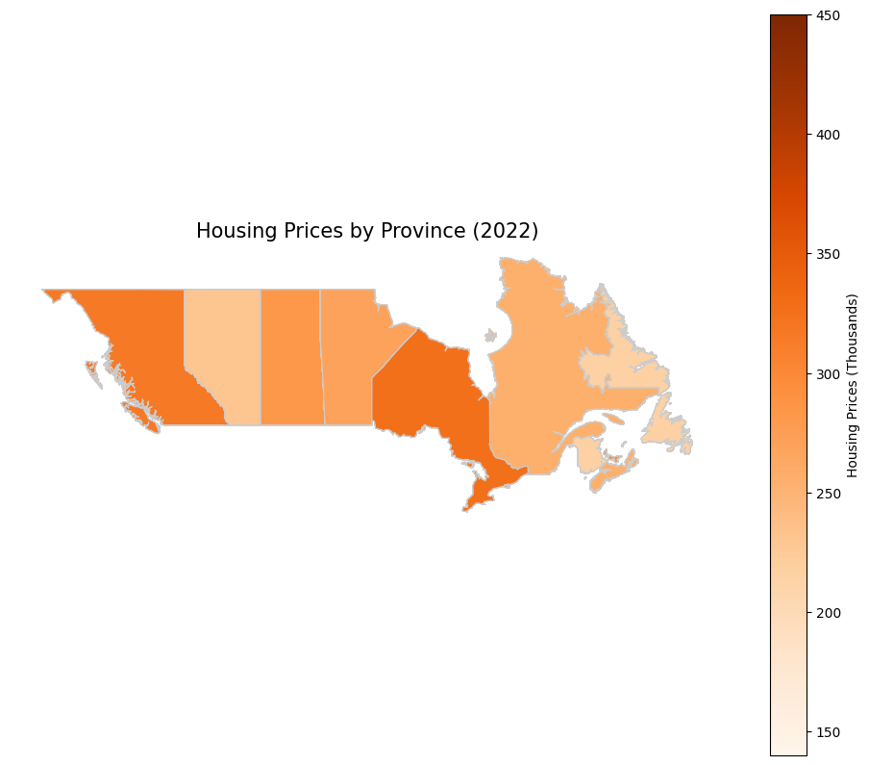
Housing Prices by Province (2022)

Slide 8
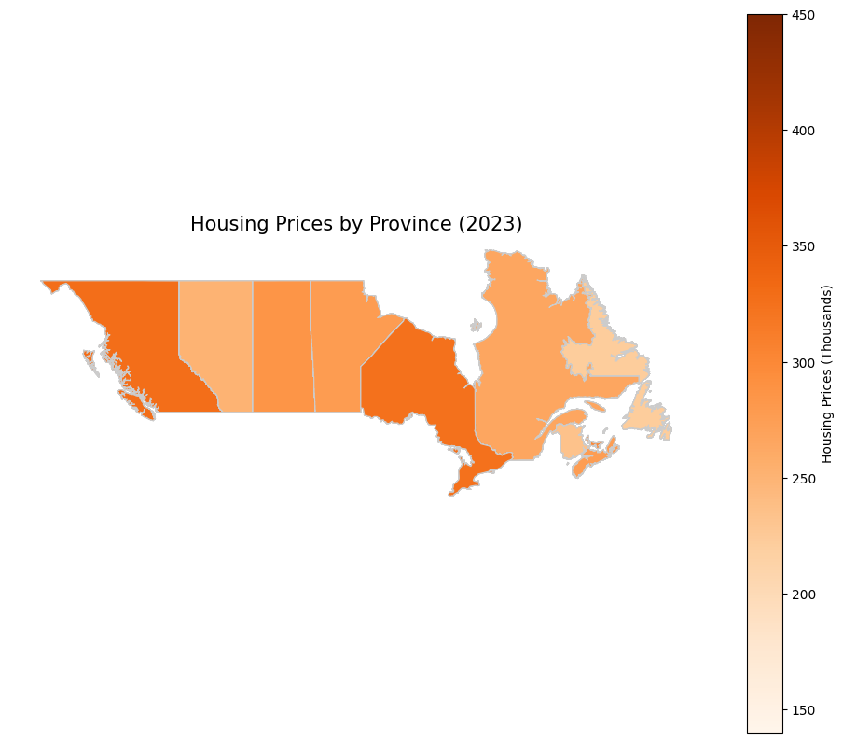
Housing Prices by Province (2023)

Slide 9
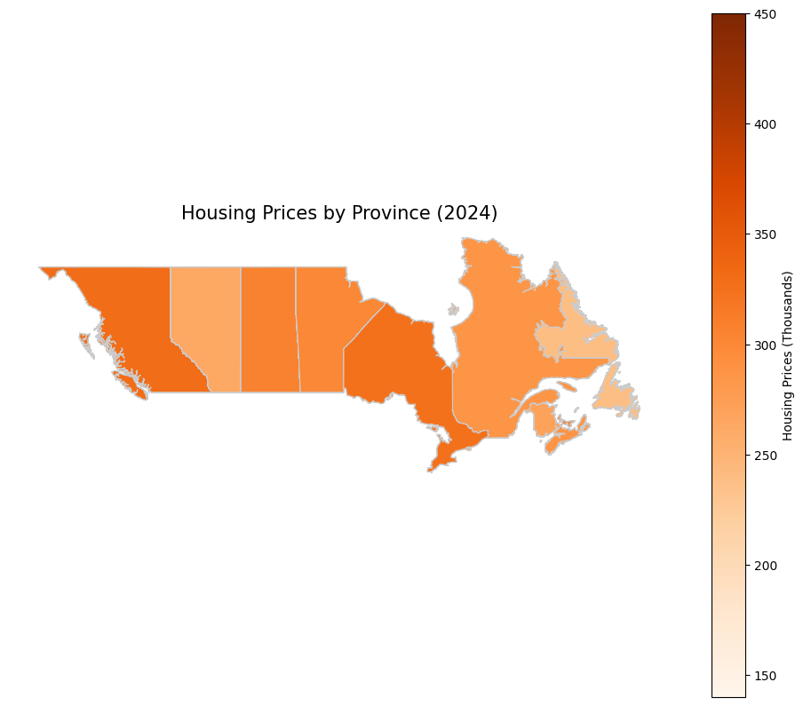
Housing Prices by Province (2024)

