Slide 1
THE FUTURE OF AI IN HEALTHCARE
Revolutionizing Diagnostics and Personalized Medicine

Slide 2
AI and Diagnostics
Enhanced Imaging Analysis
Predictive Analytics for Disease Prevention
Automated Pathology Detection

Slide 3
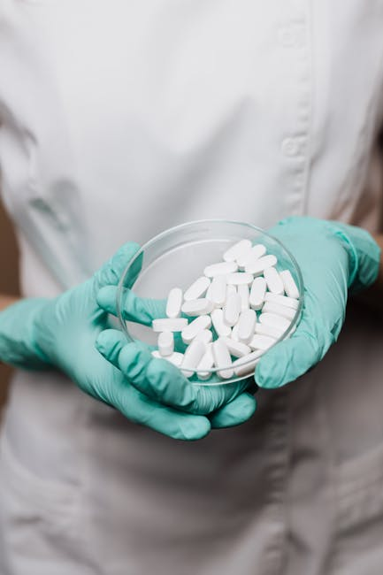
Personalized Medicine through AI
Tailored Treatment Plans
Genomic Data Analysis
Real-time Patient Monitoring

