Slide 1


Active machine learning for MD
Tell Tuttle*, Alexander van Teijlingen*, Dhwanit Dave‡
*University of Strathclyde
‡City University of New York

Slide 2
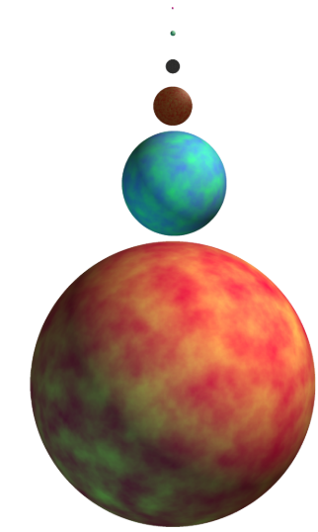
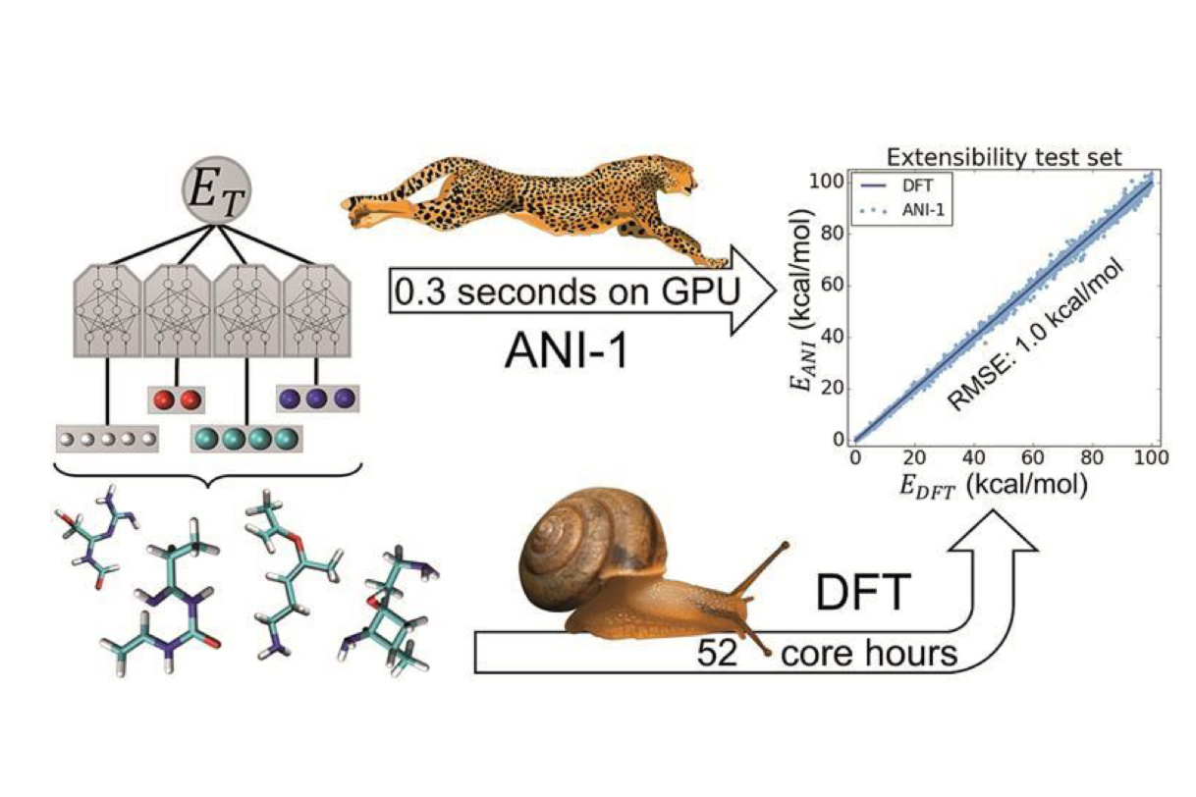
Benefits of machine learning
Screened with CGMD
TorchANI, Roitberg et al.
Beyond Tripeptides, van Teijlingen et al.

Slide 3
y=mx+b
Hyperparameters: where we fit an intercept (b), scoring method (L2/L1, categorical)
Minimize L2 norm: y² – (mx+b)² -> 0
Notes:
There is a linear relationship so a linear fit works well

Slide 4
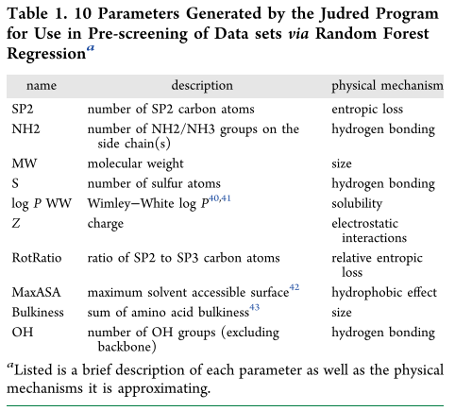

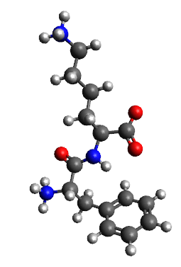
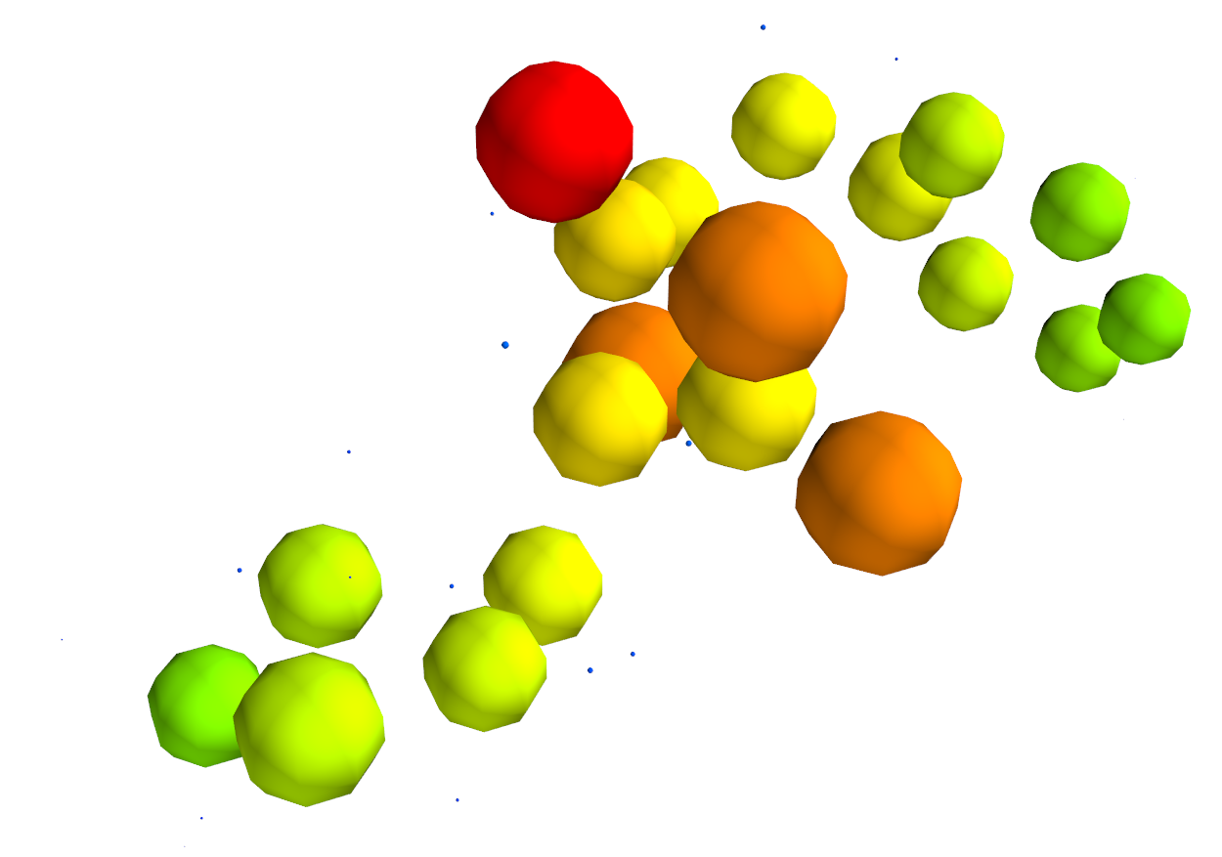

Parameters

Slide 5
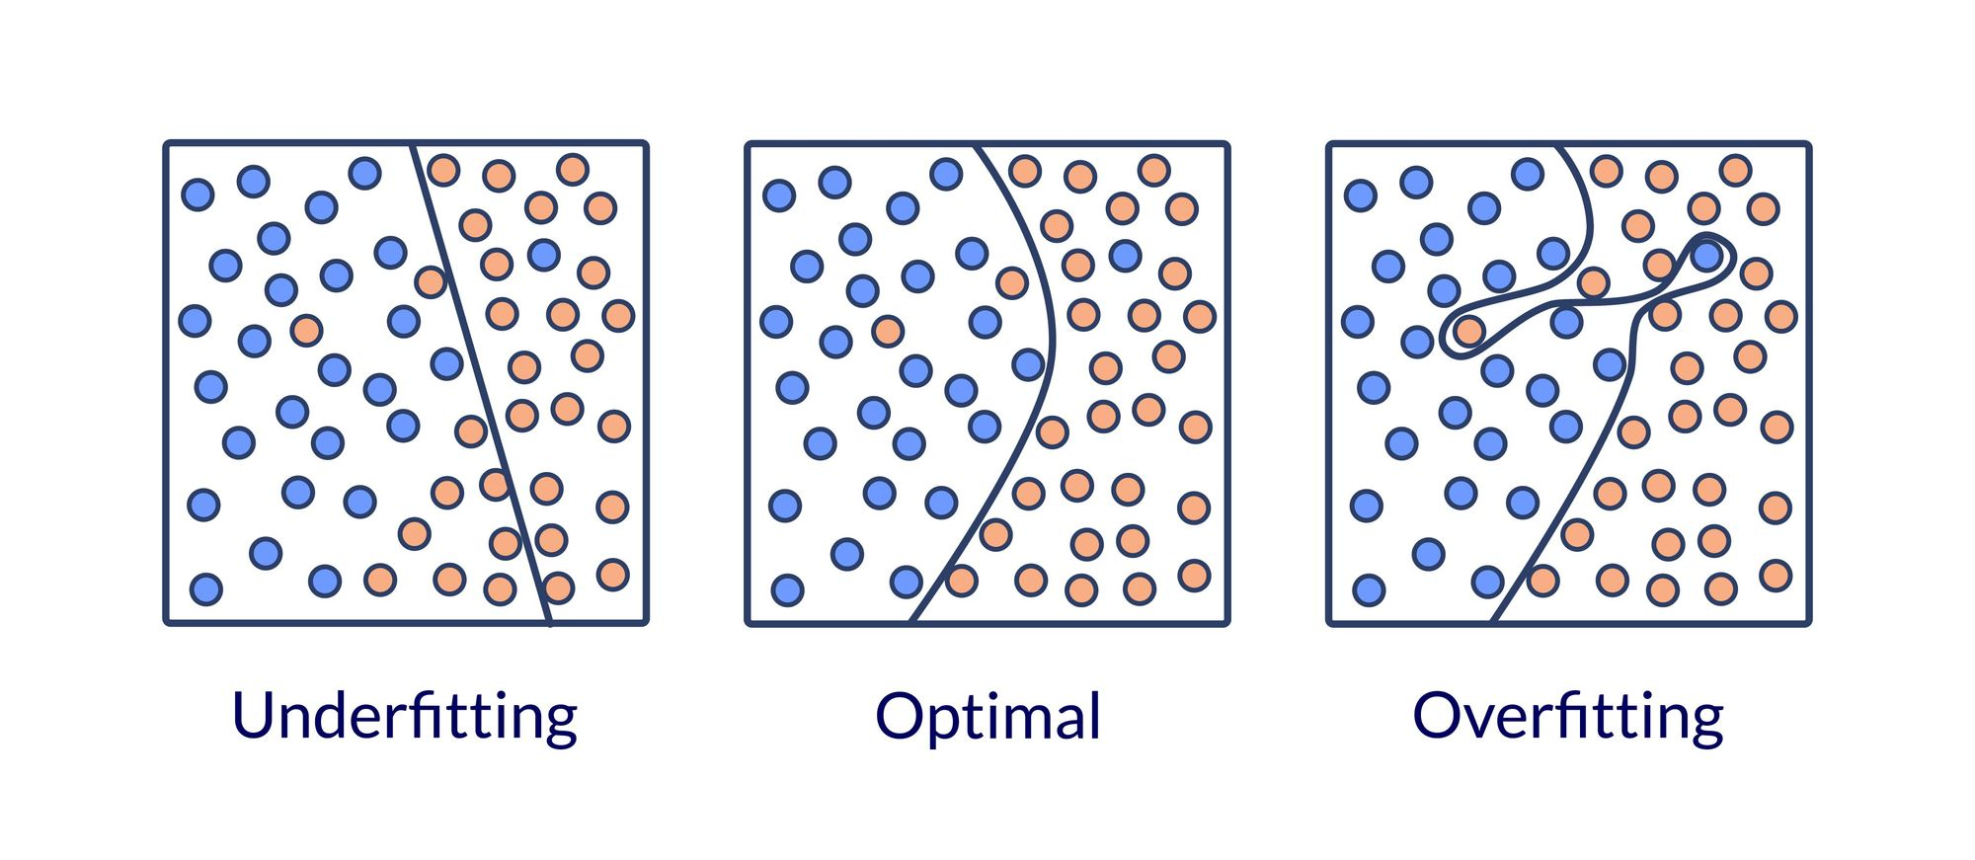
Data segregation
Overfitting
Train, test and validate!

Slide 6
Dipeptide self-assembly
400 datapoints (20²)
268 training points
132 validation points
179 training points
89 testing points

Slide 7
Hyperparameters
Other parameters that effect the fit of the data
y=abs(m)? x (+b)
fit_intercept positive Test data RMSE
2 False True 0.810048
3 False False 0.233584
0 True True 0.171678
1 True False 0.169679

Slide 8
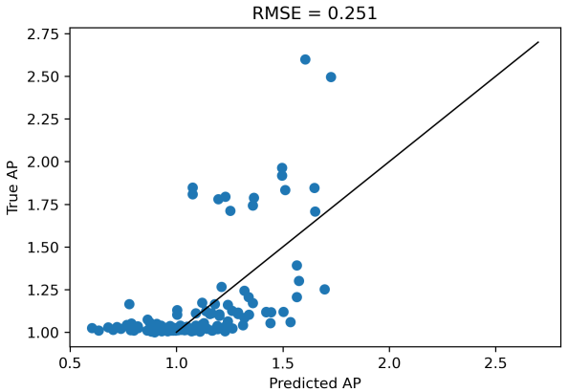
Can we predict something harder?

Slide 9
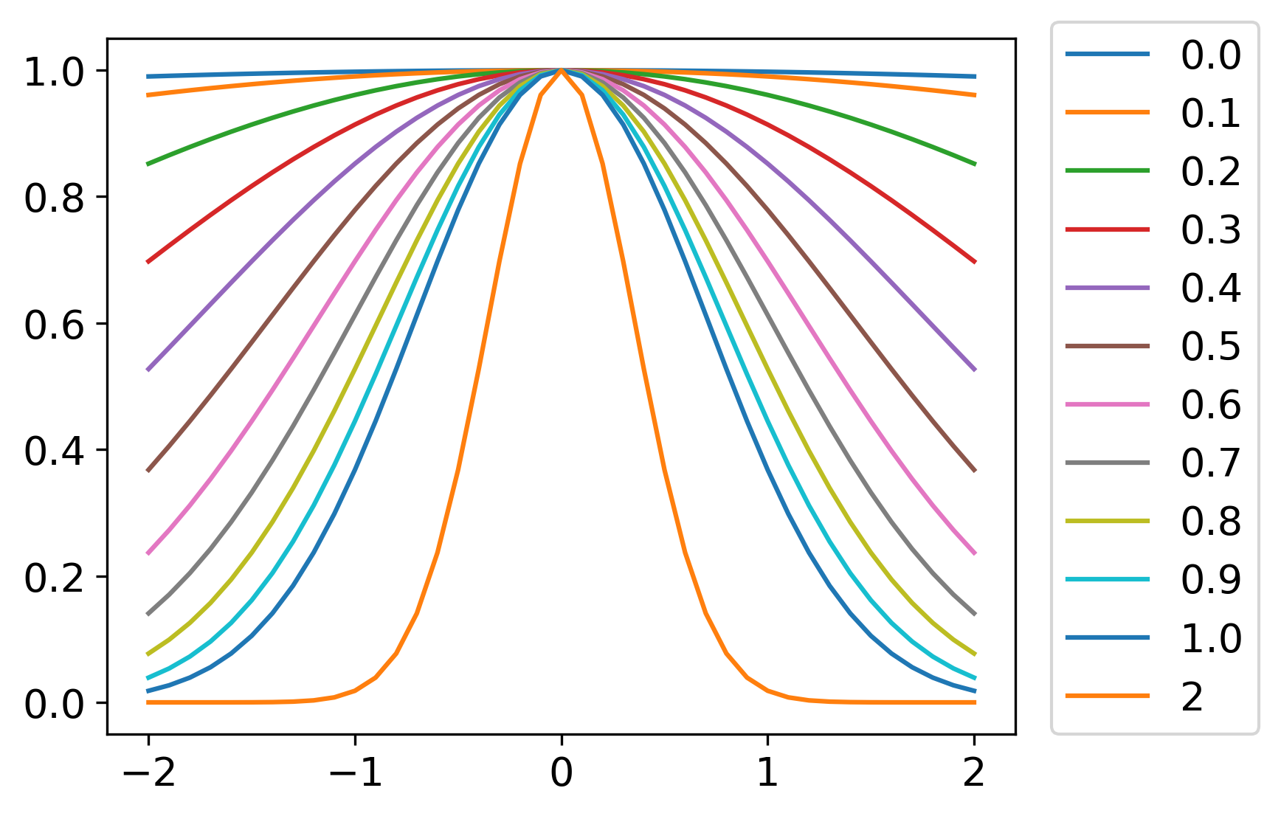
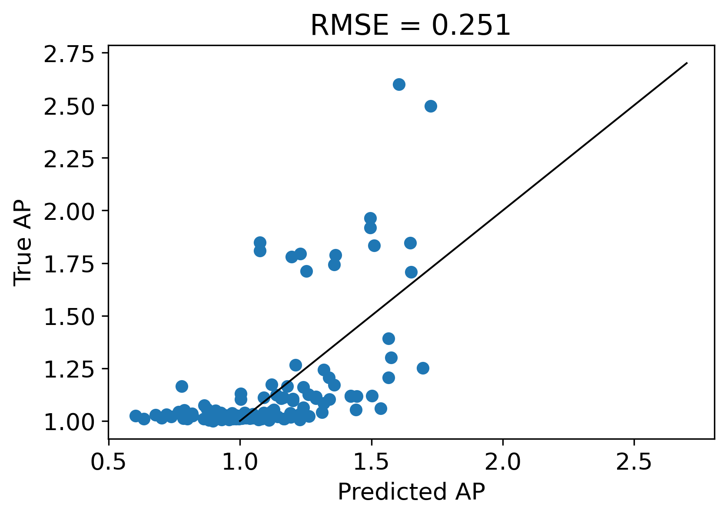
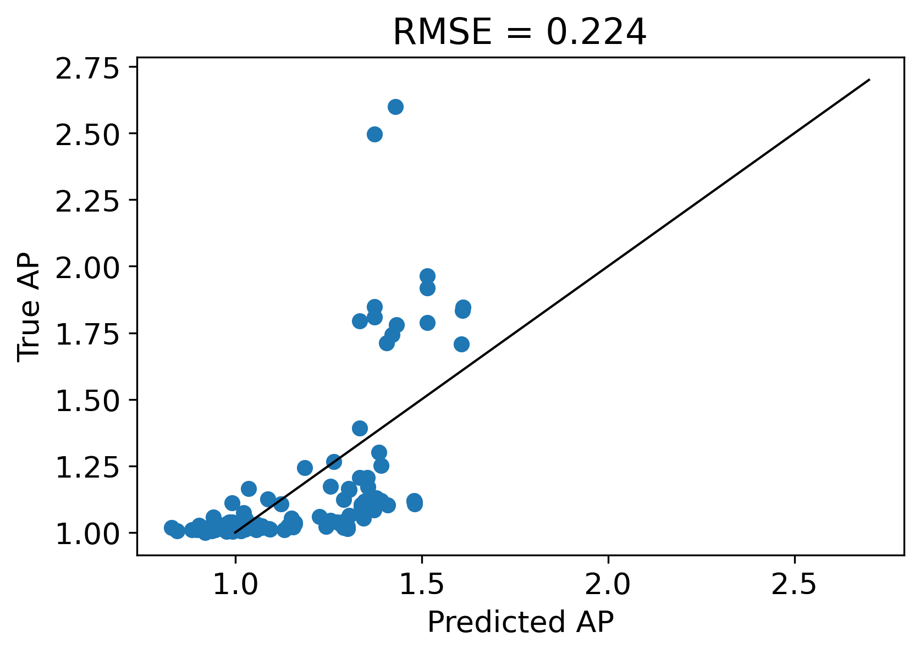

Slide 11
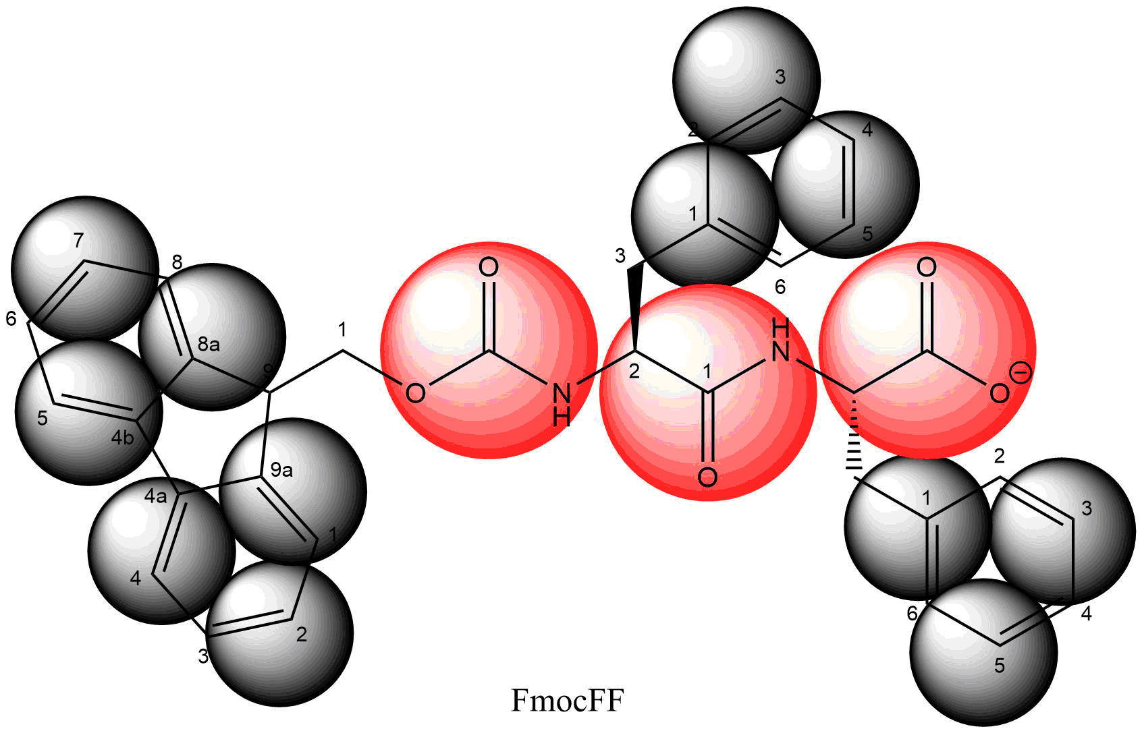
Atomic | Coarse grained
C₃₃H₂₉N₂O₅ | SC4₁₂P4₂Qa₁
69 atoms | 15 beads
69 partial charges | 1 charge
Smallest particle (H) limits time step to 1-2fs | Smallest particle (SC4) limits time step to 30 fs

Slide 12
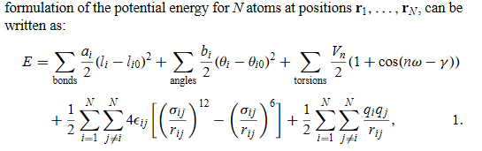

Slide 14
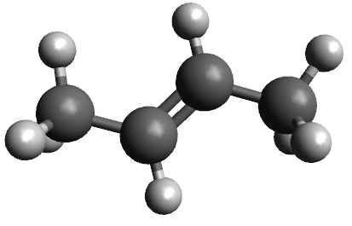
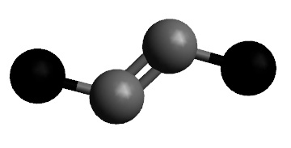
Building a CG model

Slide 15
Bottom-up
FF dihedral

