Slide 1


Active machine learning for MD
Tell Tuttle*, Alexander van Teijlingen*, Dhwanit Dave‡
*University of Strathclyde
‡City University of New York

Slide 2
y=mx+b
Hyperparameters: where we fit an intercept (b), scoring method (L2/L1, categorical)
Minimize L2 norm: y² – (mx+b)² -> 0
Notes:
There is a linear relationship so a linear fit works well

Slide 4
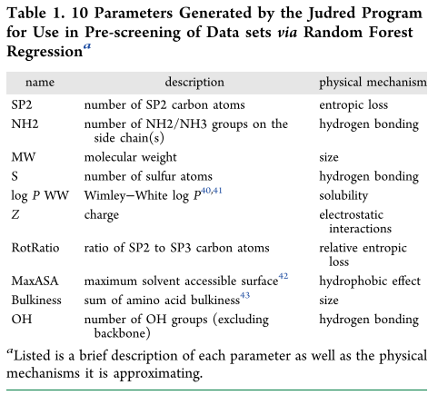
Can we predict something harder?

Slide 5
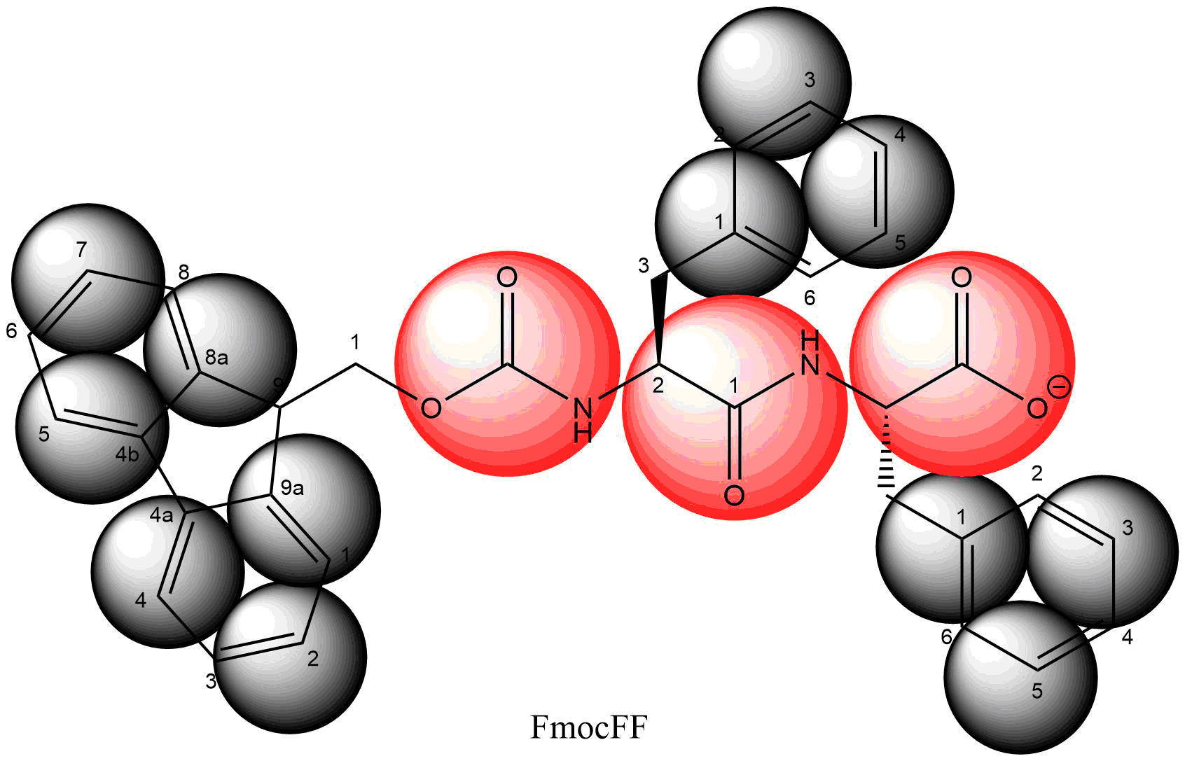
Atomic | Coarse grained
C₃₃H₂₉N₂O₅ | SC4₁₂P4₂Qa₁
69 atoms | 15 beads
69 partial charges | 1 charge
Smallest particle (H) limits time step to 1-2fs | Smallest particle (SC4) limits time step to 30 fs

Slide 6
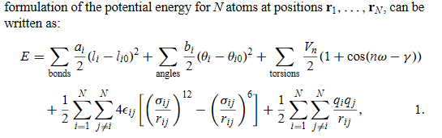

Slide 7
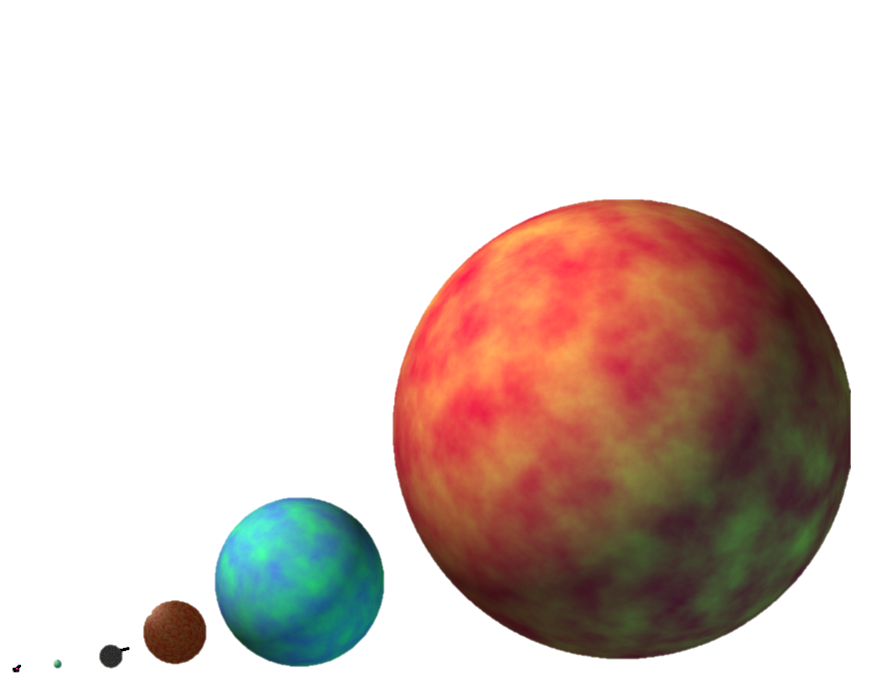

Slide 8
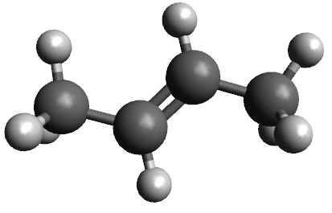
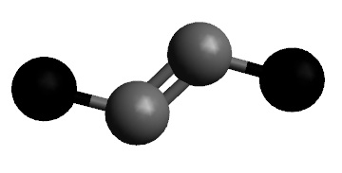
Building a CG model

Slide 9
Bottom-up
FF dihedral

