Slide 1


Active machine learning for MD
Tell Tuttle*, Alexander van Teijlingen*, Dhwanit Dave‡
*University of Strathclyde
‡City University of New York

Slide 2
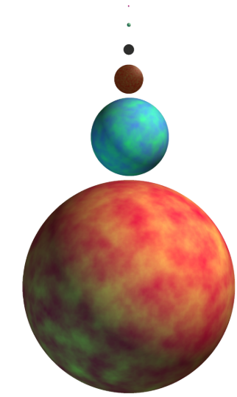
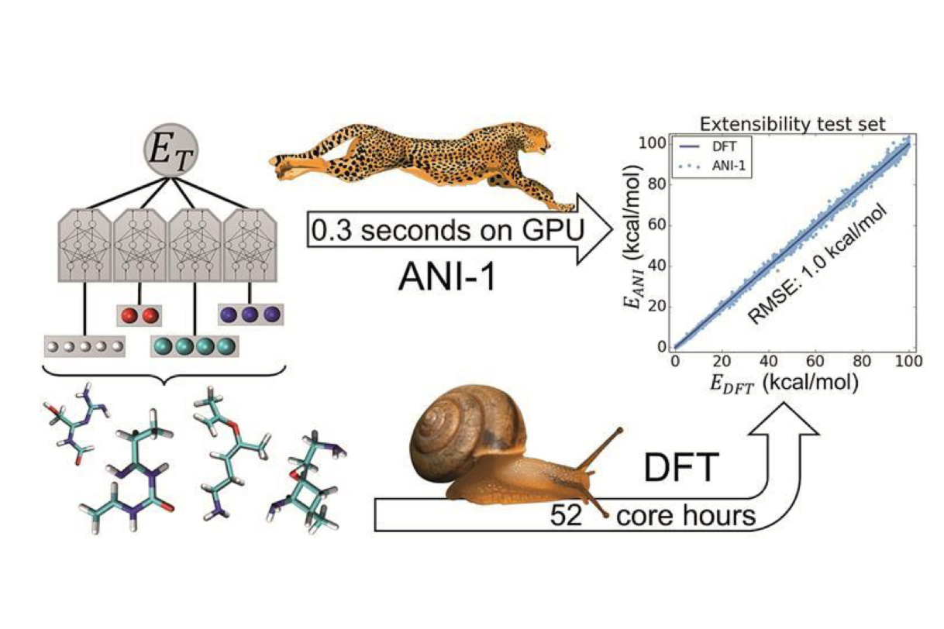
Benefits of machine learning
Screened with CGMD
TorchANI, Roitberg et al.
Beyond Tripeptides, van Teijlingen et al.

Slide 3
y=mx+b
Hyperparameters: where we fit an intercept (b), scoring method (L2/L1, categorical)
Minimize L2 norm: y² – (mx+b)² -> 0
Notes:
There is a linear relationship so a linear fit works well

Slide 4
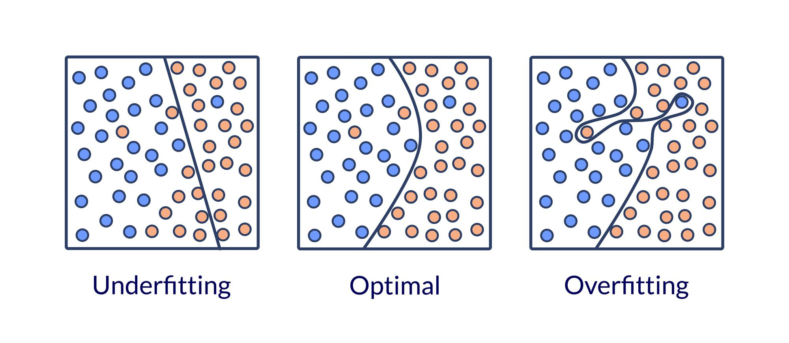
Data segregation
Overfitting
Train, test and validate!

Slide 5
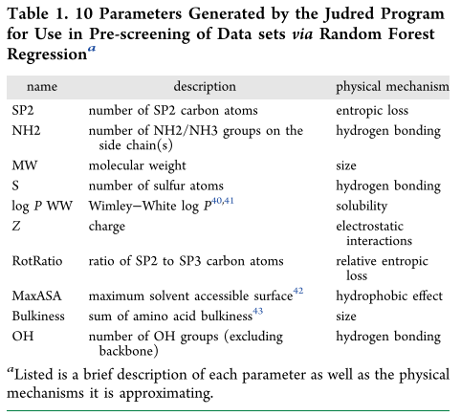

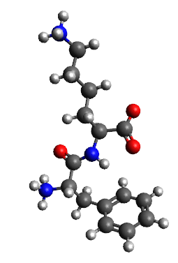
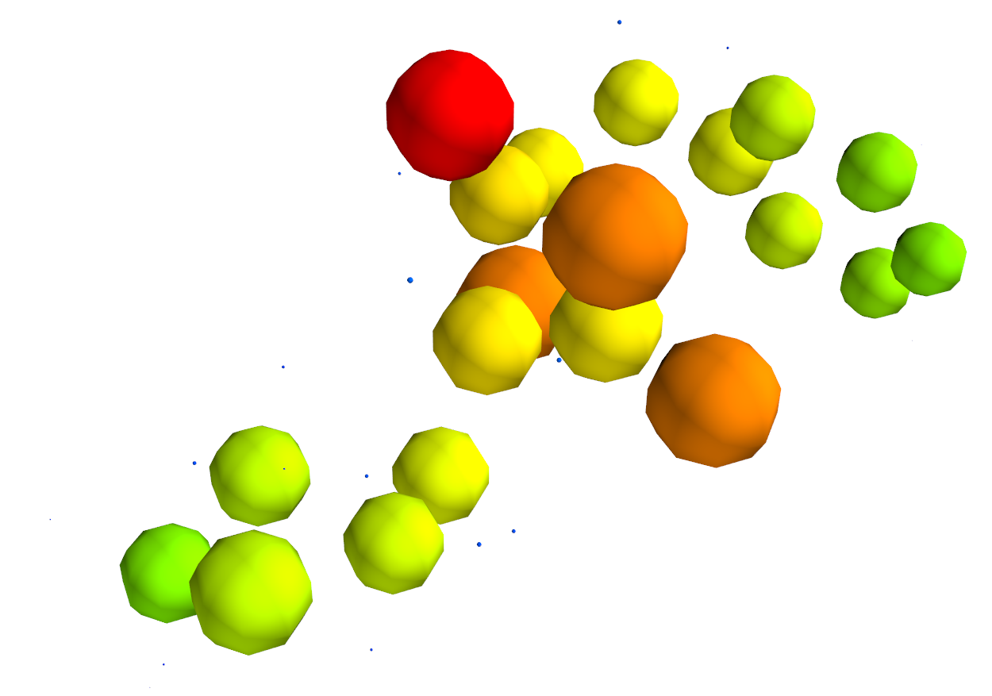

Parameters

Slide 6
Hyperparameters

Slide 7
Can we predict something harder?

Slide 10
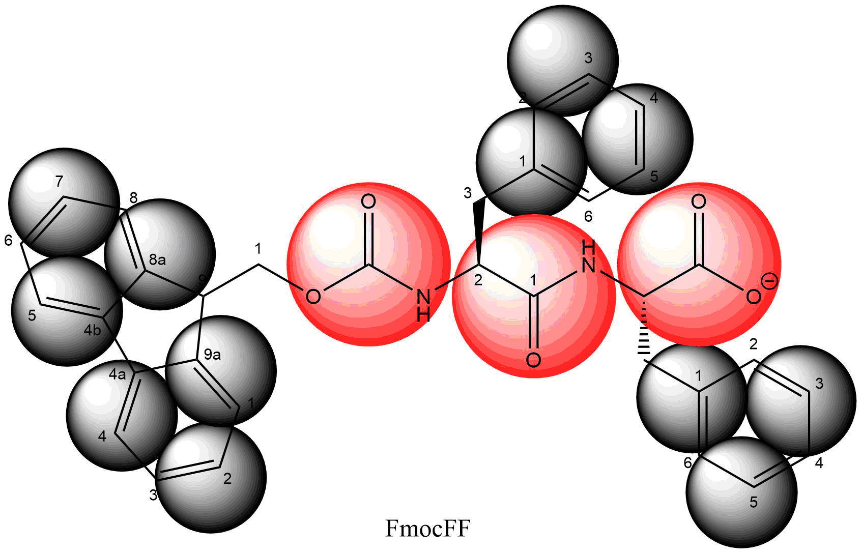
Atomic | Coarse grained
C₃₃H₂₉N₂O₅ | SC4₁₂P4₂Qa₁
69 atoms | 15 beads
69 partial charges | 1 charge
Smallest particle (H) limits time step to 1-2fs | Smallest particle (SC4) limits time step to 30 fs

Slide 11
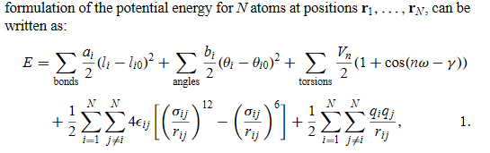

Slide 13
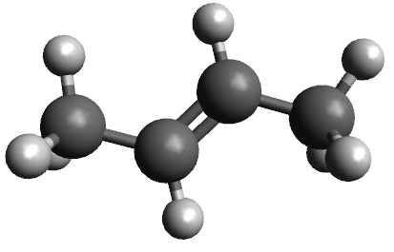
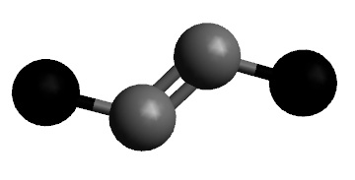
Building a CG model

Slide 14
Bottom-up
FF dihedral

