Slide 1


Active machine learning for MD
Tell Tuttle*, Alexander van Teijlingen*, Dhwanit Dave‡
*University of Strathclyde
‡City University of New York

Slide 2
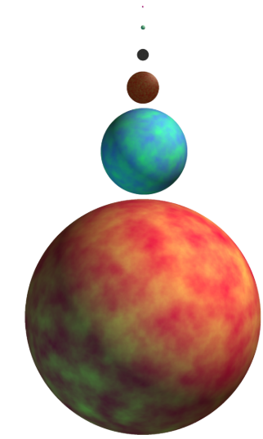
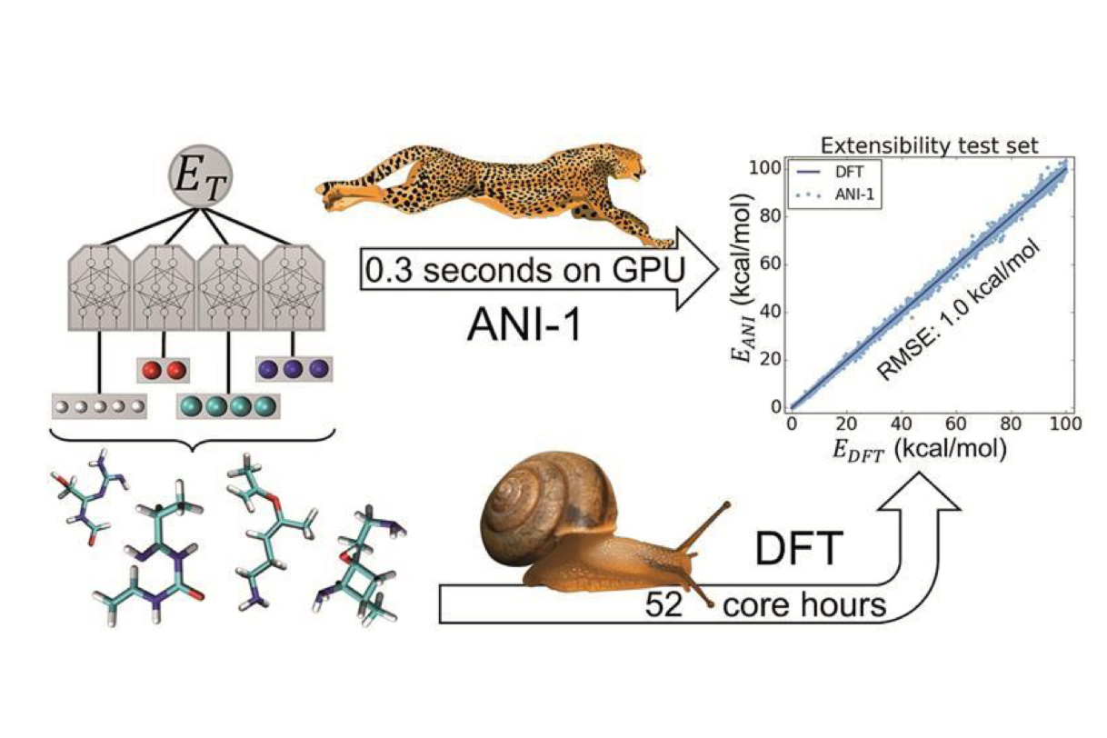
Benefits of machine learning
Screened with CGMD
TorchANI, Roitberg et al.
Beyond Tripeptides, van Teijlingen et al.

Slide 3
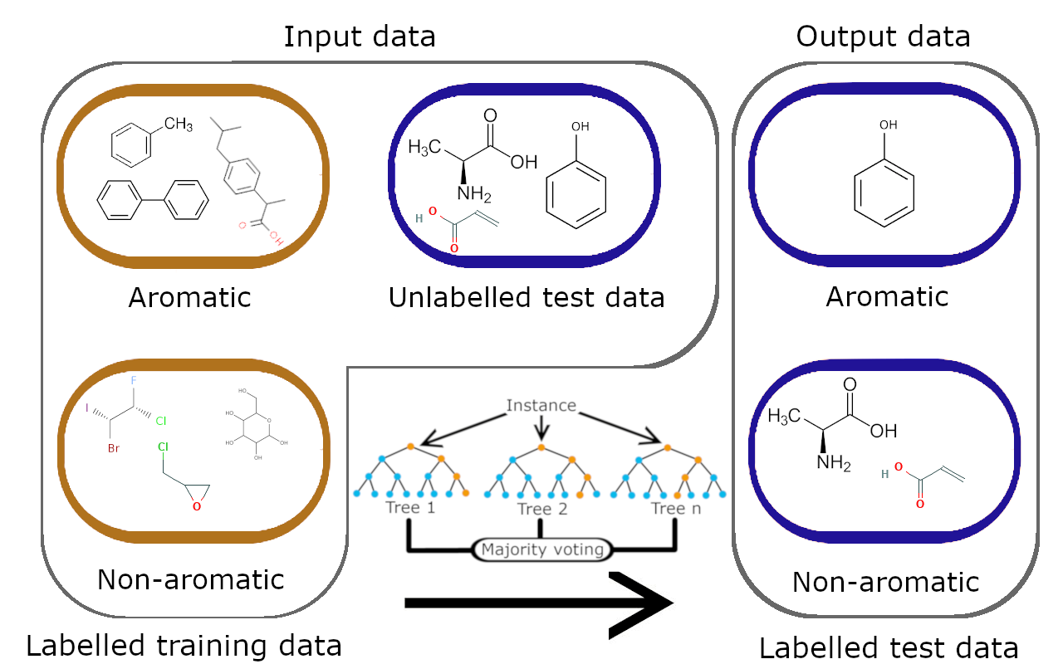
Supervised learning

Slide 4
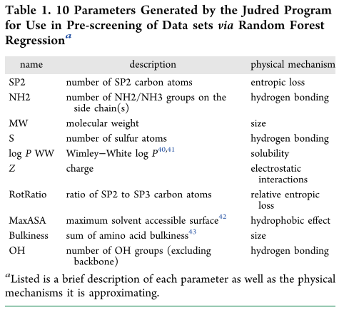

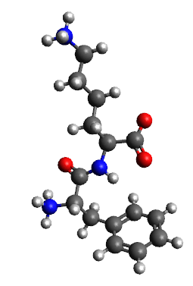
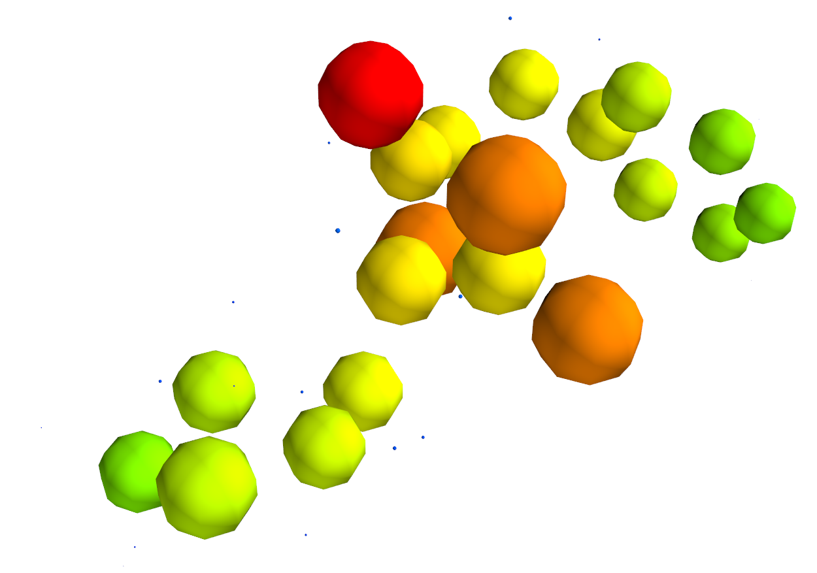

Parameters

Slide 5
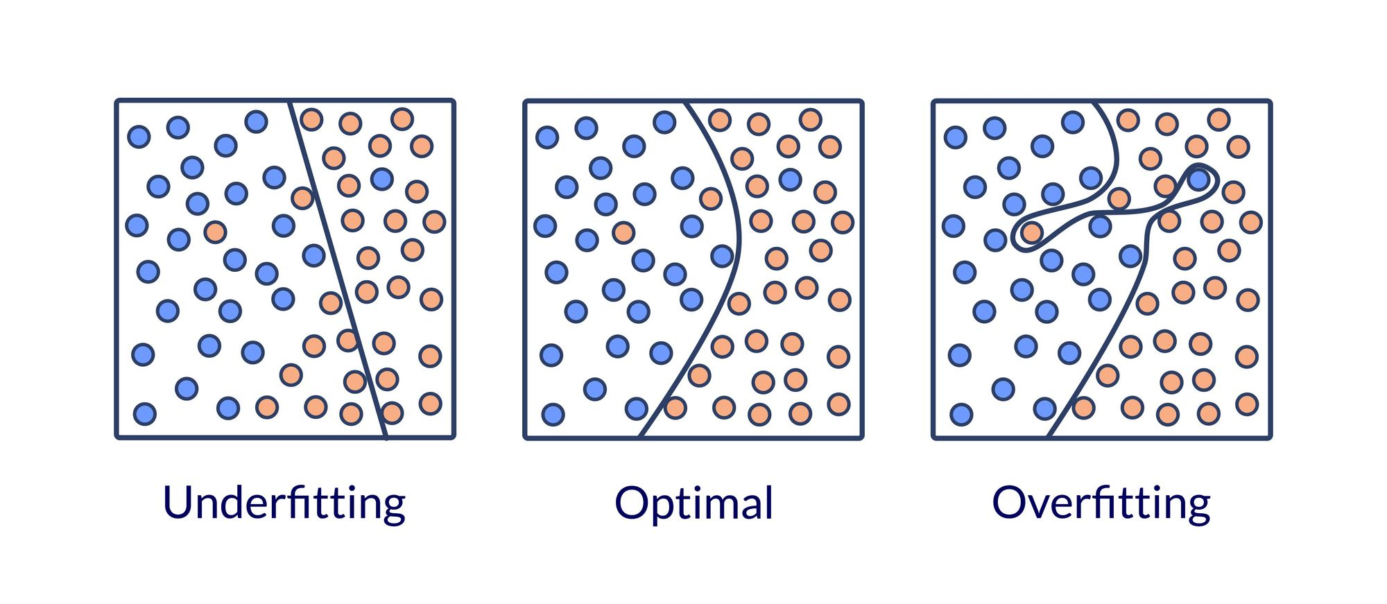
Data segregation
Overfitting
Train, test and validate!

Slide 6
Dipeptide self-assembly
400 datapoints (20²)
268 training points
132 validation points
179 training points
89 testing points

Slide 7
Hyperparameters
Other parameters that effect the fit of the data
y=abs(m)? x (+b)
fit_intercept positive Test data RMSE
2 False True 0.810048
3 False False 0.233584
0 True True 0.171678
1 True False 0.169679

Slide 8
y=mx+b
Hyperparameters: where we fit an intercept (b), scoring method (L2/L1, categorical)
Minimize L2 norm: y² – (mx+b)² -> 0
Notes:
There is a linear relationship so a linear fit works well

Slide 9
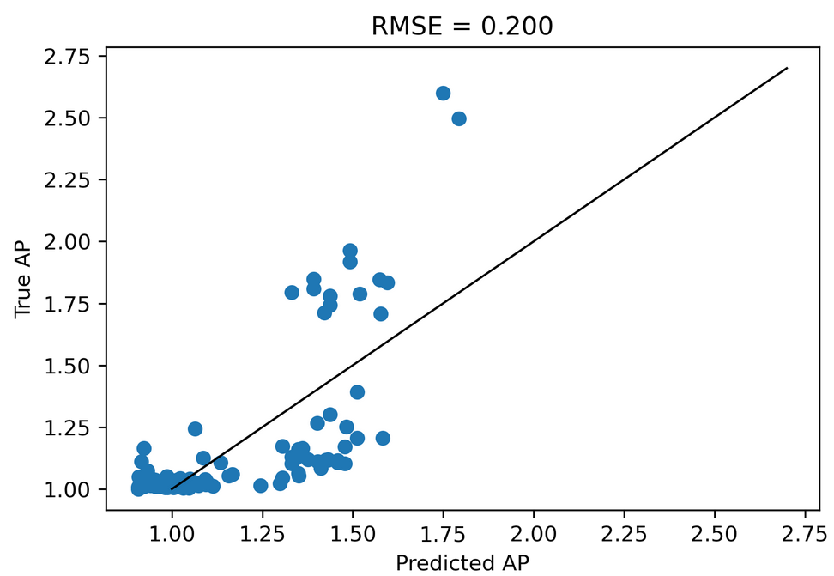
Can we predict something harder?

Slide 10
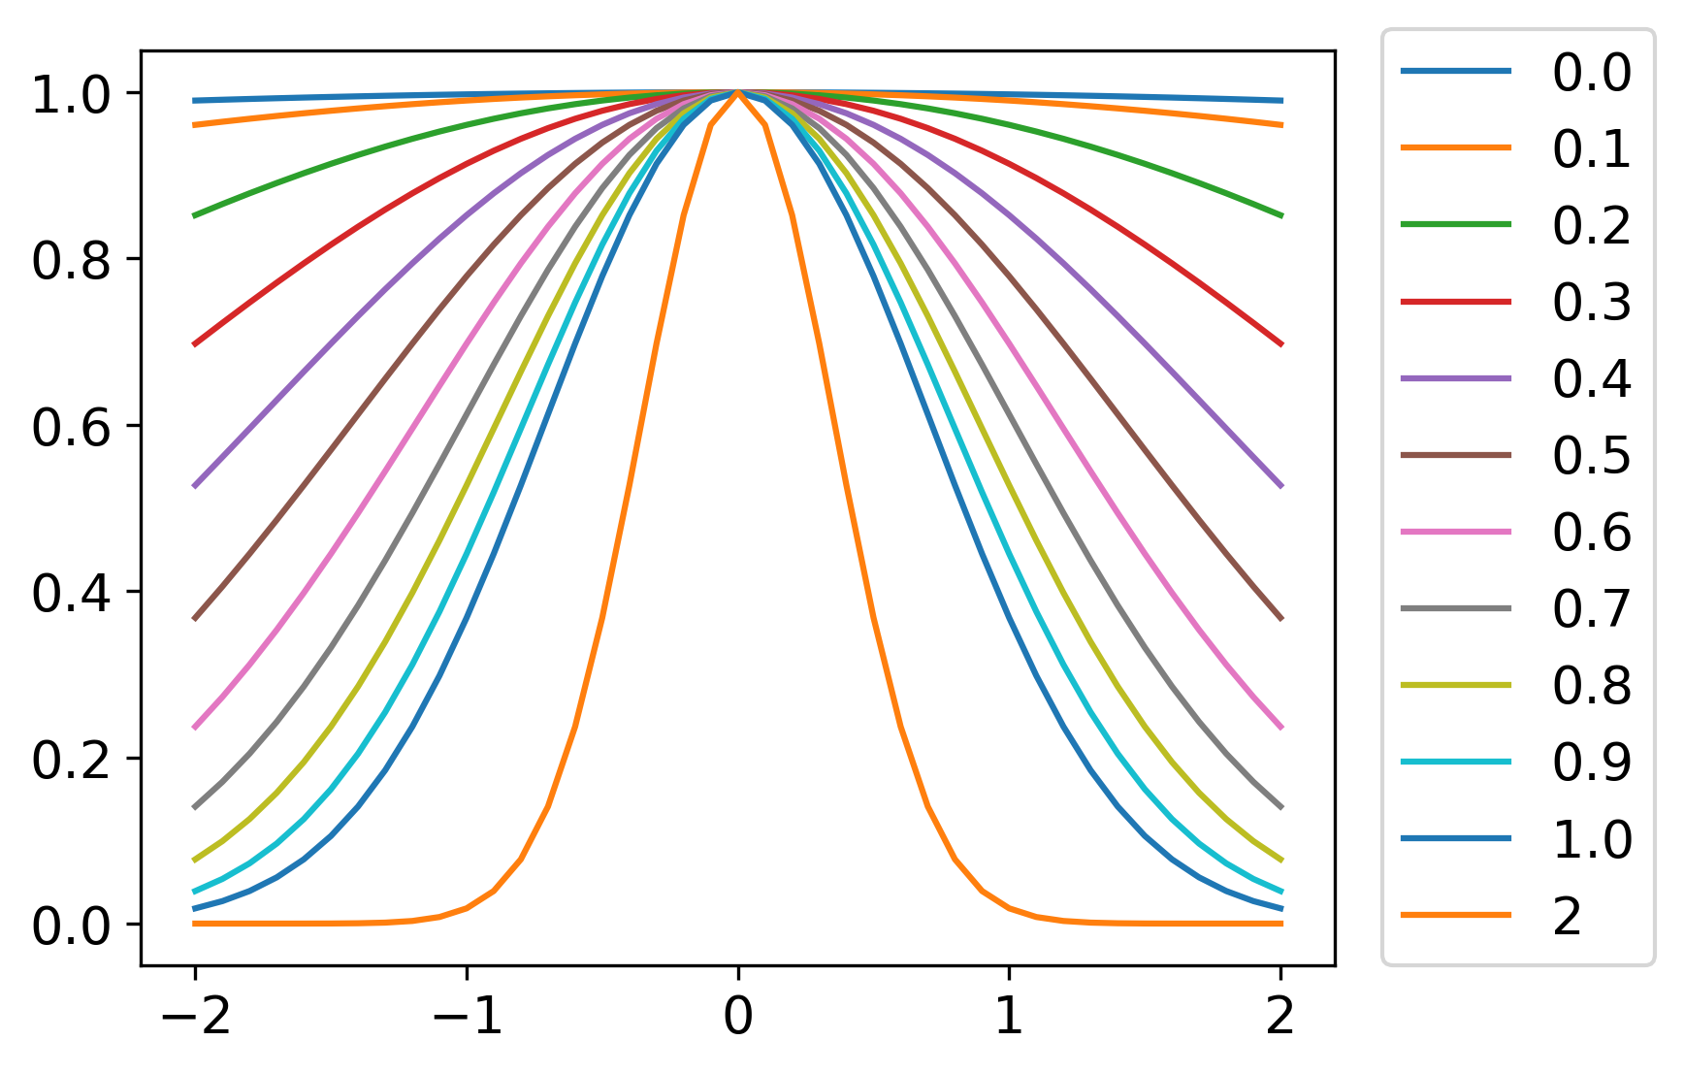
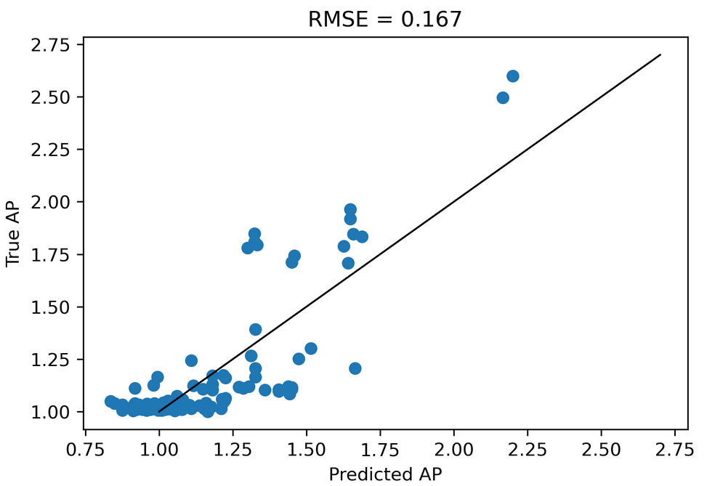
This indicates there is a non-linear relationship between our data and the AP score

Slide 11
Therefore…
We should probably not be using a linear regression model.

Slide 12
More advanced models
Random forest
Support vector machine
Deep neural networks

Slide 13
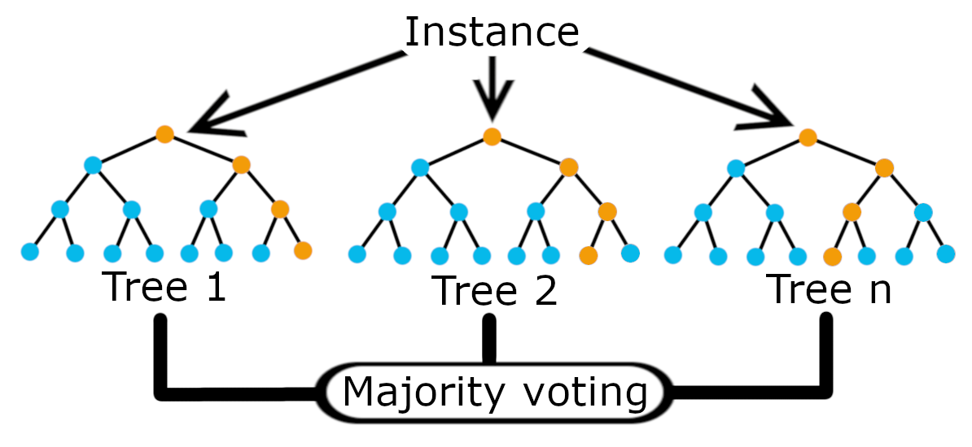

Slide 14
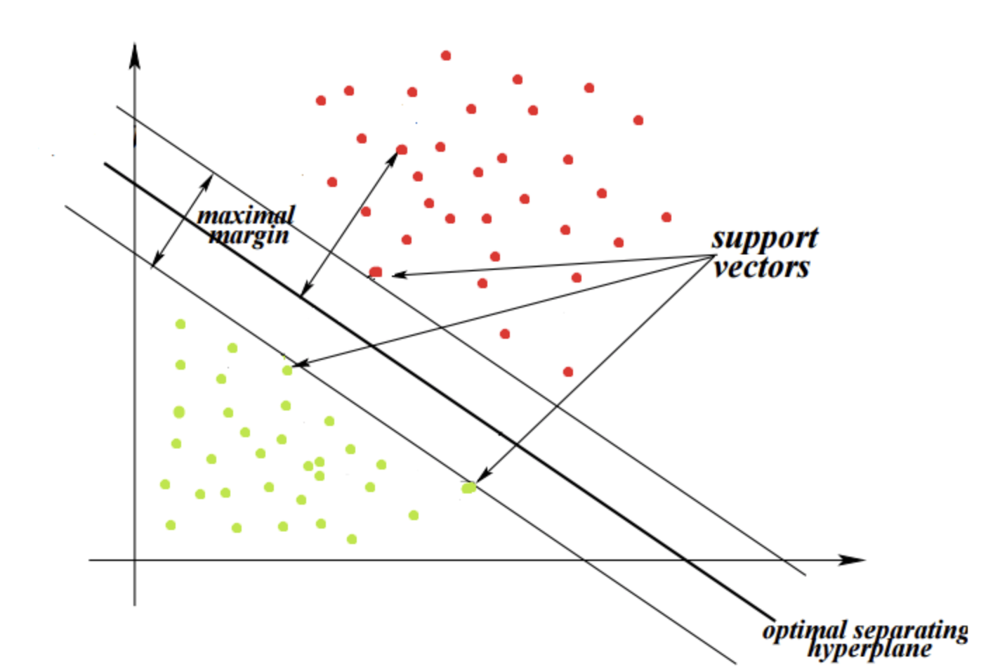

Slide 15
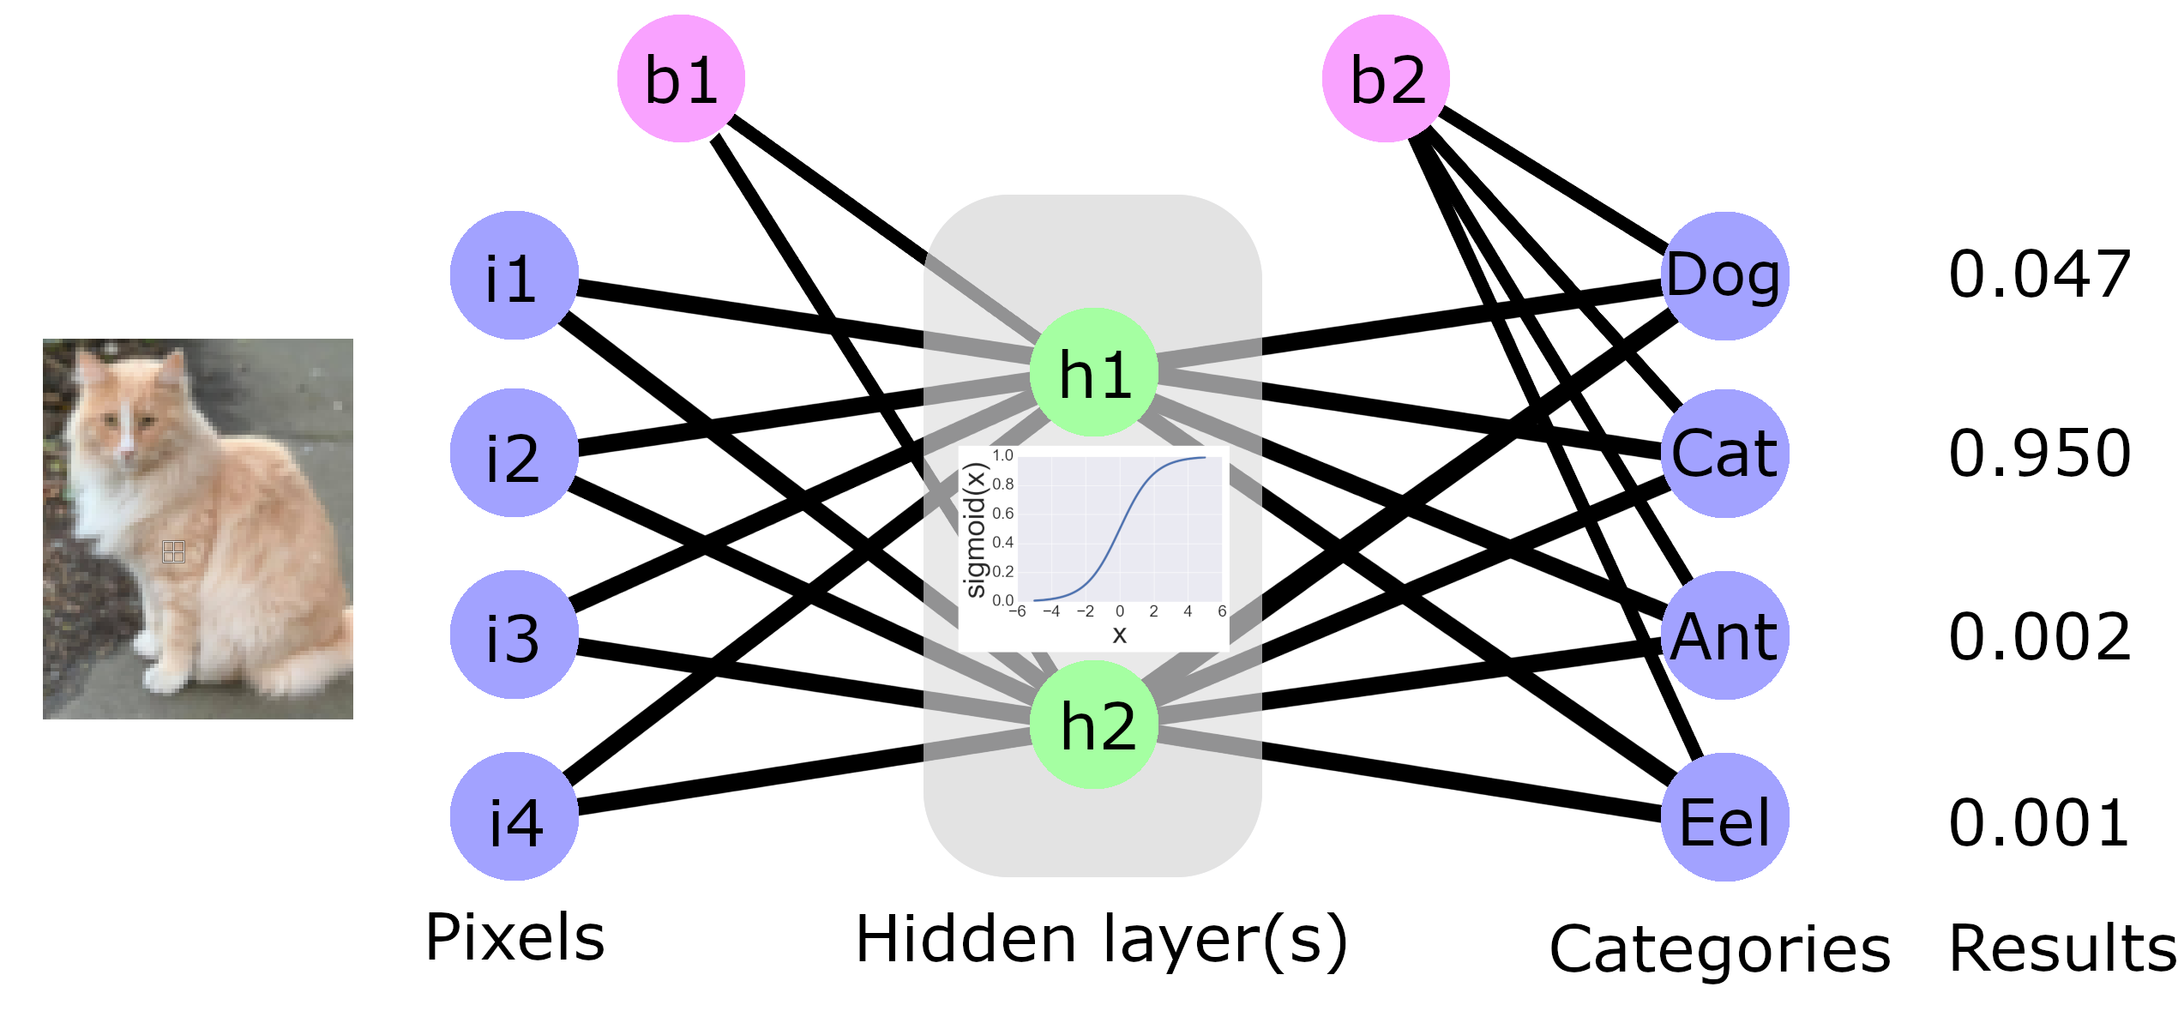

Slide 16
Dataset scaling

Slide 17
Other ways to use deep neural networks
One-hot, graph conv

Slide 18
Workshop
0. Generate a dataset using Judred
1. Run a linear regressor with these parameters after manually optimizing hyperparameters
1.5. Project parameters into a non-linear plane and re-run
2. Perform grid search CV for hyperparameter optimization for SVM, RF and DNN and compare the models for dipeptide AP prediction
- Challenge: Implement another ML model
3. Perform active learning to search the tetrapeptide (20⁴) chemical space.
- Challenge: Filter the search space to find only positively charged aggregators
- Challenge: Introduce a Monte Carlo function to increase diversity in initial searching

Slide 20
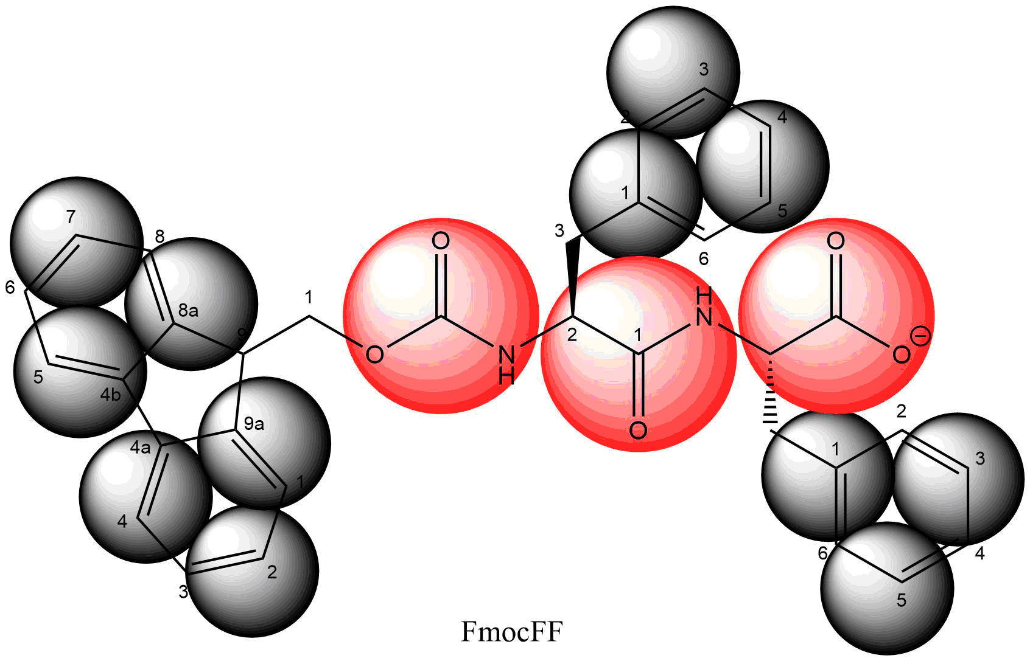
Atomic | Coarse grained
C₃₃H₂₉N₂O₅ | SC4₁₂P4₂Qa₁
69 atoms | 15 beads
69 partial charges | 1 charge
Smallest particle (H) limits time step to 1-2fs | Smallest particle (SC4) limits time step to 30 fs

Slide 21
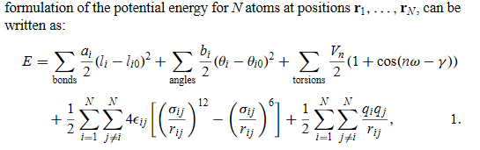

Slide 22
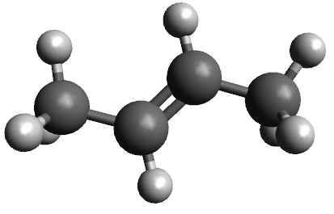
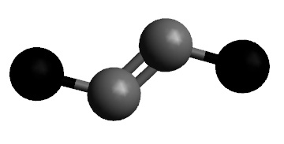
Building a CG model

Slide 23
Bottom-up
FF dihedral

