Slide 1
Coarse Grain Molecular Dynamics and how it can be used to predict Materials properties
Tell Tuttle*, Alexander van Teijlingen*, Dhwanit Dave‡
*University of Strathclyde
‡City University of New York

Slide 2
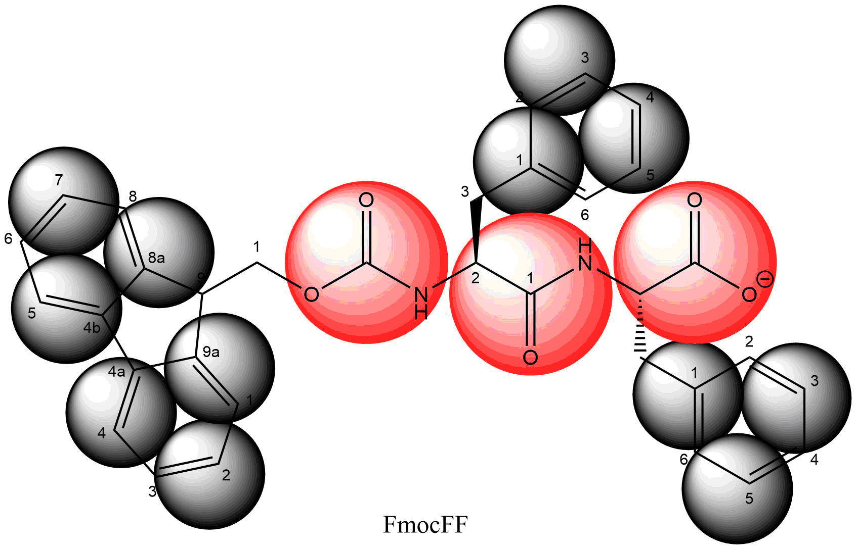
Atomic | Coarse grained
C₃₃H₂₉N₂O₅ | SC4₁₂P4₂Qa₁
69 atoms | 15 beads
69 partial charges | 1 charge
Smallest particle (H) limits time step to 1-2fs | Smallest particle (SC4) limits time step to 30 fs

Slide 3
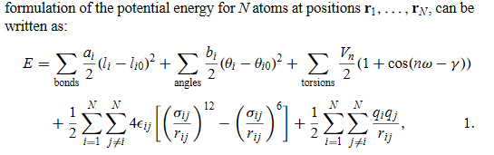

Slide 4
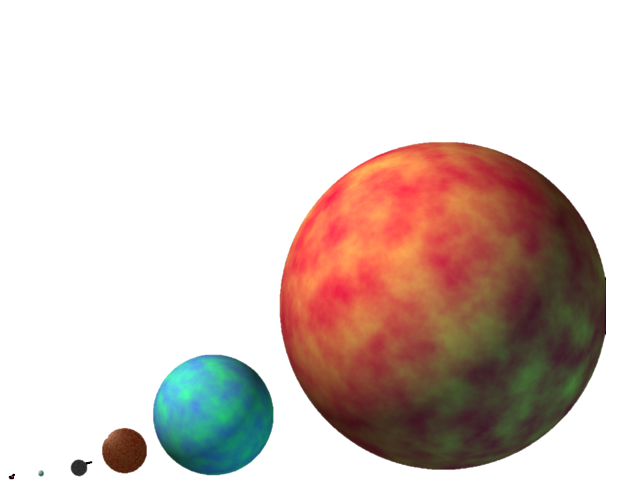

Slide 5
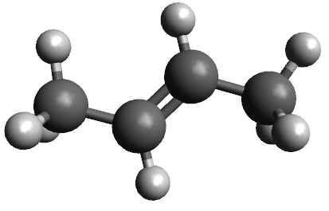
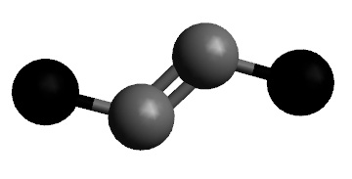
Building a CG model

Slide 6
Bottom-up
FF dihedral

