Slide 1
PROJECT
DATA ANALYTICS
Project Presentation
Name: S Niharika SRN: PES1UG20CS583
Name: Avantika Padmaraj SRN: PES1UG20CS628
Hombannavar
Name: Kruthi SRN: PES1UG20CS220

Slide 2
Abstract and Scope
Cardiovascular diseases (CVDs) are the leading cause of death globally. An estimated 17.9 million people died from CVDs in 2019, representing 32% of all global deaths. Of these deaths, 85% were due to heart attack and stroke. Hence, it is very important and concerning to predict CVDs beforehand.
We have applied various classification techniques to predict if a patient is likely to have a heart disease based on various medical features.

Slide 3
Implementation Details
MODULES USED
Pandas, NumPy, Matplotlib, Seaborn, Sklearn, Warnings, Plotnine, Imblearn, XGBoost.
DATASET
We have used the well-known Cleveland dataset, collected from UCI machine learning repository, which is available on Kaggle. It consists of 13 attributes.
1) Age (yrs) 8) Max heart rate achieved
2) Sex 9) Exercise-induced angina (0,1)
3) Chest Pain 10)ST depression when workout compared to amount of rest taken
4) Resting blood pressure(mm Hg) 11) Slope of peak exercise ST segment
5) Serum cholesterol (mg/dl) 12) No. of major vessels coloured by Fluoroscopy
6) Fasting blood sugar 13) Defect type
7) Resting electrocardiographic 14) Heart Disease

Slide 4
Implementation Details
IMPLEMENTATION
Exploratory Data Analysis (EDA) :
Separating categorical and continuous values.
Univariate analysis - For categorical features bar plots are used to calculate the number of each category in a particular variable. For numerical features, probability density plots are used to look at the distribution of the variable.
Bivariate analysis – Between various features and the target
Multivariate analysis – Using correlation matrix and finding features that are more important.
Outlier analysis
Data Splitting:
80% of the data is considered for training and the rest 20% for testing.

Slide 5
Implementation Details
Standardization of Data:
Resampling: done to handle the unbalanced datasets by over-sampling.
Feature Scaling: a technique to standardize the continuous features present in the data in a fixed range.
Models:
Logistic Regression: It’s a statistical model, used for classification and predictive analytics. It is used to estimate the relationship between a dependent variable and one or more independent variables, and to make a prediction about a categorical variable versus a continuous one
SVM: The objective of the SVM algorithm is to find a hyperplane in an N-dimensional space that distinctly classifies the data points. The dimension of the hyperplane depends upon the number of features.

Slide 6
Implementation Details
KNN: It is a non-parametric, supervised machine learning algorithm that assumes that similar things exist in close proximity. It classifies a data point based on its neighbors’ classifications. It stores all available cases and classifies new cases based on similar features.
Adaboost: An AdaBoost classifier is an ensemble method that begins by fitting a classifier on the original dataset and then fits additional copies of the classifier on the same dataset but where the weights of incorrectly classified instances are adjusted such that subsequent classifiers focus more on difficult cases.
Ensemble: Ensemble models are a machine learning approach to combine multiple weak learners in the prediction process. It offers a solution to overcome the technical challenges of building a single estimator and to improve the overall performance. We have included 4 weak learners in our model- Decision tree, KNN, Adaboost and Naïve Bayes algorithms.

Slide 7
Implementation Details
XGB: XGBoost is a popular and efficient open-source implementation of the gradient-boosted trees algorithm. The objective here is to minimize this loss function by adding weak learners using gradient descent. Each predictor is trained using the residual errors of the predecessor as labels.
Stacking: is an ensemble learning technique that combines multiple base classification model predictions into a new data set. This new data are treated as the input data for another classifier. We have included 4 learners in our model- Gradient boost, Decision trees, Random forest and Logistic regression.

Slide 8
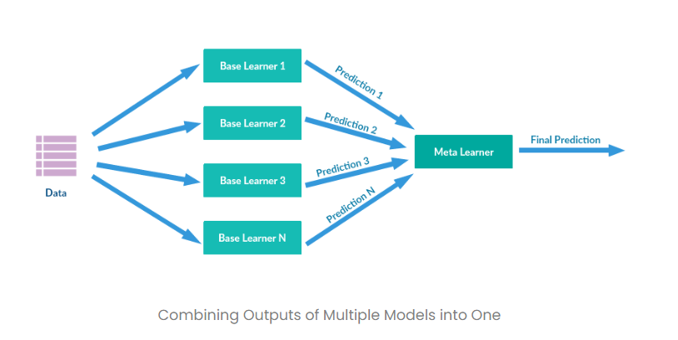
Project Demonstration
ALGORITHM:
Base Learner 1: XGBoost
Base Learner 2: Decision Tree Classifier
Base Learner 3: Random Forest
Meta Learner: Logistic Regression
Level-0 Models (Base-Models): Models fit on the training data and whose predictions are compiled.
Level-1 Model (Meta-Model): Model that learns how to best combine the predictions of the base models.
Stacking is one of the popular ensemble modeling techniques in machine learning. Various weak learners are ensembled in a parallel manner in such a way that by combining them with Meta learners, we can predict better predictions for the future.

Slide 9
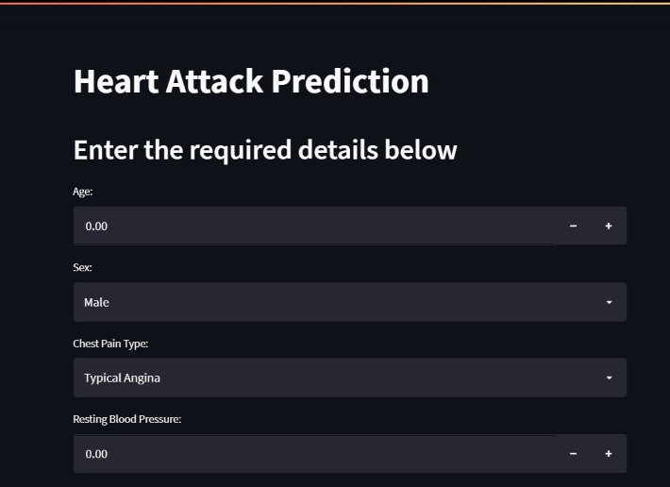

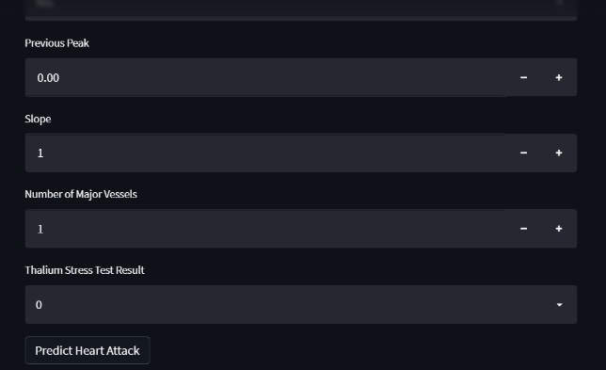
Project Demonstration
Screenshot of the interface
Appropriate inputs in their respective fields will lead us to the prediction of risk of heart disease

Slide 10
Results and Discussion
MODEL | ACCURACY
Logistic Regression | 84%
SVM | 84.36%
KNN | 90.05%
Adaboost | 90.05%
Ensemble | 93.5%
Stacking | 98.93%
We can see from the results that the stacking algorithm gives the highest accuracy of 98.93% and is quite accurate in predicting if a patient is at risk or not.

Slide 11
Conclusion and Future work
Heart disease prediction is challenging and very important in the medical field. However, the mortality rate can be drastically controlled if the disease is detected at the early stages and preventative measures are adopted as soon as possible. Further extension of this study is highly desirable to direct the investigations to real-world dataset.
FUTURE WORK:
To use different feature extraction methods like linear discriminant analysis, chi-square, etc.
Further exploration of different machine learning algorithms.

Slide 12
References
1. Salhi, Dhai Eddine, Abdelkamel Tari, and M. Kechadi. "Using machine learning for heart disease prediction." International Conference on Computing Systems and Applications. Springer, Cham, 2020.
2. Boukhatem, Chaimaa, Heba Yahia Youssef, and Ali Bou Nassif. "Heart Disease Prediction Using Machine Learning." 2022 Advances in Science and Engineering Technology International Conferences
(ASET). IEEE, 2022.
3. Gao, Xiao-Yan, et al. "Improving the accuracy for analyzing heart diseases prediction based on the ensemble method." Complexity 2021 (2021).
4. Mohan, Senthilkumar, Chandrasegar Thirumalai, and Gautam Srivastava. "Effective heart disease prediction using hybrid machine learning techniques." IEEE access 7 (2019): 81542-81554.

Slide 13
IEEE Draft
Link to report doc
https://github.com/avantika0601/Heart_Attack_Prediction

Slide 14
Thank You

