Slide 1
Stock Market Insights Using
Network Science
Phase -1 Review -2
Tag 5 - Data Science / Data Analytics
Guide: Dr. (Col.) Kumar P. N.
Co-Guide: Dayanand V.
SL NO. | Name | Roll No
1 | Avantika Balaji | CB.EN.U4CSE20309
2 | Charitha Uppalapati | CB.EN.U4CSE20311
3 | Kanumilli Pavan Sai | CB.EN.U4CSE20324
4 | Kausalyaa Sri | CB.EN.U4CSE20326

Slide 2
Motivation
Traditional stock market analysis limitations: neglects complex interdependencies among financial instruments, market participants, and external factors.
​Network analysis techniques can be used to overcome these limitations by providing better insights and predictions for investors and traders.

Slide 3
Introduction
Network-Based Analysis leverages the power of interconnected structures, or graphs, to extract valuable insights and patterns from from the complex financial systems of the stock market.
We seek to uncover hidden patterns, relationships, and dynamics that can offer novel perspectives on market behaviour.
In this project, we explore the application of network science principles to gain a deeper understanding of how stocks, traders, and external factors interact, ultimately providing valuable insights for investors and financial analysts.

Slide 4
Problem Statement
To develop a dynamic stock market analysis system using network science techniques to identify and visualize the complex relationships and dependencies among financial instruments in various sectors considering the influence of external factors.

Slide 5
Research Objectives
To develop a comprehensive stock market analysis and prediction framework by integrating Network Structure Parameters (NSP), community detection algorithms, statistical analysis, network construction techniques, influential company identification, feature ranking methodologies, and dynamic threshold calculations. This research aims to enhance understanding and forecast market behavior, contributing to more accurate stock price predictions.

Slide 6
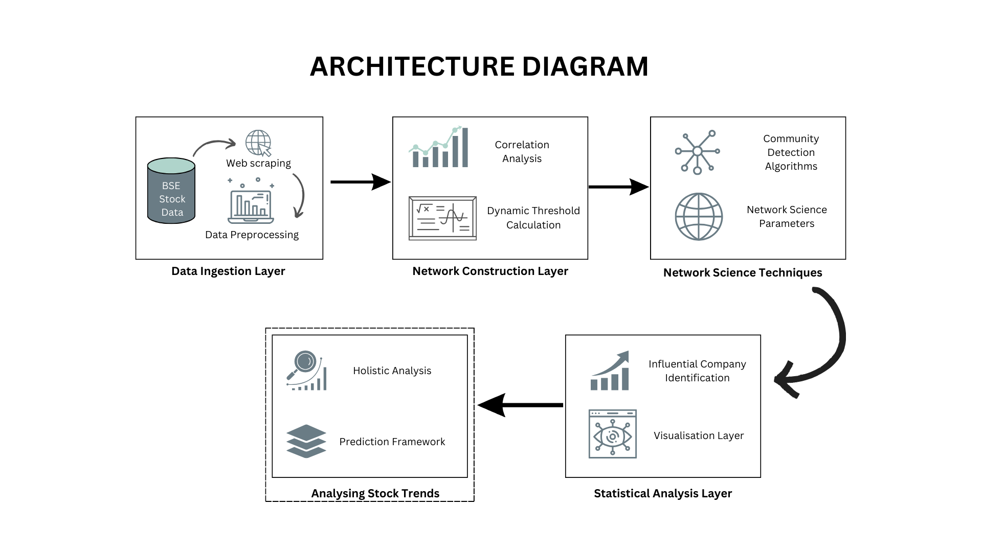

Slide 7
Work Plan
Review-1- Setting up problem statement and identifying research gaps
Guide Review: Web Scraping of Data from BSE, Correlation calculation using various features and Sub-community detection
Incorporating Graphn neural networks and forecasting techniques from time series to do stock prediction.
28-09-2023
7-11-2023
Phase-2
01-11-20233
Panel Review-2
Outcome
Pilot Implementation- Plotting graphs and identifying communities.
Using time series sensitive correlation calculation and evolving Dynamic graphs.
Research Paper on -Detailed analysis on Overall Indian stock market and portfolio recommendation

Slide 8
Details of the Modules to be implemented
Literature Review
Dataset- Web Scraping
Community Detection
Advanced Algorithms
Dynamic Graphs
Identifying the research gaps from various research papers and consolidating a comprehensive methodology inferred.
Using Selenium web scraping techniques to get the real time stock data of all companies registered with BSE.
Calculating the Correlation between companies (On Close_Price)
and identifying communities, sub communities
(Viz:Gephi)
Redefining the algorithm to use combination of variables incorporating time series sensitive calculation of correlation. Identifying sub-communities and analysing NSP
Timewise bunching of data- Dynamically evolving graphs. Calculating NSP for evolving graphs that eventually gives a time series data.

Slide 9
Research Gap
Dynamic Correlations
Causality and Lead-Lag Relationships
External Factors (global events, economic factors, news sentiment, geopolitical events)
Limited Dataset Time Frame
Single Stock Market Index Focus
Limited Temporal Coverage
Impact of External Factors during Crises

Slide 10
Thank You

