Slide 1
Cloud-Based Smart File Storage & Sharing System

Slide 2
Cloud-Based Smart File Storage & Sharing System
• Serverless Info Uploader enables secure file uploads to Amazon S3
• Metadata stored in DynamoDB
• Generates temporary pre-signed download URLs (valid for 1 hour)
• Ensures secure access without exposing S3 bucket publicly

Slide 3
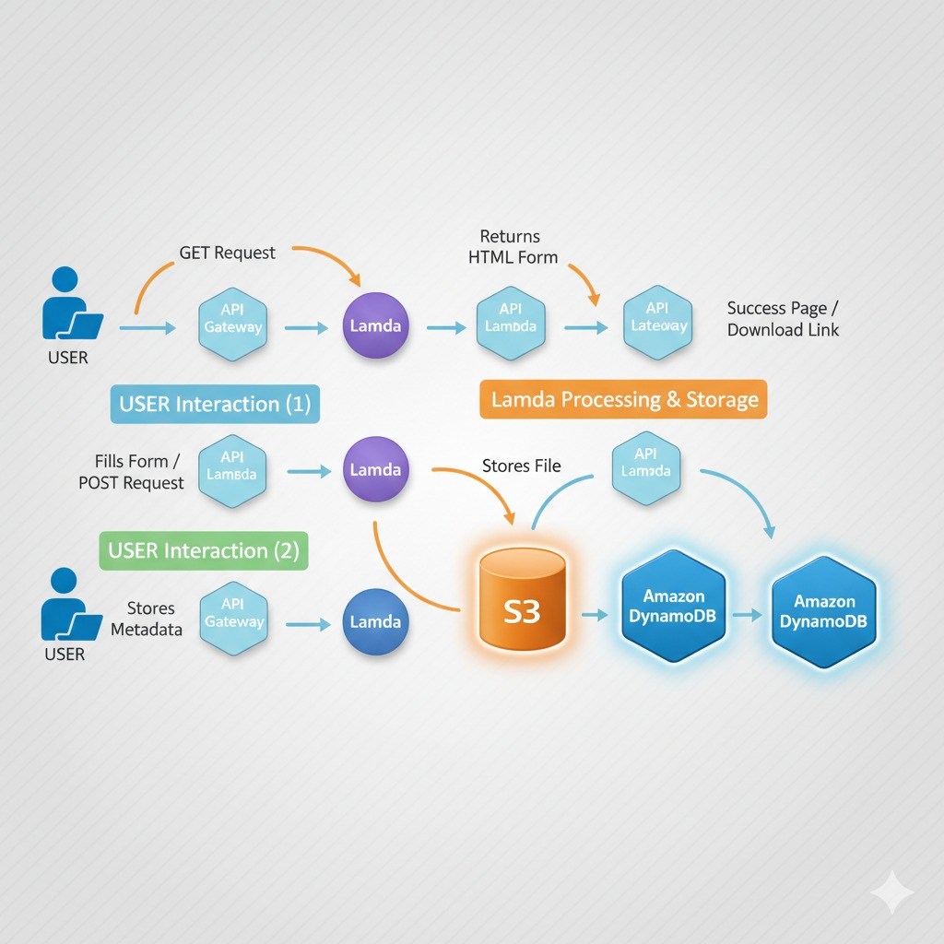

Slide 4
Serverless Architecture Components
• Amazon S3 – File/object storage
• AWS Lambda – Backend logic
• Amazon DynamoDB – Metadata storage
• AWS IAM – Access control & security

Slide 5
Benefits
1. Fully Serverless
(No Servers to Manage)
• No provisioning or scaling
concerns
• AWS manages infrastructure
2. High Security
• S3 bucket private
• Pre-signed URLs expire
• IAM least-privilege access
• Metadata in DynamoDB
3. Cost Efficient
• Pay only for usage
• No idle servers
• DynamoDB on-demand saves cost
4. Automatically Scalable
• Handles thousands of uploads
• Lambda auto-scales automatically

Slide 6
Conclusion
• Demonstrates modern, secure, scalable serverless system
• Automated workflow using S3, Lambda, DynamoDB, IAM
• Ideal for secure sharing, temporary access & metadata tracking
• Follows industry best practices: high availability, security & cost efficiency

